Slide 1

Google Trends Search Analysis on AI
Santhosh vijayagiri
Overview of global search interest across AI-related keywords

Slide 2
Objective of Analysis
- Understand global interest in AI-related keywords
- Compare search trends across countries
- Identify dominant AI topics such as ChatGPT, ML, DL, and Generative AI

Slide 3
Keywords Analyzed
- ChatGPT
- Machine Learning (ML)
- Deep Learning
- Generative AI
- Data Science

Slide 4
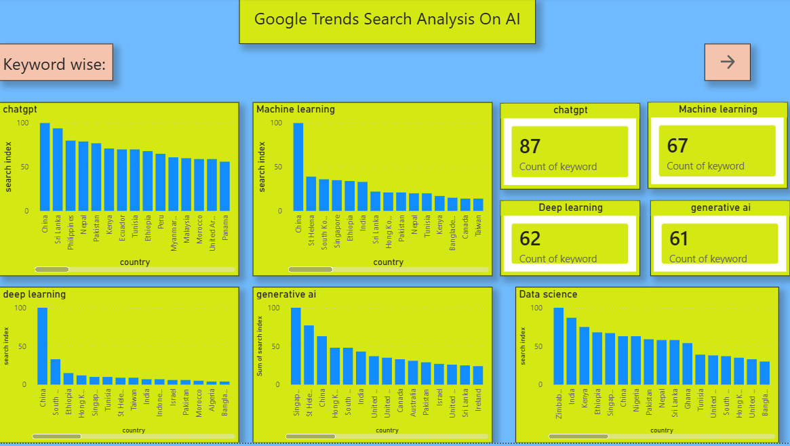
Keyword-wise Search Analysis

Slide 5
Key Insights (Keyword-wise)
- ChatGPT has the highest overall search interest
- Machine Learning and Data Science remain consistently popular
- Generative AI shows rapid emerging interest
- Deep Learning has niche but stable searches

Slide 6
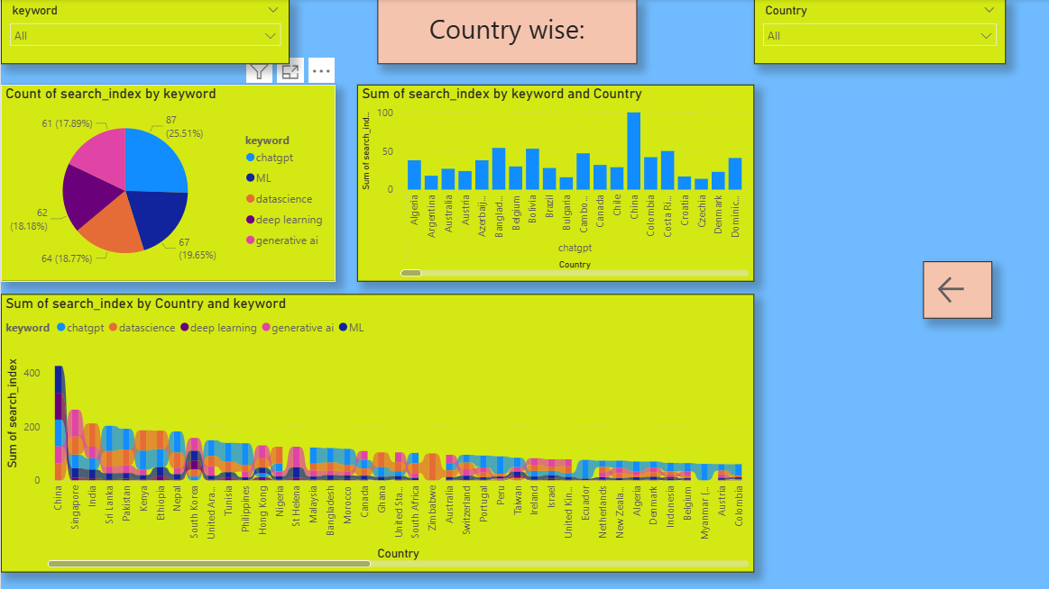
Country-wise Search Analysis

Slide 7
Key Insights (Country-wise)
- China, India, and Singapore show high AI search activity
- Developed and developing countries both contribute significantly
- ChatGPT dominates searches across most countries

Slide 8
Overall Observations
- AI awareness is global and rapidly increasing
- Practical tools like ChatGPT attract more attention than theoretical terms
- Generative AI is becoming a major trend alongside ML and Data Science

Slide 9
Conclusion
- Google Trends reveals strong global momentum in AI adoption
- ChatGPT leads AI-related searches worldwide
- Data can support decisions in education, research, and AI investments

