Slide 1
Question and Answer Chatbot

Slide 2
Chatbot
A chatbot also known as a chatterbot, bot, artificial agent, etc is basically a software program driven by artificial intelligence which serves the purpose of making a conversation with the user by texts or by speech.
The term "ChatterBot" was originally coined by Michael Mauldin (creator of the first Verbot) in 1994 to describe these conversational programs.

Slide 3
Chatbots are used in dialog systems for various purposes including customer service, request routing, or information gathering. While some chatbot applications use extensive word-classification processes, natural language processors, and sophisticated AI, others simply scan for general keywords and generate responses using common phrases obtained from an associated library or database.

Slide 4
Most chatbots are accessed on-line via website popups or through virtual assistants. They can be classified into usage categories that include: commerce(e-commerce via chat), education, entertainment, finance, health, news, and productivity.

Slide 5
Application
Messaging apps: Many companies' chatbots run on messaging apps or simply via SMS. Banks, insurers, media companies, e-commerce companies, airlines, hotel chains, retailers, health care providers, government entities and restaurant chains have used chatbots to answer simple questions, increase customer engagement, for promotion, and to offer additional ways to order from them.
Healthcare:Chatbots are also appearing in the healthcare industry.] A study suggested that physicians in the United States believed that chatbots would be most beneficial for scheduling doctor appointments, locating health clinics, or providing medication information.

Slide 6
Politics: In New Zealand, the chatbot SAM – short for Semantic Analysis Machine (made by Nick Gerritsen of Touchtech) – has been developed. It is designed to share its political thoughts, for example on topics such as climate change, healthcare and education, etc. It talks to people through Facebook Messenger.
Malicious use: Malicious chatbots are frequently used to fill chat rooms with spam and advertisements, by mimicking human behavior and conversations or to entice people into revealing personal information, such as bank account numbers. They were commonly found on Yahoo! Messenger, Windows Live Messenger, AOL Instant Messenger and other instant messaging protocols. There has also been a published report of a chatbot used in a fake personal ad on a dating service's website.

Slide 7
Limitations of Chatbots
The creation and implementation of chatbots is still a developing area, heavily related to artificial intelligence and machine learning, so the provided solutions, while possessing obvious advantages, have some important limitations in terms of functionalities and use cases. However, this is changing over time.

Slide 8
The most common ones are listed below:
As the database, used for output generation, is fixed and limited, chatbots can fail while dealing with an unsaved query.
A chatbot's efficiency highly depends on language processing and is limited because of irregularities, such as accents and mistakes.
Chatbots are unable to deal with multiple questions at the same time and so conversation opportunities are limited.
Chatbots require a large amount of conversational data to train.
Chatbots have difficulty managing non-linear conversations that must go back and forth on a topic with a user
As it happens usually with technology-led changes in existing services, some consumers, more often than not from the old generation, are uncomfortable with chatbots due to their limited understanding, making it obvious that their requests are being dealt with by machines.

Slide 9
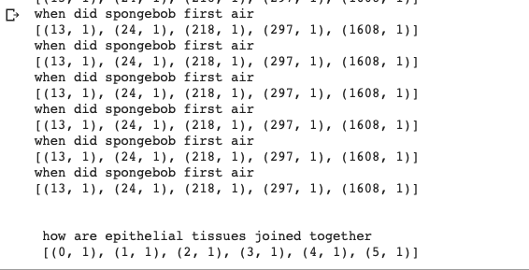
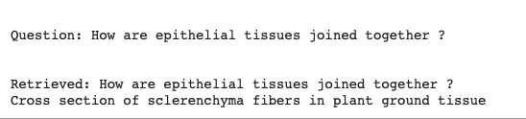
Screenshots of Q A Chatbot

Slide 10
Summary and Conclusion
In this project we developed a question and answer chatbot. Here we used a wikipedia corpus.The chatbot used this corpus for answering the questions. From the corpus we removed all the stopwords and cleaned the corpus; identified all the unique words.
Word embedding is done for each question. Cosine similarity is calculated for the question we enter form the corpus. If match is found the same will be retrieved.

