Slide 1
Digital Portfolio
NAME:M.KAVIYARASAN
REGISTER NO AND NMID:20924U09084,astvu20920924u09084
DEPARTMENT:BCA
COLLEGE: COLLEGE/ UNIVERSITY: Shanmuga industries arts & science College, Thiruvalluvar University

Slide 2
PROJECT TITLE
Digital portfolio for computer center using html, css and javascript

Slide 3


AGENDA
Problem Statement
Project Overview
End Users
Tools and Technologies
Portfolio design and Layout
Features and Functionality
Results and Screenshots
Conclusion
Github Link
3/21/2024 Annual Review

Slide 4

PROBLEM STATEMENT
The existing system lacks efficiency and user-friendliness. It is time-consuming and prone to errors in data management. A better solution is required to automate processes and improve accuracy.

Slide 5

PROJECT OVERVIEW
This project aims to develop a user-friendly and efficient solution. It automates key processes to save time and reduce errors. The system ensures accuracy, reliability, and easy accessibility.
Want me to make it sound

Slide 6

WHO ARE THE END USERS?
The end users are students, teachers, and administrators who will interact with the system. They benefit from easy access to information and smooth functionality. Their feedback helps improve the system for better usability.
Want me to make it general (for any project) or specific (for your computer center project)?

Slide 7

TOOLS AND TECHNIQUES
This project is developed using HTML, CSS, and JavaScript for a responsive design. Basic web development techniques are applied for structure, style, and interactivity. Testing and debugging methods ensure smooth performance and reliability

Slide 8
POTFOLIO DESIGN AND LAYOUT
The portfolio features a sleek black background with a clean, modern look. Sections like About, Projects, and Contact are organized for easy navigation. Responsive design ensures it looks great on all devices.
Would you like me to make it more visually descriptive (mentioning images, icons, animations) for an impressive PPT?
8

Slide 9
FEATURES AND FUNCTIONALITY
The portfolio includes sections for About, Projects, and Contact for clear presentation. Interactive navigation and responsive design enhance the user experience. Easy updates and smooth performance make it simple to maintain

Slide 10
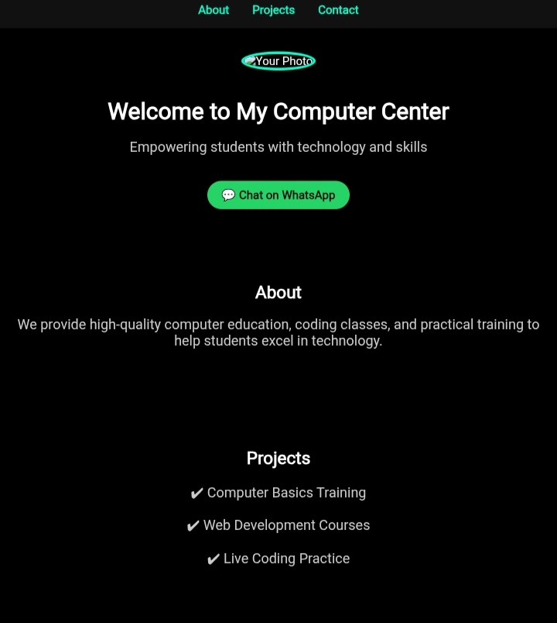
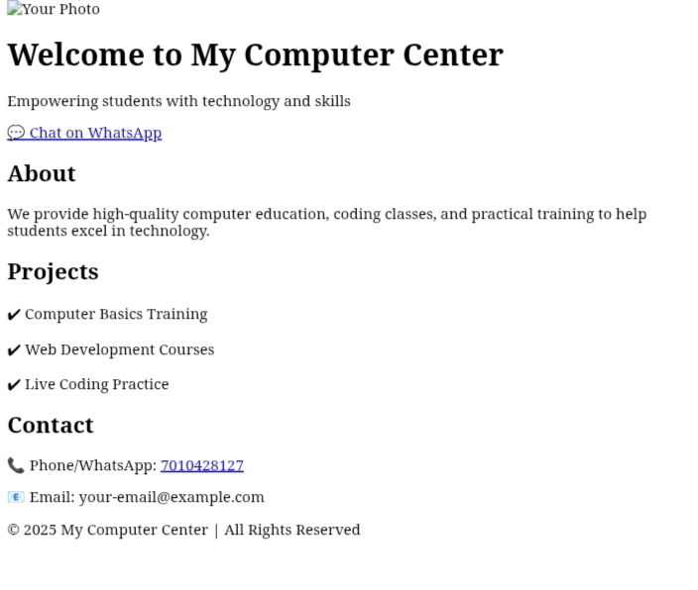

RESULTS AND SCREENSHOTS
Screenshot of each section.
Before VS after (plain HTML->with css and javascript.
3/21/2024 Annual Review
10

Slide 11
CONCLUSION
.. Digital portfolio program helps users showcase their skills and project easily
It improves carrer opportunities by providing a professional digital portfolio.
11

