Slide 1
Tamil Nadu 2026 Election Analysis Dashboard
A Storytelling- Power BI Project Decoding the 2026 TN Assembly Election

Slide 2
01
Overview
1
Scope
2
Objective
Analyzes 2021 vs. 2026 results at constituency level, using ECI data via the Codebasics Resume Project Challenge dataset.
Transform complex election data into clear, story-driven insights on constituency shifts, regional change, and competitiveness.
Non-partisan by design
3
Built entirely on public ECI datasets with transparent methods and data modeling — no commentary on outcomes.

Slide 3
02
My Process
1
2
3
4
Power Query
Data Modeling
DAX Measures
Report Build
Cleaned & reshaped raw ECI datasets
Built a RegionBridge table to resolve many-to-many region relationships
Seat gains/losses, vote share %, margin bands
5 pages, dark-navy theme, fixed party colour coding
The six research questions in the challenge brief were treated as a menu, not a checklist. Rather than answering all six as a flat list of facts, three were chosen and connected into one throughline: where the map changed, which seats flipped, and how much closer the races got.

Slide 4
03
Tech Stack
PBI
Power BI Desktop
Main visualization platform used to build and publish the report.
PQ
Power Query
Data cleaning and transformation layer for the raw ECI dataset.
DAX
DAX
Calculated measures — seat gains/losses, vote share %, margin bands.
DM
Data Modeling
Relationships across 4 tables, including a custom RegionBridge table.
FF
File Format
.pbix for development, .pdf / .png for previews and sharing.

Slide 5
04
Data Source & Research Questions
Data: ECI Results Portal + Codebasics Starter Data Pack (ECI-based CSVs)
The Geographic Story
1
How did seat distribution shift across Tamil Nadu's six regions between 2021 and 2026?
The Flip Story
2
In how many constituencies did the winning party change between 2021 and 2026?
The Margin of Victory Story
3
How did the average margin of victory change, and how many seats were won by a strong mandate vs. a fragmented one?

Slide 6
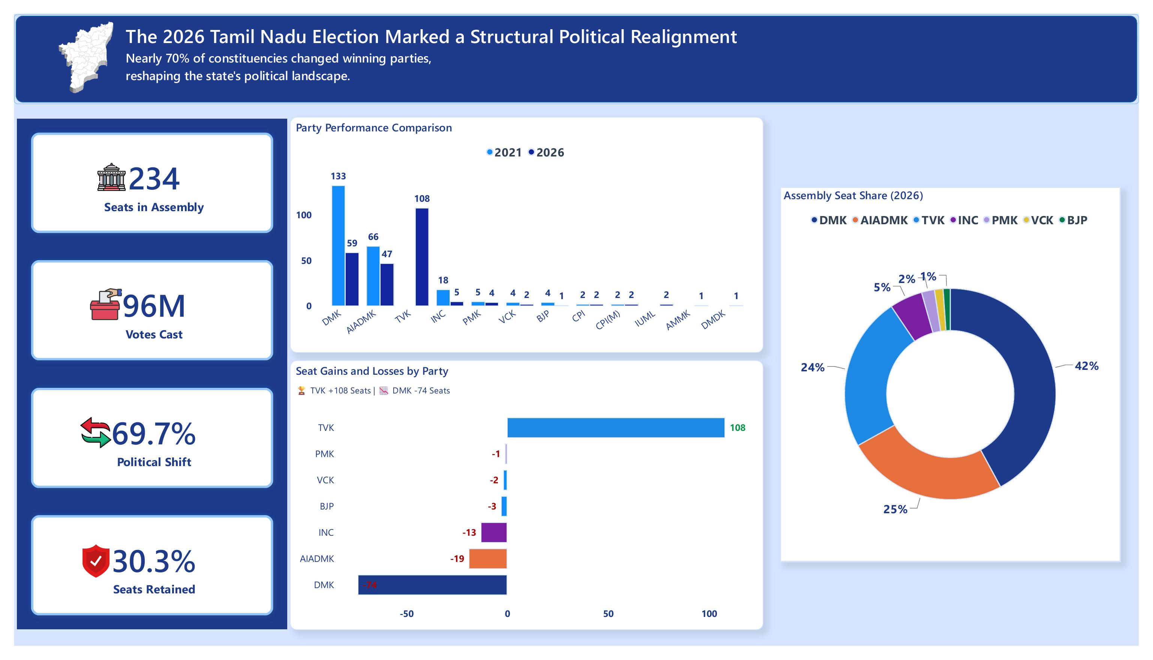
05
Executive Overview
234
69.7%
TVK +108
Seats in assembly
Seats changed hands
DMK −74 seats
One page, full-state snapshot: 96M votes cast and only 30.3% of seats retained by their 2021 winner.

Slide 7
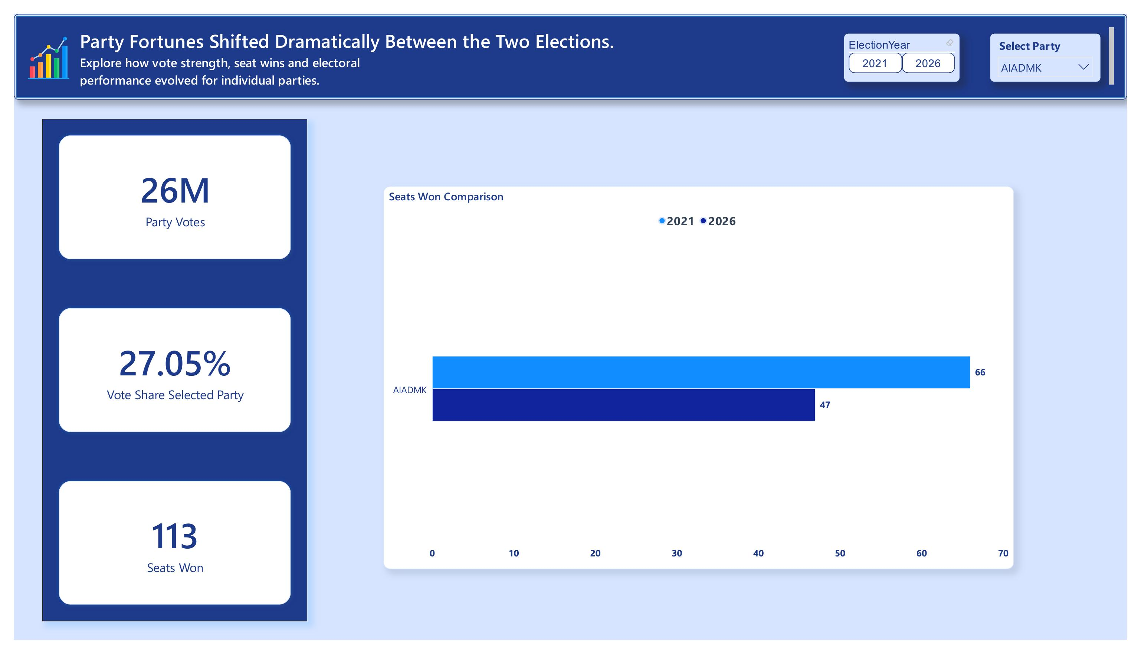
06
Party Performance Drill-Down
66 → 47
27.05%
26M
AIADMK seats, 2021→2026
AIADMK vote share
AIADMK votes
Interactive slicers let you isolate any single party's trajectory — built for a clean, ready-to-narrate talking point.

Slide 8
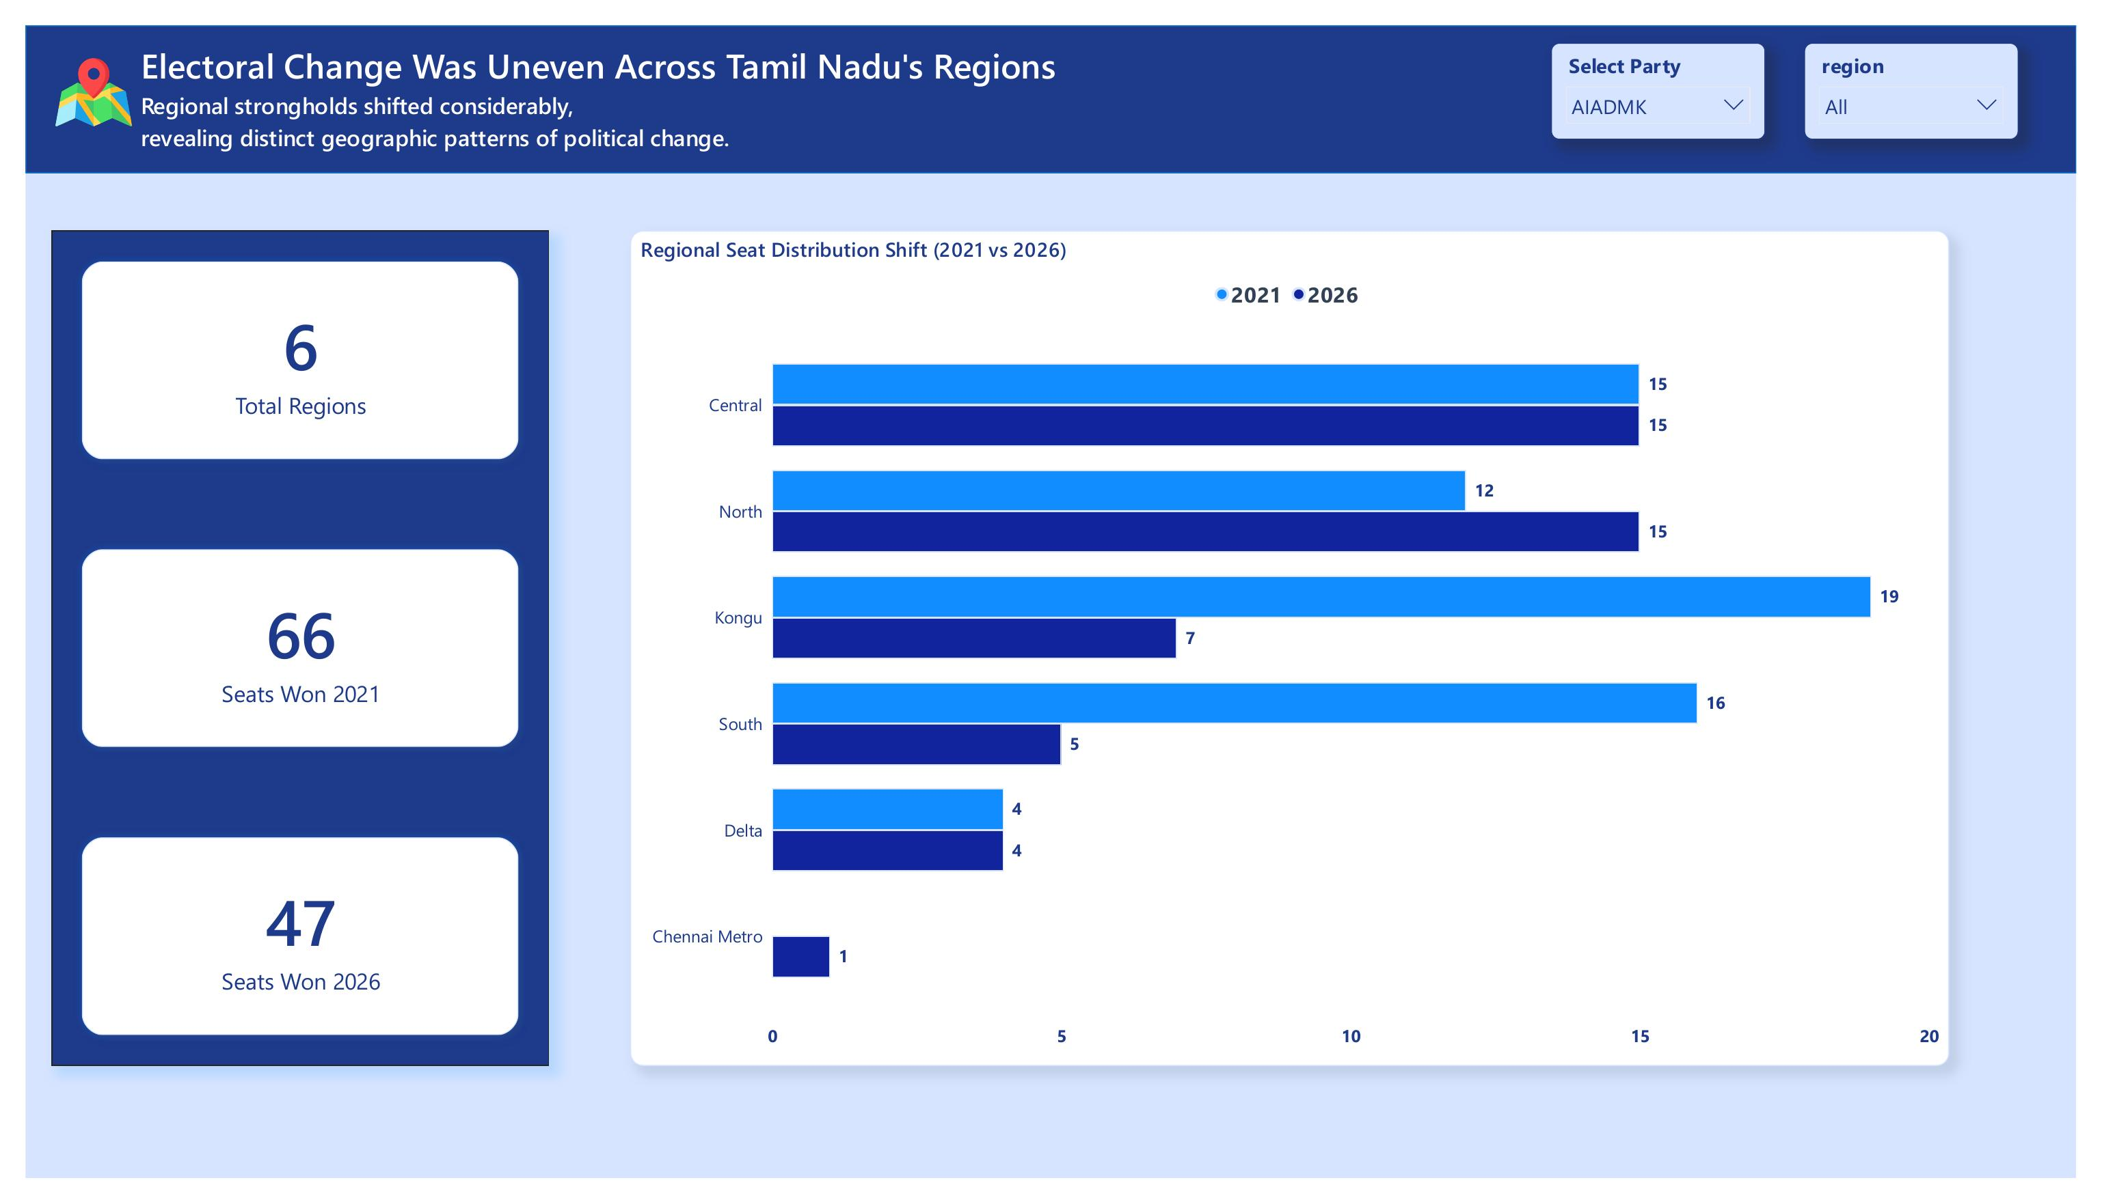
07
Regional Seat Distribution
19 → 7
16 → 5
15
Kongu region (selected party)
South region
Central region — steady
The Geographic Story: the 2026 swing was regional and uneven, not a flat statewide shift.

Slide 9
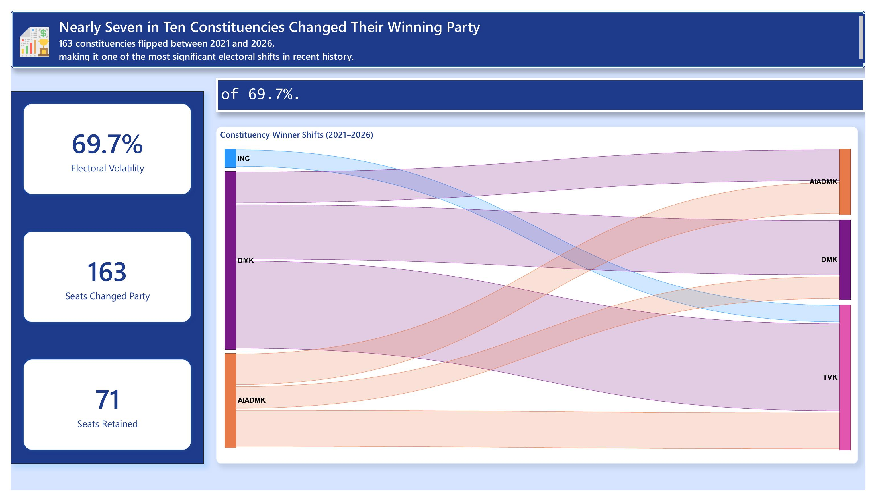
08
Constituency Flip Analysis
163 / 234
71
69.7%
Constituencies flipped
Seats retained
Electoral volatility
The Flip Story: the Sankey diagram shows TVK drawing seats from DMK, AIADMK, and INC — not just one rival.

Slide 10
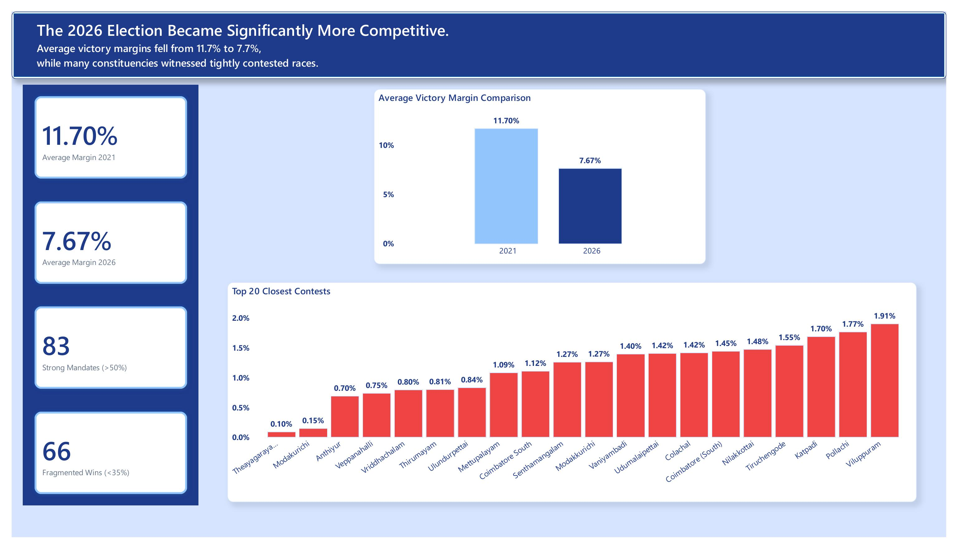
09
Competitiveness & Margin of Victory
11.70% → 7.67%
83
66
Average victory margin
Strong mandates (>50%)
Fragmented wins (<35%)
The Margin of Victory Story: the Top 20 Closest Contests chart ranks races down to a 0.10% margin.

Slide 11
Live Dashboard
Full interactive report published to the Power BI Service.
Overview · Party Performance · Regional Distribution · Flip Analysis · Margin of Victory
View the Live Dashboard →
Thank you

