Slide 1

Customer Shopping Behavior Analysis
Uncovering spending patterns, customer segments, and product preferences from 3,900 transactions to guide strategic business decisions.

Slide 2
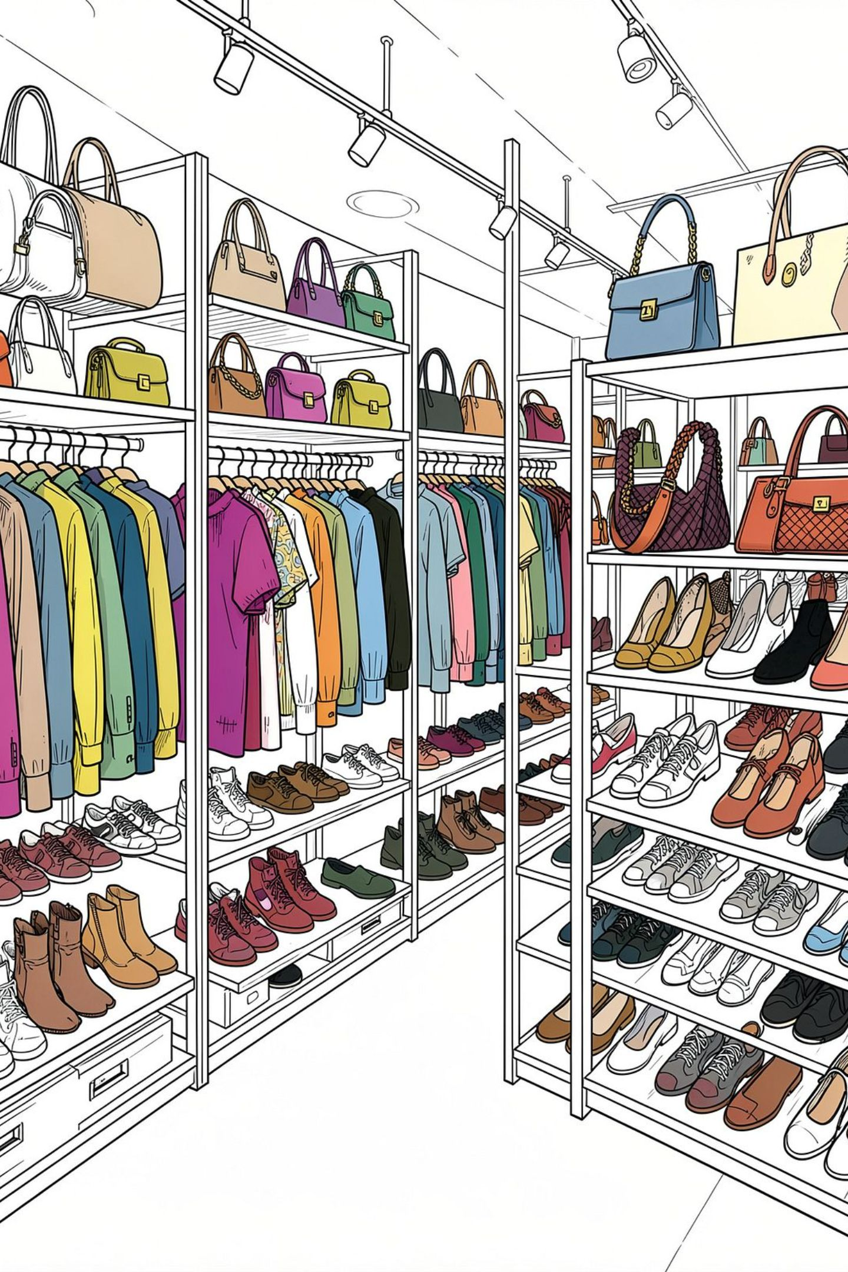
Dataset at a Glance
3,900
Transactions
18
Features
37
Missing Values
Review Rating column
$59.76
Avg Purchase
Demographics, purchase details, and shopping behavior — 4 categories, 50 locations, 25 products.

Slide 3


Data Preparation in Python
Clean
Imputed missing Review Ratings by category median
Standardize
Renamed columns to snake_case
Engineer
Created age_group & purchase_frequency_days
Integrate
Loaded cleaned data into PostgreSQL

Slide 4
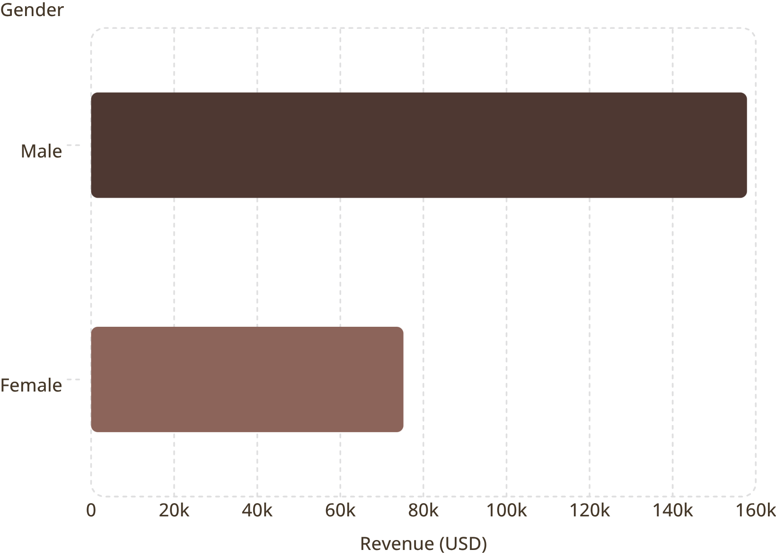

Revenue by Gender
Key Finding
Male customers generate 2.1× more revenue than female customers.
839 high-spending discount users identified — above-average spenders who still used discounts.

Slide 5
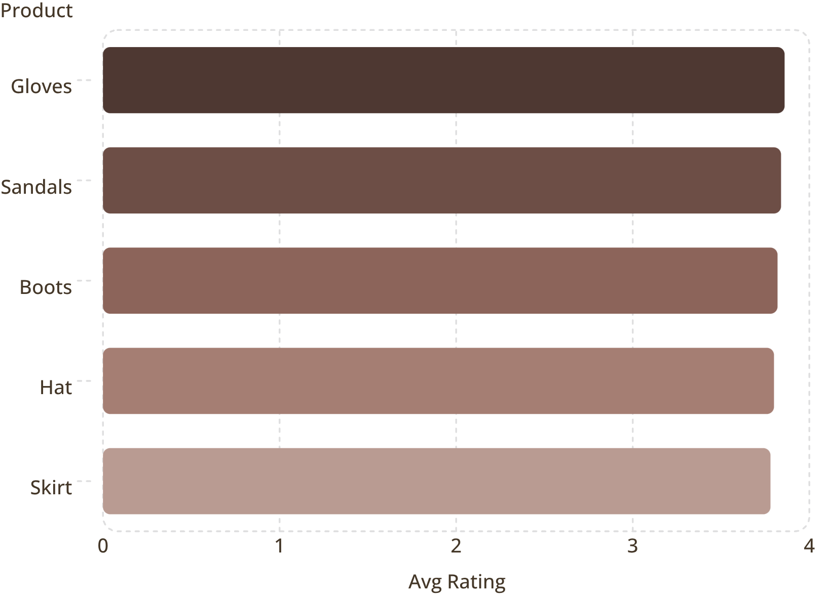
Top Products by Rating & Discount Rate
Highest Discount Rates
Hat — 50.00%
Sneakers — 49.66%
Coat — 49.07%
Sweater — 48.17%
Pants — 47.37%
Express shipping averages $60.48 vs. Standard $58.46.

Slide 6
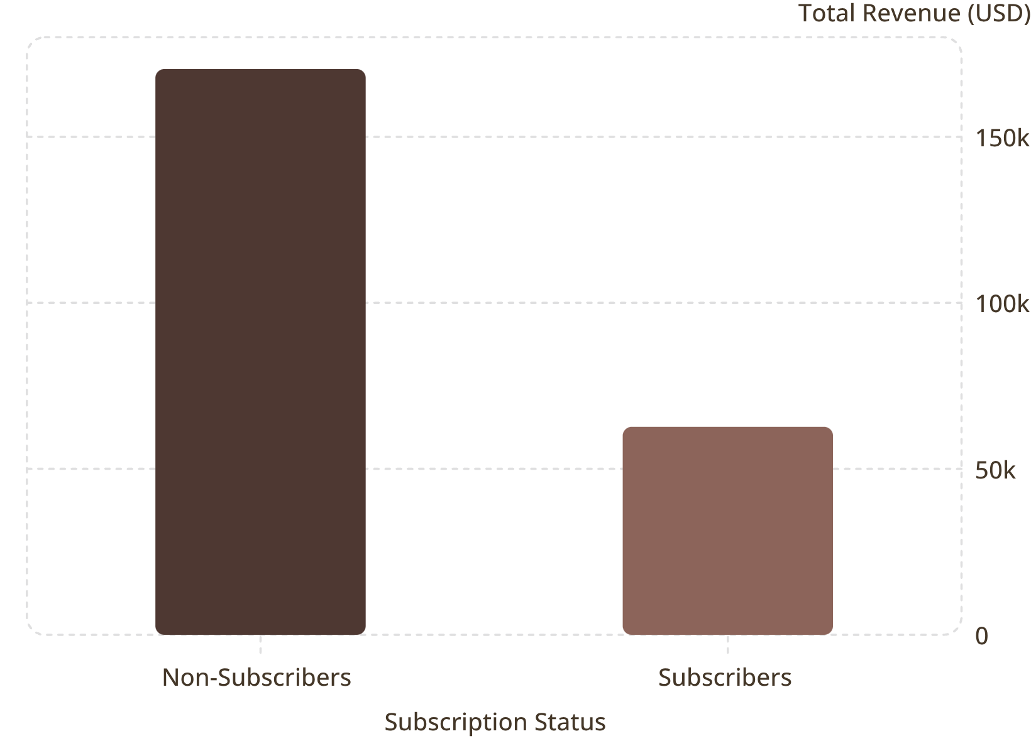
Subscribers vs. Non-Subscribers
Subscription Insights
27% Subscribers
73% Non-Subscribers
1,053 customers
2,847 customers
Avg spend nearly identical: $59.49 vs. $59.87. 958 repeat buyers subscribe.

Slide 7
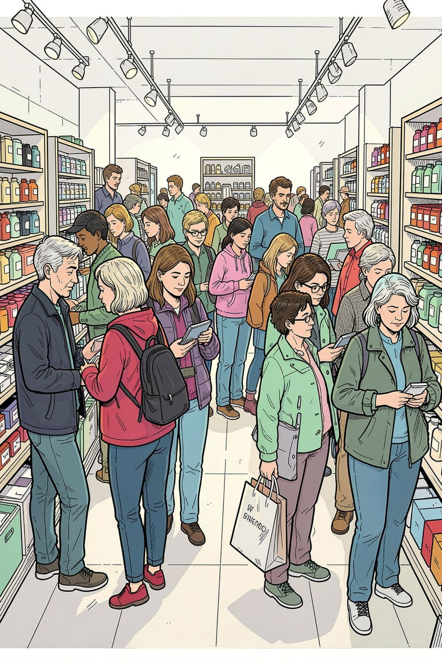
Customer Segmentation
🏆 Loyal
🔁 Returning
3,116 customers
701 customers
🆕 New
83 customers
80% of customers are Loyal — strong retention base to leverage for upselling and referrals.

Slide 8
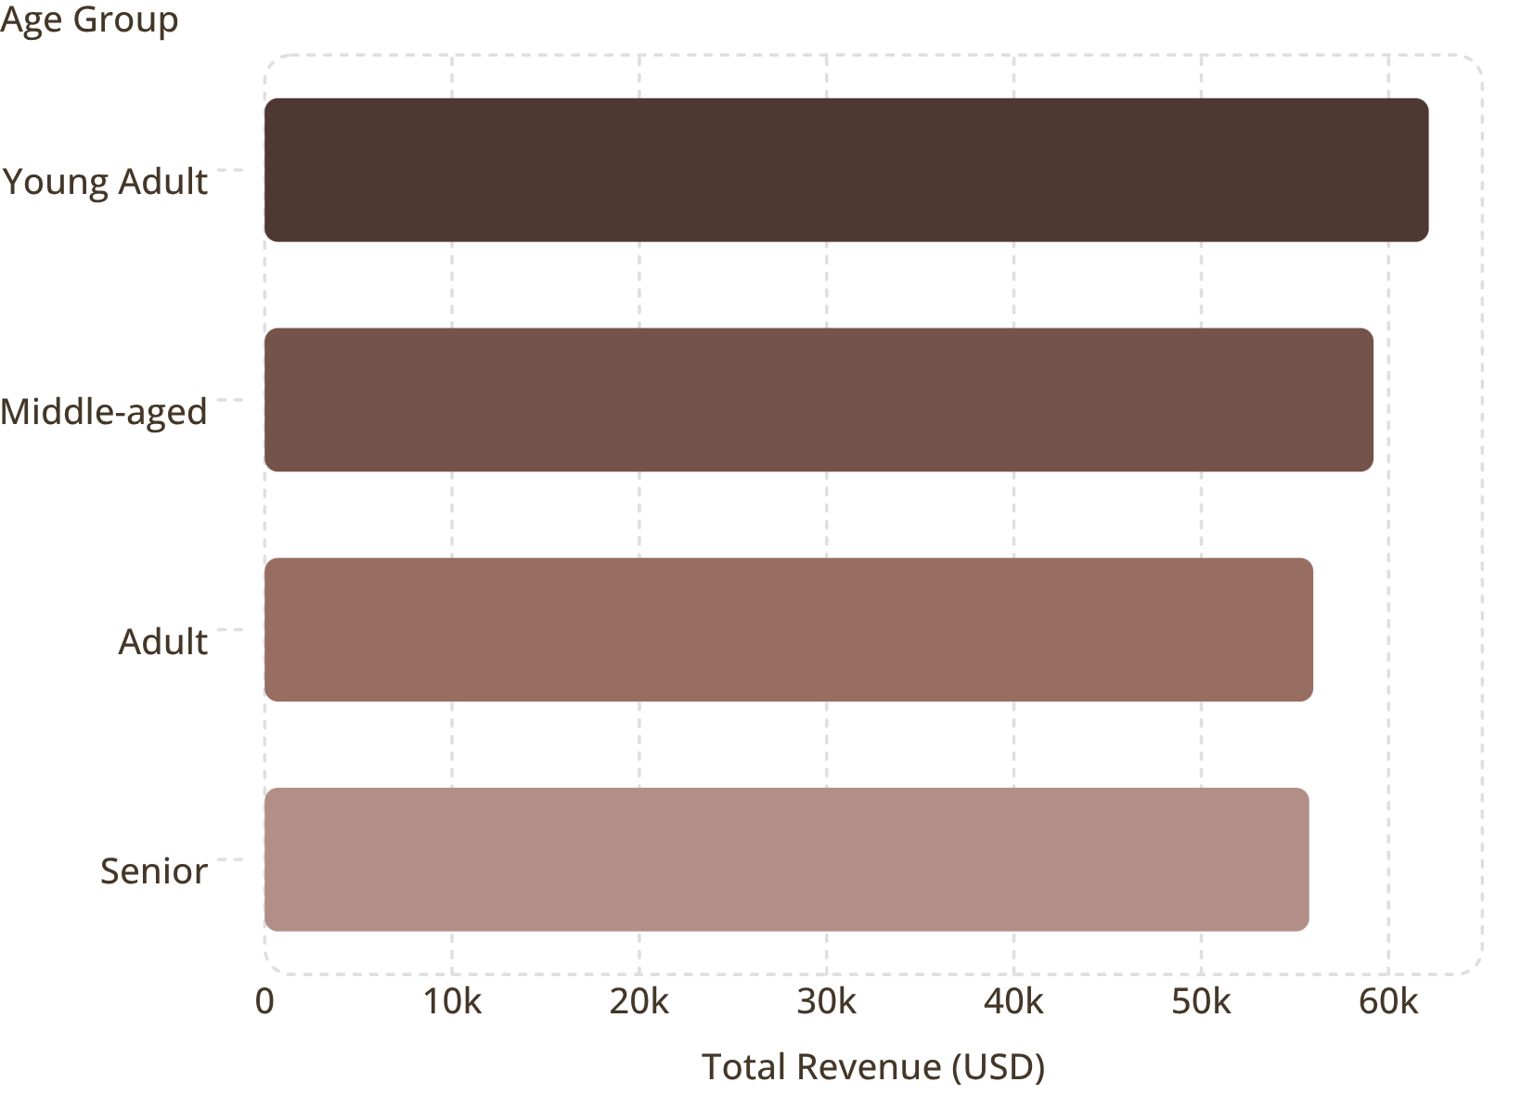
Revenue by Age Group
Top Category: Clothing
Revenue: $100K · Orders: 1,800
Accessories — $75K / 1,200 orders
Footwear — $30K / 600 orders
Outerwear — $15K / 200 orders
Young Adults lead revenue; Clothing dominates all categories.

Slide 9
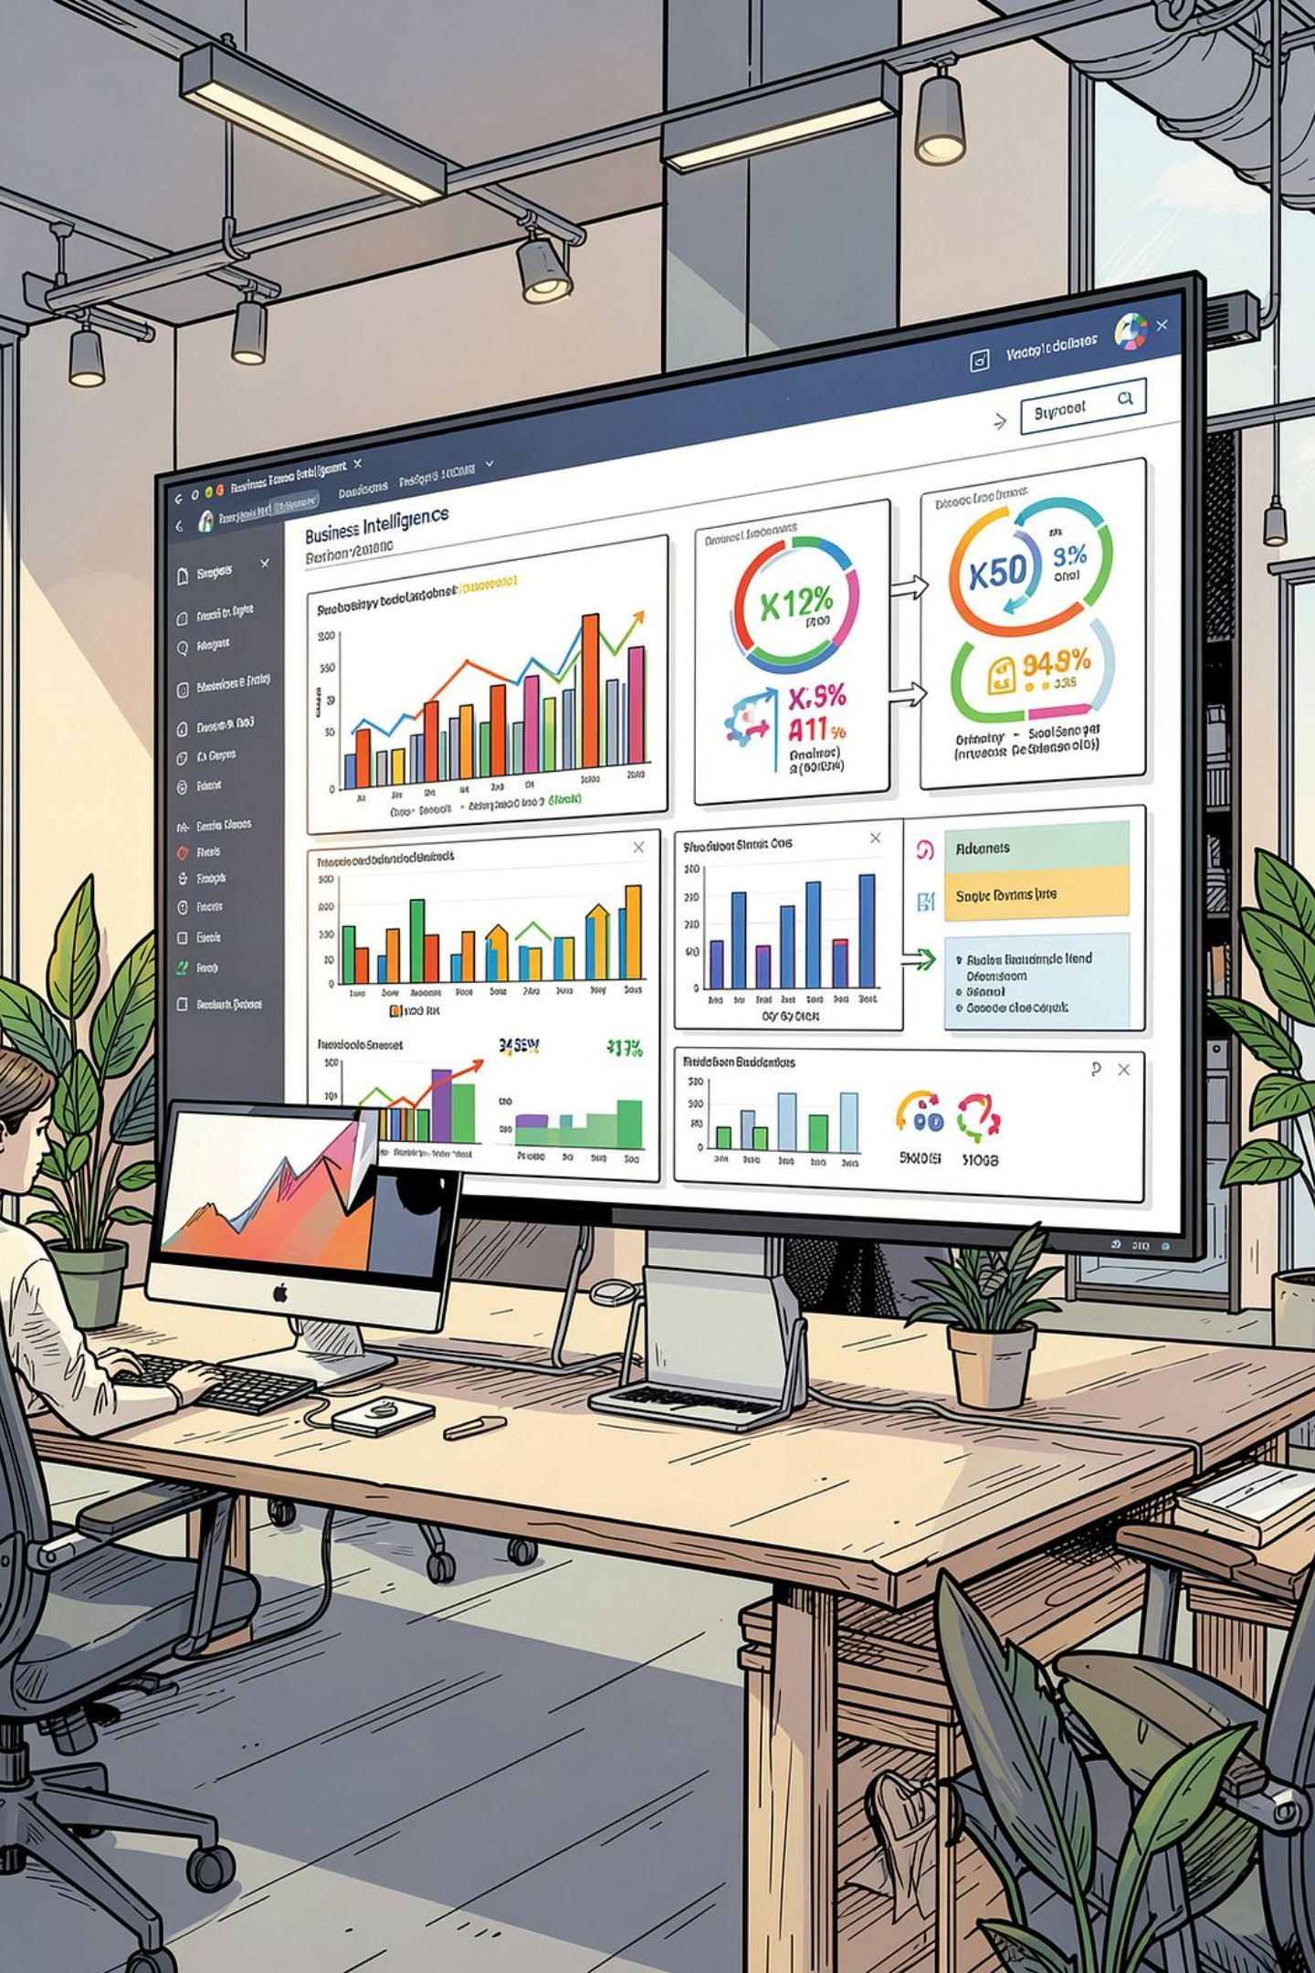




Power BI Dashboard
3.9K Customers
$59.76 Avg Purchase
3.75 Avg Rating
Interactive Filters
Subscription · Gender · Category · Shipping

Slide 10

Business Recommendations
Boost Subscriptions
Loyalty Programs
Review Discount Policy
Promote exclusive subscriber benefits
Reward repeat buyers toward Loyal segment
Balance sales lift with margin control
Product Positioning
Targeted Marketing
Highlight top-rated, best-selling items
Focus on high-revenue age groups & express shippers

