Slide 1

Blood donation management system
Vamshi Kalyan Yerramilli – 11655488
Abhiram Yashwanth Pusarla – 11712109
Amani Peddolla – 11743144
Harshith Kumar Pappula – 11646762
Vijayalakshmi Talla – 11711703
Aamani Chamarthi - 11703676

Slide 2
AGENDA
Project Description - Brief description on the blood donation management system
01
ER Diagram - Entity Relationship diagram for blood donation management system
02
Technical Stack - Tools and Technologies used for the project
03
Demo - Demo of the blood donation management system
04

Slide 3
PROJECT DESCRIPTION
The Blood Donation Management System aims to simplify blood donation by managing donor data, scheduling appointments, and ensuring smooth donation events. It helps hospitals, blood banks, and organizations track appointments, maintain donor records, and provide a seamless donation experience. The system ensures that blood donation is safe, well-organized, and convenient for those in need.
Key features include:
Donor Management and Registration: Donors can register and update personal details, including their name, contact information, and donation history.
Appointment Scheduling: Donors can schedule appointments to ensure timely and organized donations.
Appointment Tracking: The system tracks appointment progress and notifies both staff and donors about appointment dates and availability.
Security of Donor Information: Donor data, including medical histories and donation records, is securely stored and only accessible to authorized staff.
Blood Donation Events: The system helps plan and manage donation events by monitoring donor participation, blood types, and donation volumes.
Feedback and Confirmation: Donors can provide feedback on their donation experience and receive confirmation of their contribution.

Slide 4
ER DIAGRAM
ER Diagram - Entity Relationship diagram for blood donation management system

Slide 5
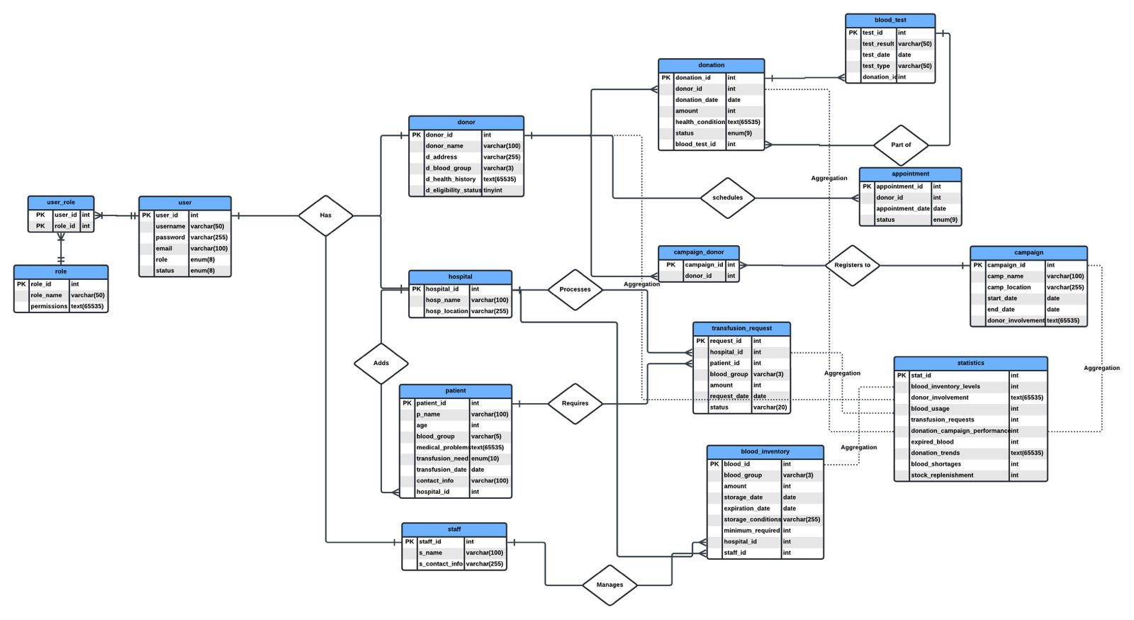

Slide 6
Technical stack
Frontend: PHP, HTML, CSS, JavaScript (for form handling and UI)
Backend: PHP with MySQL for database interaction
Database: MySQL for storing patient and transfusion-related data
Authentication: PHP sessions with role-based access control (Admin, Hospital)
Security: SQL injection prevention through data sanitization and validation

Slide 7
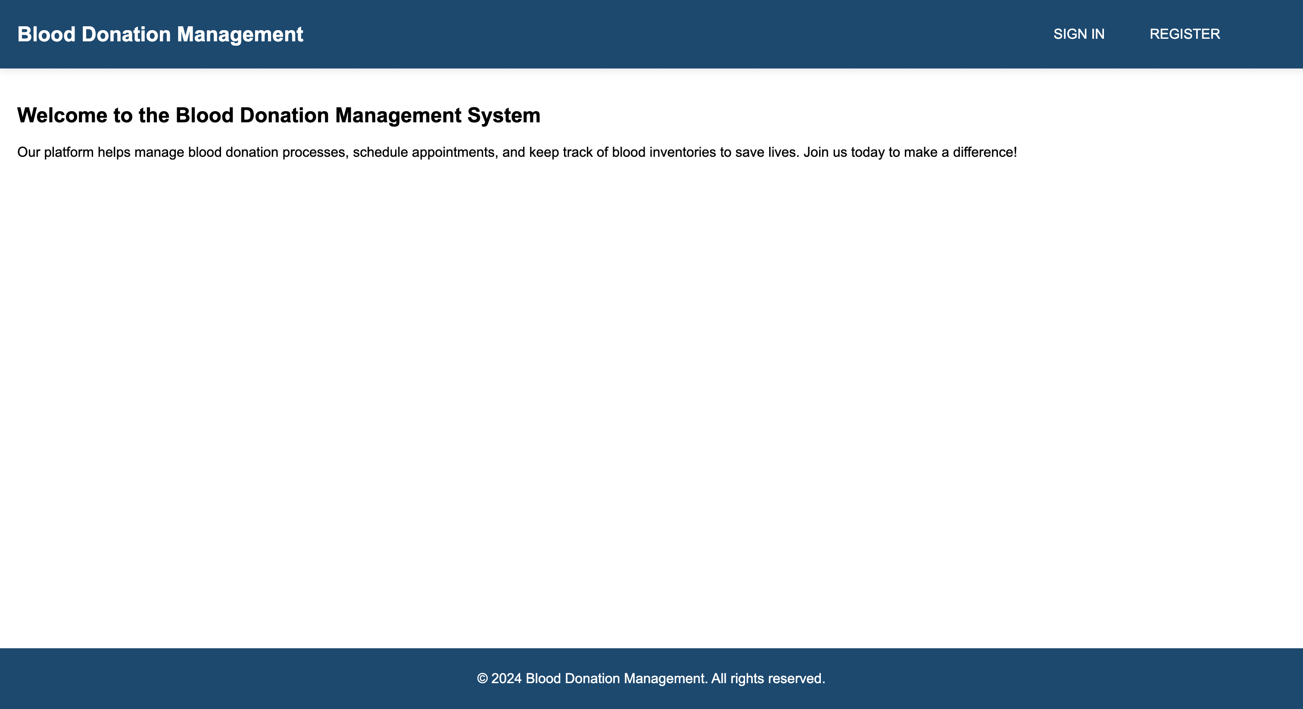
DEMO

Slide 8
THANK YOU

