Slide 1



Summer Internship on
Email Spam Detection using Machine Learning Techniques
Matrusri Engineering College
(Sponsored by: MATRUSRI ERDUCATION SOCIETY, Estd: 1980)
(Approved by AICTE, Affiliated to Osmania University)
# 16-1-486, Saidabad, Hyderabad-500059. Ph: 040-24072764
Department of Computer Science and Engineering
Email-ID: hodcse@matrusri.edu.in Website: www.matrusri.edu.in
Under the guidance of By:
M. Dattatreya Goud Vijayalaxmi Biradar
1608-21-733-312

Slide 2
Introduction
Spam emails are a growing problem, posing security risks and reducing productivity. Traditional rule-based spam filters fail to keep up with evolving spam tactics, making machine learning a more effective solution. This project focuses on building a spam detection system using Multinomial Naive Bayes (MNB) and TF-IDF vectorization for text classification. The goal is to classify emails as spam or non-spam with high accuracy. A Flask web application is integrated to provide real-time predictions, making the system practical and user-friendly for managing email spam.

Slide 3
Existing System
The current system relies on rule-based filtering and keyword matching to detect spam. While it provides basic filtering, it is not efficient in adapting to evolving spam patterns, often resulting in inaccurate classifications and poor detection of advanced spam techniques.

Slide 4
Proposed System
The proposed system leverages machine learning algorithms for accurate email spam detection. It uses techniques like TF-IDF for feature extraction and models such as Naive Bayes and Logistic Regression for classification. This system adapts to new spam patterns, improving accuracy and reducing false positives and negatives.

Slide 5
Background Knowledge
TF-IDF vectorization is used to convert text into numerical features for better classification.
Multinomial Naive Bayes (MNB) is a widely used algorithm for text classification tasks like spam detection.
The project integrates machine learning models with a Flask web application for real-time spam prediction.
It focuses on improving accuracy and offering a practical solution for email management.

Slide 6
Objectives and Goals
Internship Objectives:
Practical Application of Machine Learning Concepts
Data Handling and Preprocessing
Model Deployment and Performance Evaluation
Collaboration and Communication
Goals:
Develop a Functional Spam Detection System
Acquire Proficiency in Machine Learning and Web Development
Improve Problem-solving and Critical Thinking Abilities

Slide 7
Roles and responsibilities
Preprocessed data and applied TF-IDF for feature extraction.
Implemented machine learning algorithms and tuned models.
Evaluated performance and handled data imbalance.
Documented the project process and results.

Slide 8
Skills Acquired/Developed
Python Programming: Strong foundation in Python syntax and libraries.
Machine Learning Fundamentals: Understanding classification algorithms and evaluation metrics.
Data Preprocessing and Cleaning: Handling missing values and preparing text data.
Web Development Basics: Knowledge of Flask framework and how to build web-based services.
Model Deployment: Skills in integrating machine learning models with web applications.

Slide 9
Challenges Faced and problem solved
We tackled imbalanced data with oversampling and class weighting, and improved text vectorization using TF-IDF. Hyperparameter tuning enhanced model performance, boosting accuracy. These solutions sharpened my problem-solving skills.

Slide 10
Achievements and Contributions
Achievements:
Successful Spam Detection Model Implementation
Integration of Machine Learning Model with Web Interface
Performance Evaluation and Visualization
Contributions:
Model Development and Optimization
Web Application Development
Documentation and Abstract creation

Slide 11
Learning Experience and Growth
This project improved my skills in machine learning, data preprocessing, and model evaluation. I gained practical experience with algorithms and learned how to enhance model performance, boosting my problem-solving abilities.

Slide 12
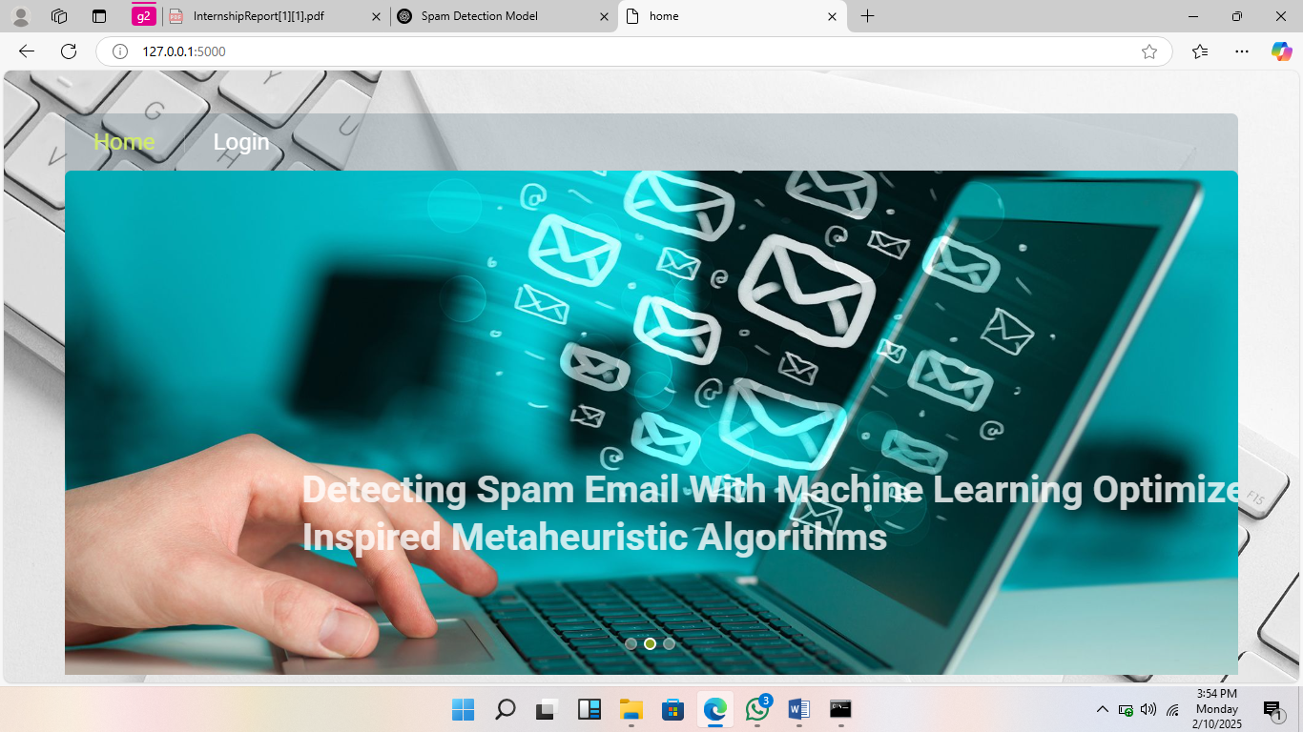
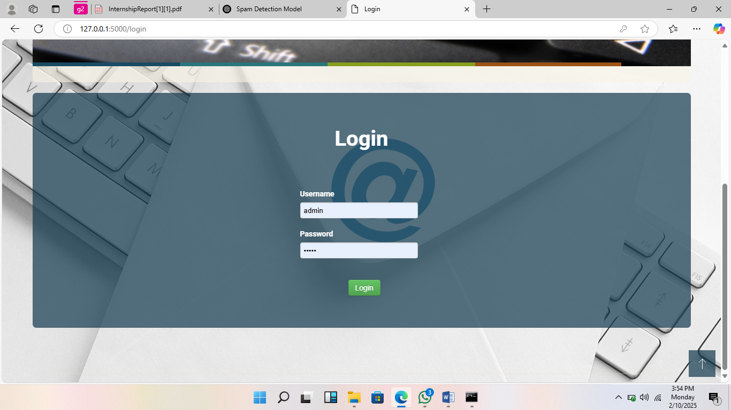
Result Screens
Home page Login page

Slide 13
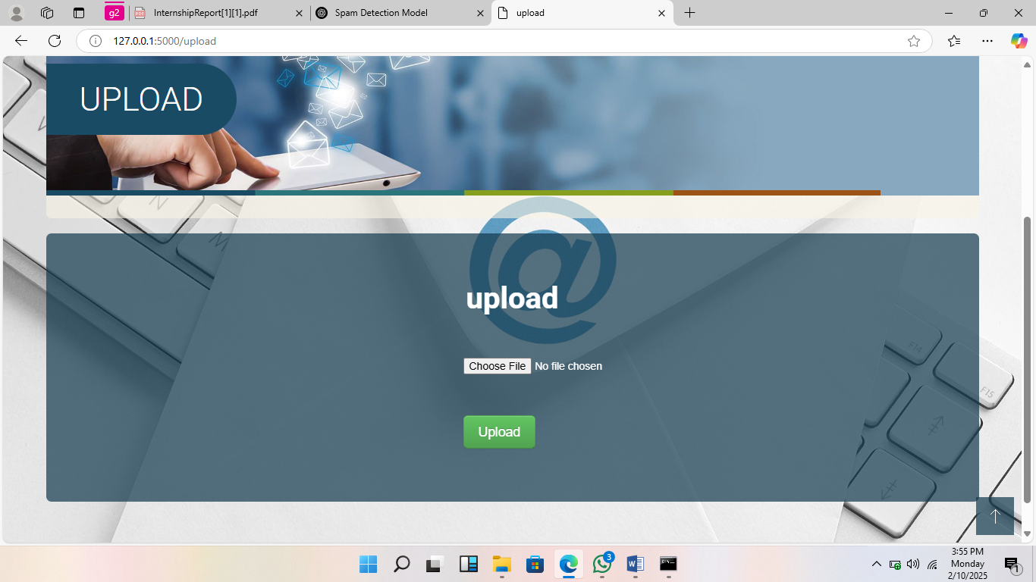
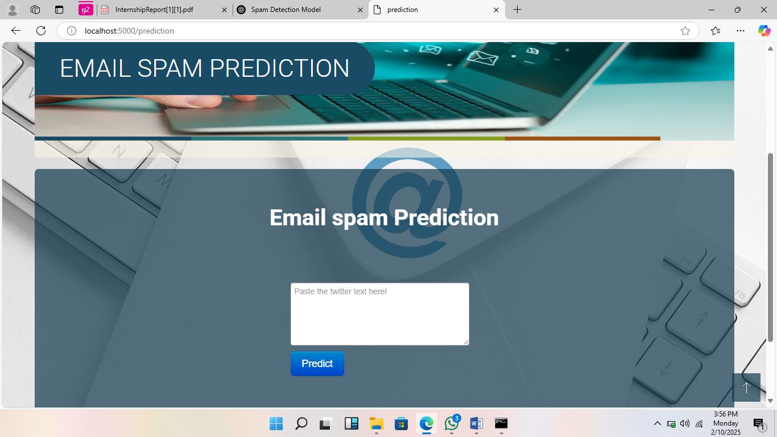
Upload page prediction page

Slide 14
Future Applications
Here are some key future applications of spam detection:
Social Media Spam Filtering
SMS Spam Detection
Phishing Website Detection
Real-Time Chat and Messaging Apps
Data Privacy and Security

Slide 15
Conclusion
This project developed an effective Email Spam Detection system using machine learning, achieving high accuracy in classifying emails. Future work could involve using deep learning models for improved performance. The project offers a strong foundation for better email security.

Slide 16
Thankyou

