Slide 1


Automated Identification of Incorrectly Labelled Shipments using Machine Learning Models
Master Thesis
By
VIJAYA MADASU

Slide 2
Contents
Business Understanding
Motivation
Methodology
Data Understanding
Data pre-processing
Machine Learning and types
Results and Comparision
Tuning of Random Forest Model
Cross Validation and Results
Over-fitting Problem
Resampling Technique
Limitations and Future Work

Slide 3
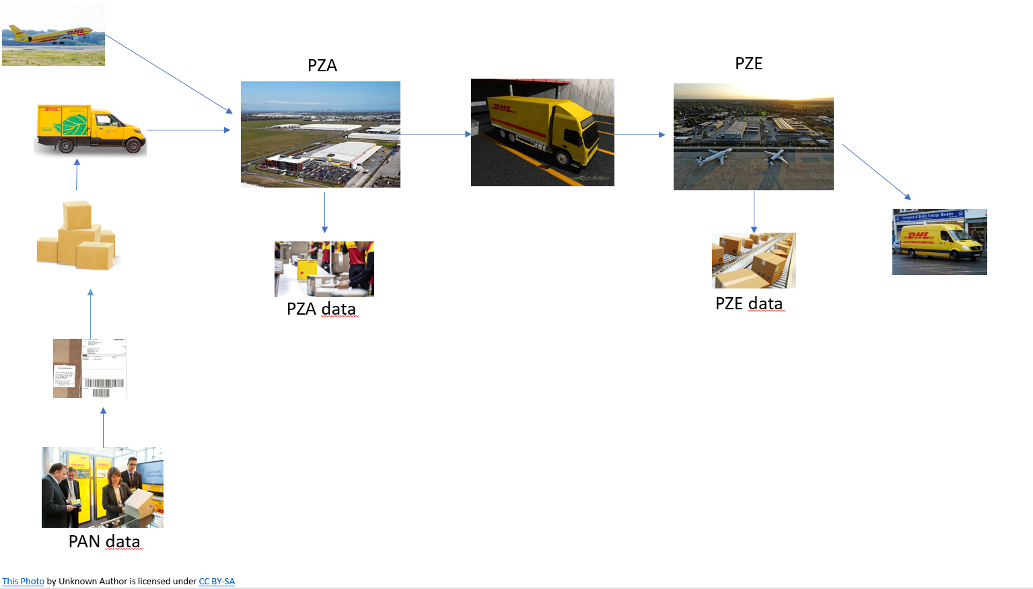
Business Understanding
PAN data : Information of the parcel given the customer
PZA data : Information of the parcel from the source parcel centre
PZE data : Information of the parcel from the destination parcel centre

Slide 4
Motivation
As part of the revision of the Postal Act, In § 73, the requirements for labeling packages with increased weight between 10 and 20 kilograms, as well as labeling packages with high weight over 20 kilograms, are specified.
Failure to comply with the Postal Act may result in penalties for DHL Group and even the possible removal of DHL from the provider directory for postal services.
Furthermore, labeling of heavy packages >20 kg is not consistently implemented at DHL currently.
Only 8 Parcel centres are having weighing scales and 33 parcel does not have weighing scales, i.e., around 60 % parcels are going through parcel centres without weighing scales
A machine learning algorithm is developed to forecast the weight of the parcels over 20kg for parcel centres without weighing scales.
"Dieses Foto" von Unbekannter Autor ist lizenziert gemäß CC BY-SA

Slide 5
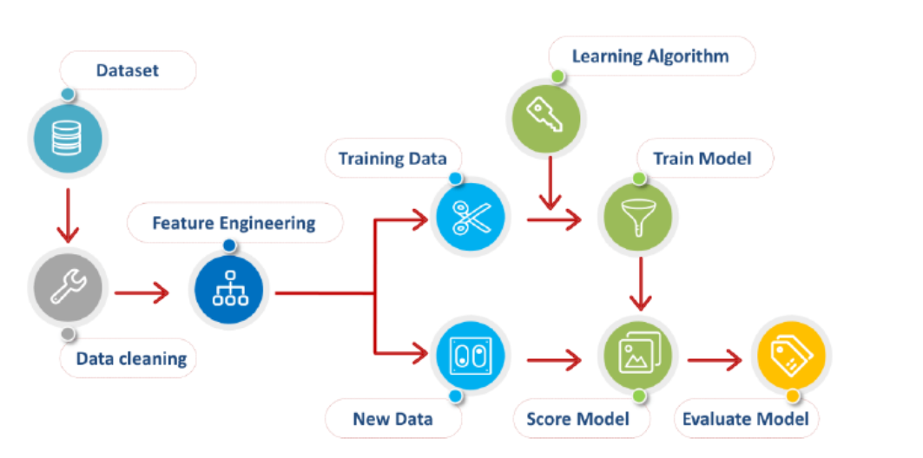
Methodology
Reference: ML systems learn, and then infer results, from data | Download Scientific Diagram (researchgate.net)

Slide 6
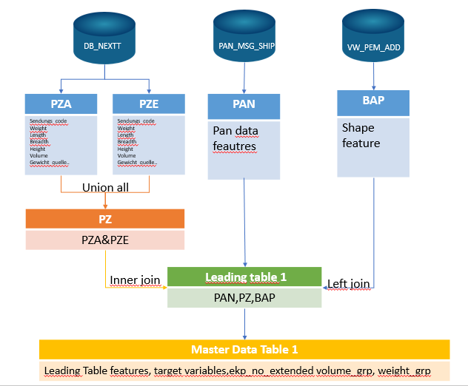
Data Understanding
Target Variables
Other Variables
Gewicht_Flag_20 : If the weight given by customer is less than 20kg, but the real weight is greater than 20kg.
Gewicht_Flag_10 : If the weight given by the customer is not in between 10kg and 20kg, but in reality the weight of the shipment is in between 10kg and 20kg.
Gewicht_real : Real weight of the parcels
Ekp_No_Extented: Unique identifier of the customer
Volumen_grp: Categorizing volume into predefined groups.
Parcel_shape: Shape of the parcel

Slide 7
Data Analysis
Around 2 Billion shipments data was considered for analysis
All the data collected were shipment data from parcel centres with weighing scale, national shipments and leagal for trade.
Data is highly imbalanced, leading to 0.03% of parcels belongs to the target group
Outliers : Around 5000 parcels for each month were having weight from customer greater than 100kg which are outliers.
Also the specific weight (weight per unit volume) of the shipments > 5kg were identified through analysis

Slide 8
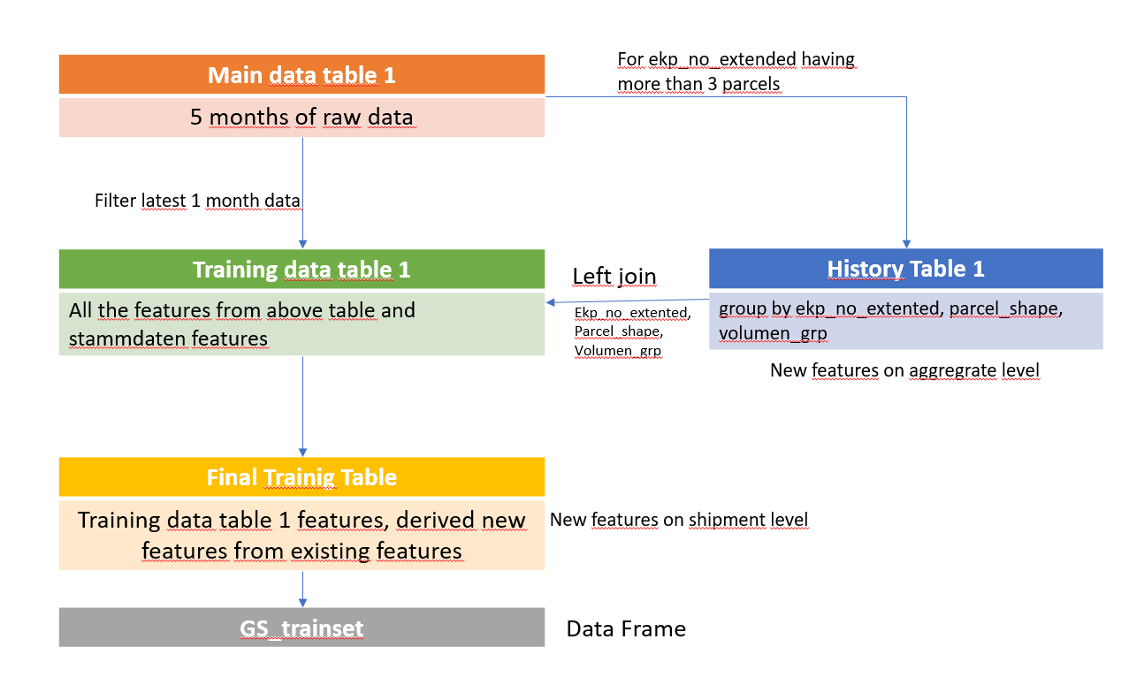
Feature Engineering
History features
Event and Weight Counts
Average Measurements
Min/Max Measurements
Flag Counts and Proportions
Weight Difference
Main Features
Ratios Involving Length, Height, and Breadth
Ratios Involving Volume and Dimensions
Ratios Involving Dimensions and Deviations
Weight Ratios and Deviations
Sum of Dimensions and Related Ratios
Volume-Weight Ratios

Slide 9
Data Processing
This steps includes features creation on ekp, volume_grp, parcel_shape aggregation level for history and new features for training data after left join of history features
Three features parcel_shape, volume_grp and gewicht_pan are with categorial values were transormed into numerical values using one-hot encoding.
One-hot encoding : One hot encoding is a technique that we use to represent categorical variables as numerical values in a machine learning model
Delete unwated features like panid, ekp, ekp_no_extended… in total 13 features and three target features.
Null Values : 53884 null values were filled with with zero
After pre-processing, the final data frame consists of 87 predictive features and three target variables.
Data is splitted into 7:3 ratio i.e, the total dataset is splitted into training data which is 70 percent of total dataset and testing data which 30 percent
Due to memory probelms in the platform, considered only 5 Million datasets in total, therefore it divided 2.1 Million data for training and 1,5 Million parcels were tested by the model.

Slide 10

Machine Learning
Reference: Machine Learning Types #2. Supervised Learning | by Rajesh Khadka | Towards Data Science

Slide 11
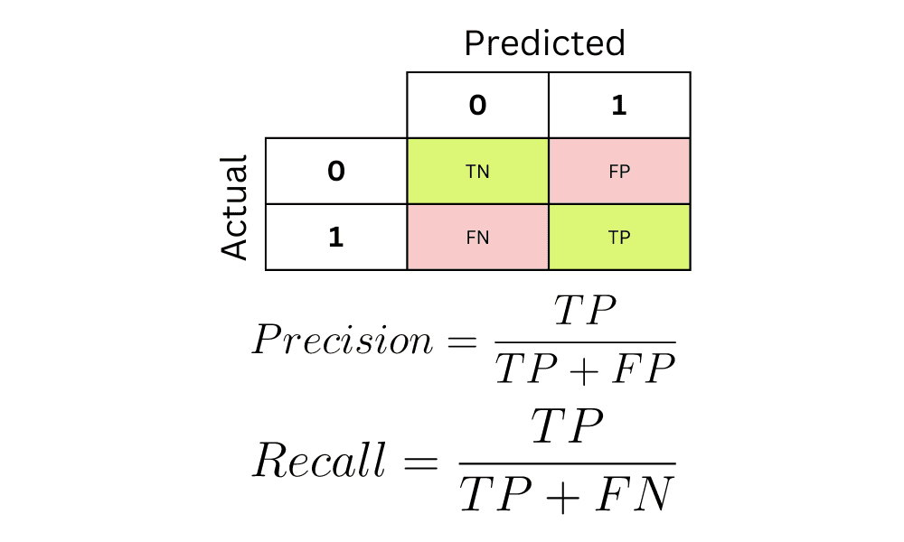
Evaluation Metrics
Accuracy : The percentage of accurate predictions to the total number of evaluated instances both true and false is represented by accuracy.
Precision : The measure of correctly predicted from the total predicted in a positive class defines precision
Recall : The true positive rate, also called recall, measures the proportion of positive instances that are correctly identified
F1 Score : This is a harmonic mean of the Precision and Recall values
Reference: https://www.kdnuggets.com/2022/11/confusion-matrix-precision-recall-explained.html

Slide 12
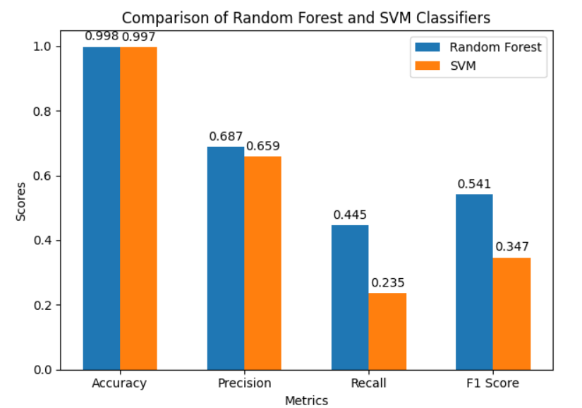
Comparision of SVM and RF Results on Test Set
RF Model out performs SVM model
SVM model requires data normalization
Time required for training SVM model is around 2414 seconds for training 3 million dataset whereas time required for training RF model is only 57 seconds.
So, we decided to choose Random Forest model for further steps such as tuning and testing on validation set

Slide 13
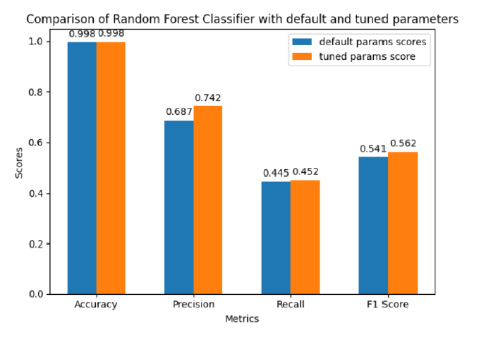
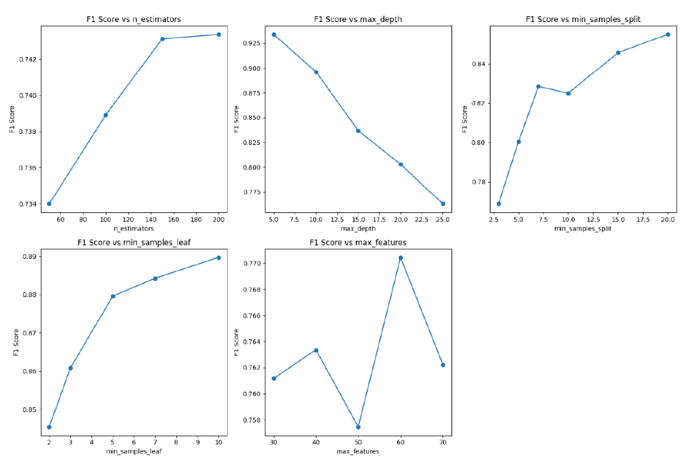
Tuning of Random Forest Model
We used manual search approach for tuning Random Forest model
Manual search involves selecting a set of hyper-parameters by hand, training the model with these hyper-parameters, evaluating its performance, and iterating this process until a satisfactory combination is found.
Tuning the model improved the results by 3.5%
Final hyper parameters

Slide 14
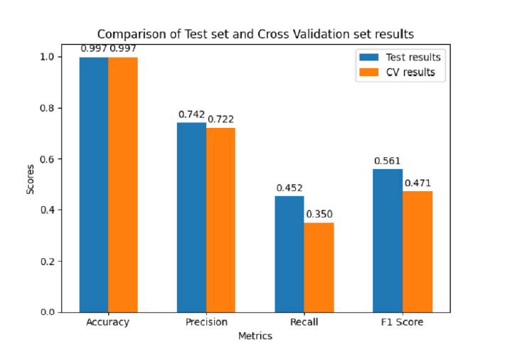
Cross Validation
Cross Validation is a technique for evaluating a machine learning model and testing its performance
Cross-validation ensures that the model performs consistently well on different subsets of the data.
Data is collected for the month of August with size of 3 million
Results on validation set by tuned RF classification model
Classification model is overfitting

Slide 15
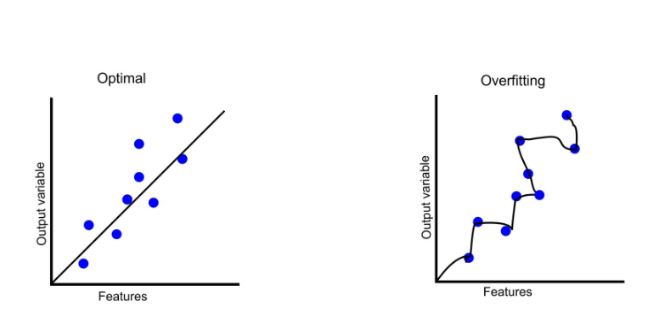
Over-fitting
Overfitting is a common challenge in machine learning where a model learns the training data too well, including its noise and outliers, making it perform poorly on unseen data.
From the seen results of RF model on Test data and Validation set data, it is clear that tuned RF model was overfitting
To overcome overfitting problem, we used resampling technique
Reference: https://www.freecodecamp.org/news/what-is-overfitting-machine-learning/

Slide 16
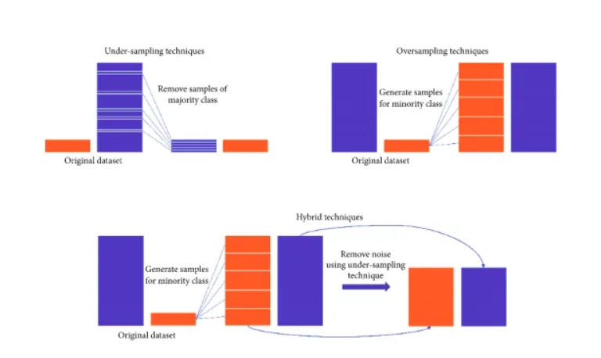
Resampling Technique
The main objective of resampling is to balance the dataset either by increasing the frequency of the minority class or by decreasing the frequency of the majority class
Under-sampling, Over-sampling, Combining both techniques.
Different ratios of majority and minority datasets in training data were considered for training the model

Slide 17
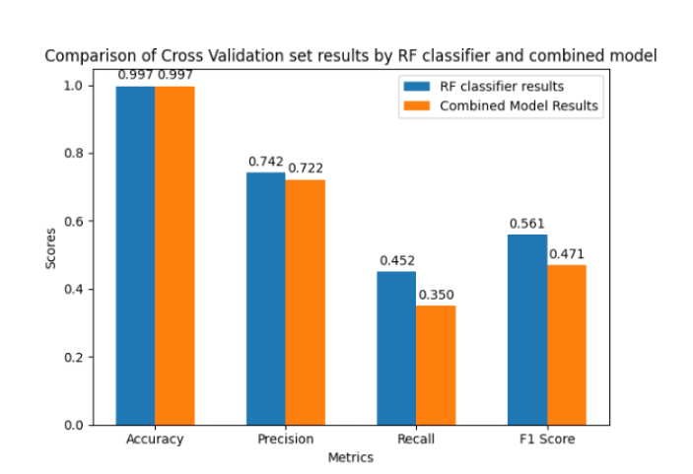
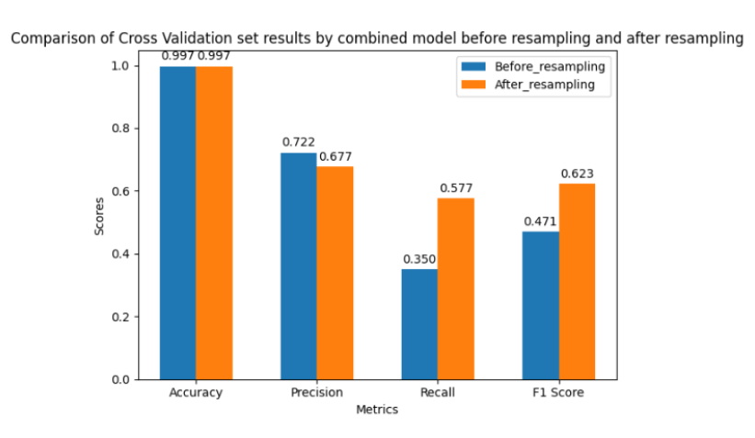
Final Results on Validation Set
Combination of Classification model and regression model
Also Relevance of each customer is calculated and combined with both model results

Slide 18
Limitation and Future Work
Limitations
Dataset Size Constraints: The study was constrained by runtime and memory issues when considering datasets larger than 5 million samples.
Insufficient International Shipment Data: The model faced challenges in accurately predicting the weight of international shipments due to insufficient data. The lack of customer data further complicated the prediction process for these shipments.
Future Work
Addressing Over-fitting: Identifying the underlying reasons for model over-fitting and implementing strategies to mitigate this issue.
Data Augmentation: Efforts should be made to acquire more comprehensive data, particularly for international shipments.
Enhanced Feature Engineering: Further analysis should be conducted to understand why the model is making incorrect predictions. This could involve exploring additional features or employing more sophisticated feature engineering techniques to improve model performance.

Slide 19


