Slide 1

Awg automation

Slide 2
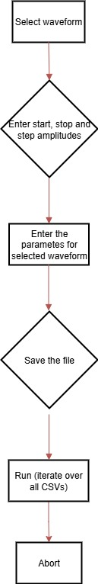
Improved features
Simplified the GUI for channels
Option to develop multiple CSVs at a time
Option to sweep over output amplitude

Slide 3
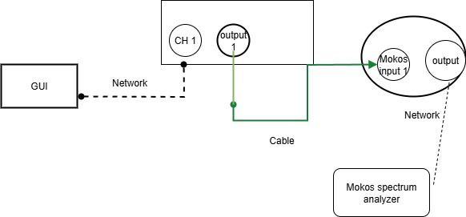
Training and validation loss for best model (trail continuing)

Slide 4
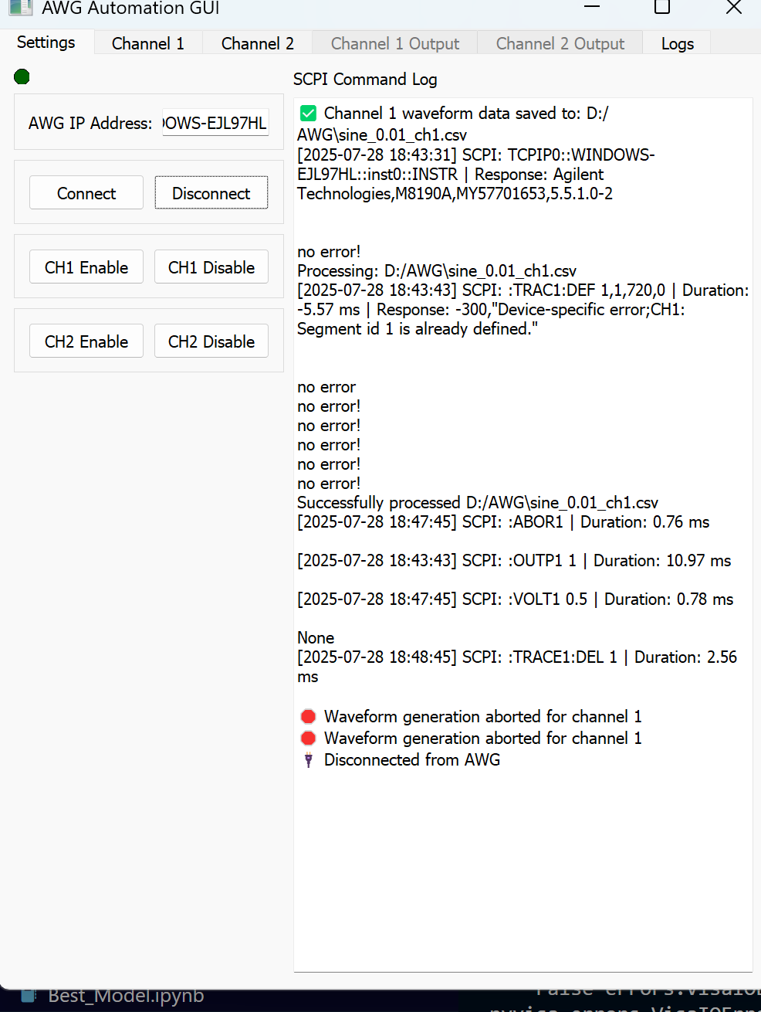
Running status

Slide 5
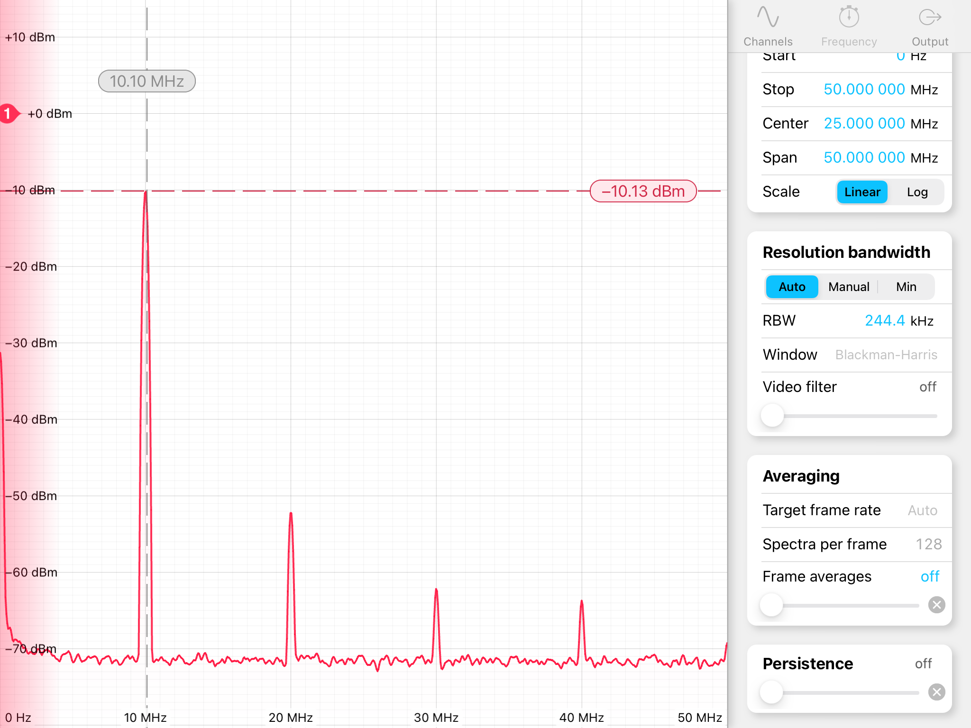
Output

Slide 6
Awg automation
Establish connection using ssh or scp
Send the files through ssh
Make the output more accurate
Make the plots interactive

Slide 7
Awg automation
Installed open ssh
Implemented file transferring via ssh
Tested file transfer with ssh
The plots made interactive using plotly

Slide 8
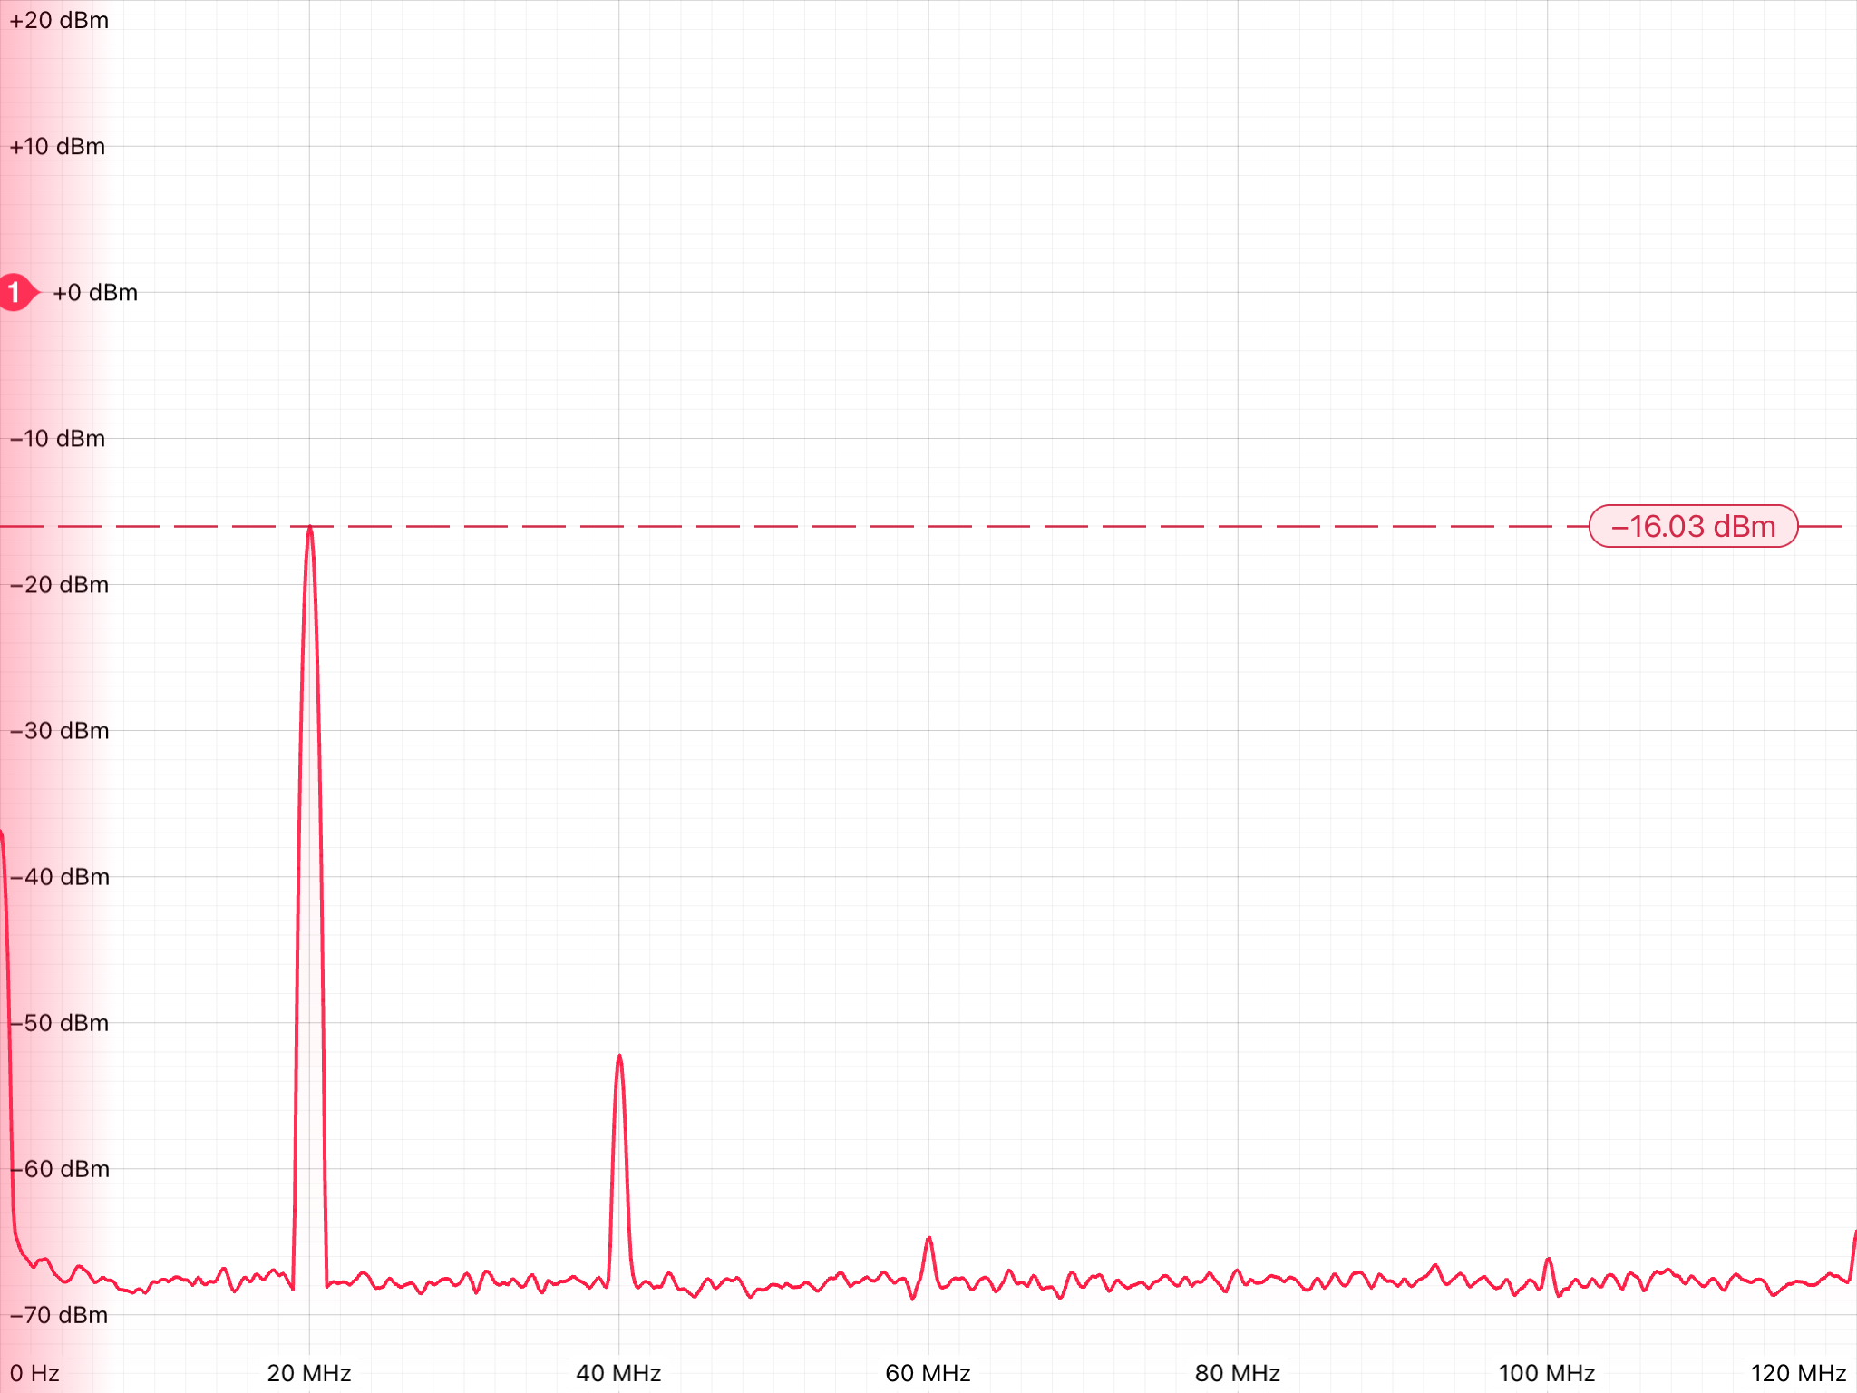

Slide 9
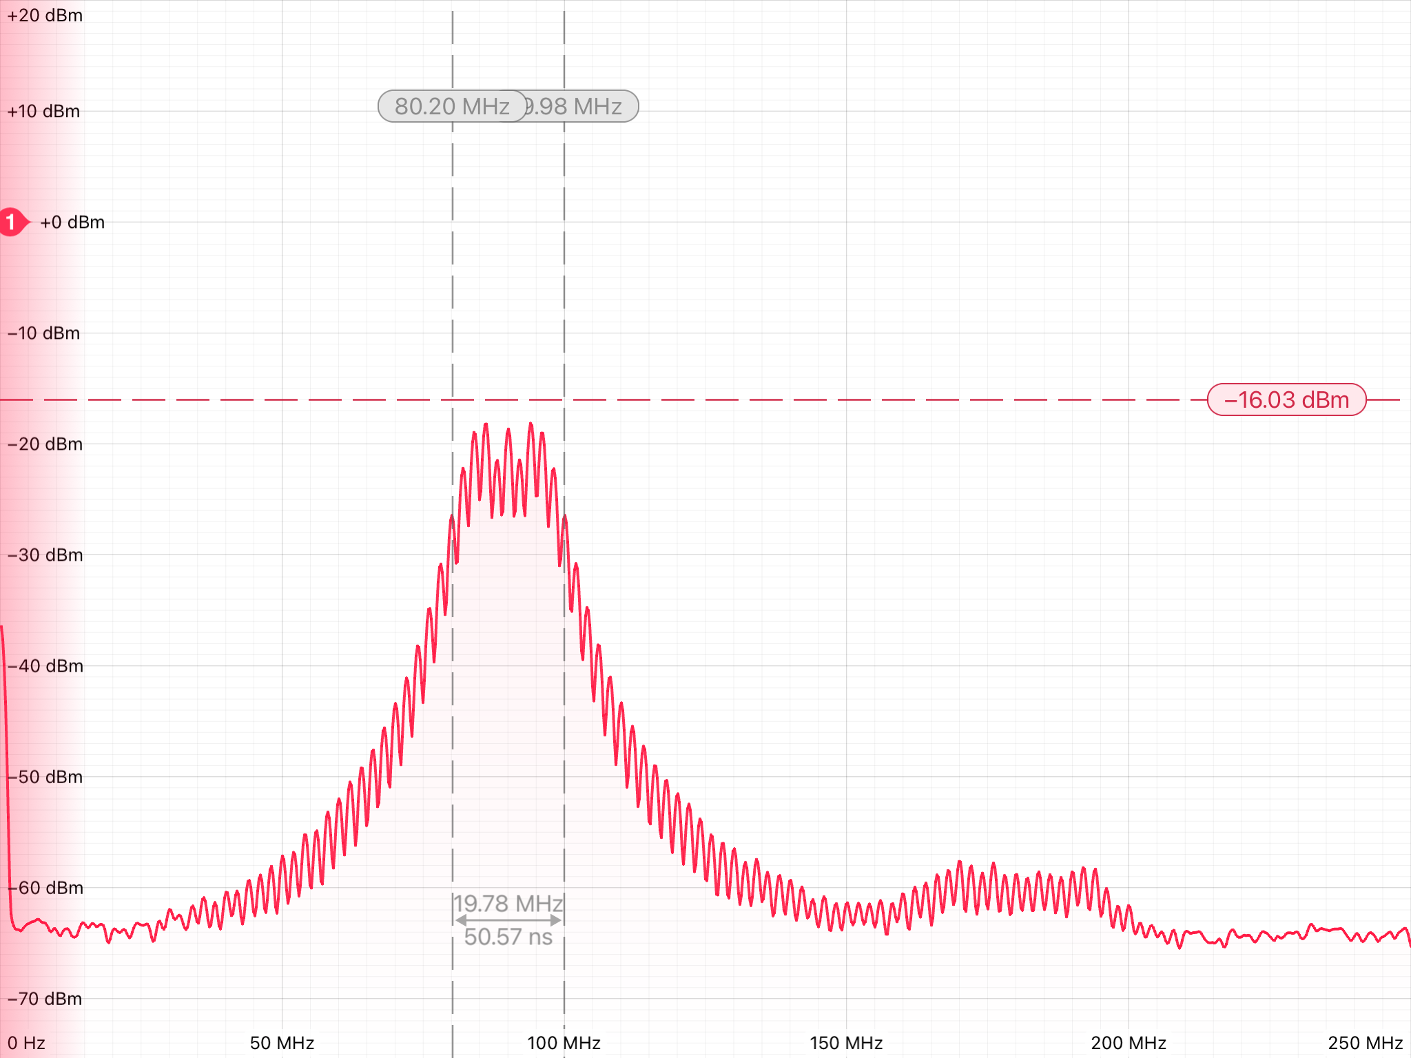

Slide 10
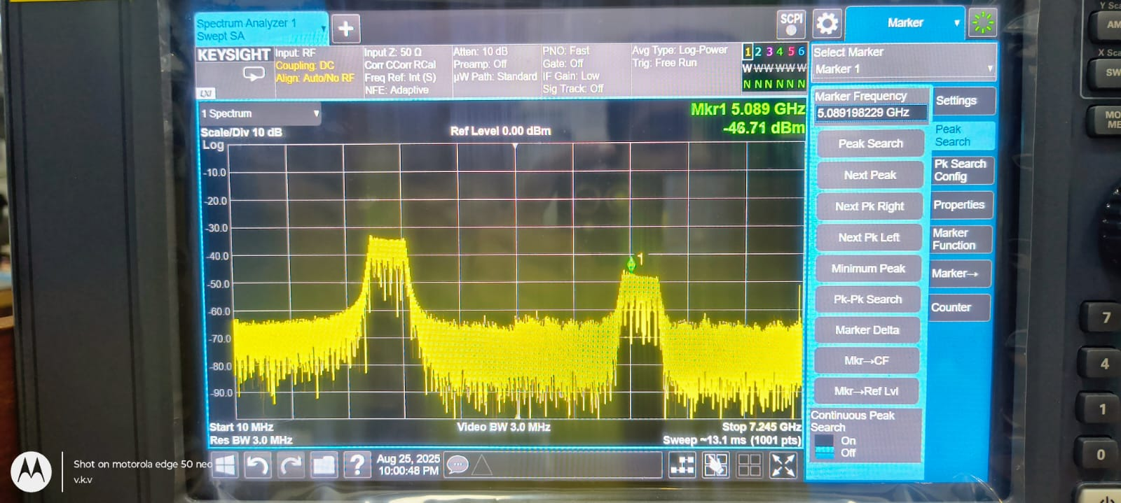

Slide 11
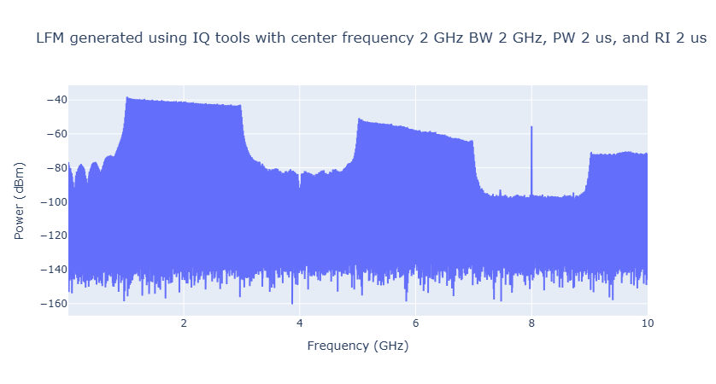
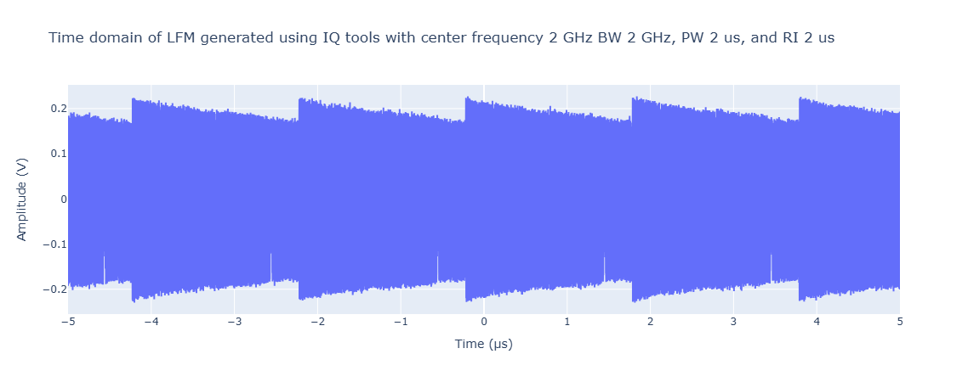
Output of lfm generated using iq tools software

Slide 12
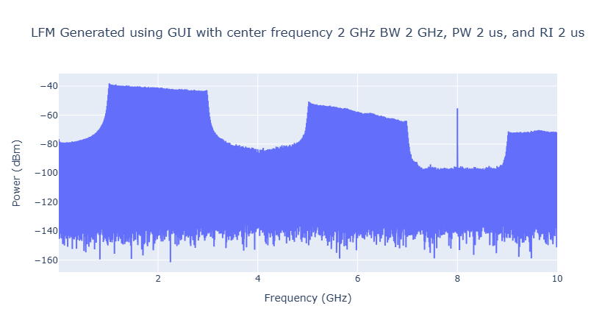
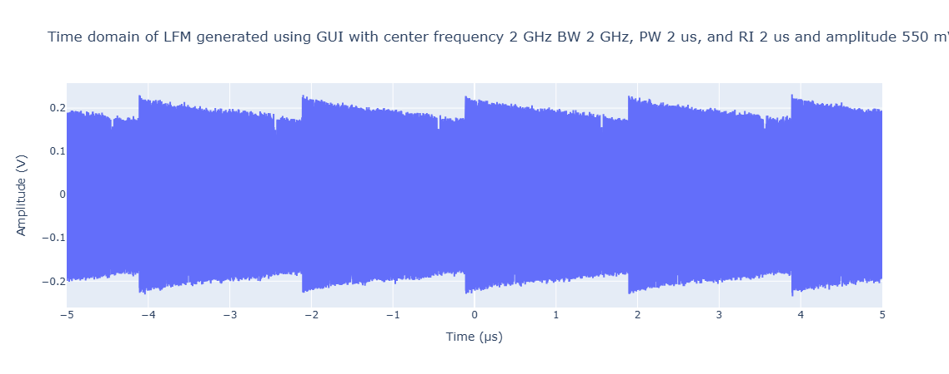
Output of lfm generated using gui

Slide 13
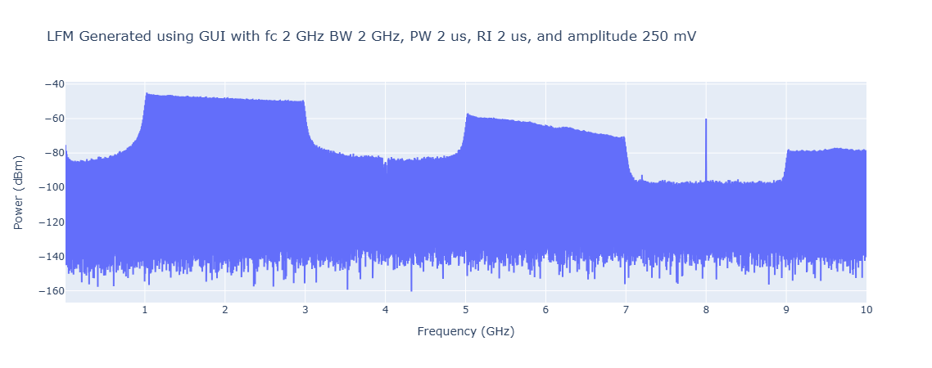
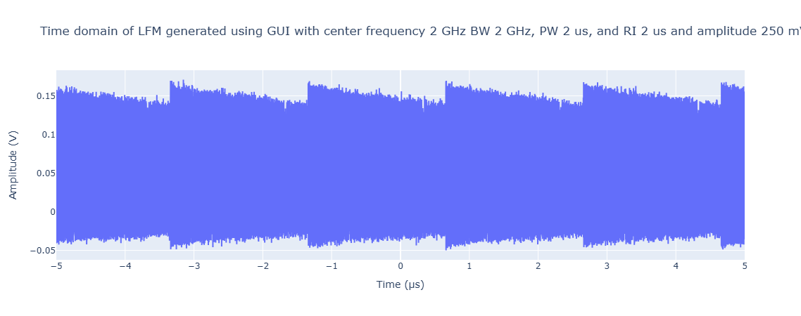
Output of lfm generated using gui

Slide 14
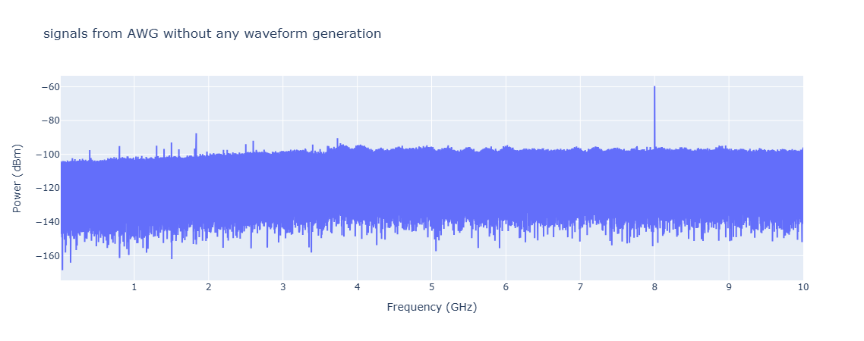
Output from awg without generating waveform

