Slide 1

Awg automation

Slide 2
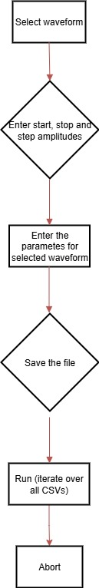
Improved features
Simplified the GUI for channels
Option to develop multiple CSVs at a time
Option to sweep over output amplitude

Slide 3
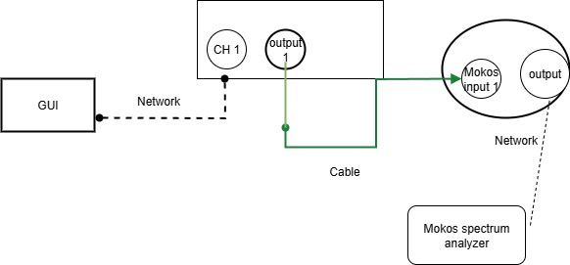
Training and validation loss for best model (trail continuing)

Slide 4
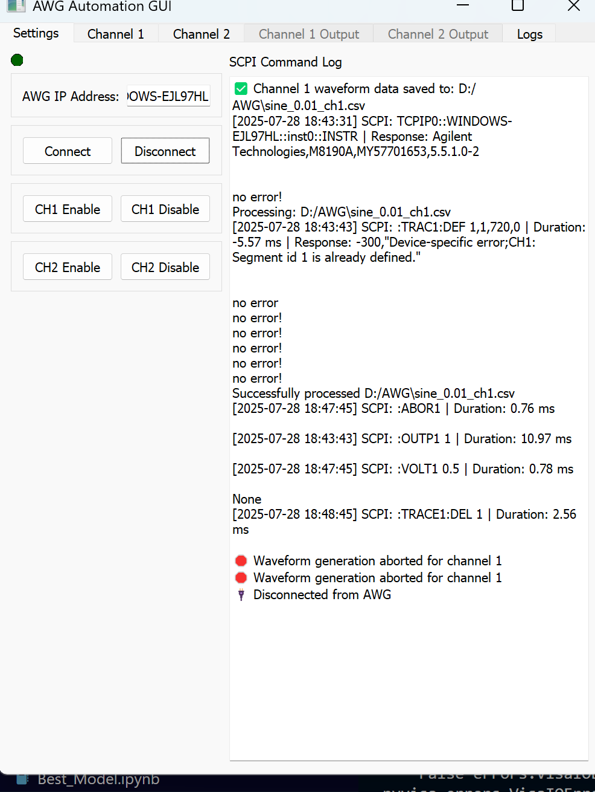
Running status

Slide 5
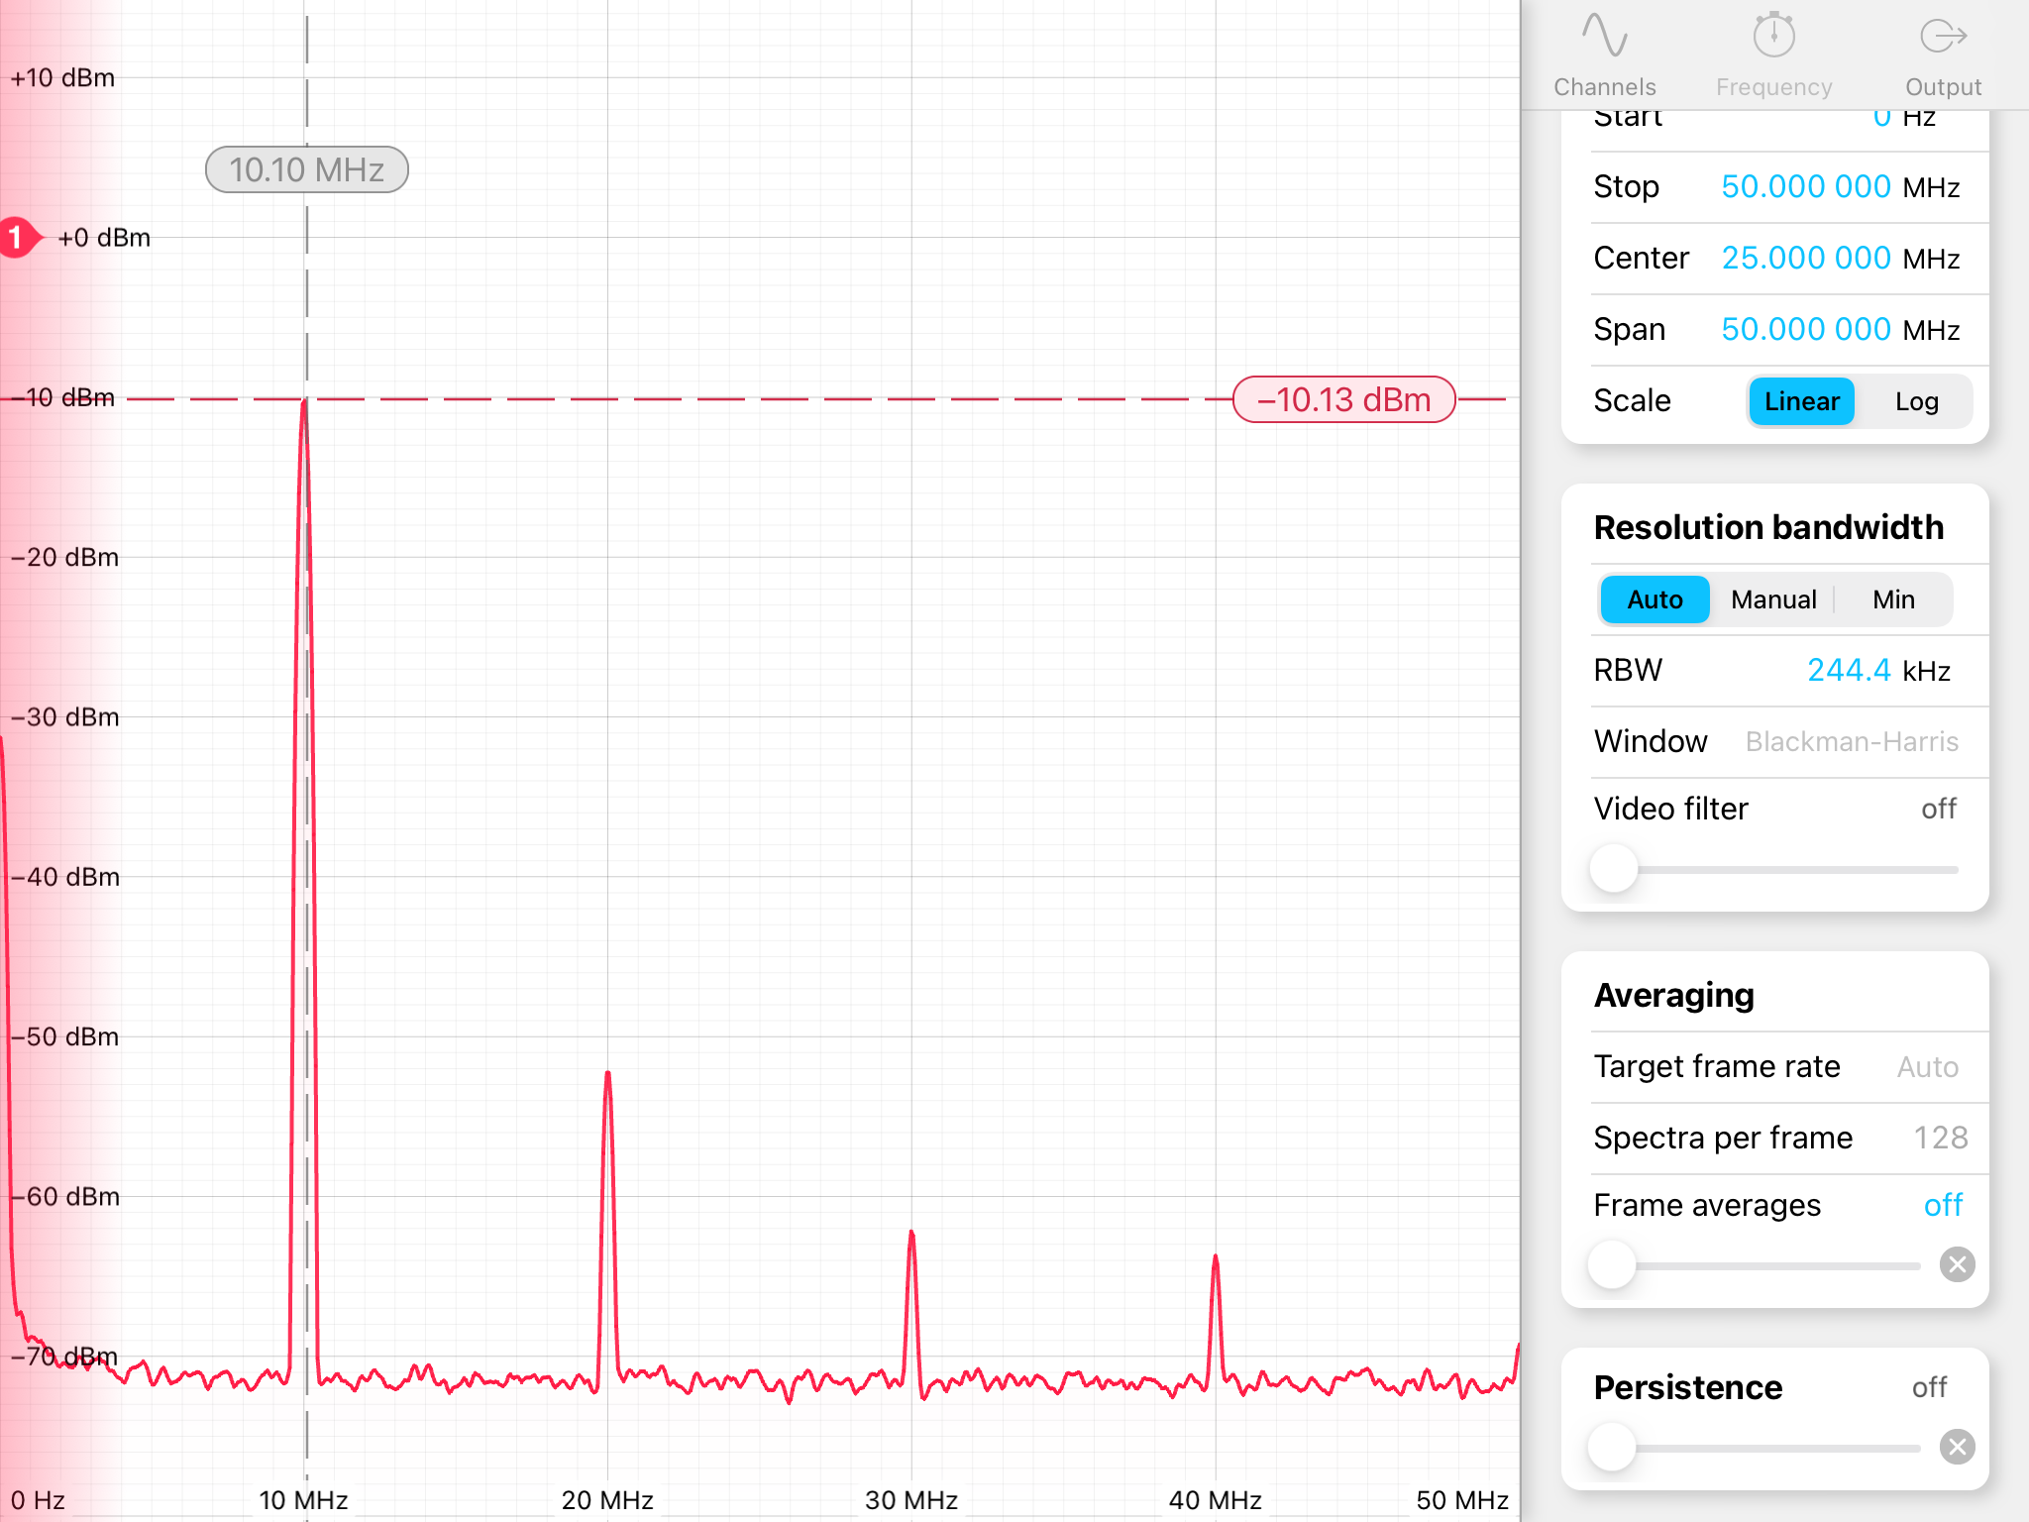
Output

Slide 6
Awg automation
Establish connection using ssh or scp
Send the files through ssh
Make the output more accurate
Make the plots interactive

Slide 7
Awg automation
Installed open ssh
Implemented file transferring via ssh
Tested file transfer with ssh
The plots made interactive using plotly

Slide 8
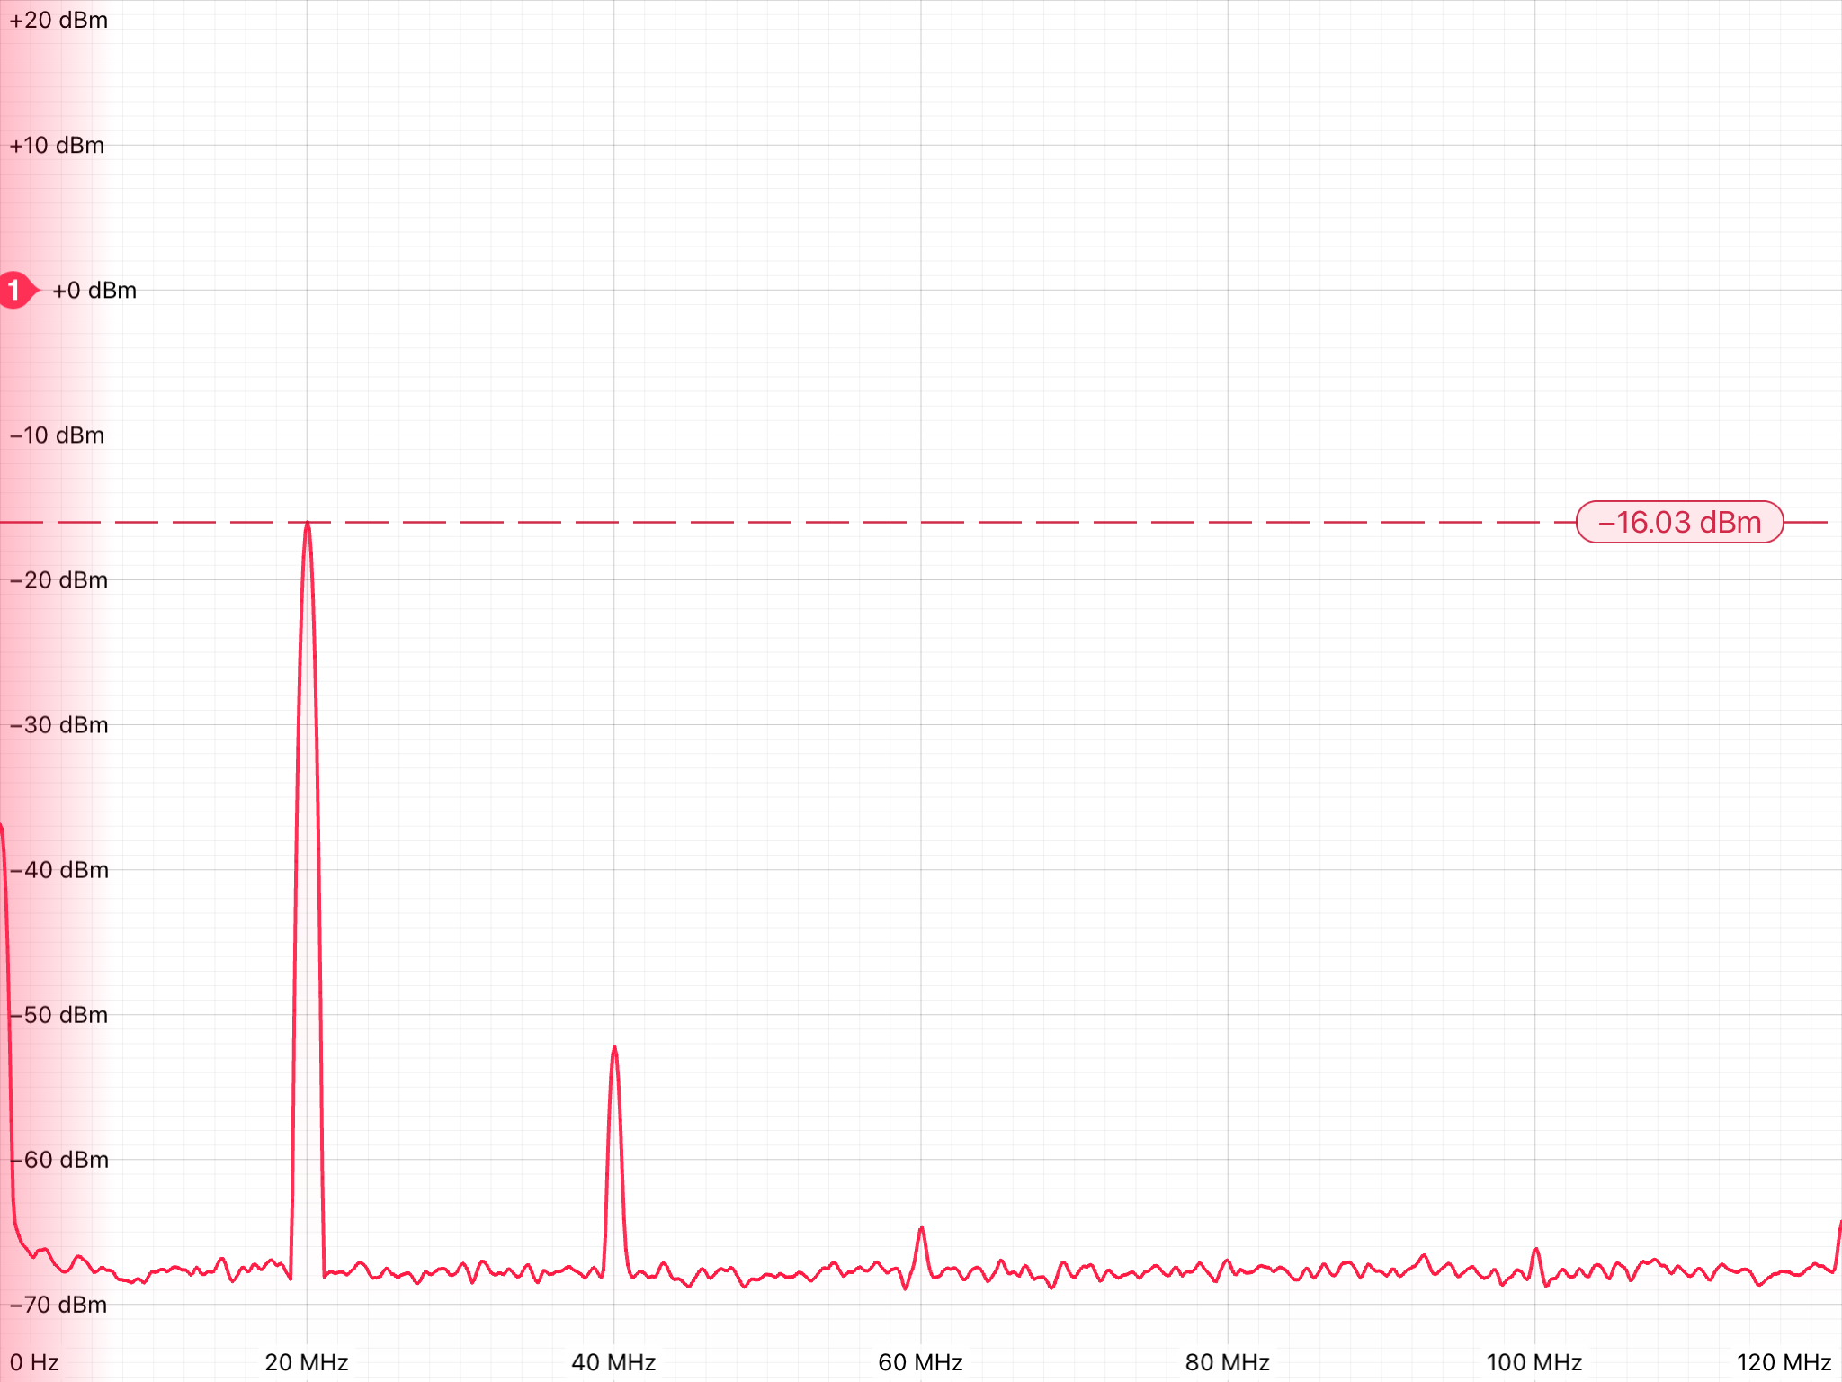

Slide 9
