Slide 1
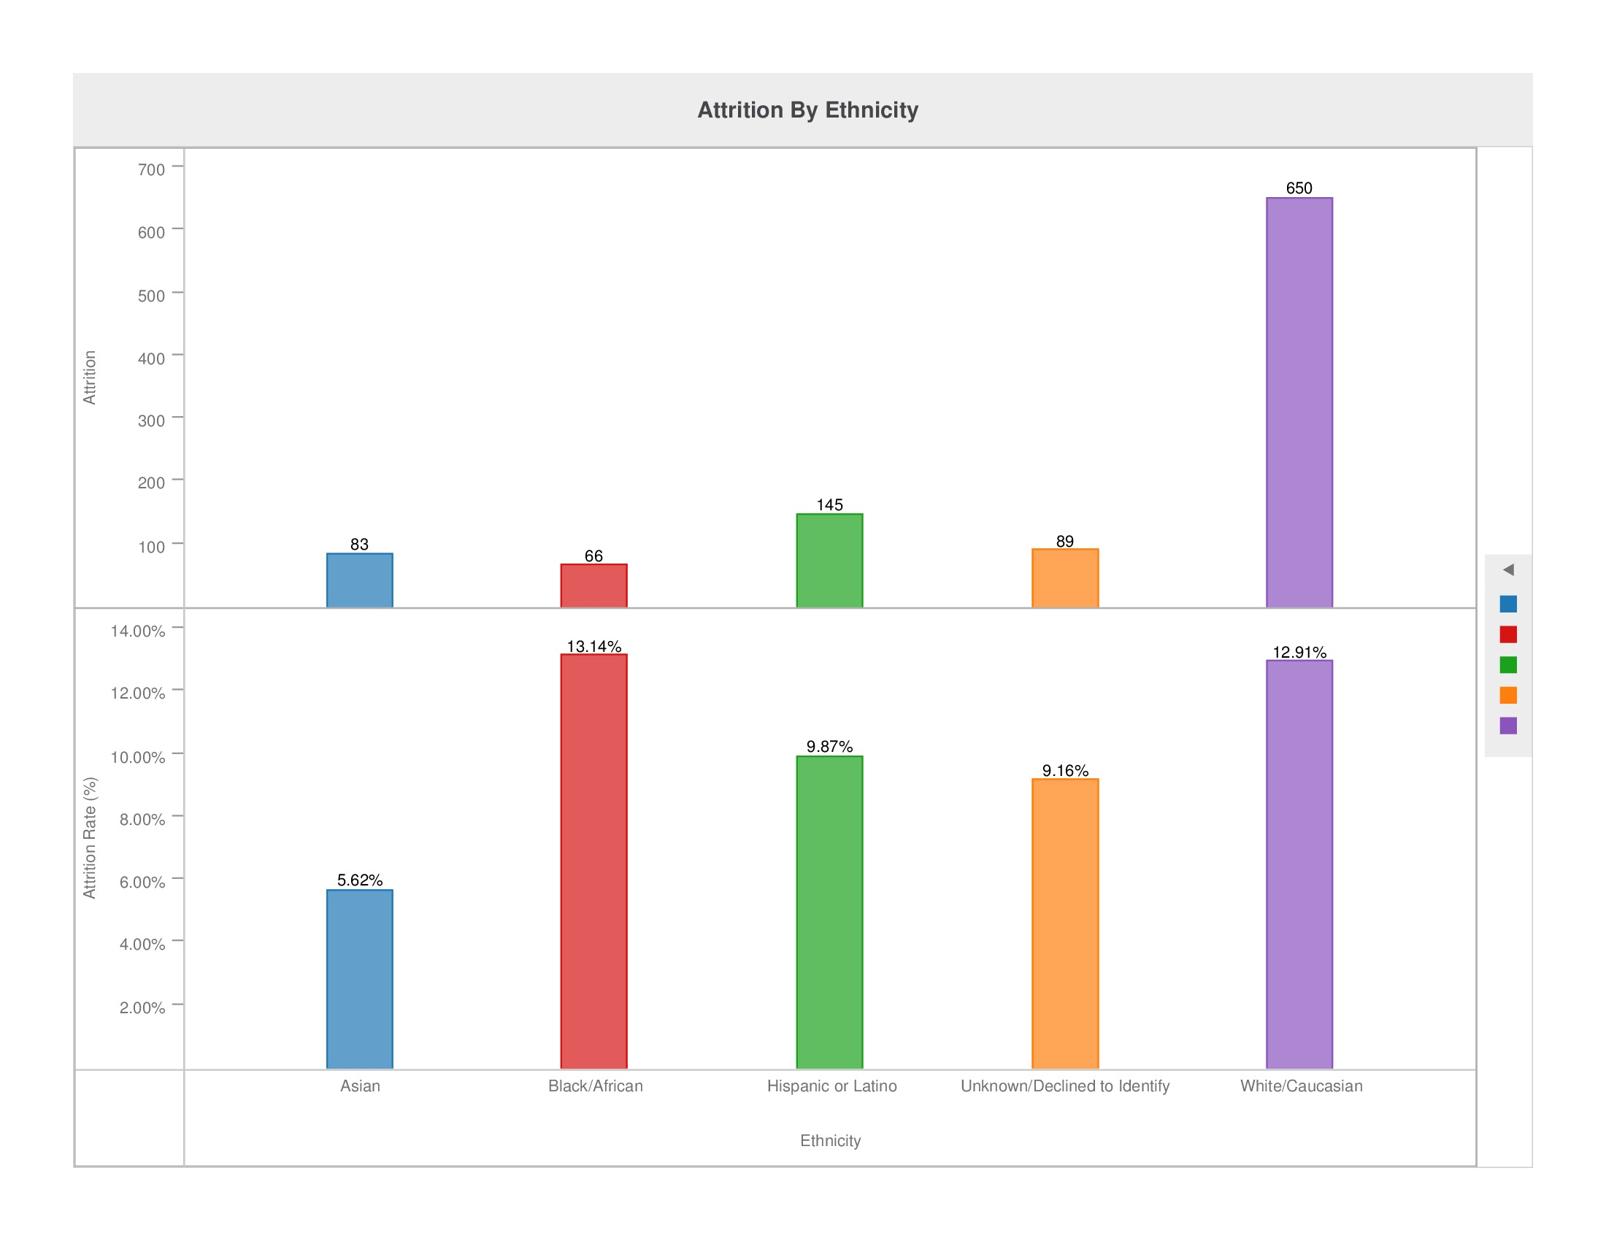
Image 1

Slide 2
Image 2

Slide 3
Image 3

Slide 4
Image 4

Slide 5
Image 5

Slide 6
Image 6

Slide 7
Image 7

Slide 8
Image 8

Slide 9
Image 9

Slide 10
Image 10

