Slide 1
Exploring Sports Venues in Navi Mumbai, India
Applied Data Science Capstone
Vijayandra Mahadik

Slide 2
Problem Statement
Explore sports venues within Navi Mumbai and create groups based on type of sport being played to help people decide which place they should live based on their sport interest
Identify locations for potential business opportunities to start a new sport venue

Slide 3
Data download and processing
List of railway stations in Navi Mumbai
https://en.wikipedia.org/wiki/Trans-Harbour_line_(Mumbai_Suburban_Railway)
Foursquare API to find coordinates of all stations in Navi Mumbai
250 venues searched within 1.5 km radius of each station
Removed duplicate venues returned for different venues
Removed Khandeshwar station as it has no sport venue

Slide 4
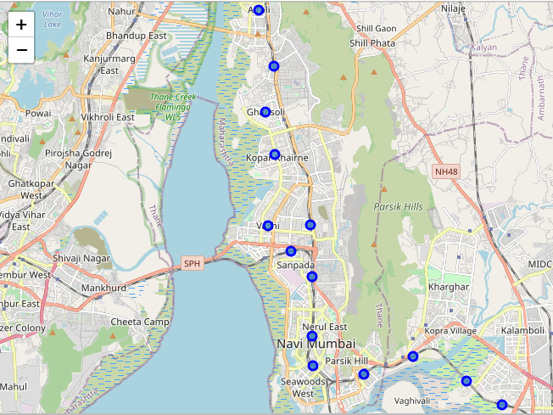
Navi Mumbai Map

Slide 5
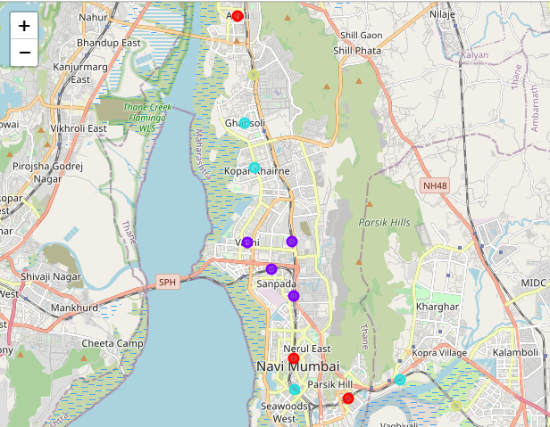
Clustered based on Sport Venue
Cluster 1 – Sports Club
Cluster 2 - Soccer, Golf, Baseball
Cluster 3 - Yoga, Martial Arts, Tennis
Cluster 4 - Basketball, Volleyball

Slide 6
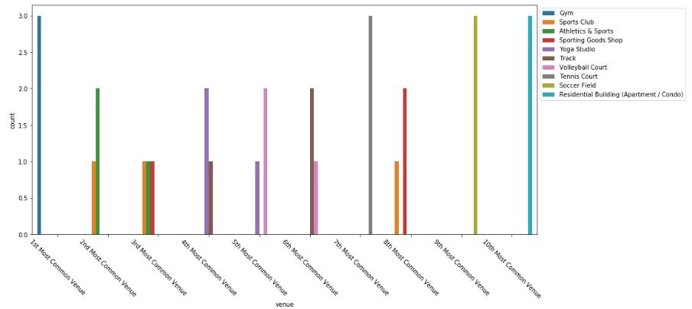
Cluster 1 – Gym and Sports Club

Slide 7
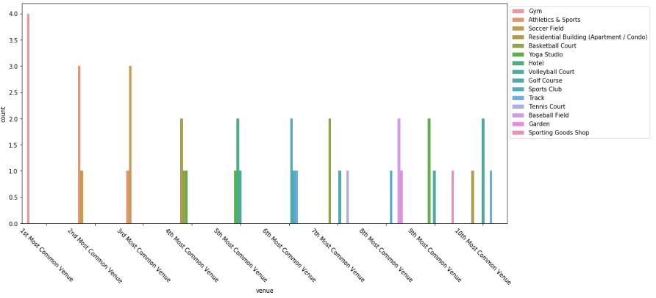
Cluster 2 - Soccer, Golf, Baseball

Slide 8
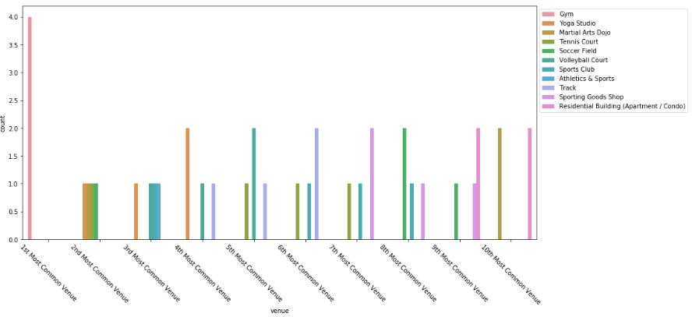
Cluster 3 - Yoga, Martial Arts, Tennis

Slide 9
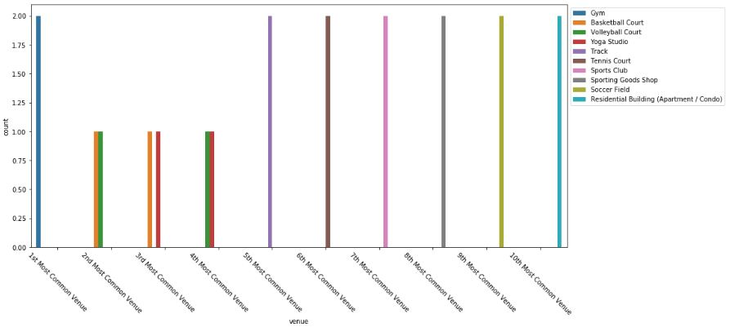
Cluster 4 - Basketball, Volleyball

Slide 10
Conclusion
If you are interested in playing open field games then visit areas with Purple dots
If your family wants to spend time together playing multiple sports under one roof then visit areas with red dots
If you are interested in playing Martial arts then visit areas with cyan dots
If you are interested in playing court games then visit areas with pale yellow dots
Business opportunity to open a new golf course in Airoli region as the nearest golf course is 11km far away.
These findings will influence your decision making but alone are not sufficient.
If we combine additional data such as property cost, population of the area, average salary, ratings and cost of membership to these venues travel options etc then it will serve in better decision making.

Slide 11
Thank You!

