Slide 1
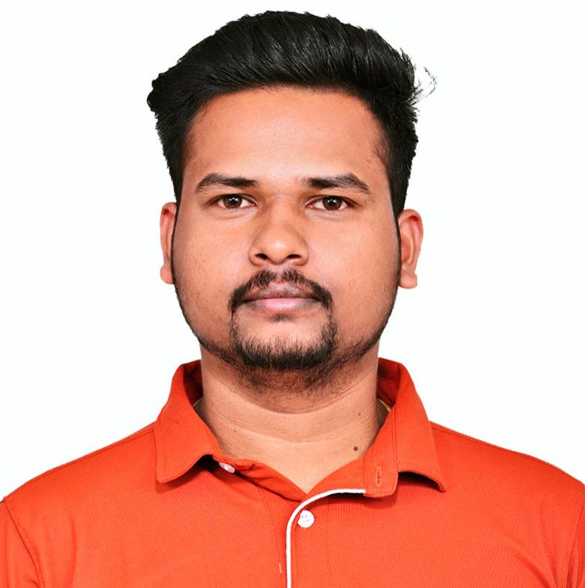
Vijayapradap Murugavel Senior Consultant
KEY ASSIGNMENTS
Senior Consultant
Capgemini Engineering (Mar 2025 - Present)
TITLE: Smart Oven Project [Happiest Minds] [Feb 2024 – Mar 2025]
Have been responsible for implementing and deploying custom modules in the Azure IoT Edge ecosystem, primarily using C programming language for building high-performance, scalable, and reliable edge modules
Worked extensively with routes and direct communication in Azure IoT Edge, setting up routing rules for message forwarding between edge devices and cloud services, optimizing communication patterns and enhancing system reliability.
Built and maintained efficient Docker containerized images for custom edge modules using CMakefile and Makefile for various platforms like arm64v8, amd64 and amd32, streamlining the process of deployment and scaling across multiple edge modules
Also implemented kernel and user space device drivers for control and read data from hardware devices which all connected with (nVIDIA) Orin Nano board through various communication protocols.
TITLE: ORU 5G Radio Unit [VVDN Technologies] [Aug 2021 – Feb 2024]
Acted as a key point of contact for technical queries and provided timely support to stakeholders, contributing to overall project success. As a senior software engineer worked with various 3GPP bands and 7.2 split options for 5G radio software
Performed rigorous testing and debugging to identify and resolve software issues, ensuring high-quality deliverables. Troubleshoot and resolve any issues related to the management plane (M-Plane) software.
Good knowledge in sysrepo and netopeer support on projects that support 5G development by providing a YANG-based datastore and a NETCONF server for managing 5G applications and devices. Manage the configuration, operation, and performance of the O-RU using YANG data models and RPC methods.
TITLE: Unmanned Ground Vehicle [Premier Astra (Client : BEL)] [Mar 2021 – Aug 2021]
Developed a C program for an NXP microcontroller that controls the speed and direction for four motor controllers.
This receives input via UART as predefined communication data format which contains SRC, DES, data length, data and checksum for protect data loss and communicates with the motor controllers using the CAN protocol.
TITLE: Machine Monitoring Unit [Schnell Energy] [Jun 2020 – Mar 2021]
Managed plug & play sensor event handling, sensor identification and resource allocation over FreeRTOS.
Developed NXP Micro-Controller RTOS based low- and high-level drivers for different sensor devices using peripheral protocols like Single Wire Protocol (SWP and UNI/O® Bus), UART, SPI and I2C.
TITLE: Firmware Development [Yantra] [Mar 2017 – Mar 2020]
Mobile starter can collect current, voltage and runtime details using various peripherals, including I2C, SPI and UART on PIC Micro-controller and send it as a message and sent it to customer through GSM module.
Designed and developed full product (hardware and software) of vehicle locator device using GSM+GPS module.
Pic here
A professional with 7.4 years of experience in embedded software development with good understanding of C.
Superior expertise in Microcontroller development.
Good knowledge on FreeRTOS with its concepts having experience for 12 months.
Strong experience in C software programming. Also having knowledge on data structures like heap, stack, queue using linked lists.
Good knowledge of software-hardware interactions and interfacing.
Good understanding to developments on Linux platform and embedded Linux developments with CMake and Makefile.
Strong experience in implementing and deploying custom modules in the IoT Edge ecosystem, primarily using C language for building high-performance, scalable, and reliable edge modules
Education
Languages
Sectors
KEY SKILLS
Languages & Technologies: - C, Embedded C, Embedded Linux, Linux Kernel / Device Driver, Shell Script, C++ (Basics), RTOS, Peta-Linux, Azure IoT Hub / Edge, Docker Containers, Linux Kernel / Device Driver
Controllers / Processors : - NXP, TI, PIC, Arduino, Raspberry Pi, BBB Rev C, Orin Nano and Xilinx SoCs
Hardware & Interface Protocols: - UART, SPI, I²C, ADC, RTC, MQTT, Wi-Fi, TCP/IP, Single Wire, UNI/O Bus, GSM, GPS
Development Tools: - Git, Jira, SDLC, Click-up, Azure DevOps
Diploma in Electronics and Communication Engineering from GPTC
English and Tamil
Embedded, IOT

