Slide 1

Annamalai university
Project viva-voce on
TWITTER SENTIMENT ANALYSIS USING R
PROJECT MEMBERS
Vijayaraj G
141080981

Slide 2
ABSTRACT
Twitter is a public platform with a mine of public opinion of people all over the world where users post their experiences. But, due to the massive volume of reviews, users can’t read all reviews.
Sentiment Analysis is an approach to classify the sentiments of user reviews, documents, etc. in terms of positive (good), negative (bad).
The main objective of this project is to implement algorithms like a Support Vector Machine (SVM) and Naïve Bayes (NB) for automatic classification of tweets and making a comparative analysis among SVM and NB by visualizing graphically in the form of the line chart.
The primary approach of this project is to focus on real-time analysis and to classify the polarity of a given tweet at the word level.
With the help of feature vector and classifiers such as SVM and NB, each tweet is categorized as either positive or negative.
Qualitative analysis of SVM and NB are carried out through performance metrics like accuracy, sensitivity, specificity, prevalence, kappa, etc.

Slide 3
TWITTER SENTIMENT ANALYSIS
Microblogging is a mode through which the users of social media connect with each other in order to communicate the essential information among them in the form of shorter sentences namely instant messages.
Twitter is one such well known example of microblogging for sharing information with other people through instant messages called “tweets”.
More specifically, twitter is an online news and social networking service that enable users to send and read short 140-character messages called “tweets”.
Recently, applying the sentiment analysis on twitter in the name of the twitter sentiment analysis is getting focused.
It is also known as Opinion extraction or Opinion mining or Sentiment mining or Subjectivity analysis.

Slide 4
DIFFERENT LEVELS OF SENTIMENT ANALYSIS
Sentiment Analysis (SA)
Document level SA
Sentence level SA
Aspect level SA
Word level SA

Slide 5
OBJECTIVE
The main objective of the project is to implement SVM and NB algorithm for automatic classification of tweets.
The major problem statement in the twitter sentiment analysis is classifying the polarity of a given tweet, i.e. finding whether the expressed opinion is positive or negative.
The process of computationally identifying and categorizing opinions expressed in a tweet, especially in order to determine whether the writer’s attitude towards a particular topic, product, etc. is positive or negative.

Slide 6
EXISTING SYSTEM
The existing system contains the following modules.
Data Collection using Twitter API
Data Preprocessing
Applying Classification Algorithms
Classified tweets
Sentiments in graphical representation

Slide 7
PROPOSED SYSTEM
TRAINING AND TESTING MODULE:
TRAINING
Dataset
Tweets, Label
Data preprocessing
Feature Extraction
Machine Learning Algorithm
TESTING
Data preprocessing
Feature Extraction
Classification Model
Sentiment

Slide 8
REAL – TIME IMPLEMENTATION MODULE
TRAINING
Dataset
Tweets, Label
Data preprocessing
Feature Extraction
Machine Learning Algorithm
DEPLOYMENT
INTERNET
Sentiment
Data
Data preprocessing
Feature Extraction
Classification Model

Slide 9
DESIGN AND IMPLEMENTATION
DESIGN MODULE:
The project discusses three modules with its components. The modules are:
1) Training Module
2) Testing Module
3) Real - Time Implementation Module
TRAINING MODULE:
The training includes the following components:
a) Dataset (Tweet, Label)
b) Data Preprocessing
c) Feature Extraction
d) Machine Learning Algorithm

Slide 10
TRAINING MODULE
a) DATASET:
A tweet contains a lot of opinions about the data which are expressed in different ways by different users.
This phase is concerned with collection of twitter datasets which contains sentiment on a particular domain.
Here the project used the dataset available in “https://github.com/vineetdhanawat/twitter-sentiment-analysis/blob/master/datasets/Sentiment%20Analysis%20Dataset.csv”.
b) DATA PREPROCESSING:
This involves cleaning and simplifying the data by performing punctuation removal, control words (words that sounds like ‘ar’, ‘or’, ‘er’, ‘ur’) removal, digits removal, hyperlinks removal, removal of alphabets, lower case conversion, stop words (words like while, before, after, etc.) removal, removal of additional blank spaces, etc. in order to remove noise from the data.

Slide 11
c) FEATURE EXTRACTION:
By the way of feature extraction method, various aspects of the processed dataset are being extracted.
Later, this aspect is used to compute the positive, negative polarity in a sentence which is useful for determining the opinion of particular tweet.
The project has considered 2006 words as positive words and 4781 words as negative words which are officially available on Github Website, sample words from these list are tabulated in Table 1 and Table 2 respectively.
By comparing if a particular word is present in the extracted features, the number of positive and negative in individual tweets are counted.
By the process of summation of all the positive and negative values, the sentiment of the tweets that are considered for testing are known.

Slide 12
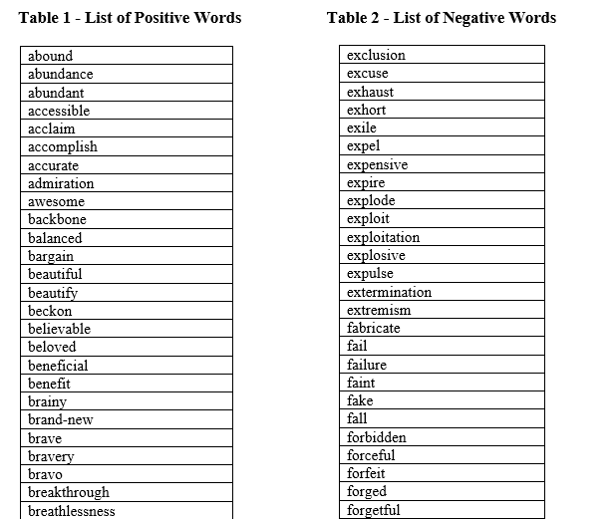
LIST OF POSITIVE AND NEGATIVE WORDS

Slide 13
d) MACHINE LEARNING ALGORITHM:
There are mainly two techniques for sentiment analysis of twitter data.
1) Machine Learning Algorithm
a) Supervised Learning
b) Unsupervised Learning
2) Lexicon Based Approaches
a) Dictionary based
b) Corpus based

Slide 14
The project follows Machine Learning Algorithm.
There are two sets, namely
a) training set – 70% of data
b) test set – 30% of data
SUPERVISED MACHINE LEARNING:
Supervised learning is based on labeled dataset and thus the labels are provided to the model during the process.
The success of this learning mainly depends on the selection and extraction of the specific set of features used to detect sentiment.
The project implements two Supervised Machine Learning techniques [3] , namely
a) Support Vector Machine
b) Naïve Bayes

Slide 15
SUPPORT VECTOR MACHINE
The main principle of SVM is to determine linear separators in the search space which can best separate the different classes.
SVM analyzes the data, define the decision boundaries and uses the kernels for computation which are performed in input space.
A margin will be found between the two classes that is far from any point.
The distance defines the margin of the classifier, maximizing the margin reduces indecisive decisions.

Slide 16
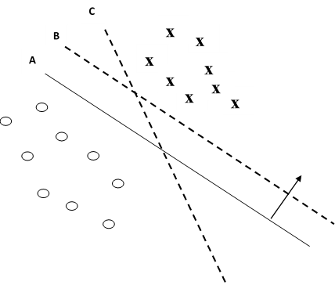
SUPPORT VECTOR MACHINE
Fig. 4 – Support Vector Machine

Slide 17
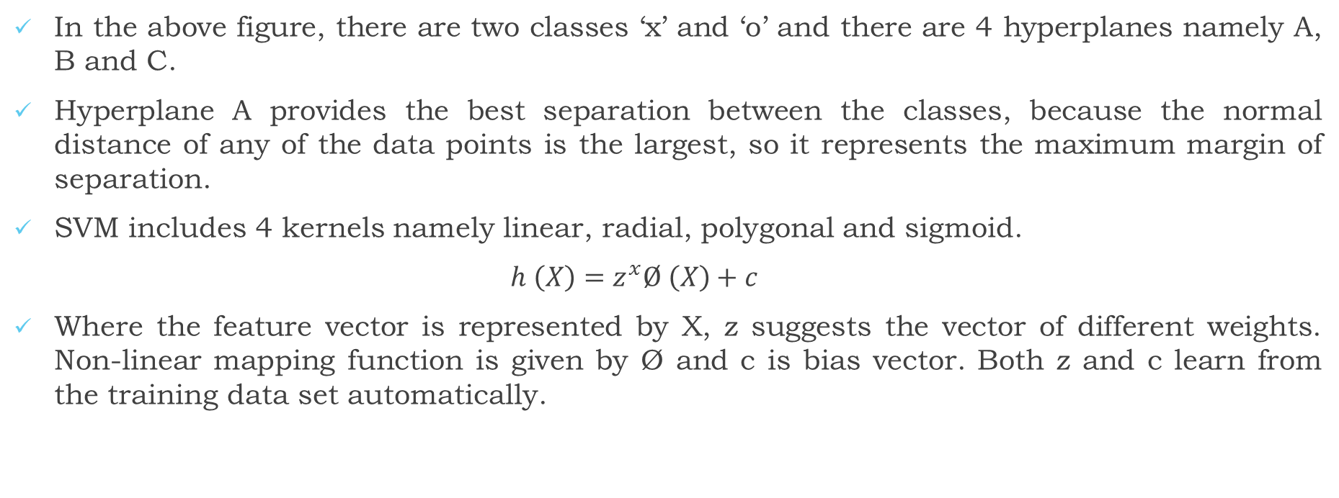
In the above figure, there are two classes ‘x’ and ‘o’ and there are 4 hyperplanes namely A, B and C.
Hyperplane A provides the best separation between the classes, because the normal distance of any of the data points is the largest, so it represents the maximum margin of separation.
SVM includes 4 kernels namely linear, radial, polygonal and sigmoid.
$h \left(X\right)=z^{x}Ø \left(X\right)+c$
Where the feature vector is represented by X, z suggests the vector of different weights. Non-linear mapping function is given by Ø and c is bias vector. Both z and c learn from the training data set automatically.

Slide 18
ADVANTAGES OF SVM:
SVM is one of the most highly accurate classifier in all other classifiers. It can achieve good performance in high dimensional feature space.
SVM performs well on data sets that have many attributes, even if there are very few cases to train the model.
There is no upper limit on the number of attributes.

Slide 19
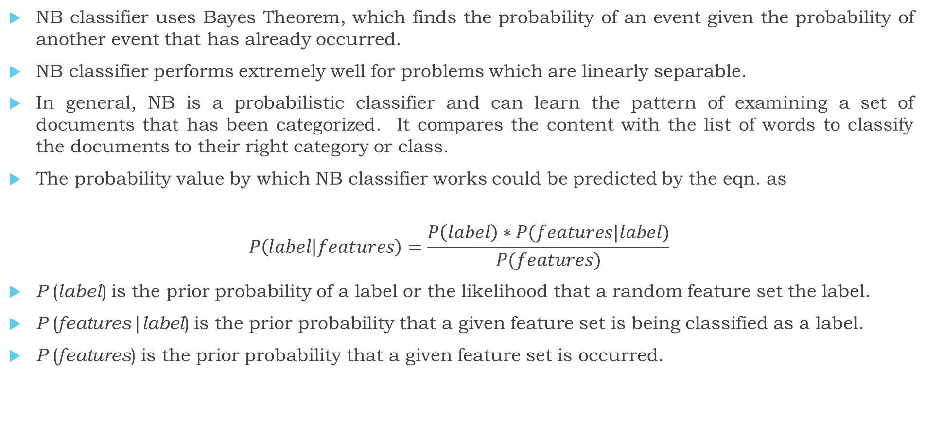
NAÏVE BAYES
NB classifier uses Bayes Theorem, which finds the probability of an event given the probability of another event that has already occurred.
NB classifier performs extremely well for problems which are linearly separable.
In general, NB is a probabilistic classifier and can learn the pattern of examining a set of documents that has been categorized. It compares the content with the list of words to classify the documents to their right category or class.
The probability value by which NB classifier works could be predicted by the eqn. as
$$P\left(label | features\right)=\frac{P\left(label\right)∗P(features|label)}{P(features)}$$
P (label) is the prior probability of a label or the likelihood that a random feature set the label.
P (features|label) is the prior probability that a given feature set is being classified as a label.
P (features) is the prior probability that a given feature set is occurred.

Slide 20
ADVANTAGES OF NB:
The main advantage of NB classifier is that in analysis each feature is independent. So it makes use of all the features in feature vector.
The major advantage of NB Classification is easy to interpret and efficient computation.

Slide 21
REAL – TIME IMPLEMENTATION
Prediction is where the actual deployment comes.
The term deployment stands for the action of bringing resources into effective action. As machine will adapt accordingly from trained data by means MLA, it provides test result with the help of Classification model.
There are two halves in real-time implementation. They include
a) Training
b) Deployment
a) TRAINING:
Here the training phase is employed to obtain the real time data results (which is similar to training done earlier as discussed).
b) DEPLOYMENT:
For implementing deployment, certain prerequisites like package installation and importing libraries are needed. Some of the packages that must be downloaded are twitteR, ROAuth, tm, stringr, plyr, dplyr, RColorBrewer, SnowballC, purrr, etc.

Slide 22
The modules in deployment are:
MODULE 1: Creating twitter account
MODULE 2: Twitter API registration
MODULE 3: Twitter Authentication
MODULE 4: Data Preprocessing
MODULE 5: Feature Extraction
MODULE 6: Classification Model
MODULE 7: Output

Slide 23

MODULE 1: CREATING TWITTER ACCOUNT

Slide 24
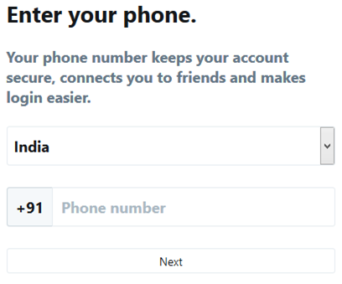
TWITTER ACCOUNT VERIFICATION

Slide 25
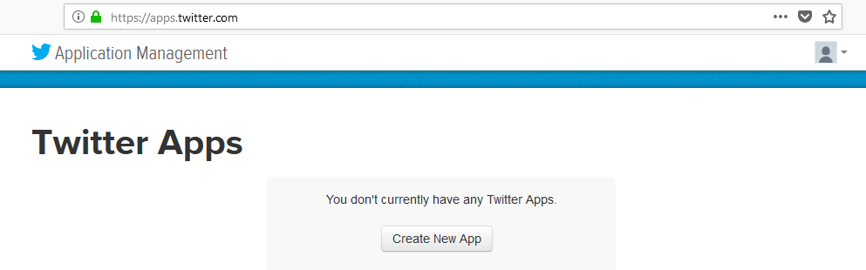
MODULE 2: TWITTER API REGISTRATION

Slide 26
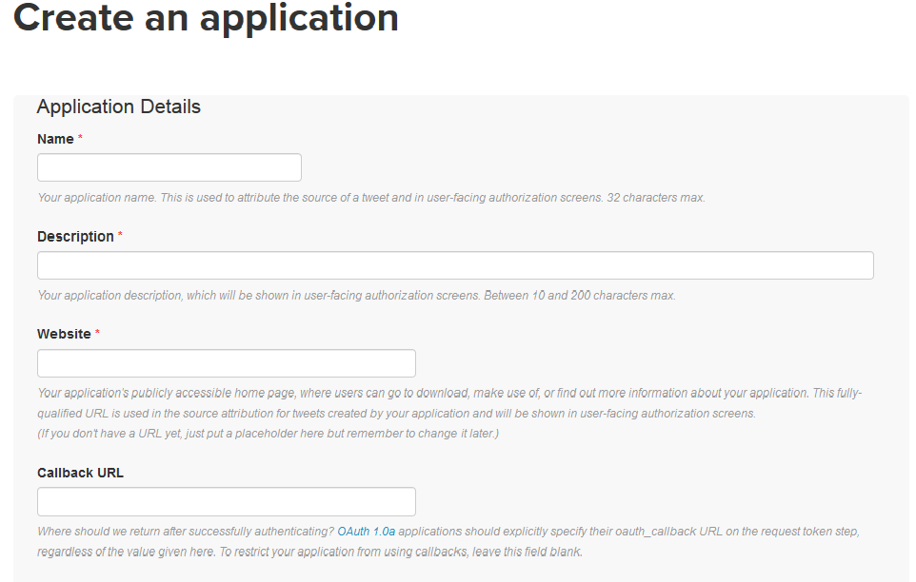
APPLICATION CREATION

Slide 27
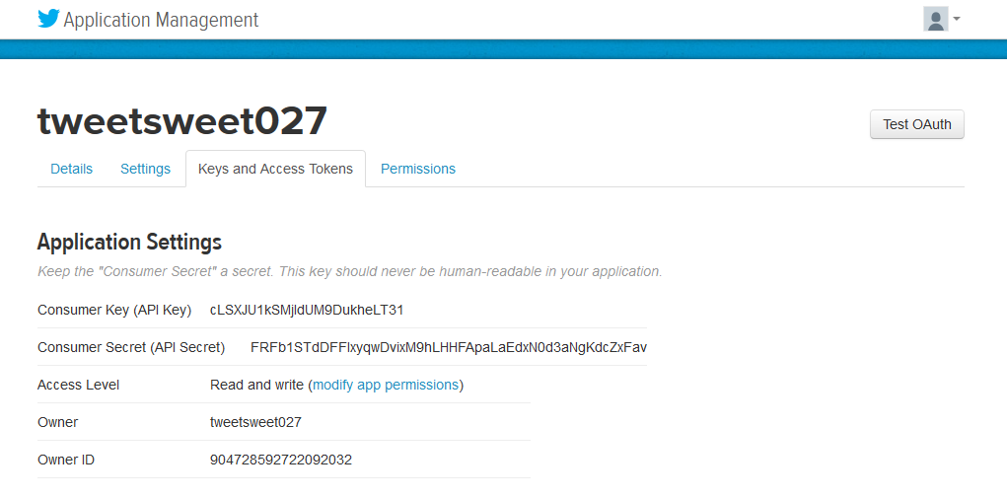
GENERATION OF CONSUMER AND CONSUMER SECRET KEYS

Slide 28
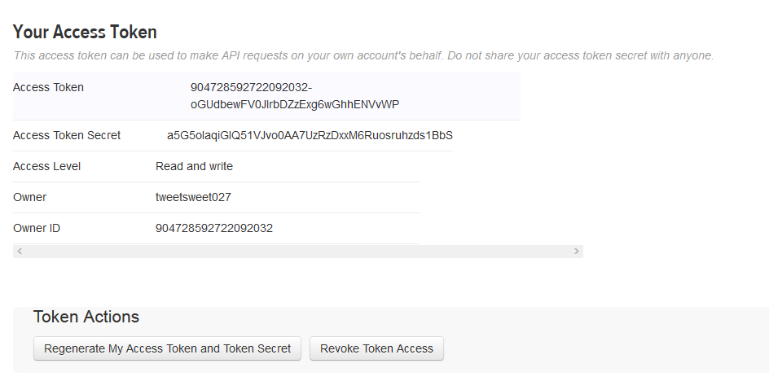
GENERATION OF ACCESS AND ACCESS TOKEN SECRET KEYS

Slide 29
MODULE 3: TWITTER AUTHENTICATION
For connecting the Developer and Twitter Streaming API, TOKENS and SECRET KEYS generated in MODULE 2 is copied and pasted in R code.
By making “setup_twitter_auth” with the above generated keys as parameters, function call is done. For extracting the tweets, the function call namely searchTwitter (searchString, n=no. of tweets, lang=language in which tweets must be) can be used.
This module is similar to preprocessing that is already being carried out in training and testing.
MODULE 4: DATA PREPROCESSING

Slide 30
MODULE 5: FEATURE EXTRACTION
This module is similar to feature extraction that is done in training and testing phase.
Based on the knowledge that is being acquired by the machine during training phase, deployment is carried out.
Through MLA namely SM and NB as the classified models, the final sentiment of the tweet in real time could be obtained.
Thereby by implementing the classification model into the real time tweets (deployment stage), prediction of sentiment that lies within the selected domain is easily done.
MODULE 6: CLASSIFICATION MODEL
MODULE 7: OUTPUT

Slide 31
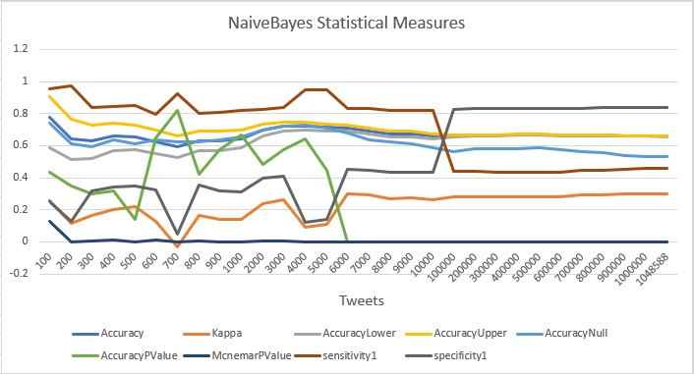
RESULTS AND DISCUSSION
NAÏVE BAYES AND ITS PERFORMANCE METRICS:
Under Naïve Bayes, the project considered all 1048588 tweets together in the scales of 100.

Slide 32
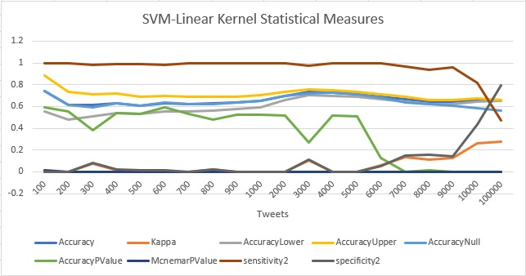
SVM – LINEAR KERNEL AND ITS PERFORMANCE METRICS:

Slide 33
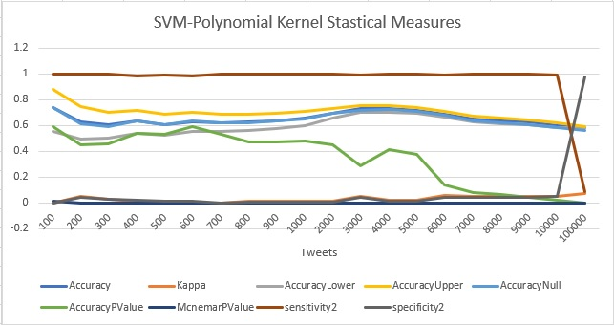
SVM – POLYNOMIAL KERNEL AND ITS PERFORMANCE METRICS:

Slide 34
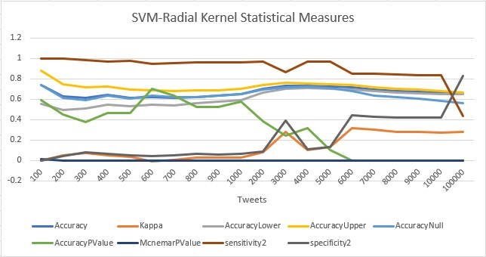
SVM – RADIAL KERNEL AND ITS PERFORMANCE METRICS:

Slide 35
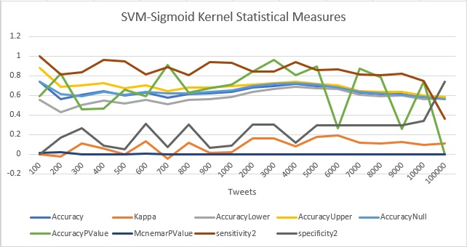
SVM – SIGMOID KERNEL AND ITS PERFORMANCE METRICS:

Slide 36
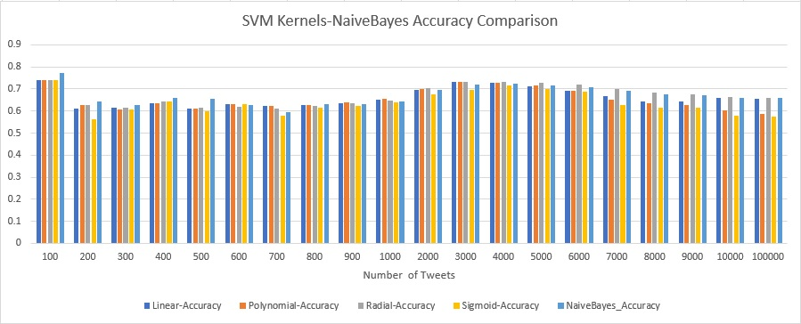
ACCURACY COMPARISON BETWEEN NB AND SVM:

Slide 37
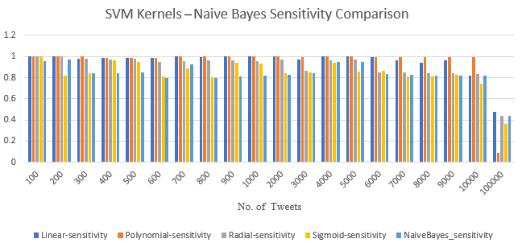
SENSITIVITY COMPARISON BETWEEN NB AND SVM:

Slide 38
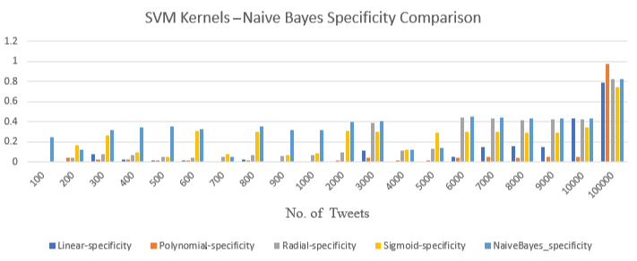
SPECIFICITY COMPARISON BETWEEN NB AND SVM:

Slide 39
CONCLUSION
In general, SVM gives 75% accuracy, whereas NB provides 65% only.
In this project, it is observed that the accuracy value of NB is about 68% (average value) with some fluctuations.
While consider SVM, the accuracy value remains almost constant as it provides accurate value nearby to 70% under Radial Kernel.
From various analysis and visualization, it is concluded that it is better to opt SVM with Radial Kernel for Twitter Sentiment Analysis to avoid fluctuations in the result.
The second most analysis has been made under NB and tested the working ability of the classifier.
If sensitivity is preferred, the linear kernel suits better.

Slide 40
Thank You!...

