Slide 1
SYSTEM SURVEILLANCE USING KEYLOGGER
GUIDE NAME:
Ms.A.VANATHI,
Associate Professor,
Department of CSE.
STUDENT NAME:
R.VIJAYARAJAN(511919104024)
JABEZ JACOB(511919104302)
PRADESHWARAN(511919104013)
B.E-3rd year & 6th Semester.
Department of CSE.

Slide 2
ABSTRACT
In many companies now-a-days data security and data recovery is the most important factor.
So there are many cases where data recovery is required.
For these kinds of problems keylogger is one of the best solutions which is often referred to as keylogging or keyboard capturing.

Slide 3
INTRODUCTION
A program or Hardware device that capture every key impression on the system.
Used to monitor user’s activities .
Used to retrieve data and forgotten URLs .
It capture the screenshot with in the particular time limit and sends the mail to admin email ID.

Slide 4
LITERATURE SURVEY
s.no | Paper Name and Author | concept | year
1 | Anith at el. (2011). Detecting keyloggers based on traffic analysis with periodic Behavior | It only record the keystocks And stores as a temp file | 2011
2 | System Monitoring and Security Using Keylogger and Preeti Tuli , Priyanka Sahu | Email moniteroing,software installation monitering and stored in local drictory | 2013

Slide 5
LITERATURE SURVEY
s.no | Paper Name and Author | concept | year
3 | Analysis and Implementation of Decipherments of KeyLogger Parth Mananbhai Patel | keylogger Detection, AntiKeylogger, Security, Detection of Keylogger | 2017

Slide 6
EXISTING SYSTEM
In existing system the keylogger is only record the alphabet and numbers
It have surveillance technology used to monitor and record each keystocke on a Specific computer
It’s store a data in local systems
DISADVANTAGES
It can’t transfer the data through the internet
It can’t record the special keys (shift , control key , esc key, etc)
it can’t take screenshot and mouse monitoring

Slide 7
PROPOSED SYSTEM
In this system it can reord all the keystockes and monitering the all screenshots
It can send the mail to cthe admin pc
It is very secured
ADAVANTAGES
Data’s will be highly securable.
it is automated.

Slide 8
SYSTEM REQUIREMENTS
HARDWARE REQUIREMENTS
PROCESSOR : PENTIUM IV a pair of.6 GHz, Intel Core a pair of pair.
RAM : 512 MB doctorate RAM
MONITOR : 15” COLOR
HARD DISK : 50 GB
SOFTWARE REQUIREMENTS
OS. : Windows 07 and above
IDE : PyCharm, Python 3.8.0
Technologies used: Advanced programming using Python

Slide 9
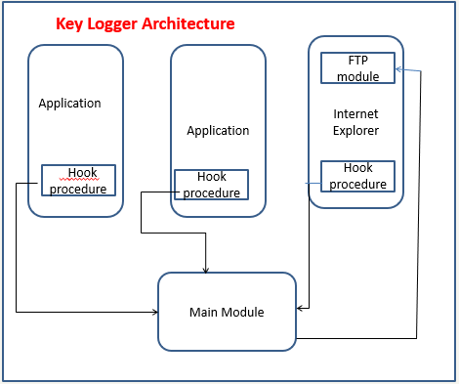
ARCHITECTURE

Slide 10
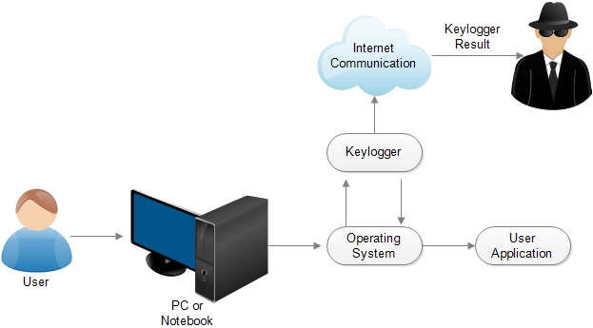
DATA FLOW DIAGRAM

Slide 11
MODULES
Module 1 : Operating system.
Module 2 : keylogger.
Module 3 : Internet communication.
Module 4 : keylogger result to admin mail id.

Slide 12
MODULE 1 :Operating system
Operating system is used for the user interact with the application and hardwares.
When the user use the notepad application in pc or laptop
It will not show the working process of keylogger.
It only show the note pad application.

Slide 13
Module 2 : keylogger
Keylogger is record all the keystocks and screenshots
It is work in background user can’t know the working process
It send the data into the internet
Although the main purpose of keyloggers is to keep on a user’s keyboard actions,
they now have advanced capabilities that widen beyond that function

Slide 14
Module 2 : keylogger
For example, they can track virtually application running on a computer.
The informations keyloggers record, sense, and transmit are the following
Chatting Monitoring ,Program / Tracking Application ,Recording Printing Activity ,Clipboard recording and Monitoring ,Recording File/folder and Monitoring Screenshots, E-mail Reporting , Password Protection and Hot Key

Slide 15
Module 3 : Internet communication
Internet is most important in this project
It can get the data from the keylogger and it transmit to the admin id .
It transmit particular time limite.
It is mail sending is work under the smtp protocal

Slide 16
Module 4 : keylogger result to admin mail id
The keylogger sends the result to the admins mail id by the help of internet
The report send with the user system informations.
The system information contains system name ,ip adderss, mac address , windows version, etc.

Slide 17
Features
Features of designed keylogger that are implemented and are going to be implemented in this project
Keystroke Recording
Screenshot History
Remote Monitoring
Web History logging
Invisible mode & password protection
Application monitoring and file tracking
Email reports

Slide 18
CONCLUSION
Software that can not only monitor every keystroke and action performed at a PC but also be used as legally binding evidence of wrong-doing has been unveiled
most network monitoring services test your server anywhere between once-per hour to once-perminute.
Be conscious what installed in the computer.
Use caution when snuffing the internet.
Keep your computer software update

Slide 19
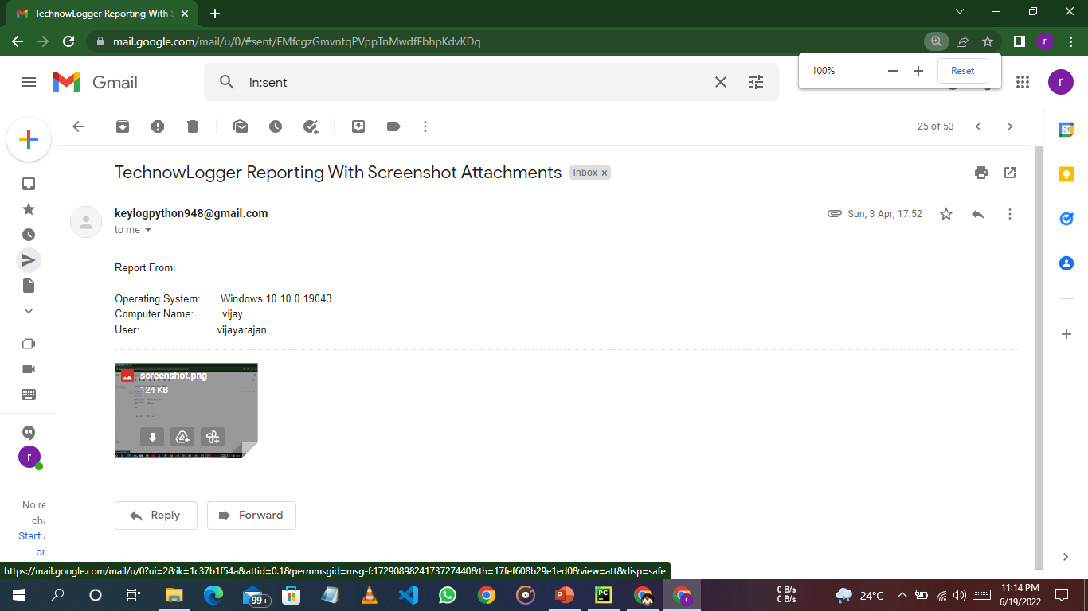

Slide 20
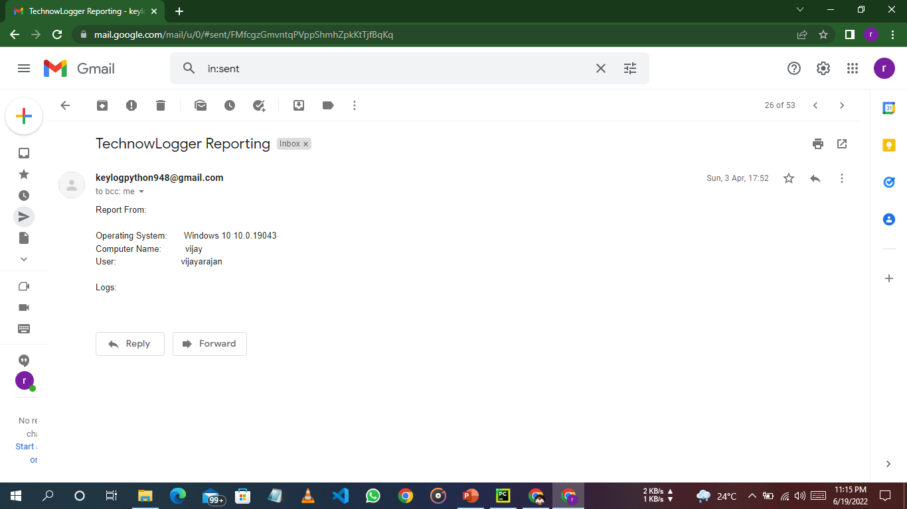

Slide 21
REFERENCES
1. S. Sagiroglu and G. Canbek, “Keyloggers,” IEEE Technology and Society Magazine, vol. 28, no. 3, pp. 10 –17, fall 2009.
2. ThinkGeek.com,“Spykeylogger,”2010(accessedMay 8, 2010), http://www.thinkgeek.com/gadgets/security/c49f/.
3. Online fi nancial fraud and identity theft 2007,” Cyveillance, 2007; http://www.cyveillance.com/web/news/press_rel/2007/2007- 03-27.asp, accessed October. 2011.

Slide 22
REFERENCES
https://medium.com/
https://www.slideshare.net/
https://en.m.wikipedia.org/wiki/
https://security.stackexchange.com/
https://www.ionos.com/digitalguide/

Slide 23


