Slide 1
SECURED ATM PIN RECOVERY WITH FINGER PRINT and face verification

Slide 2
Aim
Avoid card blocking using wrong pin.
Provide additional security for our bank account.
If we forget password we can chance pin number using additional option.

Slide 3
Abstract
Cryptography and Biometrics are two efficient and powerful technologies to appreciate high proven information security.
Biometric authentication verifies a user's identity using biometric traits.
This system is sort of a bio-cryptosystem that mixes cryptography and biometrics together to beat the difficulties of those technologies.

Slide 4
Abstract(cont…)
This project work aims at exploring the system to secure ATM pins and passwords with the fingerprint data specified only the legitimate user can access the pins and passwords by providing the valid fingerprint.

Slide 5
Motivation
Make security for our bank account.
Pin recovery.
Save more time.
No need to go bank.

Slide 6
Objectives
To avoid the user to visit the bank and do the formalities to reactivate his/her ATM card.
To activate the ATM card of the user at the ATM centre itself with the help of finger print of the user.
To alert owner of the ATM card in case of misuse.

Slide 7
Introduction
Reliable information protection and identity management mechanisms
Cryptography
PIN based verification
Fingerprint Verification

Slide 8
Hardware requirements
Processor : Pentium IV 2.4GHZ MHz
Mother Board : Intel 845 GVSR
RAM : 2 GB
Hard Disk : 500 GB
Key board : Samsung keyboard
Monitor : LG 17” Monitor 1024*768 pixels
Mouse : Samsung Optical Mouse

Slide 9
Software requirements
Operating system : Windows 10
Frontend : C#,Asp.Net
Backend : SQLServer 2008
Framework : DotNet

Slide 10
Problem Statements
Fraudulent card readers, called skimmers are placed over the authentic reader to transfer numbers and codes to nearby thieves.
Spy cameras are also used by password voyeurs to collect access codes.
If you forget your pin number, you cannot use the card.
The machine can retain your card when the machine malfunctions, when you forget your secret number or if the card is damaged.

Slide 11
Existing System
In ATM machines the user is identified by inserting an ATM card and authentication is provided by the customer entering a PIN.
The PIN provided by the customer is compared with the recorded reference PIN within the bank Server.
If the customer forgets the PIN after 3 trials ATM cards are blocked, to reactivate he needs to attend the bank and do the formalities which could be a time consuming job.
So fingerprint biometric is introduced to cut back this sort of error.

Slide 12
Drawbacks
Our investigation reveals that existing studies do not provide a thorough overview of deep learning-based architectures for detecting fake news.
The existing survey papers mostly cover the ML strategies in detecting fake news, scarcely exploring the DL strategies

Slide 13
Proposed System
We chose this field to improve safety and security for people to make the transaction easier.
The fingerprints are unique for each person. There is no insecurity of losing an ATM card and no requirement to carry an ATM card with you every time.
On comparison of different technologies for ATM security, the fingerprint technology operates better and safer than others.

Slide 14
Proposed System(cont…)
These reasons make this mechanism an effortless and secure way of transaction and also maintains a coherent ambience with users and ATM machines.
This is the most latest technology in electronic cash transactions.

Slide 15
Advantages
Introduced mechanism to increase safety and protection by proposing a fingerprint and face verification system.
The merit of finger scanning technology is accuracy.
By using this system multiple limitations are reduced fastly.
They do not have the need to take an ATM card in wallets and no thought of losing the card.

Slide 16
Architecture
If Pin correct?
ATM User
Insert Card
Enter Pin
Yes
Verify
Fingerprint, face,
No
Give Fingerprint and Face
Alert Msg to User
Yes
Create New Pin
Insert New Pin
Make Transaction

Slide 17
Literature Survey
S.No | Title | Author & Year | Method | Advantages | Disadvantages
1 | Finger shield ATM – ATM Security System using Fingerprint Authentication | Christiawan, Bayu Aji Sahar, Azel Fayyad Rahardian, Elvayandri Muchtar 2018 | Finger shield ATM | ATM Fraud can be minimized | High Cost
2 | Securing ATM pins and passwords using Fingerprint based Fuzzy Vault System | Sweedle Machado, Prajyoti D silva, Snehal D’mello, Supriya Solaskar, Priya Chaudhari 2018 | fuzzy vault system | To secure ATM pins and passwords | dummy fingerprint dataset

Slide 18
S.No | Title | Author & Year | Method | Advantages | Disadvantages
3 | ATM SECURITY SYSTEM USING FINGER PRINT AND GSM MODULE | P.PRASHANTH KUMAR REDDY, N.SHASHANK, P.SRI CHARAN REDDY-2012 | GSM Module system | One Time Password (OTP) is sent to the user registration mobile number | Need SMS Gateway
4 | Enhancing Security and Privacy in Biometrics-based Authentication Systems | N.K. Ratha, J.H. Connell, and R.M. Bolle-2001 | biometrics-based authentication | fingerprint authentication is used throughout | Difficult Detection

Slide 19
S.No | Title | Author & Year | Method | Advantages | Disadvantages
5 | Designing a Biometric Strategy (Fingerprint) Measure for Enhancing ATM Security in Indian e-banking System | S.S, Das and J. Debbarma(2011) | Integrating the fingerprint | It provides adequate security for the resources | Low Performance
6 | A Method to boost the protection Level of ATM Banking Systems Using AES Algorithm | N.Selvaraju and G.Sekar (2010) | AES | Fingerprint verification. | Slow process

Slide 20
S.No | Title | Author & Year | Method | Advantages | Disadvantages
7 | ATM Security | Apoor Va, Priya Bh, Sowmya Vk,Mahesh Prasanna K (2013) | Minutiae matching | Using Fingerprint data. | Need Hi speed internet.
8 | Fingerprint Based ATM System: Survey | Sneha Ramrakhyani, Manisha Meshram, Lata Chandani, Rasanjali Gothe, Parul Jha (2017) | Finger Print | Finger Print Survey | This only analysis result.

Slide 21
S.No | Title | Author & Year | Method | Advantages | Disadvantages
8 | Enhancing ATM Security Using Fingerprint’ published in ICTACT JOURNAL ON MICROELECTRONICS | S. Jathumithran, V. Thamilarasan, A. Piratheepan, P. Rushanthini, J. Mercy veniancya, P. Nirupa and K. Thiruthanigesan (2018) | Arduino Uno R3 Board | Real time result | Any sensor fails cant get result
9 | Enchanced Security ATM Transaction using Iris, Fingerprint, OTP Authentication | Melinda Don Seemanthy, Aleena Mary Varghese, Rakesh T K, Aravind Menon, Sebin Jose (2019) | Iris, Fingerprint, OTP | Increase Security | More time.

Slide 22
S.No | Title | Author & Year | Method | Advantages | Disadvantages
10 | Design and implementation of Log-Gabor filter in fingerprint image enhancement | Wei Wang, Jianwei Li, Feiffer Huang, Hailing Fang(2018) | Filtering method | fingerprint identification | Need quality finger print
11 | Enhancing the Current Automated Teller Machine (ATM) | Ahmed Bait Garko (2019) | banking | Deposit and withdraw in same machine. | Network problem

Slide 23
S.No | Title | Author & Year | Method | Advantages | Disadvantages
12 | Biometric based Fingerprint Verification System for ATM machines | T Sangeetha(2021) | Finger print | Transaction based on bio metric | Need devices
13 | FINGERPRINT BASED ATM SYSTEM | Prof. Ranjit Mane, Sagar Chavan , Trushali Birambole and Asmita kamble | Biometic security | include door-lock system, safe box and vehicle control or even at accessing bank accounts via ATM | Need more devices

Slide 24
S.No | Title | Author & Year | Method | Advantages | Disadvantages
14 | Enhanced ATM Security using Biometric Authentication and Wavelet Based AES | Ajish Sreedharan(2016) | Wavelet Based AES | low power consuming. | Network problem
15 | Design and Implementation of Secure ATM System Using Biometric and Hashing Technique | Resmi Karinattu ReghuNathana , and Dhanya Job(2021) | Hashing Technique | Prevents from various attack | slow

Slide 25
Architecture
ATM
Finger Print and face Verification
ATM User
Enroll Finger Print
Pin Recovery

Slide 26
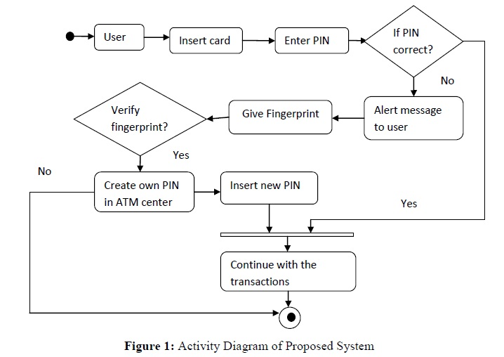
Dataflow Diagram

Slide 27
Modules
Admin
ATM Registration Staff
Account Holder/User
Verification
Fingerprint Recognition

Slide 28
Admin
In this module, the works done are initially login through ID/password.
Then banks are added and can view those.
Adding customer details to bank accounts and if there are multiple accounts it maps customer's details.
Admin approves to ATM Machine Registration.
Then loads cash to the ATM machine, views the service request from the customer.

Slide 29
ATM Registration Staff
The security of ATM transactions relies mostly on the integrity of the secure cryptoprocessor: the ATM often uses general commodity components that sometimes are not considered to be "trusted systems".
So sensitive data must be prevented from fraud.
To prevent encryption is done which is a cryptographic method.
To install an ATM machine, firstly the bank basic details should be given with ID.
Then the registration process is sent to the admin.
Once the admin approves ATM setup/Machine registration then the customer can use the ATM machine.

Slide 30
Account Holder/User
When the customer swipe card and enters the PIN number, the system verifies PIN with card number registered, if valid then the customer home navigates to a different page where it displays multiple accounts bank names, there customer should choose required bank.
There the user can check balance, withdraw, view withdraw amount, view deposit, transfer amount, view amount transfer details.
If the registered number and entered PIN are invalid, the machine gives three attempts to enter valid PIN.
After three invalid attempts the card will be blocked. Then the user is asked to swipe through the fingerprint scanner, face detection and QR code Verification, if it is the correct one then the PIN number is shared through registered Email where he can login and enter the right PIN. Also he can change PIN number in the ATM machine.

Slide 31
Fingerprint recognition
Detection of fingerprints has become one of the most popular ways of maintaining security systems in today’s world.
So, accurate identification of a person through his fingerprints is quite important.
We shall use a database of a few fingerprints and try to match a particular fingerprint with that so that we can identify the person.
We are going to use LBPH (Local Binary Patterns Histograms) algorithm here.

Slide 32
Dataflow Diagram
Admin
Biometric ATM Security
Database
User

Slide 33
Level-1
Admin
View User
Manage Transaction
Database
Block List

Slide 34
Add Account
Enter Account no
Check branch details
Check Account no Available
Account
Available
Not Available
Add Account
Account

