Slide 1

Subject : Full Stack Application Development SEZG503 Professor : Mrs. Akshaya Ganesh Assignment on BOOK EXCHANGE PLATFORM
Name : Vijaya.C.V.
BITS ID : 2023TM93684
COURSE : MTECH in Software Engineering
Sub : Full Stack Application Development SEZG503

Slide 2
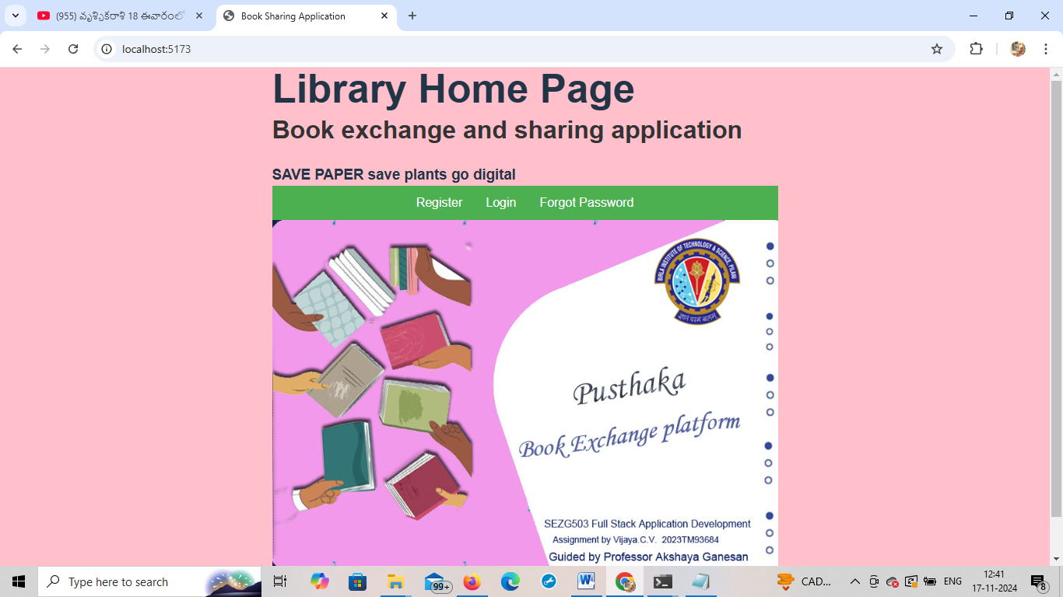
Opening screen of PUSTHAKA

Slide 3
Technologies used for Full Stack Application Development
Part I FRONT END
HTML
CSS - 3
JAVASCRIPT - 15
REACT 18.16.1
Part II DATABASE
SQLite V3
Part III BACKEND
NODE JS – V12
KOA Framework

Slide 4
Front-end Development Front End Libraries and Frameworks It is the visible part of website or web application which is responsible for user experience. The user directly interacts with the frontend portion of the web application or website.
HTML is the combination of Hypertext and Markup language. Hypertext defines the link between the web pages. The markup language is used to define the text documentation within tag which defines the structure of web pages.
CSS: Cascading Style Sheets, fondly referred to as CSS, is a simply designed language intended to simplify the process of making web pages presentable. CSS allows you to apply styles to web pages.
JavaScript: JavaScript is a famous scripting language used to create the magic on the sites to make the site interactive for the user. It is used to enhancing the functionality of a website to running cool games and web-based software.
React.js: React is a declarative, efficient, and flexible JavaScript library for building user interfaces. ReactJS is an open-source, component-based front end library responsible only for the view layer of the application.

Slide 5
Sqlite database DB Browser for SQLite V3
Database is the collection of inter-related data which helps in efficient retrieval, insertion and deletion of data from database and organizes the data in the form of tables, views, schemas, reports etc.
Authentication : JSON Web Tokens (JWT) for secure session management
Real-time Messaging : WebSockets or a library like Socket.io for user messaging
Recommendation System : Optional - A basic recommendation model using collaborative filtering or genre-based matching.

Slide 6
Back-end Technologies
It refers to the server-side development of web application or website with a primary focus on how the website works. It is responsible for managing the database through queries and APIs by client-side commands
Node.js: Node.js is an open source and cross-platform runtime environment for executing JavaScript code outside of a browser
Koa is a next generation web framework for Node.js designed by the team behind Express, which aims to be a smaller, more expressive, and more robust foundation for web applications and APIs. By leveraging async functions.

Slide 7
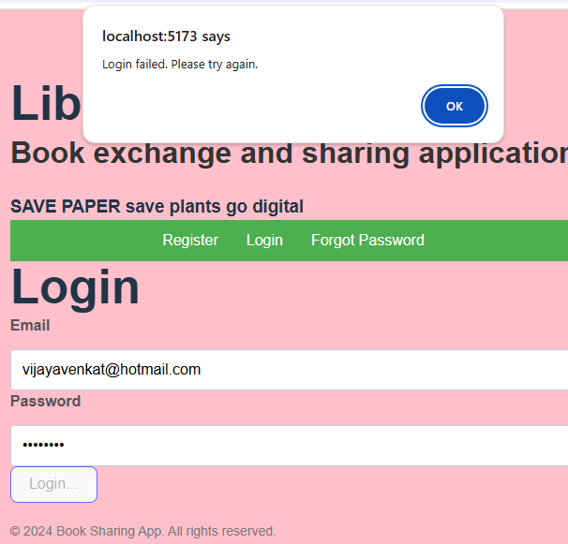
User Story 1: User Authentication LOGIN, REGISTER and forgot password reset

Slide 8
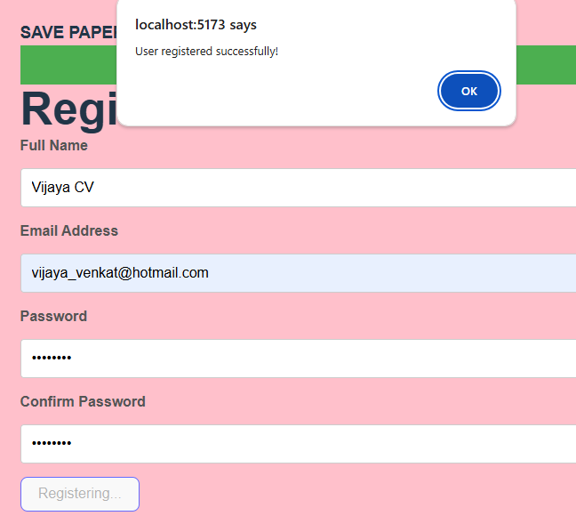
User Story 1: User Authentication LOGIN, REGISTER and forgot password reset

Slide 9
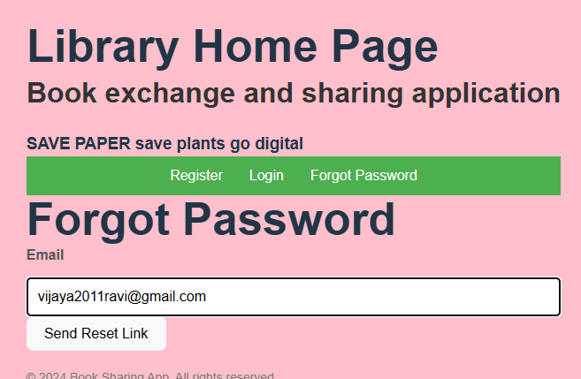
User Story 1: User Authentication LOGIN, REGISTER and forgot password reset

Slide 10
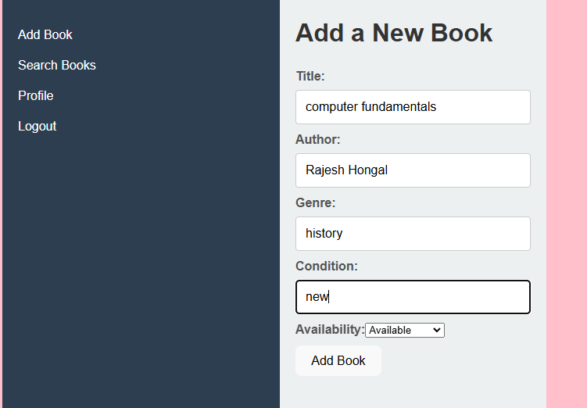
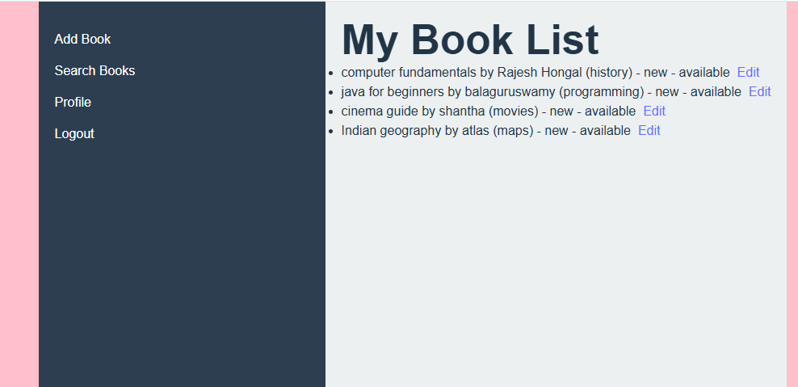
User Story 2: Book Listing

Slide 11
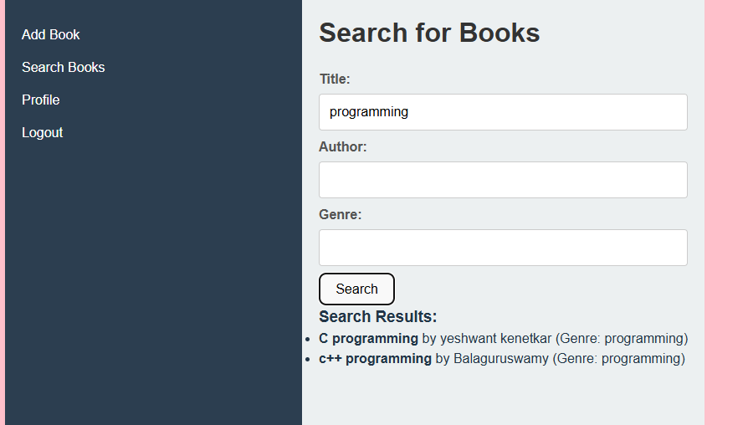
User Story 3: Book Search based on Title

Slide 12
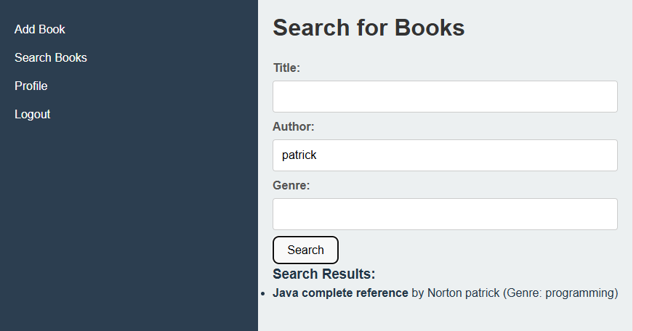
User Story 3: Book Search based on Author

Slide 13
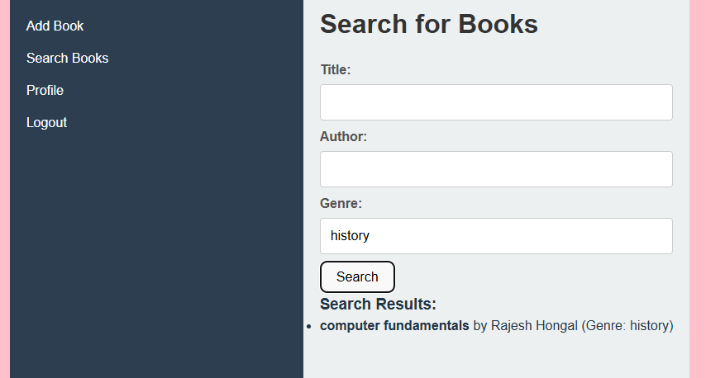
User Story 3: Book Search based on genre

Slide 14
Conclusion
The Full stack application is developed successfully using the above technologies.
I learnt a lot during the development of this assignment.
Thanks to our Professor Mrs. Akshaya Ganesan for creating this opportunity to fulfil the assignment by giving a challenging one.

Slide 15
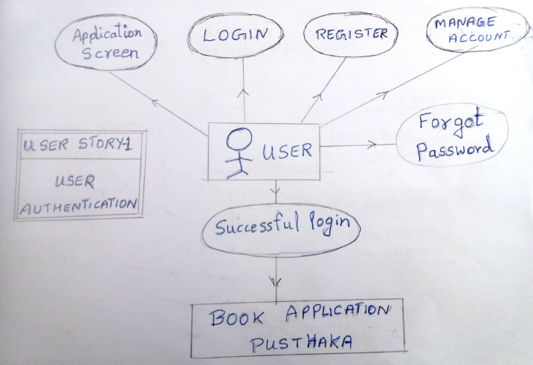

Slide 16
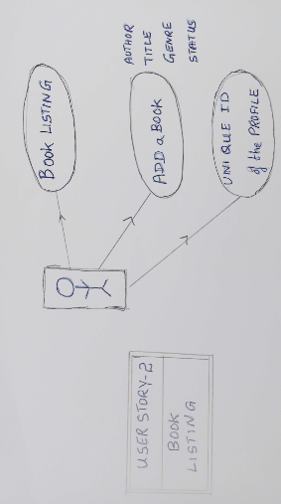

Slide 17
