Slide 1
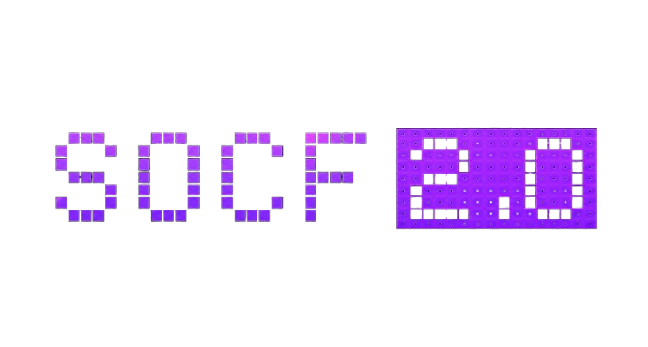
Explainable loan agreement intelligence for clause-level risk scoring and fairness assessment
Proposed by : Akhet

Slide 2
Instructions
Keep the presentation within the prescribed slide limit.
Allowed Font- Century Gothic, Times New Roman, Arial
Line spacing- 1.5, Font Color- White
Use concise text, visuals, and diagrams wherever appropriate.
Clearly explain the problem, proposed solution, feasibility, and expected impact.
Be realistic about challenges, risks, and implementation constraints.
Additional slides may be added only if essential to explain the idea.
Ensure all content is original and properly credited where external references are used.

Slide 3
Proposed Solution
Problem Statement
Modern loan agreements are lengthy, legally complex, and often difficult for borrowers to understand. Existing AI-powered contract analysis tools focus on extracting clauses or identifying legal risks but fail to evaluate whether the agreement is actually fair to both the lender and borrower.
This creates situations where a contract may be legally valid but heavily biased toward one party.
Our Solution
We propose an AI-powered contract intelligence platform that automatically analyses loan agreements and evaluates their fairness.
Instead of simply detecting risky clauses, our system independently measures:
Lender Risk
Borrower Risk
The platform then compares both scores to determine whether the agreement is:
Balanced
Lender-Favourable
Borrower-Favourable

Slide 4
Technical Strategy
Component | Technology
Programming Language | Python
Frontend | HTML, CSS, Bootstrap, JavaScript
Backend | Flask
AI/NLP | spaCy, Transformers, Rule-Based NLP
Document Processing | PyMuPDF / PDFPlumber
Database | SQLite
Visualization | Plotly / Chart.js
Explainability | SHAP / Rule Explanation Engine
Deployment | Flask Server

Slide 5
Technical Strategy
Why These Technologies?
Fast document processing
Lightweight deployment
Easy scalability
Transparent AI
Explainable decision making
Dual-Risk evaluation analysis

Slide 6
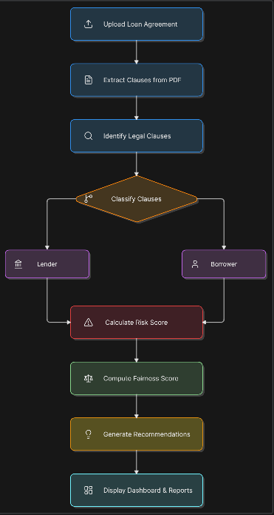
Technical Strategy

Slide 7
Feasibility and viability
Feasibility Analysis
Our solution is practical because it leverages open-source AI libraries and lightweight web technologies.
Resources Required
Standard Computer
Python Environment
Flask Server
NLP Libraries
PDF Processing Libraries
No expensive hardware or cloud infrastructure is required for deployment.

Slide 8
Feasibility and viability
Why Practical?
Low development cost
Easily deployable
Minimal maintenance
Can process contracts within seconds
Suitable for banks, fintechs, and legal firms
Validates on the basis borrower and lender
Justifies & corrects the selected clauses

Slide 9
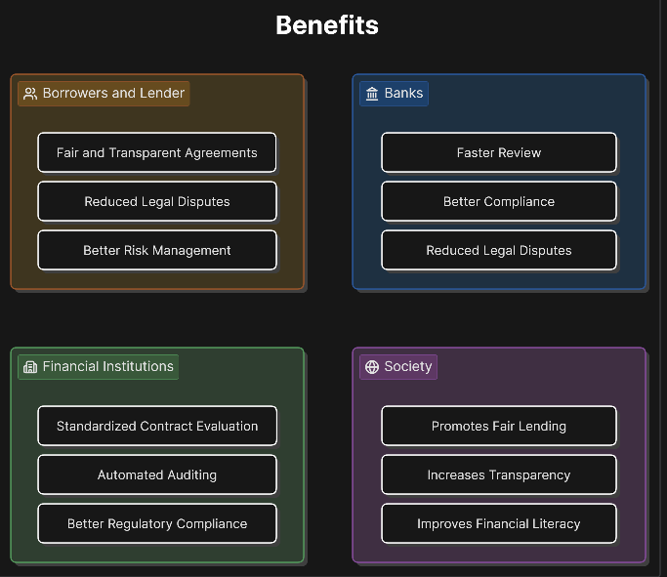
Impact and benefits envisaged
Expected Impact
The platform enables transparent, explainable, and fair evaluation of loan agreements.

Slide 10
Why this idea may fail ?
Challenges
Different countries have different legal standards.
AI may misinterpret highly complex legal language.
Limited availability of annotated legal datasets.
Organizations may hesitate to trust automated recommendations.
Continuous regulatory changes require frequent updates.
Future Improvements
Development of AI Agents to work on each process
Multi-Lingual & Multi-Document Analysis support
Live legal database integration
Blockchain-based document verification
Learns on the basis of regulatory clauses

Slide 11
REFERENCES
T. vidler, K. MCGarry, and D. Baglee, "Text mining legal documents for clause extraction," in proceedings ofthe 19th International conference on Data science (ICDATA'23), 2023
I. Dikmen, G. Eken, H. Erol, and M. T. Birgonul, "Automated construction contract analysis for risk and responsibility assessment using natural language processing and machine learning," computers in Industry, vol· 166, p. 104251 , 2025.
M. K. Nallakaruppan, B. Balusamy, V. Grover, and S. Bhattacharyya, "An explainable AI framework for credit evaluation and analysis," Applied soft computing, vol. 151 , p. 111307, 2024
R. Bahlool, N. Hewahi, and W. Elmedany, "performance, fairness, and explainability in AI-based credit scoring: A Systematic literature review," Journal ofRisk and Financial Management, vol· 19, no. 2, p. 104, 2026.
M. Rizinski and D. Trajanov, "AI agents in finance and fintech: A Scientific review of agent-based systems, applications, and future horizons," computers, Materials & continua, vol· 86, no. 1 , pp. l-34, 2026
J. Devlin, M. chang, K. Lee, and K. Toutanova, "BERT: pre-training of deep bidirectional transformers for language understanding," in NAACL, 2019 .
T. Brown et al·, "Language models are few-shot learners," inNeurIPS, 2020.

Slide 12
THANK YOU
Sponsored by

