Slide 1
Formulas chatbot
TEAM : FULL STACK
DEVELOPERS
G. Neha
P. Anusha
S. Vijaya Sri

Slide 2

Introduction
This is the chat bot used to give formulas about Mensuration and also Trignometry.
What is chatbot ?
A chatbot is a software or computer program that simulates human conversation or "chatter" through text or voice interactions. Users in both business-to-consumer (B2C) and business-to-business (B2B) environments increasingly use chatbot virtual assistants to handle simple tasks.
Example:Amazon customer service.

Slide 3
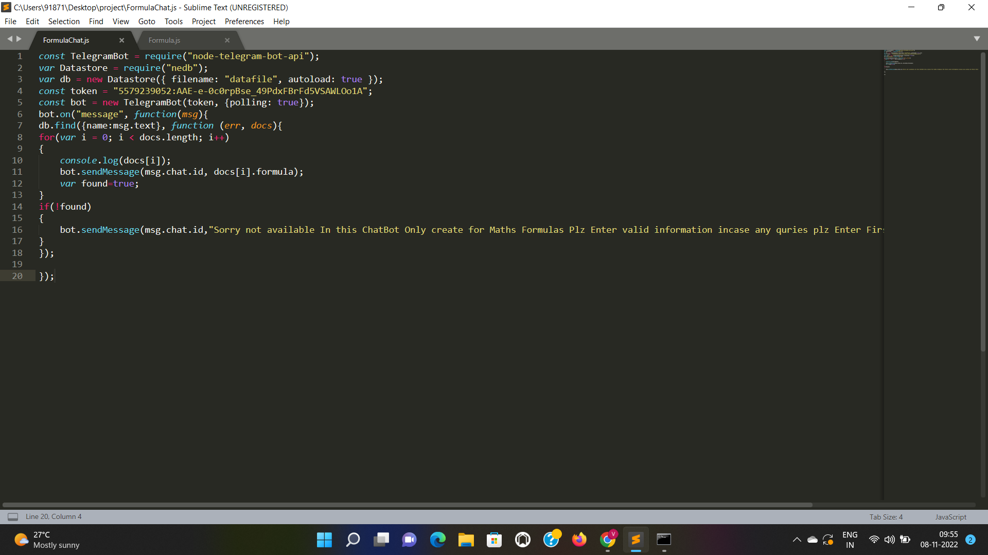
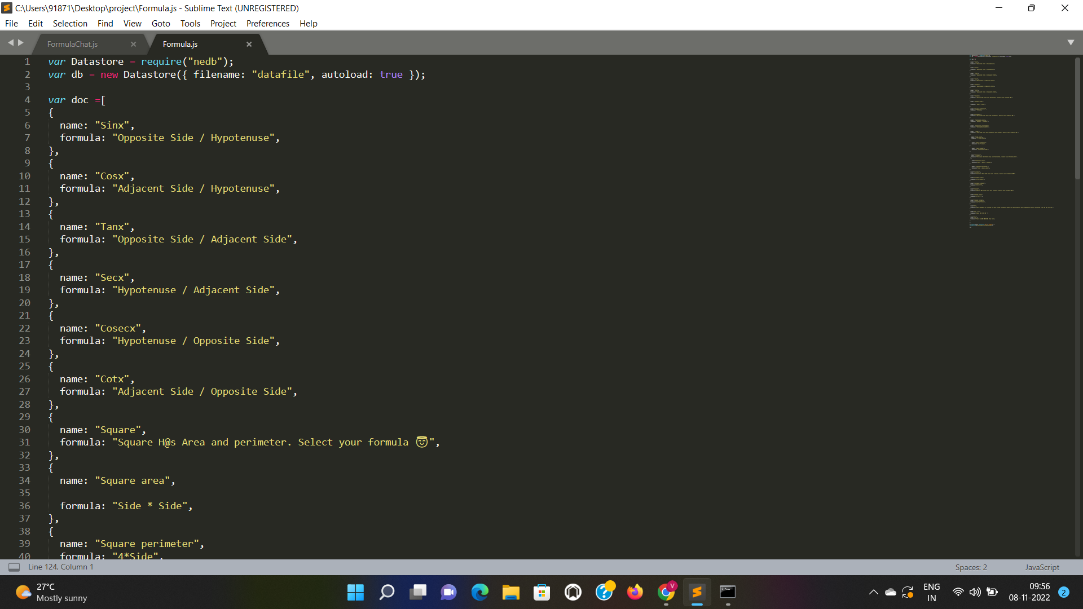
Code using NodeJS
Telegram bot code
Database code

Slide 4
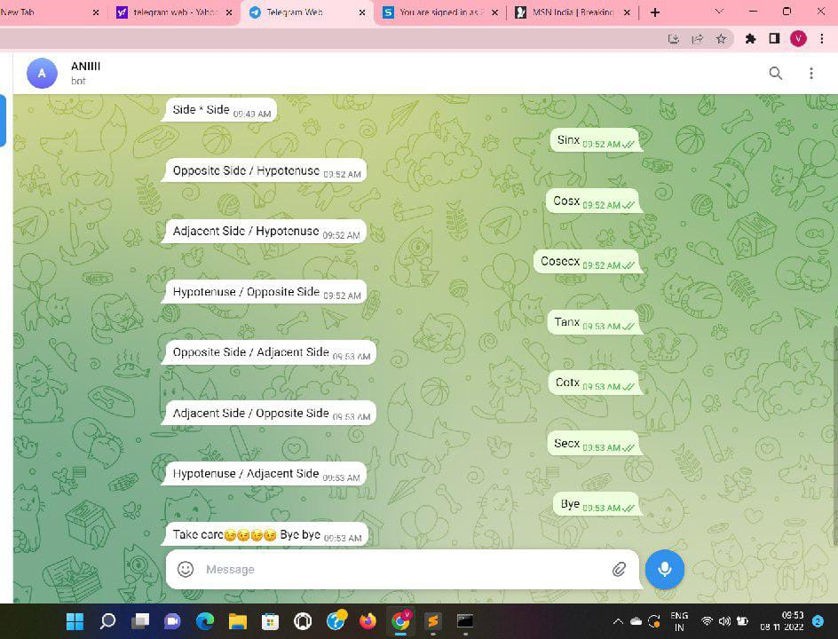
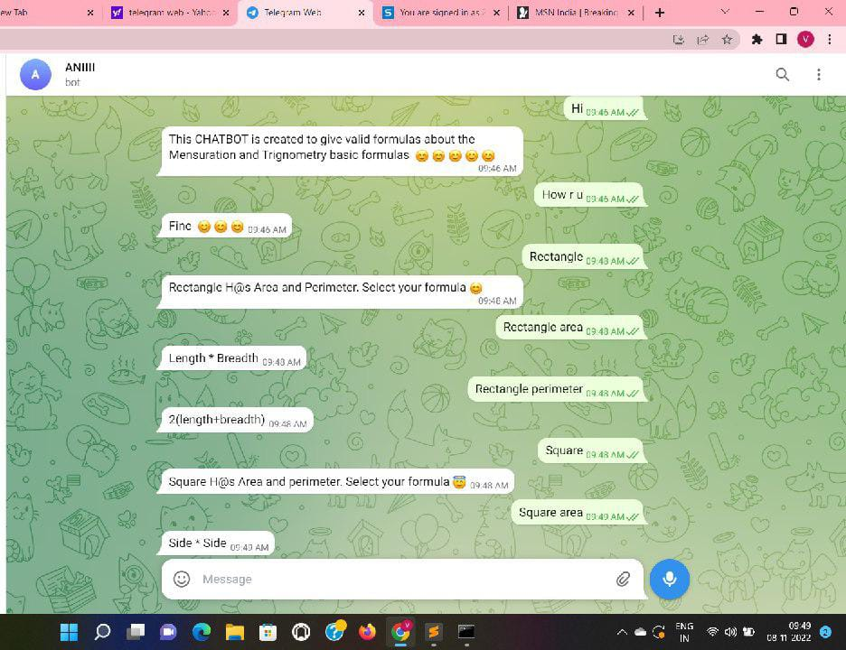
Final output in Telegram

Slide 5
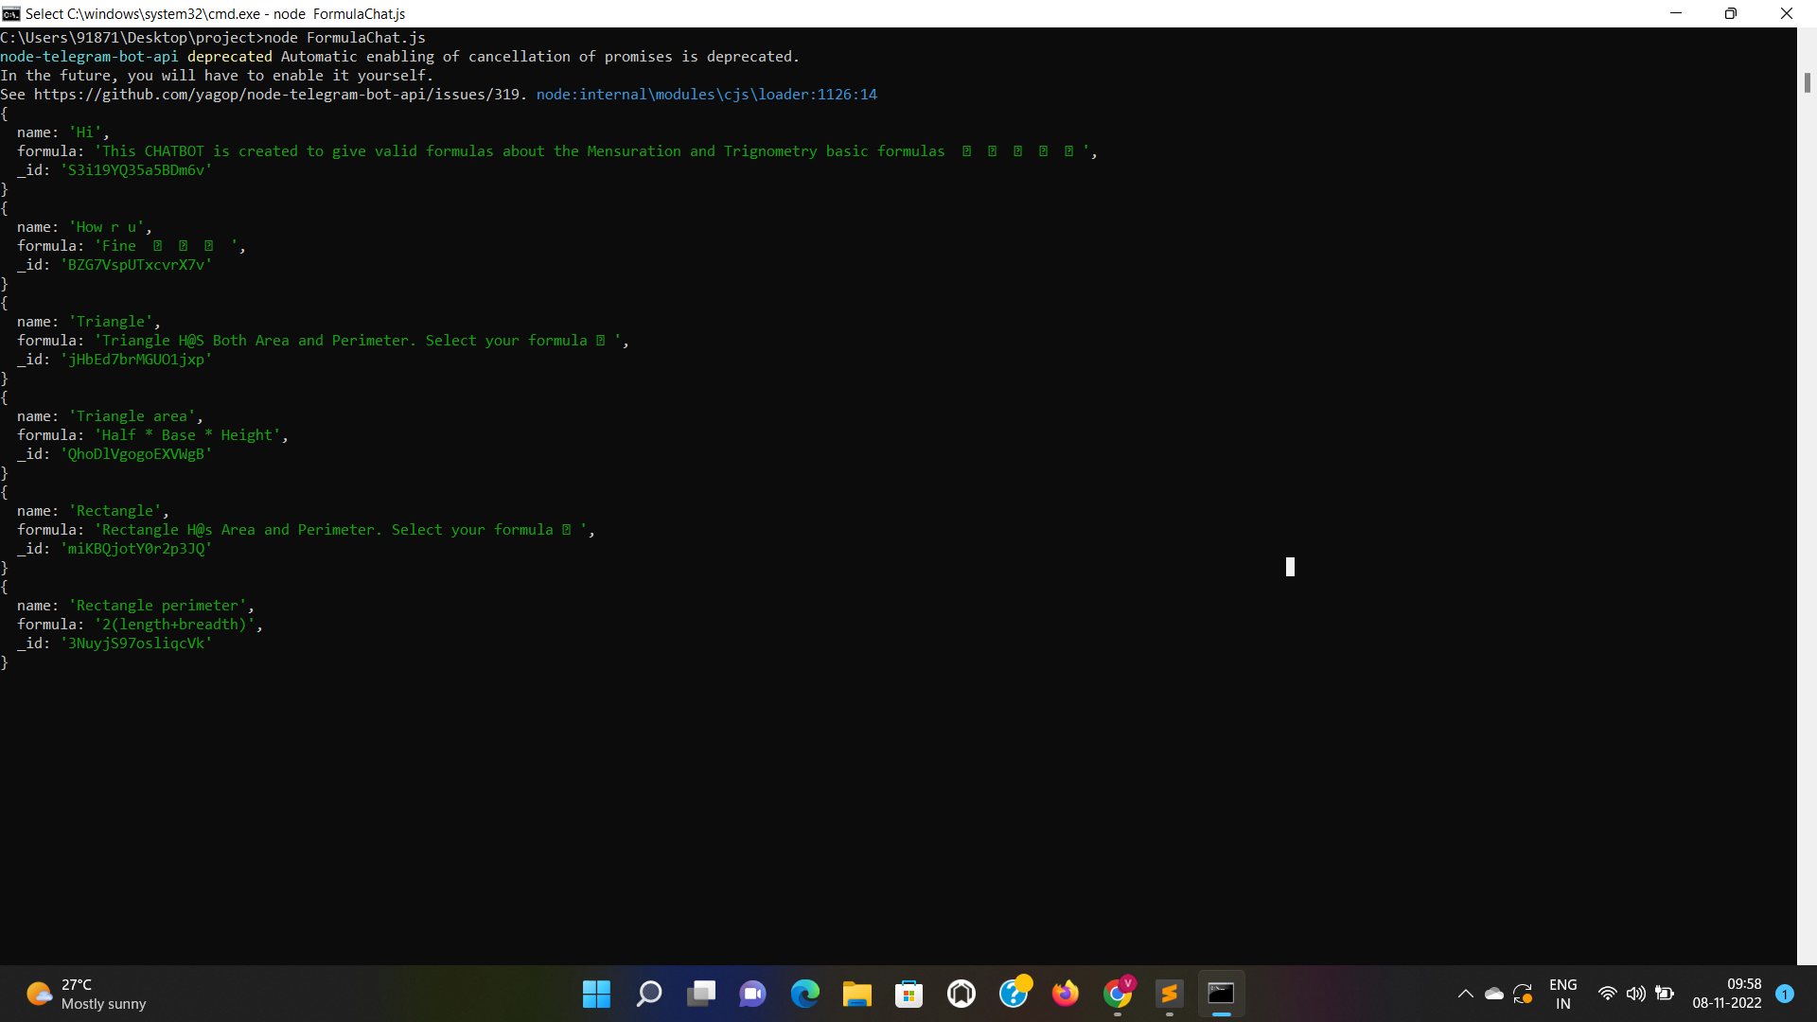
The way background works?

Slide 6
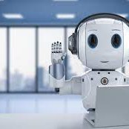
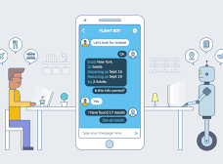
Thank you

