Slide 1
System login and Connectivity details
1. Please Log into the desktop with local ID and password as shown below
2. To change password of Infosys Domain ID
- Please try to open google.com in Internet Explorer and type in Internet guest coupon when it ask for authentication( Please note: one time internet guest coupon already shared with you)
- After successful authentication please access below URL for changing Infosys domain password, https://stsakaash.infosys.com/adfs/portal/updatepassword
Please note: You have to use above domain ID and password for accessing internet in class room as well as ECC rooms during training period.
Login ID | .\hsbc_2019
Password | Welcome123 (Please note “W” in caps)
User ID ( Infosys Domain ID) | Hsbc2019_xxxx@ad.infosys.com (Already shared with you)
Old Password | Welcome@aug@2019 (Please note “W” in caps)
New Password | Sample Passwords hint : Hsbc123? and Infy3456.
Confirm password | Confirm your new password

Slide 2
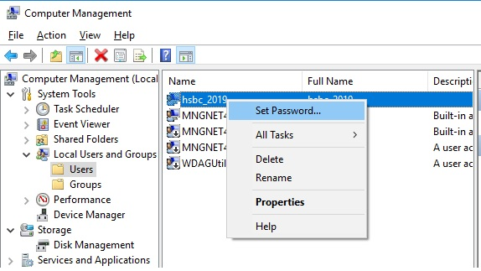
Changing local ID and Password
Please use below steps to change local password on your desktop,
Please go to start>Run> type “compmgmt.msc”
Go Local User and groups>Users, please set the password for the local ID “hsbc_2019” as shown below,
Note: This will be your new password for your desktop login, your next user ID and password are show below
Login ID | .\hsbc_2019
Password | Your new password

