Slide 1
DATA SCIENCE INTERNSHIP
VIJAYA S RAO
4CB17IS058

Slide 2

About the Company
Exposys Data Labs was found in 2016.
Exposys Data Labs aims to Solve real world business problems like Automation, Big Data and data Science.
50,000+ students trained.
1+ million hours of training.
30+ specialized professional courses.

Slide 3
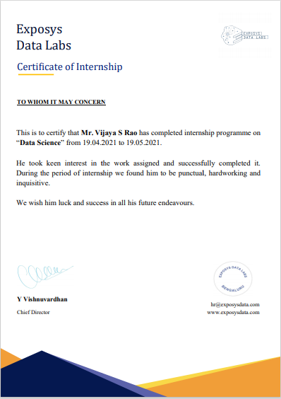
CERTIFICATE

Slide 4
Project Task
Project includes using clustering, identifying segments of customers to target the potential user base. Then dividing customers into groups according to common characteristics like gender, age, interests, and spending habits so they can market to each group effectively, to visualize the gender and age distributions and analyze their annual incomes and spending scores.
Dataset/Package:(https://drive.google.com/file/d/19BOhwz52NUY3dg8XErVYglctpr5sjT y4/view
Language: Python

Slide 5
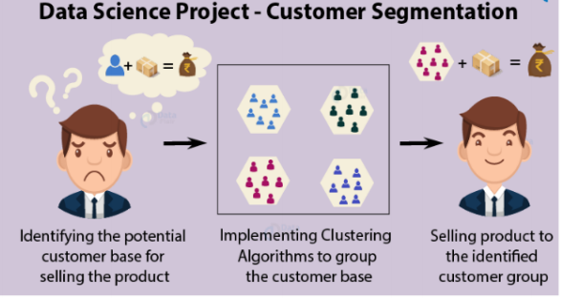

Slide 6
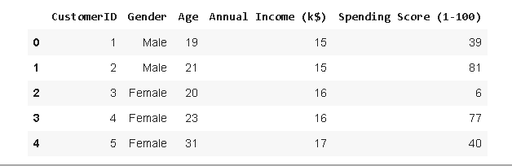
Project Task 1- Customer Details.

Slide 7
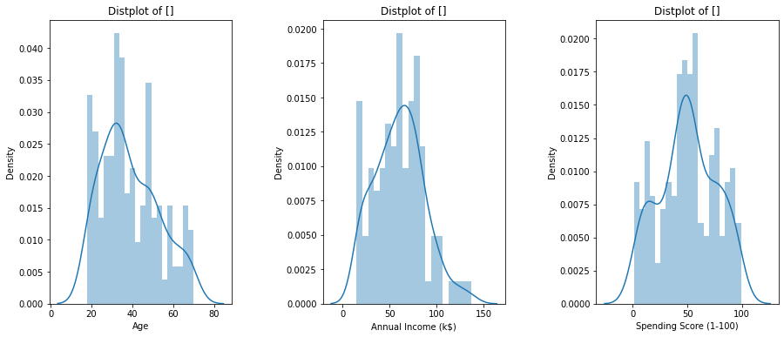
Project Task 2- Classification of Customers

Slide 8
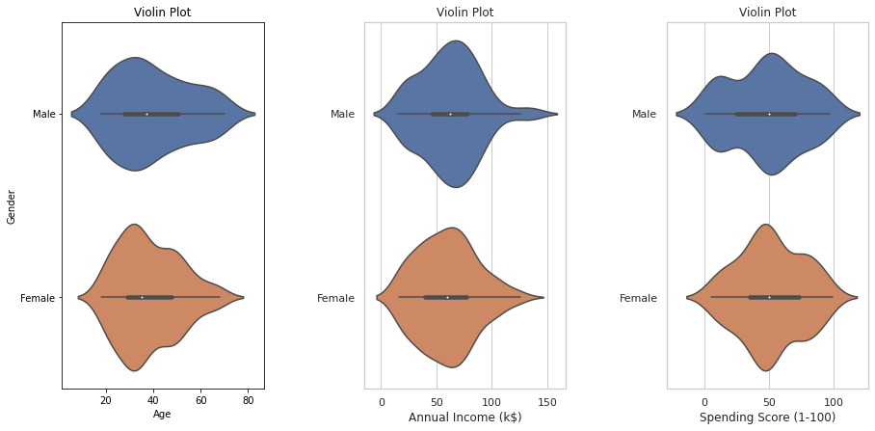
Project Task 3- Gender Wise Distribution

Slide 9
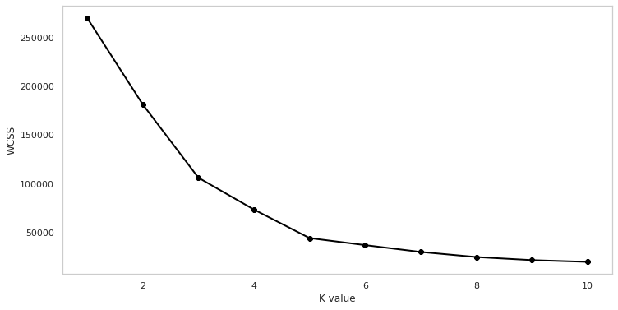
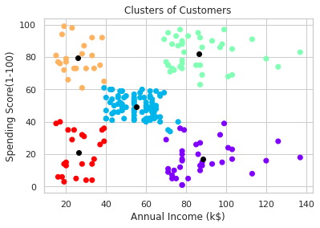
Project Task 4 : K-means Clustering.

Slide 10
Reflection
The internship program has helped, to improve basic knowledge of Data Science and Machine Learning through hands on experience by solving real world problem.
The internship program has helped, to understand working of ML algorithms which helped me to upgrade my logical thinking.
The internship helped me to gain in depth knowledge on python.
Time Management.
Materials provided are useful

Slide 11
Conclusion
The internship provided a hand full of experience apart from academics.
Each day of internship provided me with new knowledge and experience.
Learning about my basic fundamentals of python libraries.
It taught us about developing a project.
Teaching and Implementing is appreciated.
This internship has given me new insights and motivations to pursue a career in core industries.

Slide 12
Thank You

