Slide 1
DeployIQ — AI DevOps Copilot
Docker logs → evidence-grounded root-cause reports
Shravan Mote (08) • Bhushan Gosavi (37) • Vijay Barhate (05) • Sanskar Jadhav (50)
Guide: Dr. Roohum Jegan • Saraswati College of Engineering, Kharghar (2026–27)

Slide 2
Problem
• Docker failures surface as long, noisy container logs under release pressure.
• Manual triage is slow; generic LLM advice hallucinates and cites nothing.
Need: evidence-grounded RCA — every claim linked to logs + runbooks.
2

Slide 3
Objectives
• O1: Docker watching, normalization and incident grouping (SQLite + Alembic).
• O2: BM25 runbook retrieval with relevance + per-attempt snapshots.
• O3: LangGraph RCA on OpenRouter free models with fallback + validation.
• O4: React workbench — keyboard, focus, responsive, E2E-tested, green CI.
3

Slide 4
Literature snapshot
• Container monitoring (ELK/Prometheus): data, no causes.
• RAG (Lewis et al. 2020): grounding needs ranked retrieval + enforced citations.
• LangGraph agents: need evidence contracts, retries, cost guards.
• Dashboards: alerts yes; snapshot-scoped citations + approval flags rare.
4

Slide 5
Architecture
• Docker watcher → evidence extractor → BM25 runbooks → LangGraph (evidence→RAG→root-cause→report).
• FastAPI REST + SQLite snapshots → React incident center + workbench.
• One logical LLM call + one fallback retry; dedup guard; token accounting.
5

Slide 6
Results today (MVP M1–M3.3)
• Backend: 97 pytest passed; Ruff clean; migrations 0001–0005.
• Frontend: 92 Vitest; typecheck + lint; build; 7 Playwright E2E green.
• Workbench: live regions, focus restore, reduced-motion, zero-overflow, retry.
• Ghost-ID cleanup keyed on successful refreshes; failures never counted.
6

Slide 7
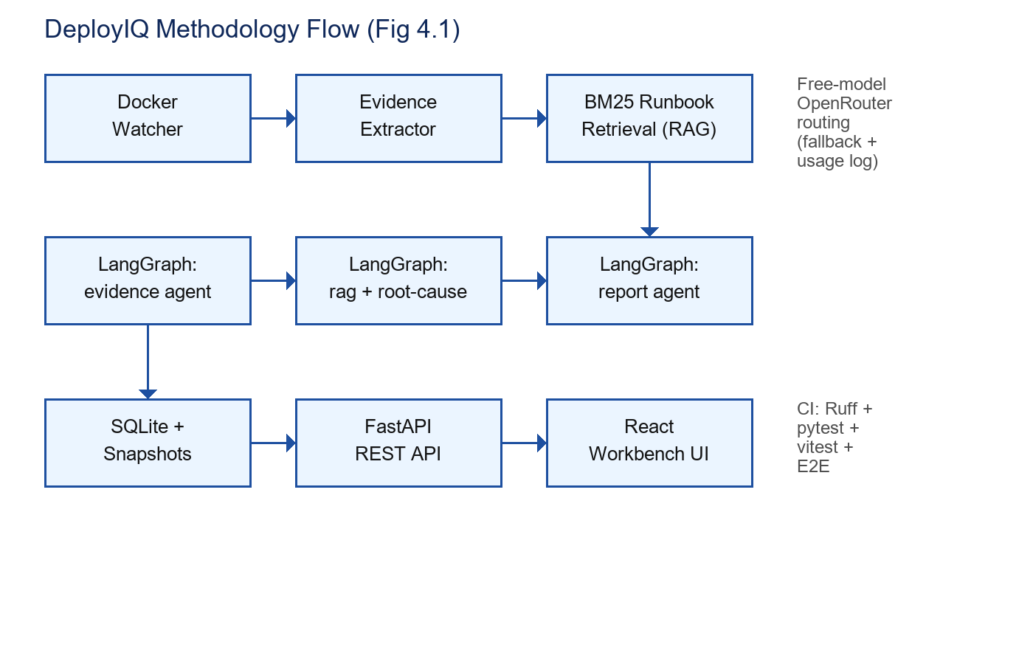
Methodology flow
Fig 4.1 — ingest, retrieve, reason, present, verify.
7

Slide 8
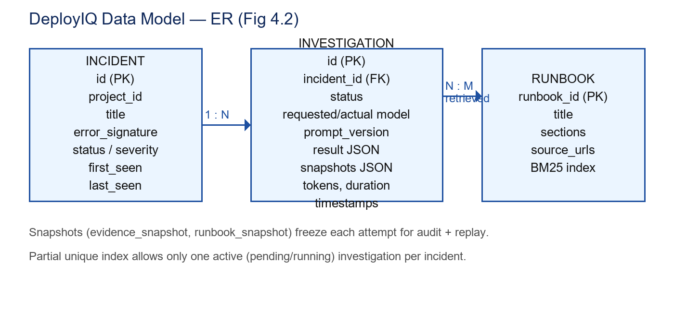
Data model (ER)
Fig 4.2 — incidents 1:N investigations; snapshots frozen per attempt.
8

Slide 9
UI / motion inspiration (references, not dependencies)
• driver.js: product-tour onboarding for the workbench demo.
• motionmaxxing + bang-motion: micro-interactions for status transitions.
• dimensional-drawing: architecture visual language for posters.
• papermorph / PaperBanana / learnharness: paper-to-story slide craft.
• openfilm + pentagi + mesh-avatar-studio: demo video + presenter avatar.
9

Slide 10
Future scope
• Live crashme demo (M3.3-E) + recorded walkthrough.
• Hybrid BM25 + pgvector retrieval, evaluated on real failures.
• Risk-score calibration + approval-gated remediation.
• Multi-project watch, alerting integrations, deployment packaging.
10

Slide 11
Thank you
Questions + live workbench demo

