Slide 1
Predictive-Scaling
By
Vijay Ram

Slide 2
Question?
How to cut down cost of cloud infrastructure using predictive analysis?

Slide 3
Predictive-Scaling
Overview:
We are burning lot of cash just for GCP from Enterprise cart and checkout. We roughly run about ~500 instances (central and east) during normal traffic days.
Idea:
Online order trend is very much predictable (except during event hrs and few days in Nov and December). In other words, predictable seasonality.Therefore , it is totally predictable year over year.
The idea is to look at the last 2 yrs data and run Machine Learning linear regression model to closely predict and auto scale our instances hrly or every day based on predictions (numbers can be overridden for planned events) so that we can cut down the infra cost significantly.
Design Overview:
Predicated Order Count(OPH)
DB
Transaction Per Second/ Historic Order Data
Micro Batch to scan DB hrly
Time Series ML Model
Scale UP/Down Cloud Machines
Notes:
We are paying lot of money to manage GCP instances. Our process for scaling up or down is manual and needs lot of manual effort to coordinate among teams.
We are almost doing this activity for every week for events such as LTO(limited time offer) they are frequent in nature.
Often times, we do not scale down after the event esp. if its close to week ending and our scaling needs are proactive in nature (not reactive)
Current scaling guidelines are static in nature and its based on CPU usage and memory consumption rather than completely relaying on TPS and order trend.
Digital order trend and TPS are relatively stationary year over year except for events hrs.
The idea is to use time series regression models to predict the trend and scale up or down our GCP instances almost by hr without any manual effort.
We can bring down considerable no of GCP instances (therefore bringing down cost) from our GCP space.
Explain the design

Slide 4
FAQ
Are we not causing Cloud cluster imbalance if we hourly scaling up and down?
Answer: We are batching our scaling up and down numbers. e.g if we need to bring down 20 nodes. we batch it thru 5 in each iteration with intervals. if that becomes problematic, we can change hourly scale down to daily. Ours is weekly seasonal. Sunday we can have 500 instances running and bring down to 100 by Wednesday and again slowly gradually increase the instances before Friday evening .
Did we take BOT/High Volume Traffic days into account ?
Answer : We have plans to override this predicated scaling suggestion from modeling from supporting Application so that operations team can override from UI and schedule it 1 day before the event.
Why not auto-scaling?
Answer : We scale ahead of time before the events generally. Auto scaling is reactive in nature. However Auto-scaling can very well compliment predictive-scaling when prediction is not accurate.

Slide 5
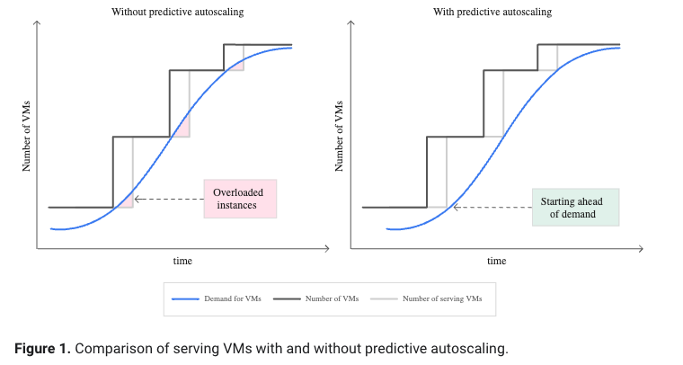
Predictive Vs Auto Scaling

Slide 6
Data Exploratory Phase
Input Dataset:
Retailers have typical volume of traffic every year.
Data Cleansing:
Data Selection
Data Cleaning
Data Transformation

Slide 7
Machine Learning Models attempted:
Time Series MODELS:
ARIMA - Autoregressive Integrated Moving Average
SARIMAX - Same as ARIMA with seasonality with additional support of external variables.
Prophet - Simple Linear regression model that fits well for time series with just one variable

Slide 8
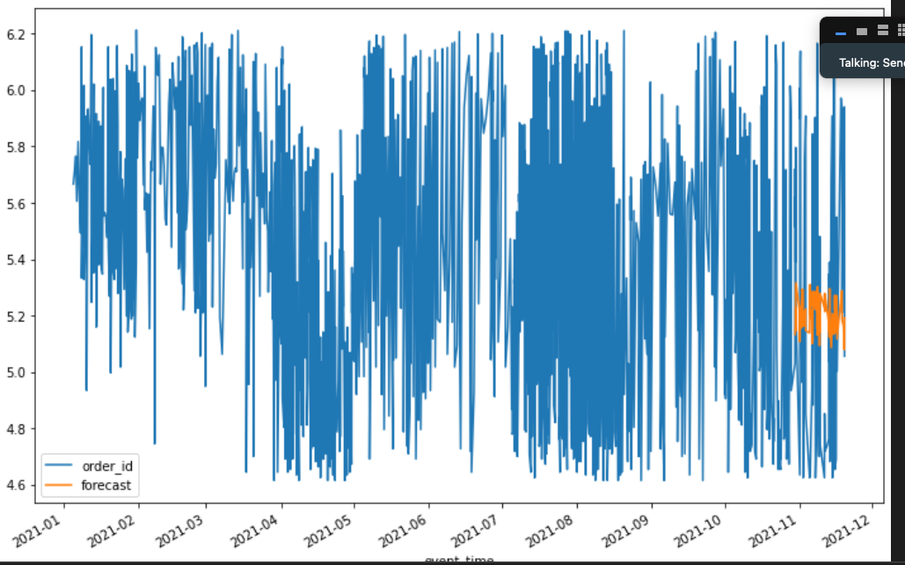
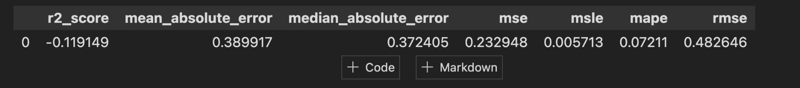
SARIMAX
Not supportive of non-stationary data
It was difficult to find the best combinations of P,D,Q,S even after several attempts

Slide 9
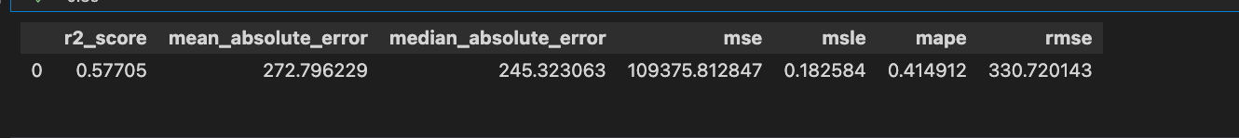
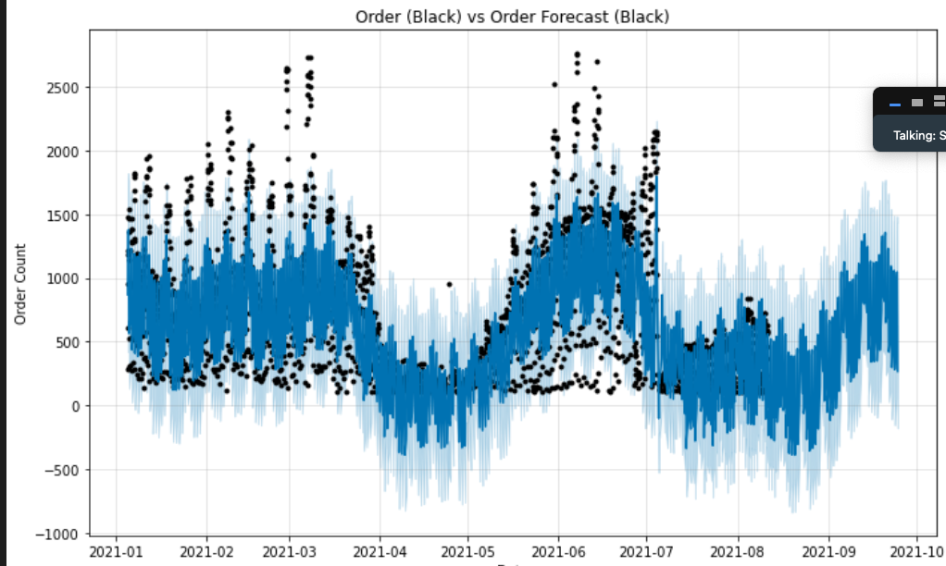
Prophet
Prophet is robust to missing data and shifts in the trend, and typically handles outliers well.
With few iterations , the following configs worked well
`yearly_seasonality: Auto seasonality
weekly_seasonality: Auto seasonality
daily_seasonality: Auto seasonality
holidays: Standard US holidays`
It’s also made for engineers without diving much into statistical details.
Forecasted Results are close enough

Slide 10
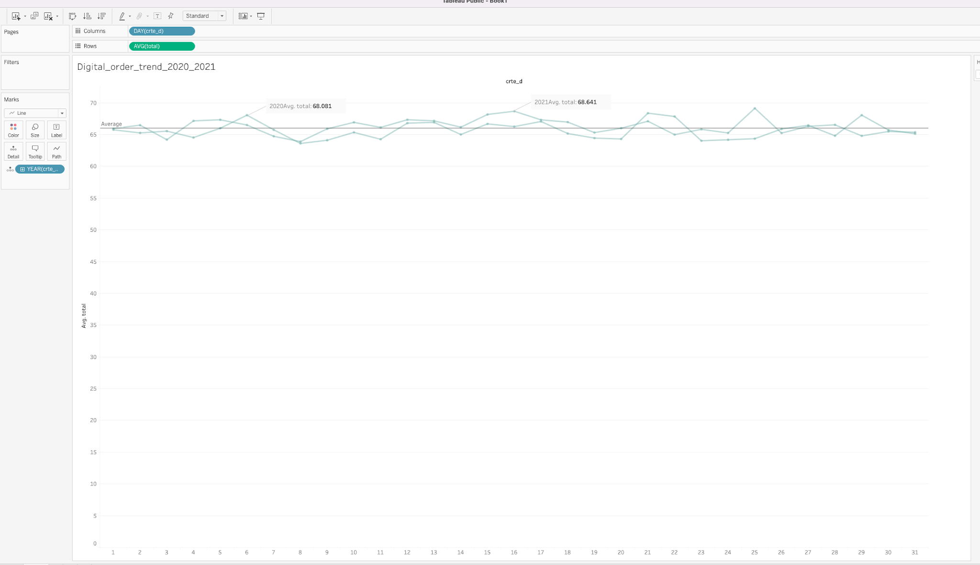
Online Order trend

Slide 11
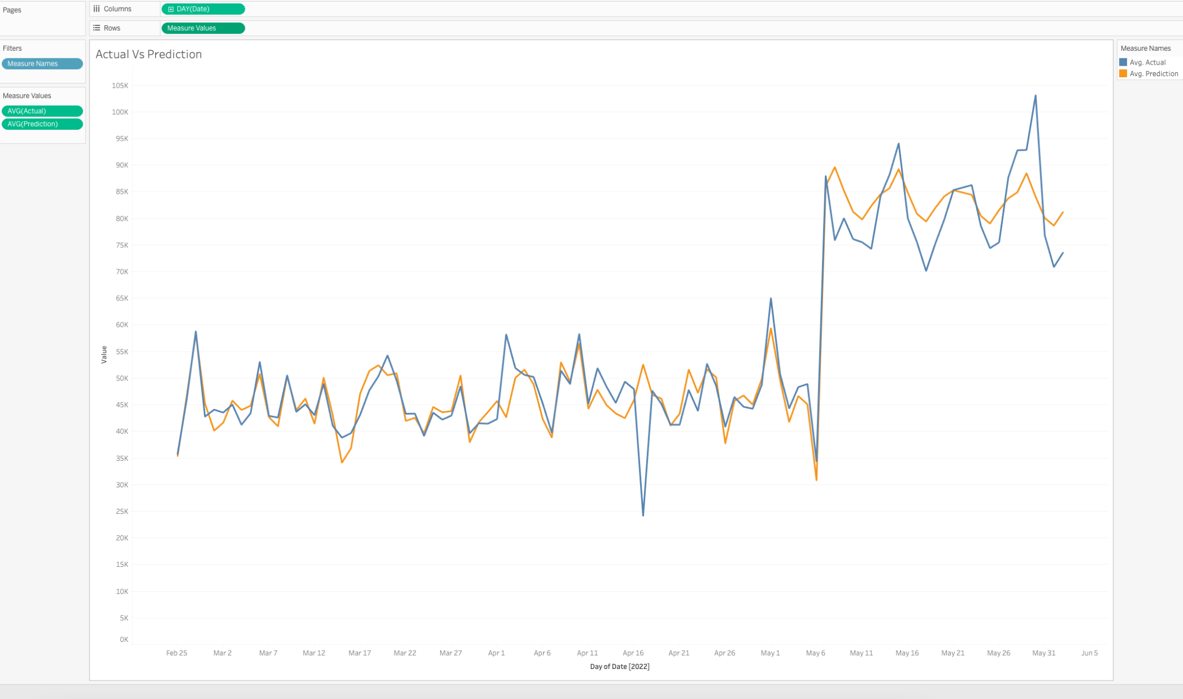
Actual Vs Prediction Accuracy

Slide 12
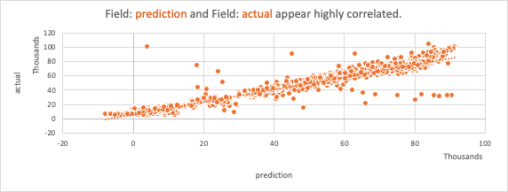
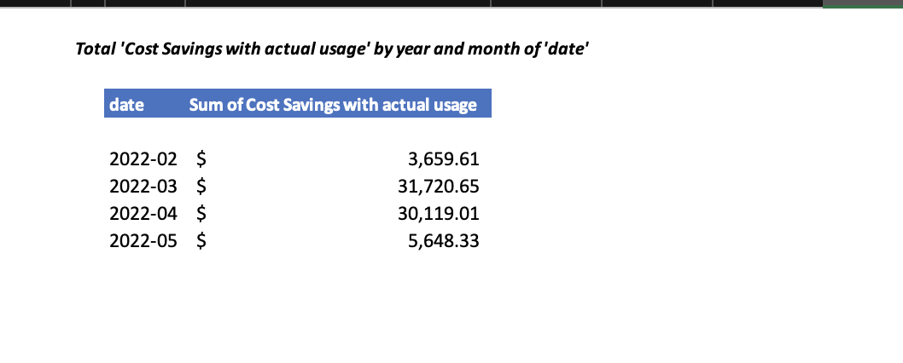
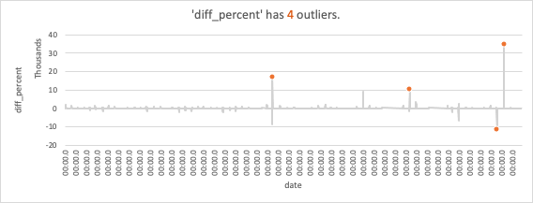
Prediction Insights:
Potential Cost Savings :

Slide 13
Autoscaler
Google Compute Engine APIs to scale up or down instances hrly
Scale up or down only if its more than 20%
Allow cooling period
Scaling with batching (5 at a time) to reduce the impact to the user.

Slide 14
DEMO

Slide 15
Learnings and Future Opportunities
Kaggle DataSet is not latest or up to date. ML models could be more accurate.
Prophet works well with recent and continuous data.
Could have used additional inputs for SARIMAX

