Slide 1
Predicting Customer Churn (Classification)

Slide 2
BUSINESS PROBLEM
The Phone Company aims to identify the customers who would discontinue service in September 2013 based on the prepaid phone data from the months of June, July, and August 2013. Customer Churn has a significant effect on a company's revenue.
Customer acquisition is thought to be five times more expensive than customer retention.
Using the dataset provided, classification models must be built that can categorize customers as 1s (likely to drop) or 0s (likely to stay or unlikely to drop).
Understanding the traits of customers who are likely to drop the service allows the company to modify its services in order to improve customer retention rates.
KEY OBSERVATIONS
We can see from the dataset that among the 3 months (June, July & August 2013) the total user spending was the highest for the month of June (despite having more total customers in August.
Also, the number of recharges done by the customers were highest for the month of June 2013 among the three months.
The number of new customers added were also highest in the month of June 2013 based on the dataset provided.

Slide 3
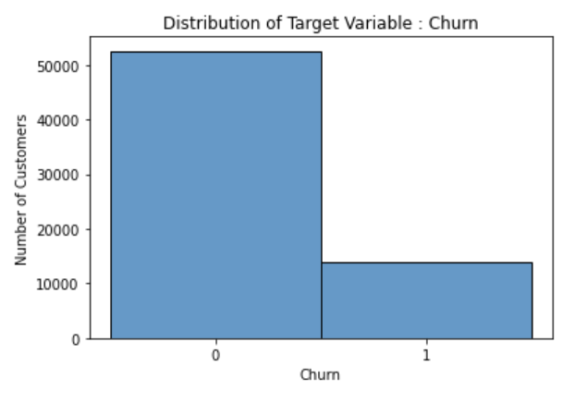
SUMMARY OF DATASET
Initial Dataset
No. of Variables / Columns : 190
No. of Rows / Observations : 66469
No. of Missing Values : 8813
No. of Categorical Predictors : 18
No. Continuous Predictors : 171
Number of 1s in Dataset : 13907
Number of 0s in Dataset : 52562
Final Dataset (for modeling)
No. of Variables / Columns : 85
No. of Rows / Observations : 57656
No. of Missing Values : 0
No. of Categorical Predictors : 15
No. Continuous Predictors : 69
Number of 1s in Dataset : 7806
Number of 0s in Dataset : 49850

Slide 4
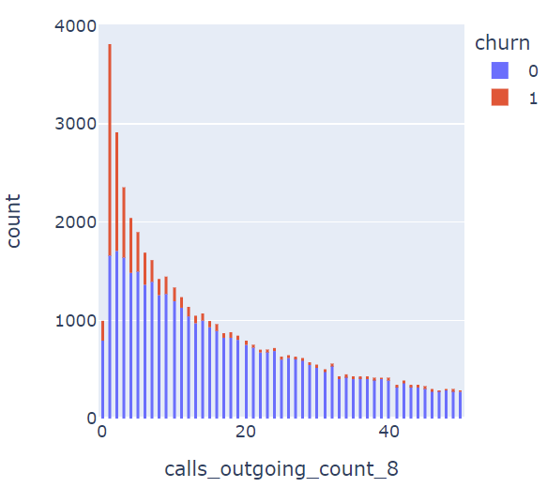
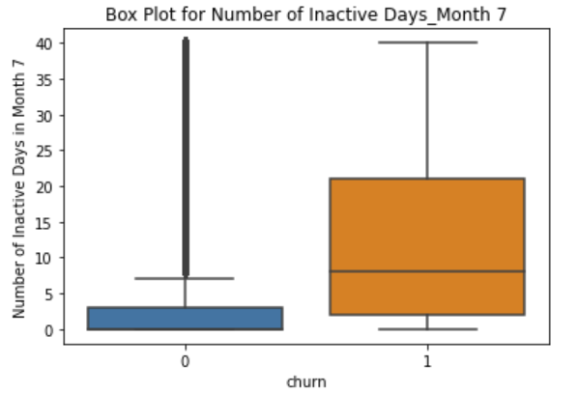
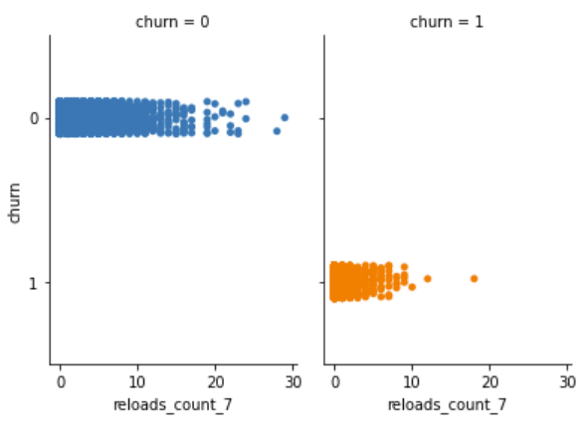
CUSTOMER BEHAVIOR
Higher the number of outgoing calls (last month), lower the chances for the customer to drop the service
Higher the duration for which a customer is inactive, higher the chances for the customer to drop the service
Higher the number of recharges done by the customer, lower the chances for the customer to drop out
Summary : To summarize customer behavior, we can say that lesser engagement or higher period of inactivity from a customer increases the chance for them to drop the service. The best thing the phone company can do to improve customer retention is to reduce the period of inactivity by introducing attractive packages that offer best plans for both incoming & outgoing , thereby encouraging more recharges & hence, more activity.

Slide 5
THANK YOU

