Slide 1
Automated On-Us Cheque Processing
Team MagnIeeT
Anubhav Nanda
Ashutosh Pathak
Neeraj Agrawal
Vijayendra Grampurohit

Slide 2
Steps for Project:
Data Generation:
Generating handwritten date.
Generating handwritten amount in word.
Generating handwritten amount in number.
Data Extraction:
Extracting Date
Amount in Word
Amount in number.
Data Validation:
Validating cheque is stale or not.
Amount in number is matching with amount in word.

Slide 3
Handwritten Data Generation:
Dates are generated automatically. Around 3000 dates are generated.
Dates are generated using MNIST data. MNIST digits are combined together with appropriate spaces for cheque.
Examples of generated Date.
Script for generating dates is provided in source code.

Slide 4


Handwritten Amount in Word
Amount in word generated automatically using five different style. Amounts are generated with different bias.
More than 20000 examples are generated to train our deep learning model based on CNN.
Two Examples of Handwritten Amount in word
Script for generating amount in word is provided in source code.

Slide 5
Handwritten Amount in Number:
Amount in number is also generated automatically. Amount in number is generated same as amount in word.
Amount in Numbers are also generated using MNIST data. MNIST digits are combined together to generate amont.
Examples of generated Date.
Script for generating amount in number is provided in source code.

Slide 6
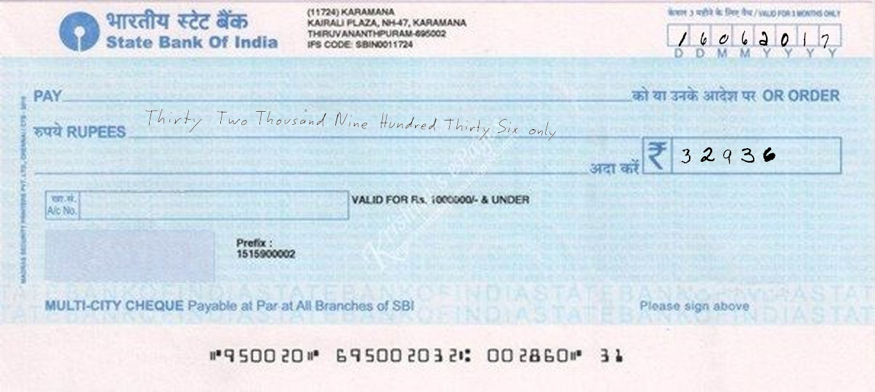
Final Cheque Generation
After generating amount in number, in words and date. They are paste together on cheques. More than 10000 cheques are generated.
Cheques are generated with many other filters to train our model.
Example of final cheque with all things pasted
Script for Pasting amount on cheque is provided in source code.

Slide 7
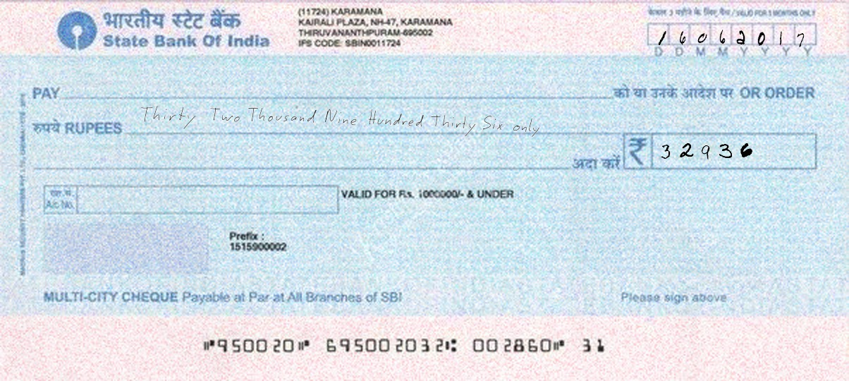
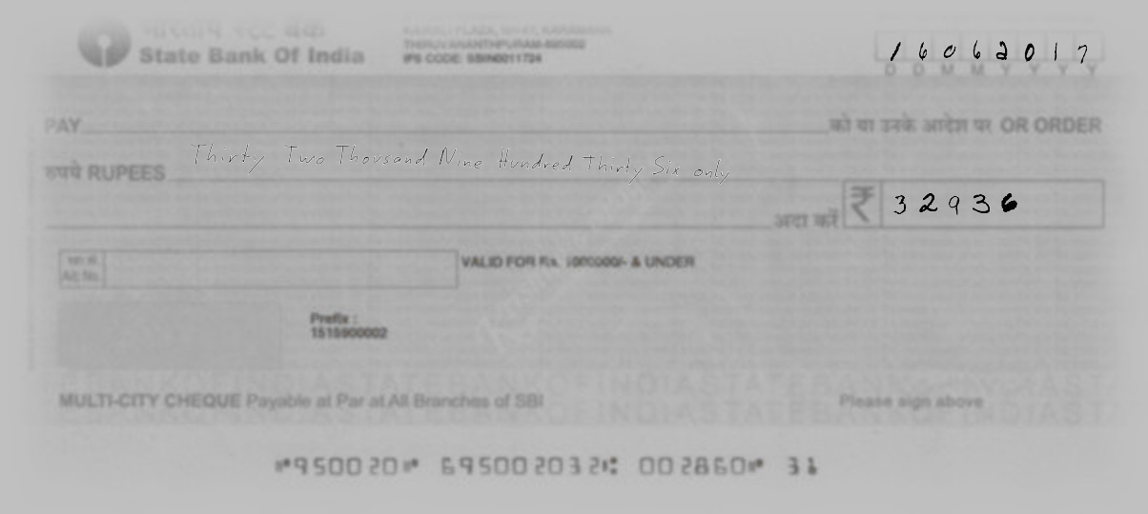
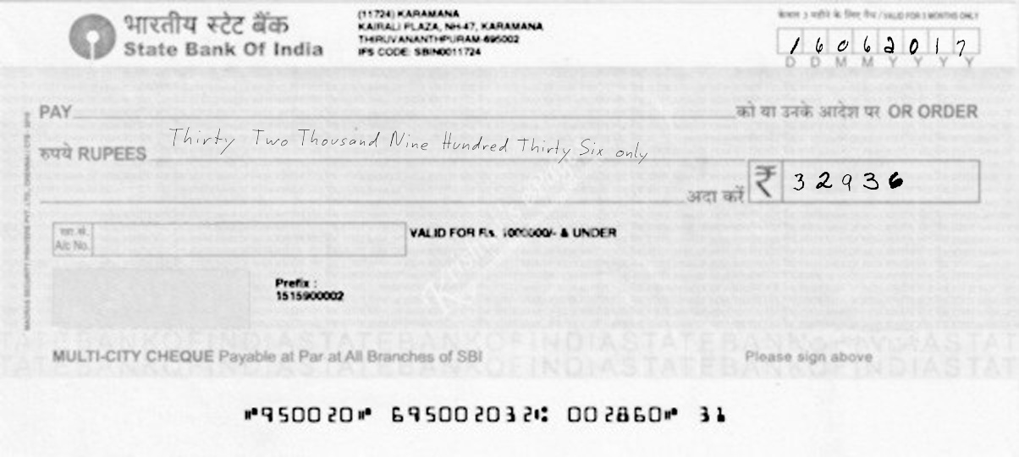
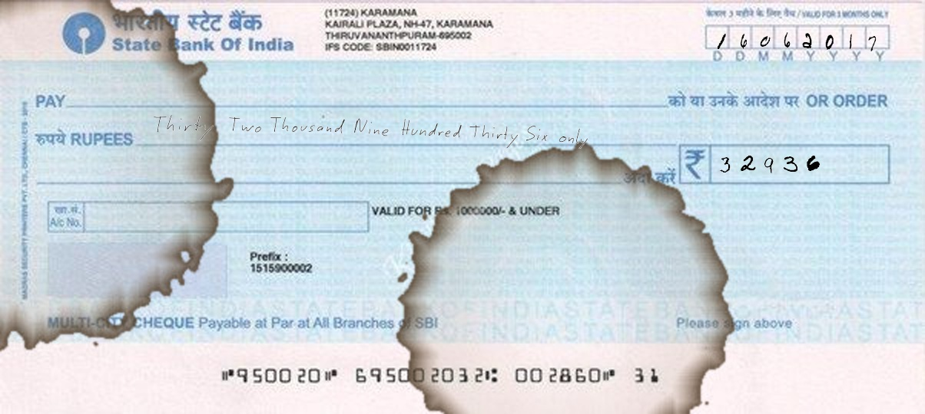
Examples of final Cheques
Hue Filter
Old Cheque
Cheque Photocopy
Coffee Filter

Slide 8
Date Extraction
For Date extraction we tried two approaches:
Deep learning based approach:
We have trained our model which will automatically identify location of text in the cheque.
Accuracy is around 80% because small dataset and not enough time to train model.
YOLO CNN architecture is used to train the model.
Script is provided in source code.
Open CV bases approach:
In this approach, we have assumed we’ll get only SBI cheque as input data without change in orientation.
We hardcoded the coordinate to extract the information from cheque.
Script is provided in source code
Script are provided in source code.

Slide 9
Cleaning of extracted info
After extracting info from cheques. Using openCV background are removed.
Image is converted into gray scale that can be used by model.
Extracted Amount in number
MICR code from Cheque
Extracted Amount
Script for cleaning data is provided in source code.

Slide 10
Data Validation: Cheque is stale or not.
After extracting information from cheque.
Dates digits are divided into individual digits.
Lenet deep learning model is trained.
Lenet is able to identify dates with 90% accuracy. With more data accuracy can be improved further.
If date on cheque is six month older from current date. Cheque is marked stale.

Slide 11
Checking amount in word and Number
For detecting amount in word:
VGG Deep learning architecture is trained with around 20000 examples.
Our novel approach converted this problem into classifying word into 38 categories rather identifying individual alphabet.
First amount in word is divided into individual word and able to classify into appropriate class.
Accuracy of model on training data set is 99%.
Accuracy of model on test data set is 95% (Can be further improved with more training)

Slide 12
Checking amount in word and Number
For detecting amount in number:
Lenet deep learning model is trained.
Individual digtits are classified into 10 classes.
Accuracy of model is 96%
After detecting amount in number and word both are compared and cheque is flagged true of false.

Slide 13
Result and Conclusion
Full pipeline is created that can take image and identify cheque is stale or not. Also cheque is true or false.
Currently accuracy of model is around 85%
Accuracy can be increase by further training on more data.
Data can be generated automatically.
More time and good GPU is needed to train model faster and with better accuracy.

