Slide 1
Docker certified Associate

Slide 2
Docker Installation on Ubuntu using Repositary
Supported operating system
Ubuntu Hirsute 21.04
Ubuntu Groovy 20.10
Ubuntu Focal 20.04 (LTS)
Ubuntu Bionic 18.04 (LTS)
Uninstall old versions
apt-get remove docker docker-engine docker.io containerd runc

Slide 3
Docker Installation on Ubuntu using Repositary
Supported storage driver
aufs
Overlay2 by default these is available
Btrfs
Installation method
Repository
Install from the package
Install using script

Slide 4
Docker Installation on Ubuntu using Repositary
Installation method-Repository
Add official GPG Key
root@docker:~# apt-get install \
> apt-transport-https \
> ca-certificates \
> curl \
> gnupg \
> lsb-release
curl -fsSL https://download.docker.com/linux/ubuntu/gpg |
sudo gpg --dearmor -o /usr/share/keyrings/docker-archive-keyring.gpg

Slide 5
Docker Installation on Ubuntu using Repositary
Command for the stable repository
Update and install the packages
echo \
"deb [arch=amd64 signed-by=/usr/share/keyrings/docker-archive-keyring.gpg] https://download.docker.com/linux/ubuntu \
$(lsb_release -cs) stable" | sudo tee /etc/apt/sources.list.d/docker.list > /dev/null
sudo apt-get update
sudo apt-get install docker-ce docker-ce-cli containerd.io

Slide 6
Uninstall the docker engine
Uninstall the docker engine
To delete all images, containers, and volumes:
sudo rm -rf /var/lib/docker
sudo rm -rf /var/lib/containerd
apt-get purge docker-ce docker-ce-cli containerd.io

Slide 7
Configure docker to start on boot
Start the service using docker
sudo systemctl enable docker.service
sudo systemctl enable containerd.service

Slide 8
systemd vs daemon.json
Systemd unit file change to accept remote connection
Configuring Docker to accept remote connections can be done with the docker.service systemd unit file for Linux distributions using systemd, such as recent versions of RedHat, CentOS, Ubuntu and SLES, or with the daemon.json file which is recommended for Linux distributions that do not use systemd.
Configuring remote access with systemd unit file
Add the /lib/system/system/docker.service file
[Service]
ExecStart=
ExecStart=/usr/bin/dockerd -H fd:// -H tcp://127.0.0.1:2375 <== unencrypted connection

Slide 9
systemd vs daemon.json
Docker service restart to take config changes
systemctl daemon-reload
systemctl restart docker.service
netstat –nltp

Slide 10
systemd vs daemon.json
Daemon.json change to accept remote connection
{
"hosts": ["unix:///var/run/docker.sock", "tcp://127.0.0.1:2375"]
}

Slide 11
Docker Container Command Line
docker container run --name mynginx -dt nginx
Image that you want to pull
Container name that you want to apply
Container run in detached mode with tty enable
docker container stop [ ID | name ]
docker container ls -a <<= to list all the container -l for the latest -s size -q Id
docker container rm [ ID | name ] to remove the container
docker container restart [ ID | name ] to restart the container
docker container rename oldcontainername newcontainername

Slide 12
Docker Container Command Line
docker container stats mynginx <<= find the cpu memory and disk io usage
docker container exec -it mynginx /bin/bash <<= login interactively into container
docker container pause [container name ] <== pause the container process
docker container unpause [container name ] <== resume the process
docker container top [container name ] <== show process of container using pid
docker container inspect [ container name] <== find the container information
docker container logs [ container name] <== display container logs

Slide 13
Docker Container Command Line
docker container port mynginx <<= list the port mapping
docker container cp mytext.txt mynginx:/etc/ <<= copy file from host to container
docker container cp snap/ mynginx:/etc/ <<= directory can be copied
docker container create <== to create the continaer with custom parameter
docker container export mynginx -o mynginx.tar <<= export the container filesystem
docker container diff mynginx <== inspect the file and directory changes in container
docker container commit<== create the docker image from container changes
docker container prune<== remove the container that are stopped

Slide 14
Docker Container Command Line
docker events <<= grab the live log of for the command perform on docker server
docker import mynginx.tar <<= import the filesystem as image /use file that created by export command
docker image tag 079391614c6f newnginx <<= import the filesystem as image
docker container create <== to create the continaer with custom parameter
Docker info <<= provide the information about the docker environment

Slide 15
Create custom docker image -ubuntu
Create the directory customimage [ you can choose any name for the directory
Create the DockerFile inside the directory
FROM ubuntu
RUN apt-get update && apt-get install nginx -y
EXPOSE 80
CMD ["nginx", "-g", "daemon off;"]
Docker image build -t vijay/nginx:v1 . To create the custom image
Docker container run -dt --name testing vijay/nginx:v1
Docker container exec -it testing /bin/bash <<= access the container interactively

Slide 16
Create custom docker image -centos
Create the directory centoshttpd [ you can choose any name for the directory
Create the DockerFile inside the directory
FROM centos:7
RUN yum update -y && yum install httpd -y
COPY ./index.html /var/www/html/index.html < == index html file should be present in directory
EXPOSE 80
CMD ["httpd", "-D" ,"FOREGROUND"]
Docker image build -t vijay/apche:v1 . To create the custom image
Docker container run -dt --name myserver vijay/apache:v1
Docker inspect myserver [ grab Ip of container | and perform curl using host machine

Slide 17
Remotely execute command on docker server
Connection are unencrypted – port 2375
Ubuntu
windows
Docker Server
Docker cli

Slide 18
Steps to configure the unencrypted connection
Configuration step on Ubuntu server
Vi /usr/lib/systemd/system/docker.service
Add ExecStart=/usr/bin/dockerd -H fd:// -H tcp://192.168.0.246:2375 --containerd=/run/containerd/containerd.sock
Systemctl restart daemon-reload
Systemctl restart docker .service
Configuration step on windows machine
Install the docker for windows desktop
Install WSL and its kernel plugin
Run the CMD as administrator and set the variable as below
set docker_host=tcp://192.168.0.246:2375
then execute the command it will display the content of remote inventory

Slide 19
Remotely execute command on docker server
Connection are encrypted – port 2376
Use TLS (HTTPS) to protect the Docker daemon socket
Ubuntu
windows
Docker Server
Docker cli

Slide 20
Use TLS (HTTPS) to protect the Docker daemon socket
Create a CA, server and client keys with OpenSSL
Docker daemon’s host machine, generate CA private and public keys
openssl genrsa -aes256 -out ca-key.pem 4096
openssl req -new -x509 -days 365 -key ca-key.pem -sha256 -out ca.pem
openssl genrsa -out server-key.pem 4096
openssl req -subj "/CN=docker.example.dom" -sha256 -new -key server-key.pem -out server.csr
echo subjectAltName = DNS:docker.example.dom,IP:192.168.0.246,IP:127.0.0.1 >> extfile.cnf
echo extendedKeyUsage = serverAuth >> extfile.cnf
openssl x509 -req -days 365 -sha256 -in server.csr -CA ca.pem -CAkey ca-key.pem \
-CAcreateserial -out server-cert.pem -extfile extfile.cnf

Slide 21
For client authentication, create a client key and certificate signing request:
perform this step on the Docker daemon’s host machine as well.
openssl genrsa -out key.pem 4096
openssl req -subj '/CN=client' -new -key key.pem -out client.csr
echo extendedKeyUsage = clientAuth > extfile-client.cnf
openssl x509 -req -days 365 -sha256 -in client.csr -CA ca.pem -CAkey ca-key.pem \
-CAcreateserial -out cert.pem -extfile extfile-client.cnf
chmod -v 0400 ca-key.pem key.pem server-key.pem <<= remove the write permission
chmod -v 0444 ca.pem server-cert.pem cert.pem <<== remove the write permission
{
"tls": true,
"tlsverify": true,
"tlscacert": "/etc/docker/ssl/ca.pem",
"tlscert": "/etc/docker/ssl/server-cert.pem",
"tlskey": "/etc/docker/ssl/server-key.pem"
}
Configuration in daemon.json
in docker server

Slide 22
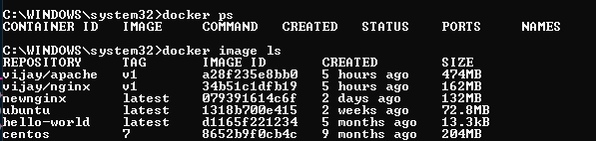
For client authentication, create a client key and certificate signing request:
perform this client end – scenario is based in windows 10
Copy ca.pem,cert.pem,key.pem to C:\Users\Sam\.docker
Set the environment variable in windows command prompt
set DOCKER_HOST=tcp://192.168.0.246:2376
set DOCKER_TLS_VERIFY=1
Perform docker image ls command it will display the remote server images

Slide 23
Daemon and client authentication mode
 | Daemon mode | Client mode
Authenticate clients | tlsverify, tlscacert, tlscert, tlskey
Do not authenticate clients | tls, tlscert, tlskey
Authentication public CA pool |  | tls
Authentication server based on given CA |  | tlsverify, tlscacert
Authenticate with client certificate |  | tls, tlscert, tlskey
Authenticate with client certificate + authenticate server based on given CA |  | tlsverify, tlscacert, tlscert, tlskey

Slide 24
Use SSH to protect the Docker daemon socket
windows
Linux
Create ssh-keygen in your windows machine
Copy C:\Users\Sam\.ssh copy public key text
Create user in linux machine using useradd docker1
Add user into docker group usermod –a –G docker docker1
and place under /home/docker1/.ssh/authorized_keys
Chmod 700 /home/docker1/.ssh
Chmod 600 /home/docker1/.ssh/authorized_keys

Slide 25
Use SSH to protect the Docker daemon socket
143.110.181.49
windows
Linux
Docker info
docker context create \
--docker host=ssh://docker1@143.110.181.49
--description="Remote engine"
my-remote-engine
It will execute the command on remote server
export DOCKER_HOST=ssh://docker1@143.110.181.49 <<= if you are using linux client
Set DOCKER_HOST=ssh://docker1@143.110.181.49 <<== if you are using the windows client

Slide 26
Configure persistent storage using volume
docker volume create myvol -d local
Docker volume ls <<= to list the volume
Create the container using persistent volume
docker container run -v myvol:/vijay -itd --name mynginx2 nginx
docker container exec -it mynginx2 /bin/bash <<= access the container verify the /vijay folder inside the container and create the file inside that directory
Now remove the container forcefully not remove the persistent volume data and the data is still available under /var/lib/docker/myvol/_data folder
The same value can be mounted to another container and the data will be available again
docker container run -v myvol:/data -itd --name nginx1 nginx

Slide 27
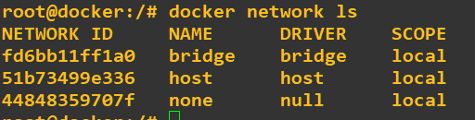
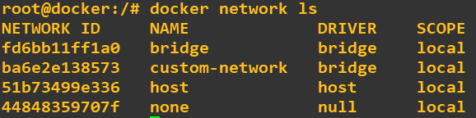
Configure the networking in the docker
docker network ls <<= to list the available network inside the directory
Three type of network bridge ,none,host
docker network create custom-network --driver bridge --subnet 192.168.4.10/24

Slide 28
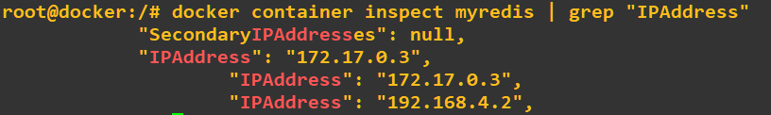
Container can be connect to different bridge
docker network connect custom-network myredis <<= container connect to custom-network bridge that we made in previous task
It will display the ip address for the both the bridge as we connect the myredis container to both the bridge network
docker network disconnect custom-network myredis <= to disconnect the from the custom-network

Slide 29
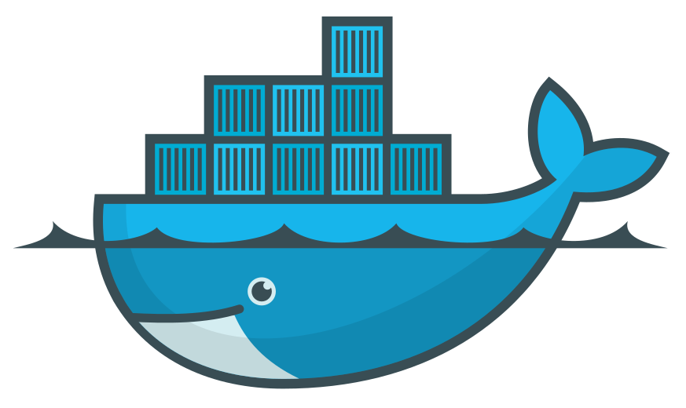
Docker Swarm
10.122.0.2
10.122.0.3
10.122.0.4
Manager1
Manager2
Manager3
etc/hosts
10.122.0.2 manager1
10.122.0.3 manager2
10.122.0.4 manager3
Install the docker on system using step >> https://docs.docker.com/engine/install/centos/
Systemctl enable docker.service & systemctl start docker.service

Slide 30
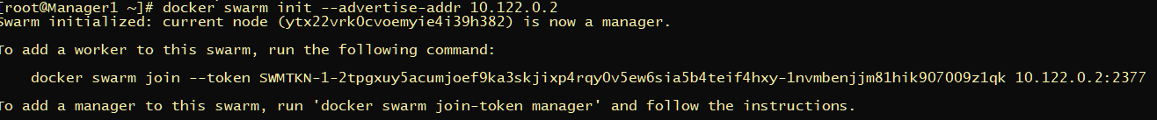
Docker Swarm
10.122.0.2
10.122.0.3
10.122.0.4
Manager1
Manager2
Manager3
docker swarm init
Use --advertise-addr if you have the multiple ethernet adapter active on system and you need to choose
among them

Slide 31
Docker Swarm
10.122.0.2
10.122.0.3
10.122.0.4
Manager1
Manager2
Manager3

Slide 32
Docker Swarm
10.122.0.2
10.122.0.3
10.122.0.4
Manager1
Manager2
Manager3

Slide 33
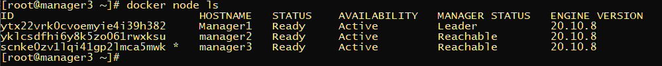
Docker Swarm
10.122.0.2
10.122.0.3
10.122.0.4
Manager1
Manager2
Manager3
all manager node listed in swarm * will display currently working node

Slide 34
Docker Swarm -cluster
10.122.0.2
10.122.0.3
10.122.0.4
Manager1
Manager2
Manager3
10.122.0.5
10.122.0.6
10.122.0.7
worker1
worker1
worker2

Slide 35
Docker Swarm worker node
10.122.0.5
10.122.0.6
10.122.0.7
worker1
worker1
worker2
etc/hosts
10.122.0.5 worker1
10.122.0.6 worker2
10.122.0.7 worker3

Slide 36
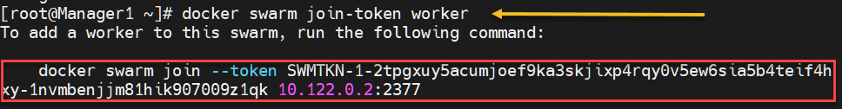
Docker Swarm -cluster
Manager1
10.122.0.2
10.122.0.5
10.122.0.7
10.122.0.6
worker1
worker3
worker2

Slide 37
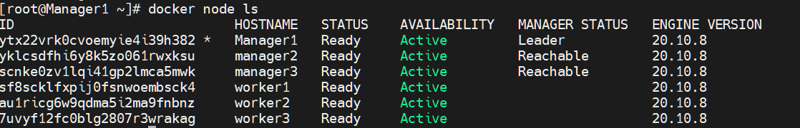
Docker Swarm status
Leader node is actively take the decision while other two manager node manager2 and manager3 take
Responsibilities if the manager1 experience any issue

Slide 38
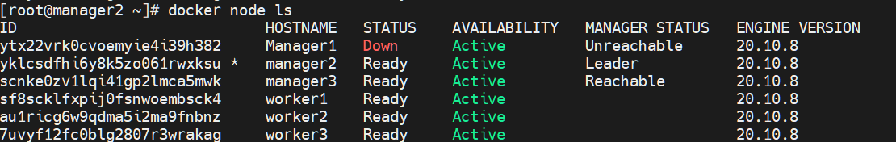
Stopping manager1 node to check quoroum
Perform systemctl stop docker on the manager1
It will show the manager1 node is down and unreachable so it automatically make the manager2 to leader

Slide 39
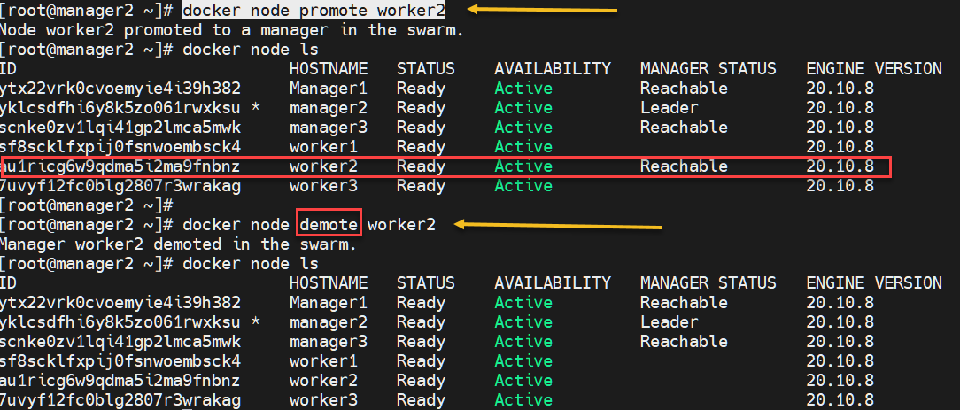
Promote worker node to leader
Worker node can be promoted and demoted to work as manager from swarm command line

Slide 40
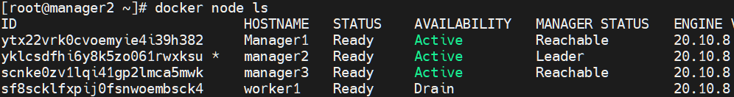
Docker node update
--availability drain | pause | active
docker node update --availability drain worker1 << use active to reverse the scenario
--label-add <<= add label to the nodes
docker node update --label-add env worker1
docker node inspect worker1 | grep env <<= verify the lable attached to node
docker node update --label-rm env worker1
--role << convert manager to worker and worker to manager
docker node update --role manager worker2

Slide 41

Leaving the swarm node
--availability drain | pause | active
docker node update --availability drain worker1 << use active to reverse the scenario
Execute the docker swarm leave on worker on

Slide 42
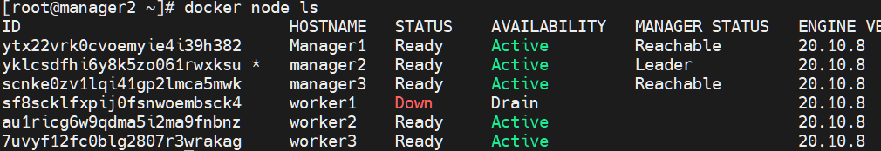
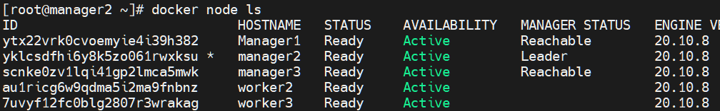
Docker node ls
docker node rm worker1

Slide 43
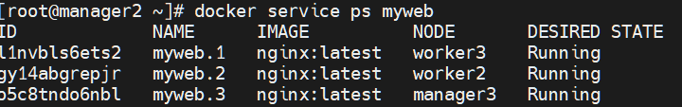
Docker service create and replicas
docker service create --replicas=3 --name=myweb -p 80:80 nginx
image
replicas
Service name
Host port
Container port
docker service update --replicas=1 myweb

Slide 44
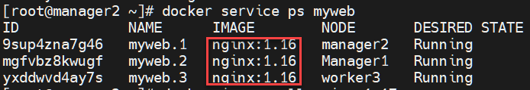
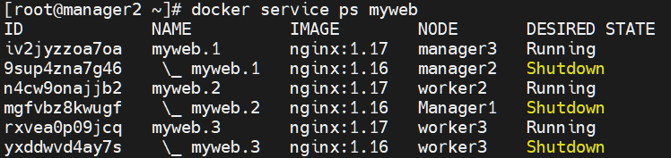
Docker service rolling updates
docker service create --replicas=3 --name=myweb -p 80:80 nginx:1.16
docker image pull nginx:1.17
docker service update --replicas=3 --image=nginx:1.17 myweb
docker service update --rollback myweb

Slide 45

Labels and constrains
docker node update --label-add type=cpu-optimized worker1
Assign label to worker node server as cpu-optimized node
docker service create --constraint=node.labels.type==cpu-optimized --name mytest nginx
Service automatically mapped with the worker1
Hence placement of the service can be configured according to labels that you give to worker node

Slide 46
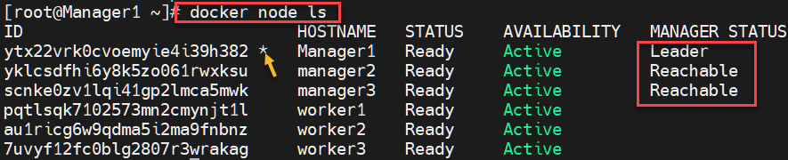
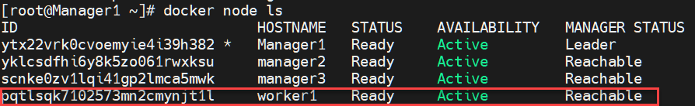
Docker node
docker node ls <<= display all the docker node including manager and worker
docker node promote worker1 <<= to promote the worker node to manager node

Slide 47
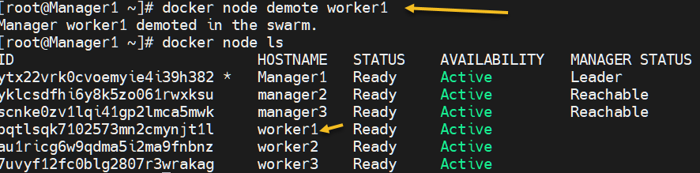
Docker node
docker node demote worker1 <<= demote the worker node from manager to worker
docker node inspect worker1 <<= to get the details information about the node
docker node ps worker1 | Manager 1<<= to find out the resources under worker or manager node

Slide 48
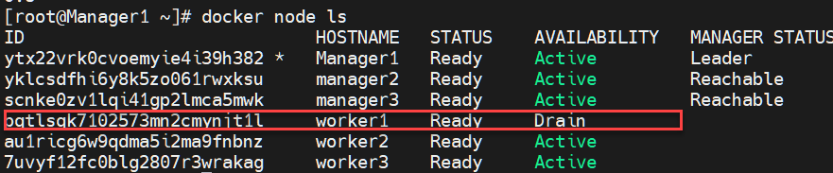


Docker node remove procedure
docker node update --availability drain worker1 <<= to drain the particular node
docker swarm leave from the worker node--availability drain worker1 <<= to drain the particular node
Docker rm | remove worker1 << = remove the worker node –f can be used for forceful action

Slide 49
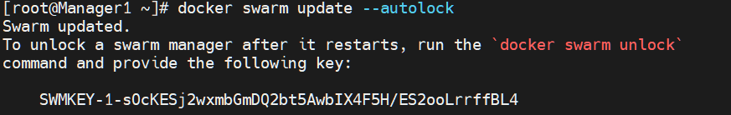
Docker swarm command
docker swarm join-token worker <== to create the token to join the worker node
Execute these on worker node
docker swarm join --token SWMTKN-1-2tpgxuy5acumjoef9ka3skjixp4rqy0v5ew6sia5b4teif4hxy-1nvmbenjjm81hik907009z1qk 10.122.0.2:2377
docker swarm update –autolock <== manager node locking mechanism
Store the key in the safe place

Slide 50

Docker swarm command
If the manager2 docker service restart then node will not participate again in swarm
Except we provide the unlock key to the manager node
docker swarm unlock to re-join the manager node

Slide 51
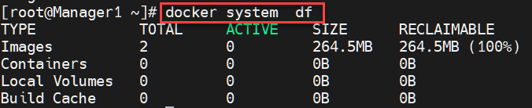
Docker system info
docker system info <<= display the information about the docker environment
Default logging driver is json-file ,
default runtime is runc
Default root dir /var/lib/docker
docker system df <<= display reclaimable size occupied by images

Slide 52
Docker system info
docker system events <<= display the information about the docker environment
docker system events --since 2021-08-17
docker system events --filter
docker system events –until
docker system events –format
docker system prune –a remove the all dangling images
docker system prune –volumes <== remove the all unused volume

Slide 53
Docker backup and disaster recovery
Back up the swarm
Docker manager nodes store the swarm state and manager logs in the /var/lib/docker/swarm/ directory. This data includes the keys used to encrypt the Raft logs. Without these keys, you cannot restore the swarm.
If the swarm has auto-lock enabled, you need the unlock key to restore the swarm from backup. Retrieve the unlock key if necessary and store it in a safe location
Stop Docker on the manager before backing up the data, so that no data is being changed during the backup.
Back up the entire /var/lib/docker/swarm directory.
Swarm backup consists Raft keys,membership,services,networks overlay,config,secrets swarm unlock key must be saved at different place

Slide 54
Docker backup and disaster recovery
Restore the swarm
Restore the /var/lib/docker/swarm directory with the contents of the backup.
Start Docker on the new node. Unlock the swarm if necessary.
Re-initialize the swarm using the following command
docker swarm init --force-new-cluster
You must use the same IP as the node from which you made the backup.

Slide 55
Docker backup and disaster recovery
Docker UCP backup
Backup should be restore on the same version of cluster.
More than one backup at a time is not supported
Ucp does not include swarm workloads
docker swarm init --force-new-cluster

Slide 56
Docker backup and disaster recovery
Docker UCP backup contents
Data | Baked Up
Configuration | yes
Access control | yes
Certificate and keys | yes
Metrics data | yes
Organization | Yes
Volume | Yes
Overlay network | No
Config,secrets | No
Service | No
Data | Baked Up
ucp-metrics-data: | no
ucp-node-certs | no
Routing mesh settings | no
Interlock L7 ingress configuration | no
Kubernetes declarative objects Pods, deployments, replicasets, configurations | Yes

Slide 57
DTR=MSR
DTR [ Digital trusted Repository ]
Feature
Image store platfom
Image and job management
Availibility
Efficiencey
Built-in access-control
Security scanning
Image signing
Amazon s3
Nfs
Cleversafe
Googlecloud storage
Openstack
Microsoft azure
https://docs.mirantis.com/msr/2.9/install/install-online.html

Slide 58
DTR=MSR
DTR [ Digital trusted Repository ]
DTR installed on worker node and for the high availabilities one more instance can be distributed across the node
Data | Baked Up
Configuration | yes
Repository metadata | yes
Access control to repos and images | yes
Notary data | yes
Scan results | Yes
Certification and keys | Yes
Image content | No
User,orgs.team | No
Vulnerability | No

Slide 59
Use volumes Volume
Volumes are the preferred mechanism for persisting data generated by and used by Docker containers. While bind mounts are dependent on the directory structure and OS of the host machine.
Volumes can be more safely shared among multiple containers.
Volume drivers let you store volumes on remote hosts or cloud providers, to encrypt the contents of volumes, or to add other functionality.
Differences between -v and --mount behavior
As opposed to bind mounts, all options for volumes are available for both --mount and -v flags.
When using volumes with services, only --mount is supported.

Slide 60
Domain 2: Image Creation, Management, and Registry

Slide 61
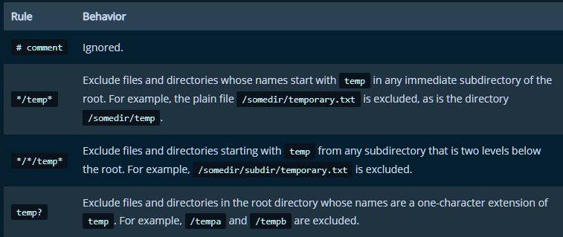
Domain 2: Image Creation, Management, and Registry
The docker build command builds an image from a Dockerfile and a context
Do not use root directory for build context
To increase the build’s performance, exclude files and directories by adding a .dockerignore file to the context directory

Slide 62
Domain 2: Image Creation, Management, and Registry
Use –f to specify the docker file location and user –t to assign the tag for docker file
The Docker daemon runs the instructions in the Dockerfile
. A Dockerfile must begin with a FROM instruction.

Slide 63
Docker Enterprise Edition installation
Visit the Url and register using business email https://www.mirantis.com/download/mirantis-cloud-native-platform/mirantis-kubernetes-engine/
Download the launchpad for client if you are trying to install the from windows to linux machine hosted on cloud platform
Linux client
UCP Linux Machine
DTR Linux Machine
Chmod +x launchpad
./launchpad register << fill the necessary details on prompt
./launchpad.exe init << initialize the configuration file

Slide 64
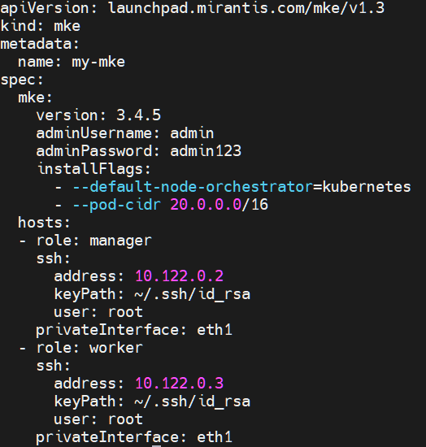
Docker Enterprise Edition installation
./launchpad init > launchpad.yaml
It will only generate the file but you need to make changes according to your environment
./Launchpad apply
Script will fail to join the worker node if your machine are not able to communicate with other vm hence you can manually setup the swarm cluster
Docker swarm leave –force << run in manger node
Docker swarm init --advertise-addr 10.122.0.2
Docker swarm join-token worker
Join the worker node using generated token
Then re- run ./launchpad apply

Slide 65
Docker Secrets –only available in swarm
MARS
Password
SSH Private Key
SSL Certificate
important data such as the name of a database or internal server
Generic strings or binary content (up to 500 kb in size)
What it can store
Secrets are encrypted during transits and at the rest in docker swarm
A given secret is only accessible to those services which have been granted explicit access to it, and only while those service tasks are running.
Secrets can be rotate by using update service command
Location of secret in windows container C:\ProgramData\Docker\secrets
Location of decrypted Secret in Linux containers : /run/secrets/<secret_name>

Slide 66
Docker Content Trust
Content trust gives you the ability to verify both the integrity and the publisher of all the data received from a registry over any channel
signatures allow client-side or runtime verification of the integrity and publisher of specific image tags.
Trust for an image tag is managed through the use of signing keys
A key set consists of the following classes of keys:
an offline key that is the root of DCT for an image tag
repository or tagging keys that sign tags
server-managed keys such as the timestamp key, which provides freshness security guarantees for your repository
Docker CLI we can sign and push a container image with the $ docker trust command
To sign a Docker Image you will need a delegation key pair. These keys can be generated locally using $ docker trust key generate or generated by a certificate authority

Slide 67
Domain 6: Storage and Volumes
Identify the correct graph drivers to uses with various operating systems
Describe and demonstrate how to configure devicemapper
Compare and contrast object and block storage and when they should be used
Describe how an application is composed of layers and where these layers reside on the filesystem
Describe how volumes are used with Docker for persistent storage
Identify the steps you would take to clean up unused images on a filesystem, also on DTR. (image prune, system prune and from DTR)
Demonstrate how storage can be used across cluster nodes, ex.
Describe how to provision persistent storage to a Kubernetes pod using persistentVolumes
Describe the relationship between container storage interface drivers, storageClass, persistentVolumeClaim and volume objects in Kubernetes

Slide 68
Domain 6: Storage and Volumes
Identify the correct graph drivers to uses with various operating systems
Feature | overlay2 | fuse-overlayfs | Btrfs/ZFS | aufs | Vfs | Devicemapper
Use Case/ feature | All platform | Rootless docker | snapshots | Support older os and Docker versiion | Testing purpose | Direct-lvm for production purpose
File Storage | Yes |  |  | Yes
Block Storage |  |  | Yes
File-system backing | Xfs ,ext4 | Any | Btrfs/zfs | Xfs ,ext4 | Any | Direct-lvm
Flaws |  |  | lot of memory.
Stability | Yes |  |  | Yes |  | yes

Slide 69
Domain 6: Storage and Volumes
OverlayFS storage driver
OverlayFS is a modern union filesystem
The overlay driver only works with two layers.
The overlay2 driver natively supports up to 128 lower OverlayFS layers
each image layer is implemented as its own directory under /var/lib/docker/overlay
Device Mapper storage
Device Mapper is a kernel-based framework
device mapper requires the lvm2 and device-mapper-persistent-data packages to be install
Loop-lvm is testing mode while direct-lvm is production mode
Use dm.directlvm_device in dameon.json file to configure the driver

Slide 70
Domain 6: Storage and Volumes
Btrfs storage driver
Btrfs is a next generation copy-on-write filesystem
btrfs requires a dedicated block storage device such as a physical disk
Btrfs provide the snapshot feature
ZFS storage driver
ZFS is a next generation filesystem that supports many advanced storage technologies such as volume management, snapshots, checksumming, compression and deduplication, replication and more.
ZFS is not supported on Docker EE or CS-Engine, or any other Linux platforms
Changing the storage driver makes any containers you have already created inaccessible on the local system

Slide 71
Port Information
Port 7946 TCP/UDP for container network discovery
Port 4789 UDP for the container ingress network
TCP port 2377 for cluster management communications

Slide 72
Differences between user-defined bridges and the default bridge
user-defined bridges
User-defined bridges provide automatic DNS resolution between containers
User-defined bridges provide better isolation.
Containers can be attached and detached from user-defined networks on the fly.
Each user-defined network creates a configurable bridge.
default bridge
Linked containers on the default bridge network share environment variables.
To configure the default bridge network, you specify options in daemon.json

