Slide 1

LIVE PLATFORM & HIGHLIGHTS
Live Website
dermo-scan-nesn.vercel.app
Open on any phone or laptop browser; free and live
AI HEALTHCARE INTERNSHIP PROJECT
DermoScan
Source Code
github.com/vijayesh26/Dermo-Scan-
Complete React and TypeScript source code
Smart Skin Check & Triage Assistant
Easy on the Eyes
Calm Medical Blue Design
No scary red alert meters; clean, easy-to-read cards
Upload a photo of a skin rash or problem and get instant, easy-to-understand AI guidance. Helps you understand what it might be and what safe steps to take before seeing a doctor.
Doctor Standards
Real ICD-10 Medical Codes
Uses standard medical codes used by doctors worldwide
Student: Bhumireddy.Vijayesh Vardhan Reddy
University Roll Number: 72312924
Course: B.Tech in Computer Science and Engineering (AI & DS)
University: CT University, Ludhiana (Punjab), India
Organization: Data Valley Pvt. Ltd. (in collaboration with APSCHE)
Guides: Shaik. Arshad (Data Valley) | Er. Rohit Kumar (CT University)
100% Private
Your Photos Are Never Saved
Everything stays in your device memory; zero cloud storage

Slide 2
DERMOSCAN AI ASSISTANT
The Problem: Getting skin rashes checked is slow and confusing
Skin problems are very common, but getting the right help quickly is surprisingly difficult.
01
02
03
04
Long Doctor Wait Times
Waiting 1 to 3 Months
Specialist skin doctors are few and far between. People often wait weeks just for a 5-minute appointment, while rashes get worse.
Rashes Look Very Similar
Hard to Tell Apart
Psoriasis, eczema, allergies, and ringworm often look almost identical to normal people and general doctors in early stages.
Wrong Creams Used
Dangerous Self-Treatment
Many people buy strong steroid creams from pharmacies for fungal infections. This makes the fungus grow much deeper into the skin.
Harder on Darker Skin
Redness Gets Hidden
Most medical textbooks only show white skin. Redness is hard to see on brown or dark skin, leading to missed or delayed diagnosis.
The Result: People panic, try the wrong creams at home, and crowd hospitals for minor issues that could be easily managed.

Slide 3
DERMOSCAN AI ASSISTANT
The Solution: Fast, simple skin checks in 4 easy steps
DermoScan gives anyone quick, safe guidance and home-care advice in seconds.
1
2
3
4
Take & Upload Photo
Step 1: Simple Photo
Take a clear photo of the skin rash using your smartphone or upload any picture. Big camera photos are resized automatically so it runs fast.
Add Quick Details
Step 2: Basic Info
Tell the system where the rash is (e.g. elbow, face, hand), how long you have had it, and if it feels itchy, burning, or painful.
Smart AI Checks It
Step 3: Instant Analysis
Smart artificial intelligence looks at the color, edges, surface texture, and rash pattern to see what condition it matches best.
Get a Clear Report
Step 4: Helpful Guidance
See the most likely condition with a simple percentage match, safe home-care tips (like moisturizing), and what to avoid.
The Goal: Less confusion. Safe home-care tips. Knowing immediately when you need to see a doctor in person.

Slide 4
DERMOSCAN AI ASSISTANT
Three Core Parts of the DermoScan System
Designed to be simple for anyone to use, helpful for clinicians, and completely private.
1. Easy Photo & Details Intake
Collects what is needed in seconds
2. Smart AI Results Dossier
Clear, understandable findings
3. Complete Safety & Privacy
Keeps your data safe & private
• Drag and drop any picture (JPG, PNG, WebP) from phone or laptop
• Automatically resizes large photos so it works fast even on slow 4G
• 16 simple body spots to pick from (elbow, face, scalp, hands, etc.)
• Tap buttons to say if it feels itchy, burning, painful, or tender
• Simple timeline choices: less than 1 week, 1-4 weeks, or months
• Calibrated for all skin tones from light to dark
• Identifies conditions clearly (Psoriasis, Eczema, Ringworm, etc.)
• Shows a friendly match score (e.g. 89% match) in calm blue
• Breaks down the rash into 4 simple signs: shape, color, edges, spot
• Lists other possible conditions just in case (differential diagnosis)
• Gives clear, safe self-care tips (e.g. which moisturizer to use)
• Warns against using wrong creams (e.g. don't put steroids on fungus)
• Your photos are NEVER saved to any online server (100% private)
• Keeps a scan history only on your own screen while you use it
• One-click to re-open any past scan from your current session
• Rejects blurry photos or non-skin pictures automatically
• Warns immediately if a rash looks like an emergency (e.g. Cellulitis)
• Clear reminder that it is an assistant, not a final doctor prescription

Slide 5
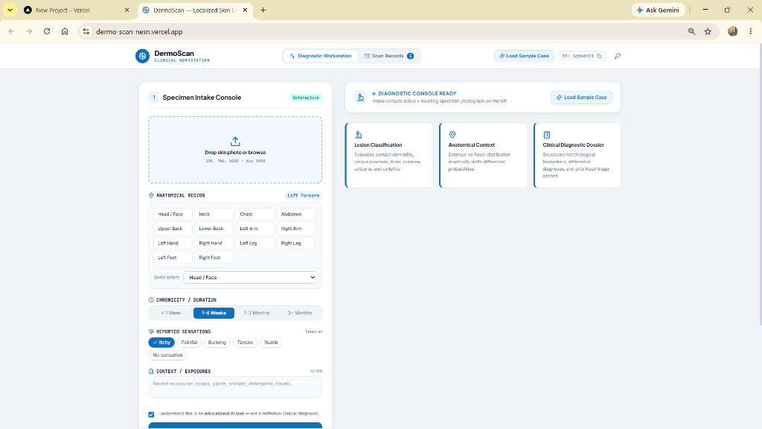
DERMOSCAN AI ASSISTANT
Live App: Uploading a photo & entering details
A clean, simple screen where anyone can add their photo and describe how they feel.
1. Upload Box
Drag any skin photo here or tap to choose from your phone gallery. See a live preview immediately.
2. Body Spot Dropdown
Easily pick where the rash is located from a list of 16 common spots (like elbow, knee, or face).
3. Sensation Buttons
Tap quick buttons to select feelings: Itchy, Painful, Burning, Tender, or Numb.
4. Run Scan Button
Click 'Run Diagnostic Scan' and the AI starts analyzing. Takes less than a second to finish.
Photo 1: Live Intake Screen at dermo-scan-nesn.vercel.app

Slide 6
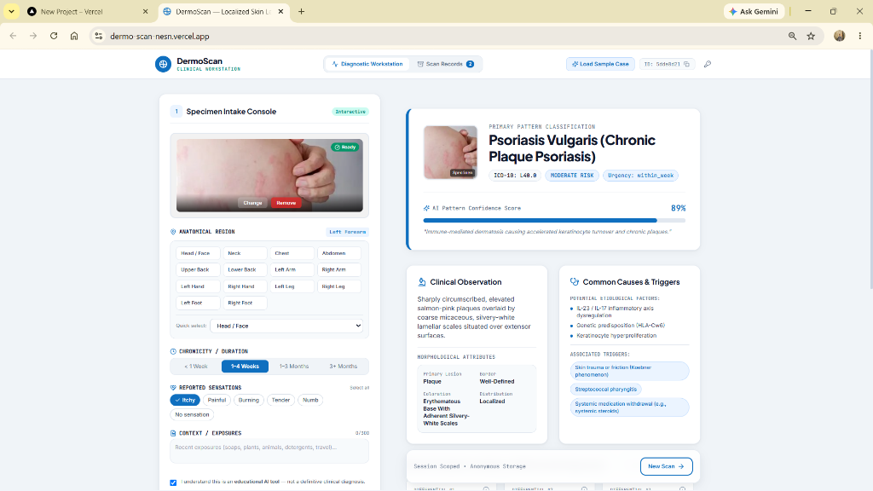
DERMOSCAN AI ASSISTANT
Live App: Clear AI results and safe next steps
A sample result showing an 89% match for Psoriasis with clear explanations.
1. Clear Name & Code
Clearly names the condition: 'Psoriasis Vulgaris' with its official medical code (L40.0).
2. Simple Match Percentage
Shows '89% AI Pattern Confidence' using a calm blue bar instead of stressful red warning bars.
3. 4-Point Explanation
Breaks down what it saw: raised red plaques, silvery white scales, sharp edges, on outside elbows.
4. What To Do & What To Avoid
Recommends gentle moisturizers and warns against misusing steroid creams before a doctor check.
Photo 2: Live Results Screen showing Psoriasis Vulgaris detected with 89% AI match.

Slide 7
DERMOSCAN AI ASSISTANT
How the AI looks at skin: 4 Key Visual Signs
Instead of a mysterious black box, DermoScan explains its thinking using 4 basic signs.
SIGN 1
SIGN 2
What type of bump or rash is it?
Looks at the surface: Is it a raised thick patch (plaque), a flat red spot (macule), or small water blisters (vesicles)?
• Why it matters: Tells apart raised psoriasis from flat allergies and small fluid blisters.
What color is the skin?
Looks at the color: Is it salmon-pink, deep purple, brown, or pale with white silvery skin on top?
• Why it matters: Shows how irritated the skin is and helps diagnose properly on brown and dark skin tones.
SIGN 3
SIGN 4
Are the edges sharp or blurry?
Looks at the borders: Are the edges sharp and clean, or are they blurry and fading into normal skin?
• Why it matters: Psoriasis almost always has sharp borders; eczema usually has blurry, fading edges.
Where is it located on the body?
Looks at the spot: Is it on outer joints (elbows, knees), or inside folds (armpits, neck, behind knees)?
• Why it matters: Outer joints usually mean psoriasis; inner folds usually mean atopic eczema.

Slide 8
DERMOSCAN AI ASSISTANT
Common Skin Conditions DermoScan Can Identify
Uses the same international medical codes (ICD-10) used by hospitals and clinics.
L40.0
Plaque Psoriasis (Very Common)
Common spot: Elbows, knees, scalp
Signs: Red raised patches with silvery flaking scales that bleed if peeled.
L20.9
Atopic Eczema (Very Common)
Common spot: Inside elbows, behind knees
Signs: Very itchy, dry, rough skin that flares up with weather or dust.
L30.1
Hand & Foot Blisters (Pompholyx) (Common)
Common spot: Sides of fingers, palms, soles
Signs: Tiny, deep-set itchy water blisters that burst and peel.
B35.9
Ringworm / Fungal Infection (Fungal Issue)
Common spot: Body skin, groins, feet
Signs: Circular ring rash with an active scaly border and clear skin in center.
L71.0
Rosacea (Facial Redness) (Chronic)
Common spot: Cheeks, nose, forehead
Signs: Persistent redness on the face with visible tiny blood vessels.
L03.9
Cellulitis (Severe Infection!) (Emergency!)
Common spot: Legs, feet, or arms
Signs: Fast-spreading red, hot, swollen skin with fever. Emergency hospital visit!
Why medical codes matter: Having standard ICD-10 codes makes it easy to share results with any clinic or doctor.

Slide 9
DERMOSCAN AI ASSISTANT
How DermoScan Works Behind the Scenes
A simple 5-step journey from your photo to your private health report.
01
02
03
04
05
1. You Upload
Your Browser
Open the website on phone or laptop and upload your photo.
2. Auto-Resize
Fast Scaling
Browser quickly downsizes big 15MB photos so it loads fast.
3. AI Scan
Vision Analysis
Smart AI checks skin color, shape, border edges, and location.
4. Safety Rules
Medical Guardrails
Double-checks against medical rules and scans for emergencies.
5. Your Report
On-Screen Only
Shows clear results on screen. Nothing is saved online!
Our 100% Privacy Promise
Your skin photo is processed right inside your device's memory. No photos, personal names, or medical records are ever saved on our servers or sold to advertisers. You are completely in control.

Slide 10
DERMOSCAN AI ASSISTANT
Modern Tools Built for Speed and Simplicity
Built with the latest reliable web tools so it runs smoothly on any smartphone or computer.
Super Fast (Under 1 Second)
Resizing images right on your device reduces file size from 15MB to under 250KB, making scans almost instant.
React 18
Builds a smooth, interactive website with zero page reloads
TypeScript 5.7
Prevents bugs and ensures all medical data is handled correctly
Calm Medical Blue Design
We purposely removed harsh red and yellow warning lights to reduce patient anxiety and make it easy to read.
Vite 6
Ultra-fast modern development tool for instant loading
Tailwind CSS
Creates a clean, simple look that adjusts to any screen size
Works on Phones and Laptops
Whether you open it on an Android phone, iPhone, tablet, or PC, the layout adjusts automatically.
HTML5 Canvas
Resizes heavy phone photos directly inside the browser
Lucide Icons
Clear, friendly medical and navigation icons
Reliable Even Offline
Has built-in fallback rules so the triage system keeps working even if the internet connection is weak.
Vercel Hosting
Hosts the app online so anyone in the world can access it for free

Slide 11
DERMOSCAN AI ASSISTANT
Safety First: Clear Rules and Ethical Safeguards
DermoScan is built to assist and guide, never to replace your doctor.
S1
S2
S3
S4
Helper, Not a Doctor
Always See a Doctor
It gives helpful guidance and information, but always reminds users that only a licensed doctor can give a final medical diagnosis.
Rejects Blurry Photos
Quality Image Check
If a photo is too blurry, too dark, or doesn't show skin, it asks you to take a clearer photo instead of guessing blindly.
Emergency Alerts
Fast Emergency Warning
If signs indicate a fast-spreading severe infection (like Cellulitis), it displays an immediate warning to visit a hospital.
Stops Wrong Cream Misuse
Prevents Self-Harm
Explicitly warns against applying steroid creams to ringworm or fungal infections, preventing dangerous skin damage.
Golden Rule: DermoScan is a helpful guide. Never start prescription medicine without seeing a doctor first.

Slide 12
DERMOSCAN AI ASSISTANT
Problems We Faced and How We Solved Them
Every real project faces challenges. Here is how we tackled each one simply and smartly.
Challenge 1: Big phone photos were too slow to upload
Modern smartphones take 15MB photos. Uploading them on slow mobile connections took forever and caused errors.
Solution: Auto-Resize Inside Browser
We added browser-based resizing that shrinks the photo to a lightweight size in milliseconds before sending.
Challenge 2: Red warning meters scare patients
Traditional healthcare apps use bright red, yellow, and green meters that make users panic unnecessarily.
Solution: Calm Medical Blue Theme
We switched to a clean, calm medical blue (#0F6FBF) palette that shows facts clearly without causing alarm.
Challenge 3: AI models sometimes return messy text
AI models sometimes add extra symbols or unpredictable wording instead of clean structured answers.
Solution: Smart Text Cleaning Filters
We wrote automated filters that clean the AI answer and format it neatly into the exact same boxes every time.
Challenge 4: Redness is hard to see on brown skin
Red skin rashes do not show up brightly on darker Indian and African skin tones, confusing visual-only AI.
Solution: Asking Questions About Symptoms
We asked patients where it is, how long they have had it, and how it feels, so the AI doesn't rely on color alone.

Slide 13
DERMOSCAN AI ASSISTANT
What Comes Next & Project Conclusion
Future improvements to make skin checks accessible to everyone across India.
Offline Mobile App
A lightweight phone app that works completely offline without any internet connection.
Better Indian Skin Calibration
Special color tuning to better detect rashes on brown and deeper skin tones.
Direct Hospital PDF Export
Download a 1-page PDF summary to show directly to your clinic or family doctor.
Pocket Lens Support
Support for low-cost dermatoscope magnifying lenses attached to phone cameras.
Indian Regional Languages
Add support for Hindi, Telugu, Punjabi, and other regional languages.
1-Click Doctor Consultation
An easy button to connect with an on-call skin specialist if you need a quick chat.
Thank You! — DermoScan Smart Skin Check Assistant
• Try Live App: https://dermo-scan-nesn.vercel.app/ | • Code on GitHub: https://github.com/vijayesh26/Dermo-Scan-
Developed by Bhumireddy.Vijayesh Vardhan Reddy (Roll No: 72312924) • B.Tech CSE (AI & DS)
Department of Computer Science & Engineering, CT University, Ludhiana | Data Valley Pvt. Ltd.
Academic Notice: DermoScan is an educational and guidance assistant. Always see a certified doctor for real skin treatments.

