Slide 1
Reinforcement Learning
A type of dynamic programming that trains algorithms using a system of reward and punishment.

Slide 2
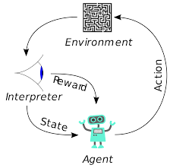
Reinforcement learning is an area of machine learning concerned with how software agents ought to take actions in an environment to maximize some notion of cumulative reward.
Environment: The context in which the algorithms will run.
Agent :Something which interacts with our environment.
Action: The steps that can be taken by the agent at any state.
State: The information used to determine what happens next.
Reward: Allow RF to conclude instead of arriving at a prediction.
Policy: Agent's strategy

Slide 3
MAB: Multi Armed Bandit Problem
optimal resource allocation under uncertainty
Problem Statement
Machine is characterized by the pair of random sequences ({ X(0), X(1),..., } ,R( X(0), X(1),... )} , where X(n) denotes the state of the machine1 after it has been operated n times, and R(X(n)) denotes the reward obtained when the machine is operated for the nth time.
X(n) = f_{n−1} (X(0),...,X(n − 1)) ,
Most efficiently identify the best machine to play, whilst sufficiently exploring the many options in real time?

Slide 4
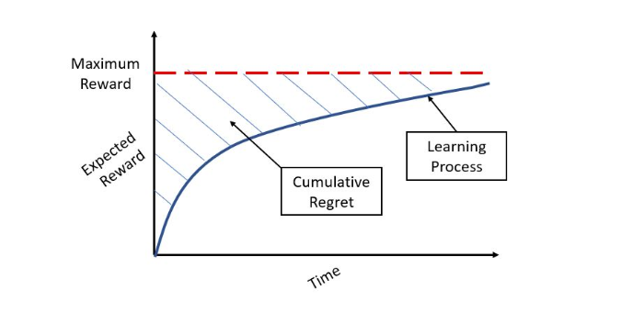
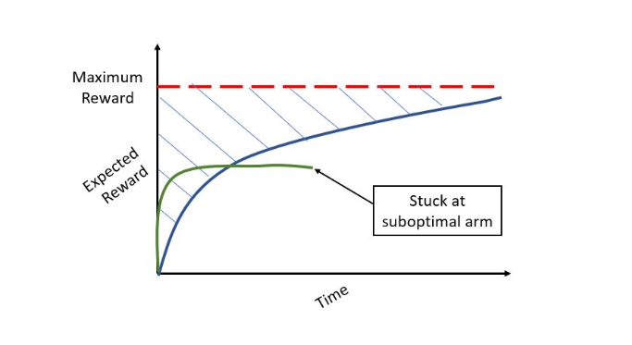
Regret Difference between maximum reward and reward obtained following the algorithm.

Slide 5
A/B Tests
directing a percentage of traffic across each of the variants.
performing statistical tests to identify which variant is the best.
Limitations
fails when there are many variations.
Opportunity Cost Is high.
Opportunity Cost: what did Investor miss out on by putting my money into investment A rather than that investment B?

Slide 6
Exploration-Exploitation Tradeoff
Balance between sufficiently exploring the variant space and exploiting the optimal action.
you also want to continue to explore other feasible variants in case they provide better returns in the future.
continuing to experiment (a little) with sub-optimal variants if their payouts change. If they do, our algorithm should pick up on the change and will begin selecting this variant for new customers.

Slide 7

Gamma Distribution
A two-parameter family of continuous probability distribution.
With a shape parameter k and a scale parameter θ.
With a shape parameter α = k and an inverse scale parameter β = 1/θ, called a rate parameter.
Mean = α/ β
Variance = α/ β²

Slide 8
Approach 1 : Epsilon(e)-Greedy
After an initial period of exploration (for example 1000 trials), the algorithm greedily exploits the best option k, e percent of the time.
Limitation
under explore the variant space before exploiting.

Slide 9
Approach 2 :Thompson Sampling
This is not a greedy search method.
Exploration is more complex.
It is Bayesian
Approach
Set a uniform prior distribution between 0 and 1 for each variant k’s payout rate.
Draw a parameter theta from each k's posterior distribution.
Select the variant k that is associated with the highest parameter theta.
Observe the reward and update the distribution parameters.
Posterior Distribution = Prior Distribution + Likelihood Function (“new evidence”)

Slide 10
Approach 3 UCB (Upper Confidence Bound)

Slide 11
Dynamic Pricing For Hotel Room Booking
MAB is analogy for a common problem that organizations face all the time, that is, how to identify the best message to present to customers (message is broadly defined here i.e. webpages, advertising, images, price) such that it maximizes some business objective (e.g. clickthrough rate, signups, revenue).

