Slide 1

Dynamic pricing using Reinforcement Learning

Slide 2
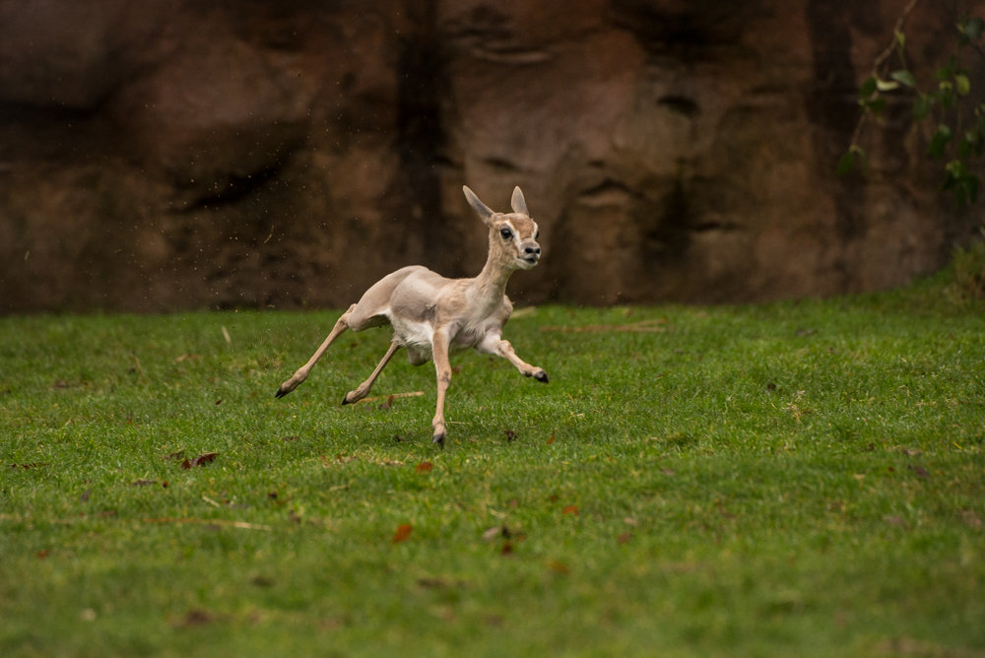
"A gazelle calf struggles to its feet minutes after being born. Half an hour later it is running at 20 miles per hour." - Sutton and Barto

Slide 3
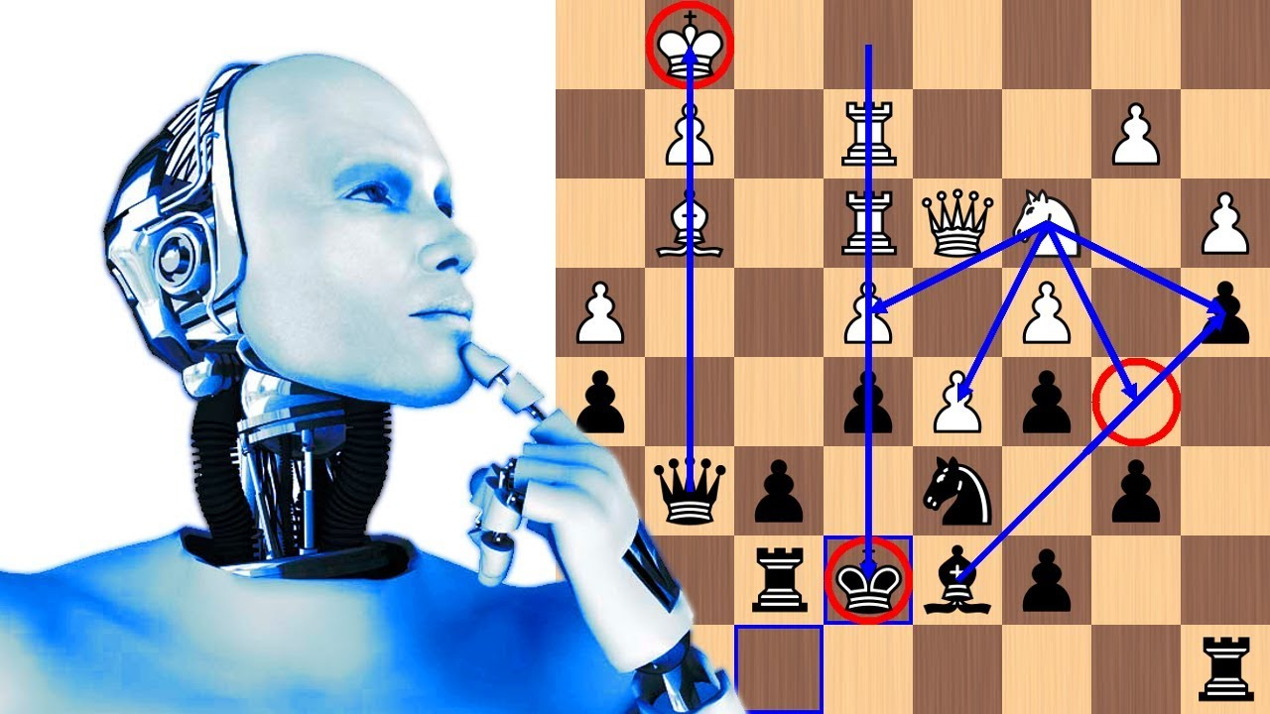
“We have been playing this game for over 600 years, and all it takes for it is four hours”
- Vishy Anand

Slide 4
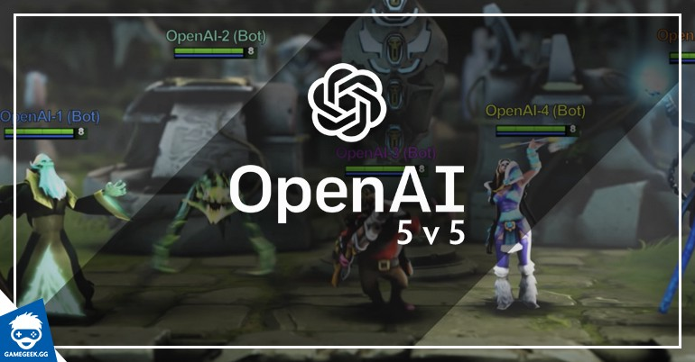

Slide 5
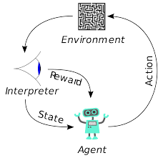
Reinforcement learning is an area of machine learning concerned with how software agents ought to take actions in an environment to maximize some notion of cumulative reward.
Environment: The context in which the algorithms will run.
Agent :Something which interacts with our environment.
Action: The steps that can be taken by the agent at any state.
State: The information used to determine what happens next.
Reward: Allow RF to conclude instead of arriving at a prediction.
Policy: Agent's strategy

Slide 6
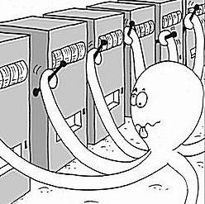
MAB: Multi Armed Bandit Problem
optimal resource allocation under uncertainty
Problem Statement
* Given N different arms to choose from, each with an unknown reward, what strategy should we use to explore and learn the values of each arm, while exploiting our current knowledge to maximize profit?
* This is a very common approach for optimizing online marketing campaigns.
* This can be thought of as a single-state reinforcement learning problem
Most efficiently identify the best machine to play, whilst sufficiently exploring the many options in real time?
MAB is analogy for a common problem that organizations face all the time, that is, how to identify the best message to present to customers (message is broadly defined here i.e. webpages, advertising, images, price) such that it maximizes some business objective (e.g. clickthrough rate, signups, revenue).

Slide 7
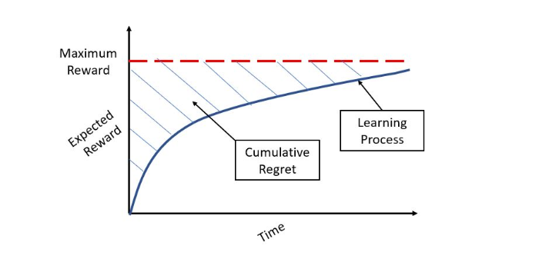
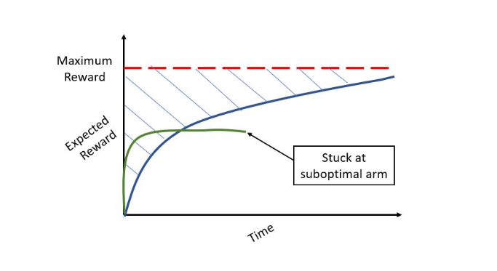
Regret
Difference between maximum reward and reward obtained following the algorithm.

Slide 8
A/B Tests
directing a percentage of traffic across each of the variants.
performing statistical tests to identify which variant is the best.
Limitations
Fails when there are many variations.
Opportunity Cost Is high.
Opportunity Cost: what did I miss out on by putting my money into investment A rather than that investment B?

Slide 9
Exploration-Exploitation Tradeoff
Balance between sufficiently exploring the variant space and exploiting the optimal action.
you also want to continue to explore other feasible variants in case they provide better returns in the future.
Continuing to experiment (a little) with sub-optimal variants if their payouts change. If they do, your algorithm will pick up on the change and will begin selecting this variant for new customers.

Slide 10
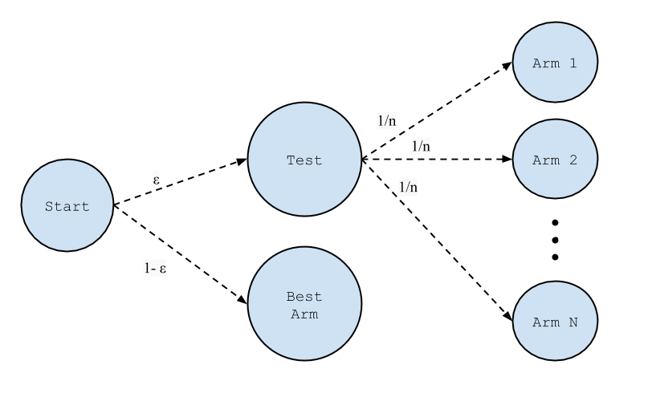
Epsilon(e)-Greedy
After an initial period of exploration (for example 1000 trials), the algorithm greedily exploits the best option k, e percent of the time.
Limitation
under explore the variant space before exploiting.

Slide 11
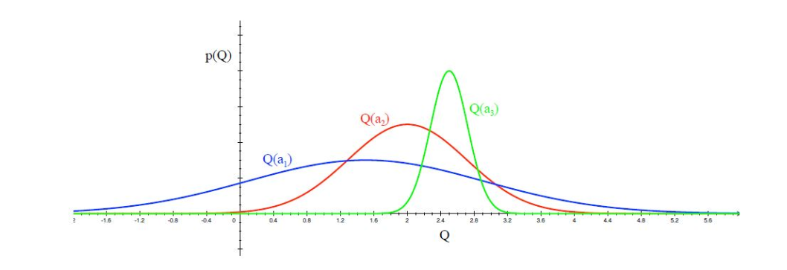
UCB (Upper Confidence Bound)
Optimize in the face of uncertainty.(more uncertain more explore)
Choose a1 until variance reduces to certain threshold.

Slide 12

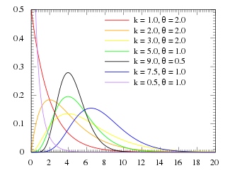
Gamma Distribution
A two-parameter family of continuous probability distribution.
With a shape parameter k and a scale parameter θ.
With a shape parameter α = k and an inverse scale parameter β = 1/θ, called a rate parameter.
Mean = α/ β
Variance = α/ β²

Slide 13
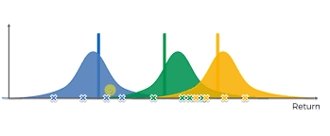
Thompson Sampling
Approach
Set a uniform prior distribution between 0 and 1 for each variant k’s payout rate.
Draw a parameter theta from each k's posterior distribution.
Select the variant k that is associated with the highest parameter theta.
Observe the reward and update the distribution parameters.
Posterior Distribution = Prior Distribution + Likelihood Function (“new evidence”)
This is not a greedy search method.
Exploration is more complex.
It is Bayesian

Slide 14

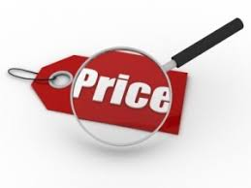




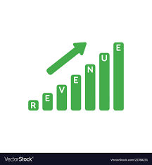

Dynamic pricing for hotel rooms with Reinforcement Learning
Reinforcement learning algorithm to maximize revenue
Business background
Solution
Business Benefits
Chooses price based on previous experience
Maximize Revenue
Automatic price setting
Pricing
Agent
Returns actual demand as reward for chosen price
Environment - Hotel
Usage with little or no data
Find optimal daily price for rooms to
maximize revenue
Bayesian Reinforcement Learning
Benefits and features
Increased revenue shown even in shorter term period during validation (around 10% increase in revenue)
Flexible. Can be modelled for weekday/weekend and seasonality
Can work with less/no data
Customers can book the room of their choice through different agents
Customers are given three different meal types to choose from
The hotel has assortment of rooms varying in prices
Find the optimal price for hotel’s rooms daily to realize the maximum revenue
The algorithm explores prices above and below the base price. It sets priors for these prices
Best price picked based on learnings from historical data and offered to the customers
Then actual demand is observed, and priors are updated. The actual demand acts as reward
This cycle continues and model learns to set the price everyday to gain maximum revenue

Slide 15
Technical details
Objective: To find the daily price(s) that maximizes revenue for the hotel rooms
For a given Day, Agent, Room and Meal type fix a price
Set price exploration range above and below this price
For each price, let demand distributions be gamma distribution.
alpha = demand, beta =1, mean = demand
For a given date,
Sample demand from each of the gamma distribution associated with the prices.
Find optimal price so that we maximize the Revenue => Price x Demand. Observe the actual demand
Update the alpha, beta parameters
Alpha = Alpha + Obs demand
Beta +=1
RL with Thompon’s sampling
Price Regression model
Two stage Demand model
1
Classifier – presence of demand (0 or 1)
Simulators
Features
Room type
Agent
Meal
Exogenous- Day related
Features
Room type
Agent
Meal
Price
Exogenous- Day related
Simulators
2
Regressor - Demand predictor

