Slide 1
Chapter 3
Language Basic

Slide 2
Language Basic
Comments
Variable
Operators

Slide 3
Comments

Slide 4
Comment
Java supports following type of comments
Single line comment
E.g. // This is test
Multi-line comment
E.g. /* This is test */
Java Doc comment
E.g. /** Class, Method or vairable document comment */

Slide 5
Variables

Slide 6
Variable
Why?
E.g.:
int speed = 0;
int gear = 1;
String name = “MyName”;

Slide 7
Variable Names
Case-sensitive
number and NUMBER are not same

Slide 8
Variable Names
Variables Name Rules:
Can begin with a letter, $ or _.
Can not start with number
Subsequent characters may be letters, digits, $, or _
White space is not permitted

Slide 9
Variable Names
Variable naming convention:
For constants use all uppercase with underscore character as separator
Do no use $ in var name
Do not start var name with _
Use camel case for variable name
Parameter always start with a prefix
Use “this” prefix for instance variable.

Slide 10
Variables Example
int numberOfStudents;
float PI_VALUE = 3.14;
int add (int aFirstNumber, int aSecondNumber) {
return aFirstNumber + aSecondNumber - this.index; }
String NULL_VALUE = null;

Slide 11
Data Types

Slide 12
Data Type
Primitive Data Types
Object Data Type

Slide 13
Primitive Data Types
byte: The byte data type is an 8-bit signed two's complement integer. It has a minimum value of -128 and a maximum value of 127 (inclusive).
short: The short data type is a 16-bit signed two's complement integer. It has a minimum value of -32,768 and a maximum value of 32,767 (inclusive).
int: The int data type is a 32-bit signed two's complement integer. It has a minimum value of -2,147,483,648 and a maximum value of 2,147,483,647 (inclusive).
long: The long data type is a 64-bit signed two's complement integer. It has a minimum value of -9,223,372,036,854,775,808 and a maximum value of 9,223,372,036,854,775,807 (inclusive).

Slide 14
Primitive Data Types
float: The float data type is a single-precision 32-bit IEEE 754 floating point. This data type should never be used for precise values, such as currency. For that, you will need to use the java.math.BigDecimal class instead.
double: The double data type is a double-precision 64-bit IEEE 754 floating point.For decimal values, this data type is generally the default choice. As mentioned above, this data type should never be used for precise values, such as currency.
boolean: The boolean data type has only two possible values: true and false. Use this data type for simple flags that track true/false conditions.
char: The char data type is a single 16-bit Unicode character. It has a minimum value of '\u0000' (or 0) and a maximum value of '\uffff' (or 65,535 nclusive).

Slide 15
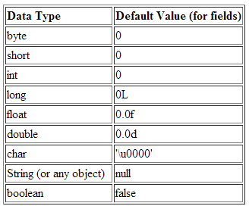
Default Value

Slide 16
Literals
boolean result = true;
char capitalC = 'C';
byte b = 100;
short s = 100;
int i = 100000;
// The number 26, in hexadecimal
int hexVal = 0x1a;
// The number 26, in binary
int binVal = 0b11010;
double d1 = 123.4;
// same value as d1, but in scientific notation
double d2 = 1.234e2;
float f1 = 123.4f;
long creditCardNumber = 1234_5678_9012_3456L;
float pi = 3.14_15F;
long hexBytes = 0xFF_EC_DE_5E;
long hexWords = 0xCAFE_BABE;

Slide 17
Quiz
Which of the following is not a valid comment:
a. /** comment */ b. /* comment */ c. /* comment d. // comment

Slide 18
String
String is special class in java
This is not a primitive data type
This is a class
String has many utility methods like
toLower
trim
toUpper
isEmpty

Slide 19
Operators

Slide 20
Operators
Operators are special symbols that perform specific operations on one, two, or three operands, and then return a result.
Operators with higher precedence are evaluated before operators with relatively lower precedence.
All binary operators except for the assignment operators are evaluated from left to right; assignment operators are evaluated right to left.

Slide 21
Operators
Simple Assignment Operator
= Simple assignment operator
E.g.:
numberOfPizza = 3;

Slide 22
Operators
Arithmetic Operators
+ Additive operator (also used for String concatenation)
- Subtraction operator
* Multiplication operator
/ Division operator
% Remainder operator
E.g.:
total = number1 + number2;
diff = number1 – number2;

Slide 23
Operators
Unary Operators
+ Unary plus operator; indicates positive value (numbers are
positive without this, however)
- Unary minus operator; negates an expression
++ Increment operator; increments a value by 1
-- Decrement operator; decrements a value by 1
! Logical complement operator; inverts the value of a Boolean
E.g.:
number1 = 10;
number1++;
largeNumer = true;
smallNumber = ! largeNumer

Slide 24
Quiz
What will be the output following:
int number1 = 10;
System.out.println(“Number “ + number1);
number1++;
System.out.println(“Number “ + number1);
number1--;
System.out.println(“Number “ + number1);
System.out.println(“Number “ + ++number1);
System.out.println(“Number “ + number1++);

Slide 25
Operators
Equality and Relational Operators
== Equal to
!= Not equal to
> Greater than
>= Greater than or equal to
< Less than
<= Less than or equal to
E.g:
number1 = 10; number2= 20;
areNumberEqual = (number1 == number2);
greater = number1 > number2

Slide 26
Operators
Conditional Operators
&& Conditional-AND
|| Conditional-OR
?: Ternary (shorthand for if-then-else statement)
E.g.:
allNumberMoreThan100 = num1 > 100 && num2 > 100
atleastOneNumberMoreThan100 = num1 > 100 || num2 > 100
maxNumber = num1 > num2 ? num1 : num2;

Slide 27
Operators
Type Comparison Operator
instanceof Compares an object to a specified type
Bitwise and Bit Shift Operators
~ Unary bitwise complement
<< Signed left shift
>> Signed right shift
>>> Unsigned right shift
& Bitwise AND
^ Bitwise exclusive OR
| Bitwise inclusive OR

Slide 28
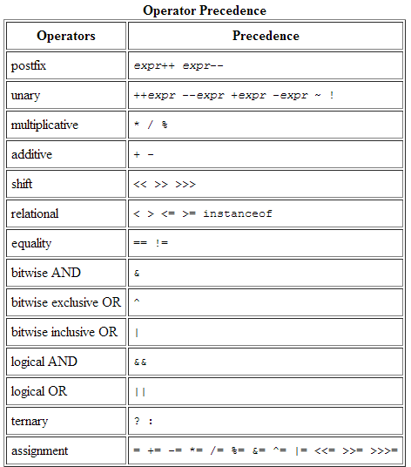
Operator Precedence

Slide 29
Equals
= operator works on primitive data type
= Operator doesn’t work on class data type
Use “equals” method to compare 2 objects
E.g.
5 = 5 returns true
String name1 = “Vijay”
String name2 = “Vijay”
name1 == name2 returns false

Slide 30
Quiz
Which one is valid method definition:
a. Public static void main () {}
b. public static void main ()
c. public static void main () {}
d. public static main (String[] args) {}

Slide 31
Thanks!
Any questions?
You can find me at:
vijay_garry@hotmail.com
https://github.com/vijaygarry

