Slide 1
Java Training
20-Jun-2021

Slide 2
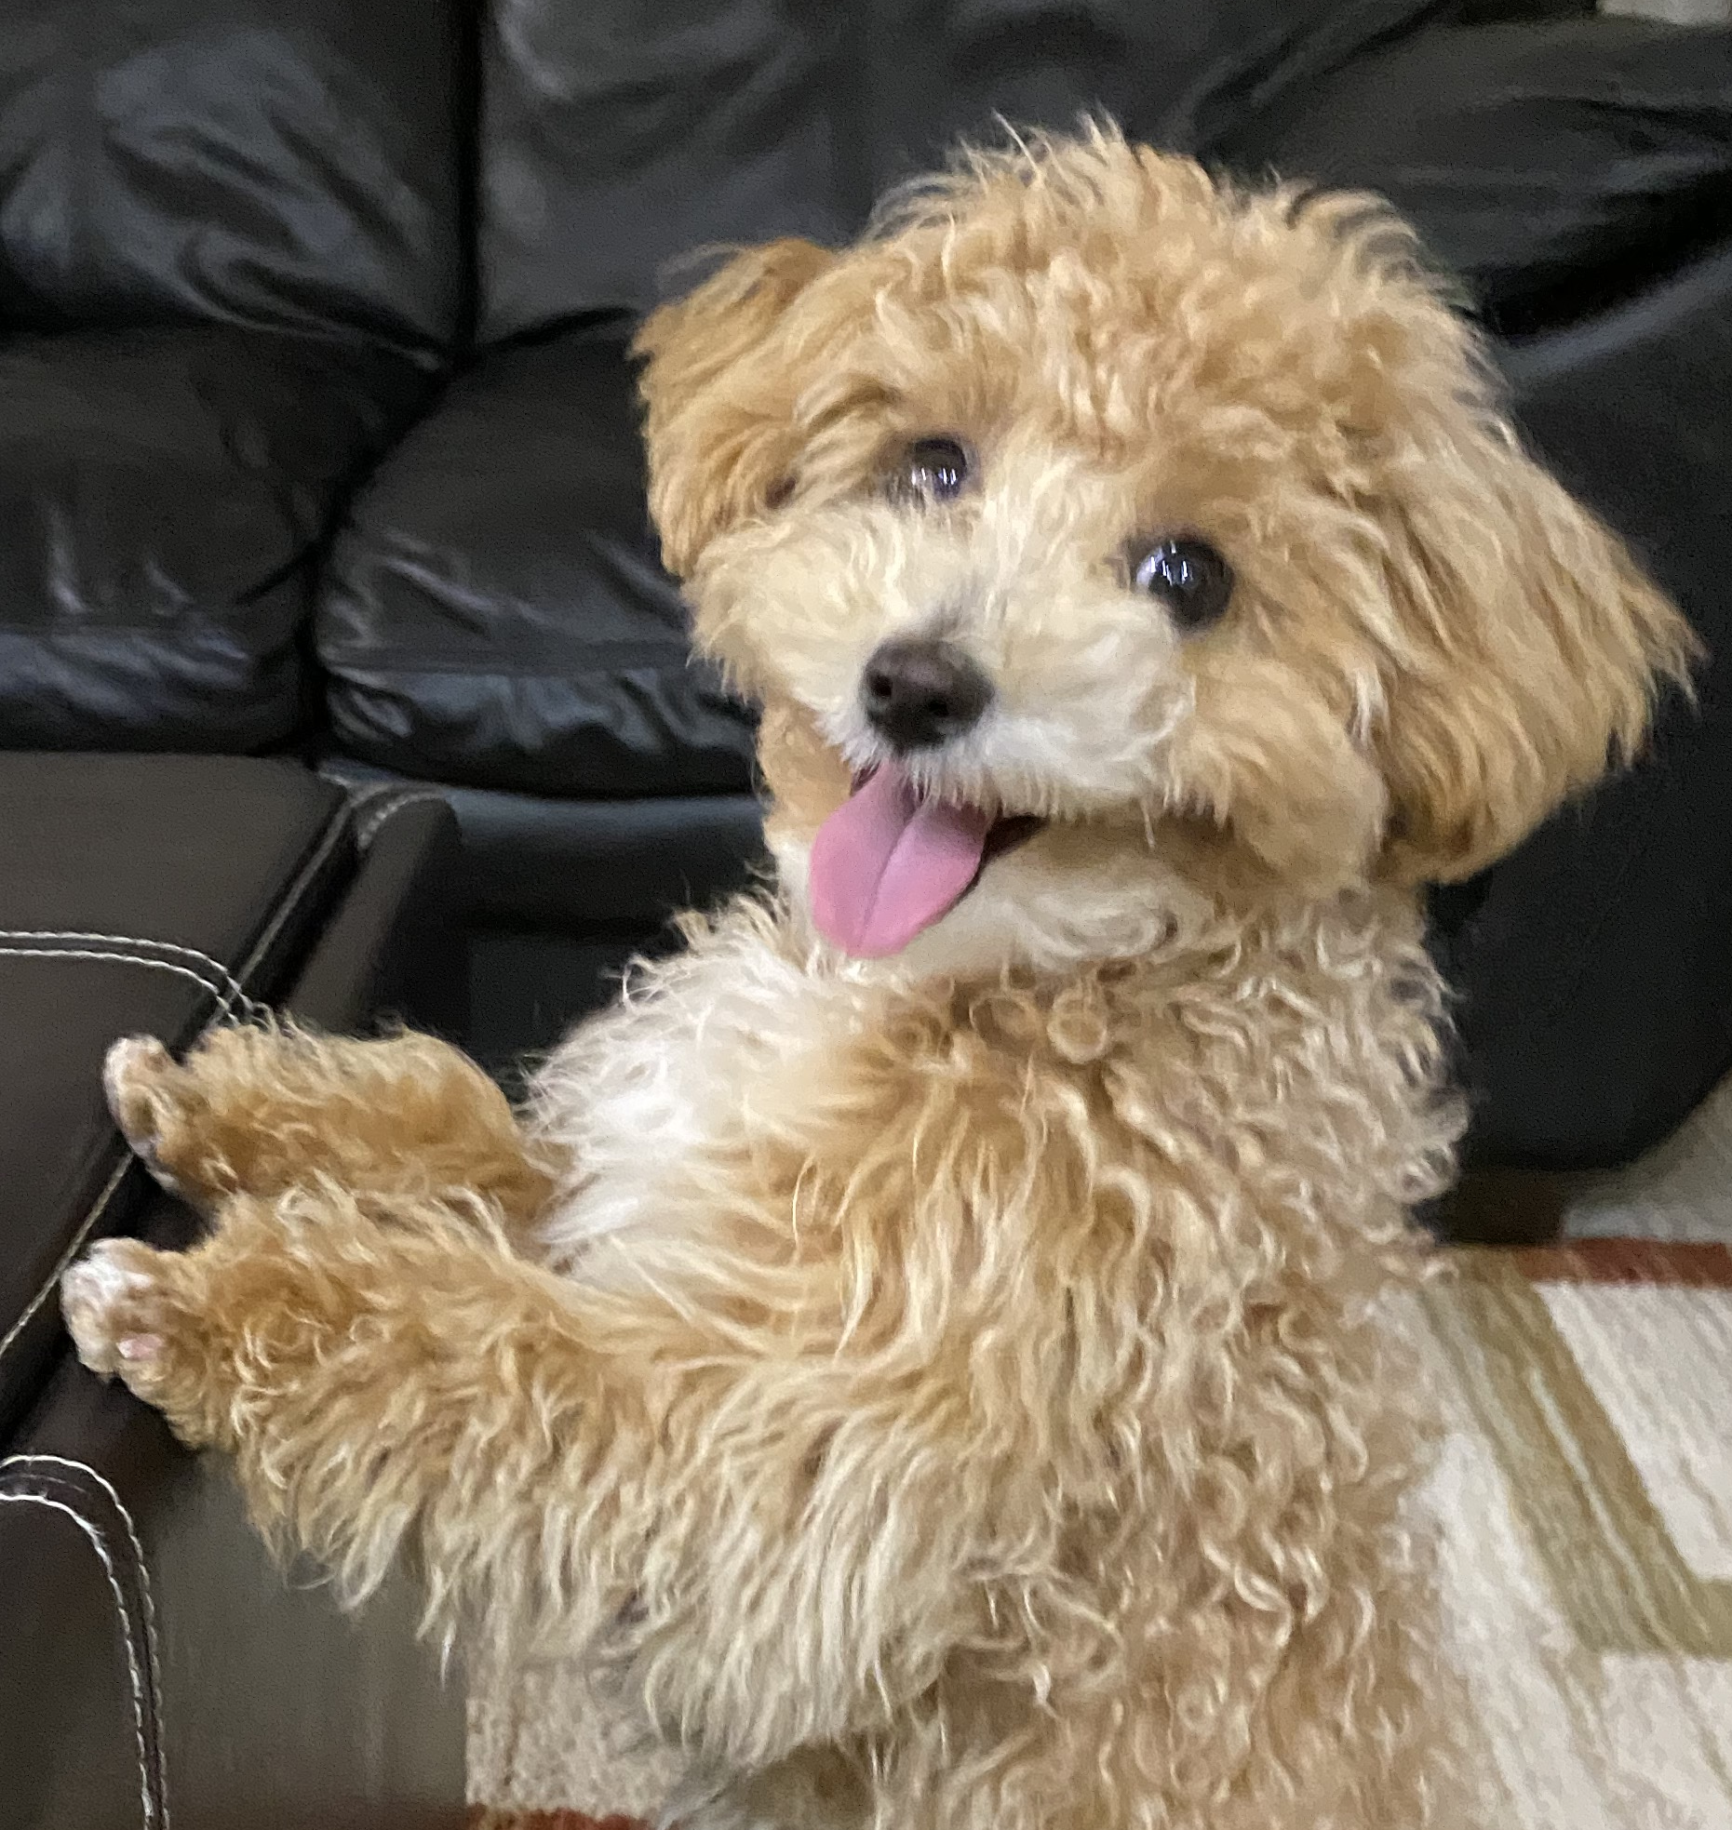
Hello!
I am Vijay Garothaya
I love Java
You can find me at:
vijay_garry@hotmail.com
https://github.com/vijaygarry

Slide 3
1.
Software Setup
Let’s start with setting up required software

Slide 4
Software Required
Java Development Kit - 11
Eclipse
Git Setup
Git Account
Client - Source Tree

Slide 5
Java 11

Slide 6
Java Installation
Please follow the link to install Java
https://github.com/vijaygarry/JavaTrainingForKids/blob/master/documentation/Java11-Installation.pdf

Slide 7
Eclipse Installation
Please follow the link to setup eclipse
https://github.com/vijaygarry/JavaTrainingForKids/blob/master/documentation/Eclipse-IDE-Installation.pdf

Slide 8
Git Setup
Please follow the link to setup git account
https://github.com/vijaygarry/JavaTrainingForKids/blob/master/documentation/Git-Setup.pdf

Slide 9
Verification
Now are ready to go with the following:
Java 11
Eclipse
Git Account

Slide 10
Thanks!
Any questions?
You can find me at:
vijay_garry@hotmail.com
https://github.com/vijaygarry

