Slide 1

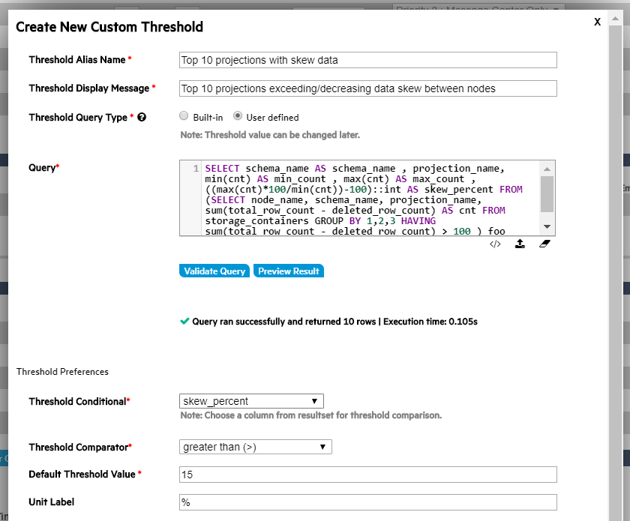
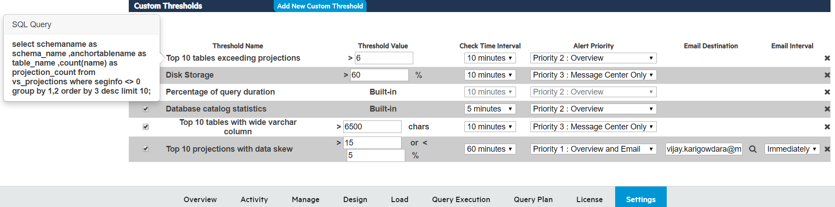
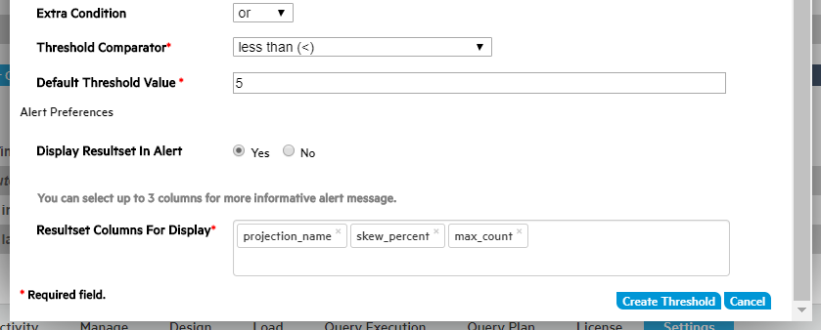
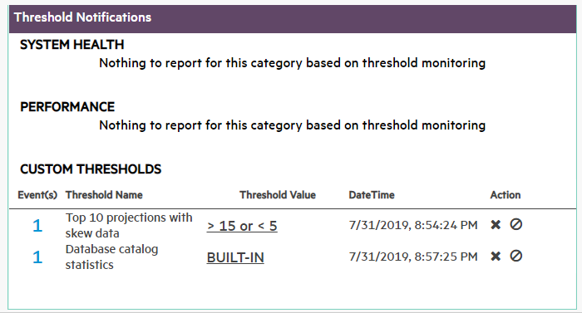
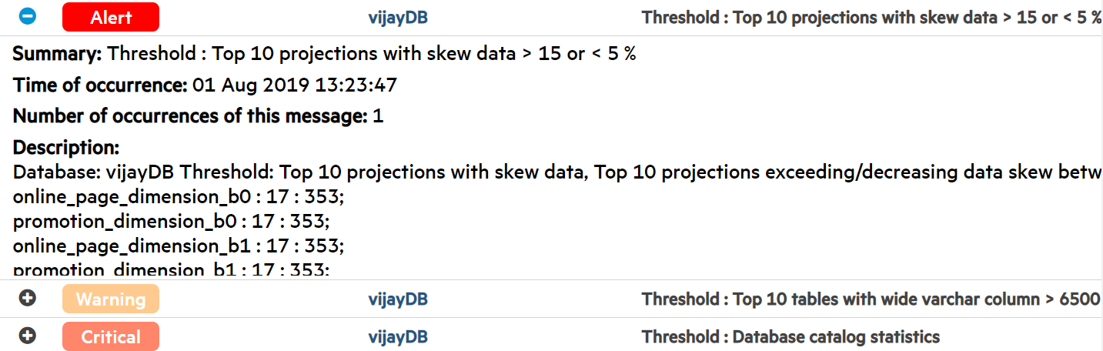
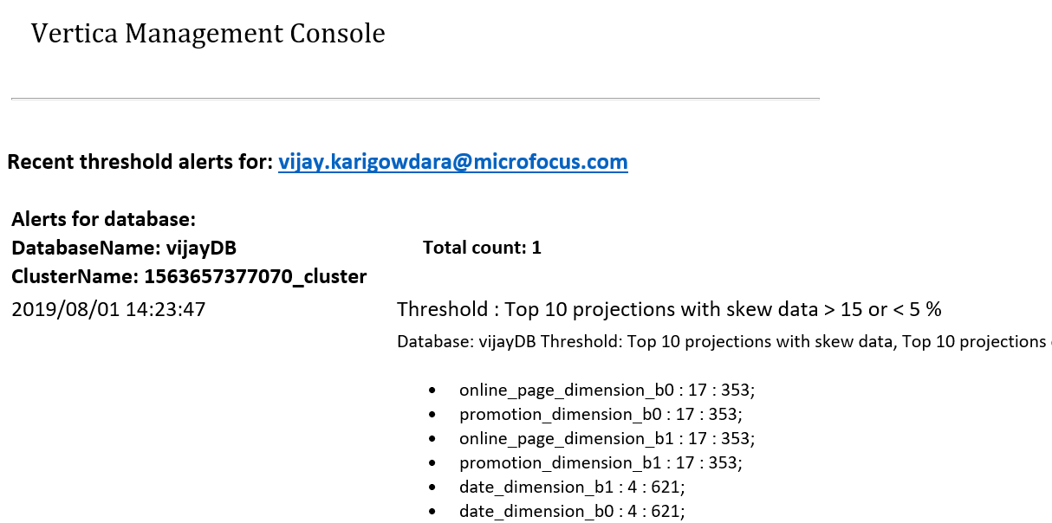
Vijay Karigowdara
Boston University
Computer Information Systems
December 2019
MC-Threshold Builder
Java/UI Intern
Management Console Team
Goal
Provide customers the ability to create custom thresholds by allowing them to use their own queries. Also provides alerts containing detailed information.
Technologies used
Java, JavaScript, jQuery, Angular, CSS, HTML. Spring, Rest APIs, Quartz Job.
Challenges
Saving the larger result set of the custom query as an alert. Threshold revalidation during polling. Revalidating the query execution time. Canceling the query if exceeded execution time. Disabling threshold and generating the disabled alert.
Create
Visualize
Alert Triggered
Overview Message center Email
Micro Focus Restricted

