Slide 1
MC : Threshold Builder
Vertica MC team
Vijay Karigowdara

Slide 2
Feature Description
Goal:
Provide the customers the ability to create custom thresholds.
Summary:
This feature allows customers to create threshold using 2 methods:
Fixed – Allows user to enter a query with threshold criteria built into the query providing result for an alert to be generated.
Adjustable – Allows users to enter a query for which the threshold value can be adjusted later.
Note: Only MC Admin user is allowed to create this threshold.

Slide 3
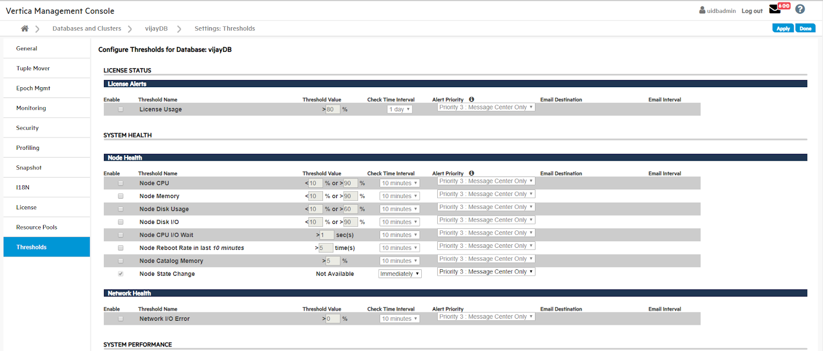
Existing Threshold section

Slide 4
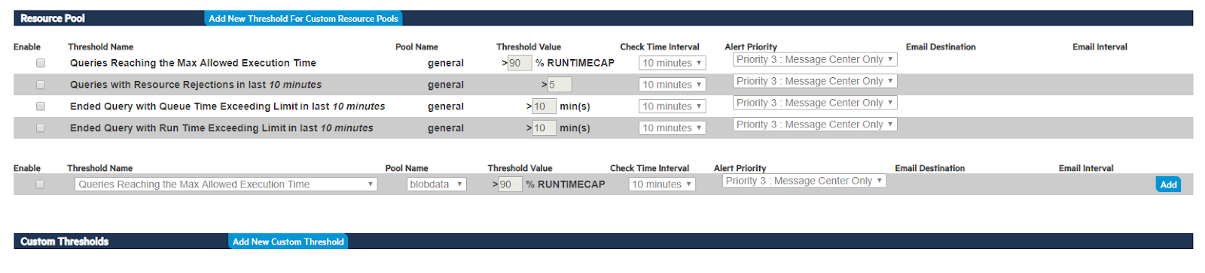
Custom Threshold section

Slide 5
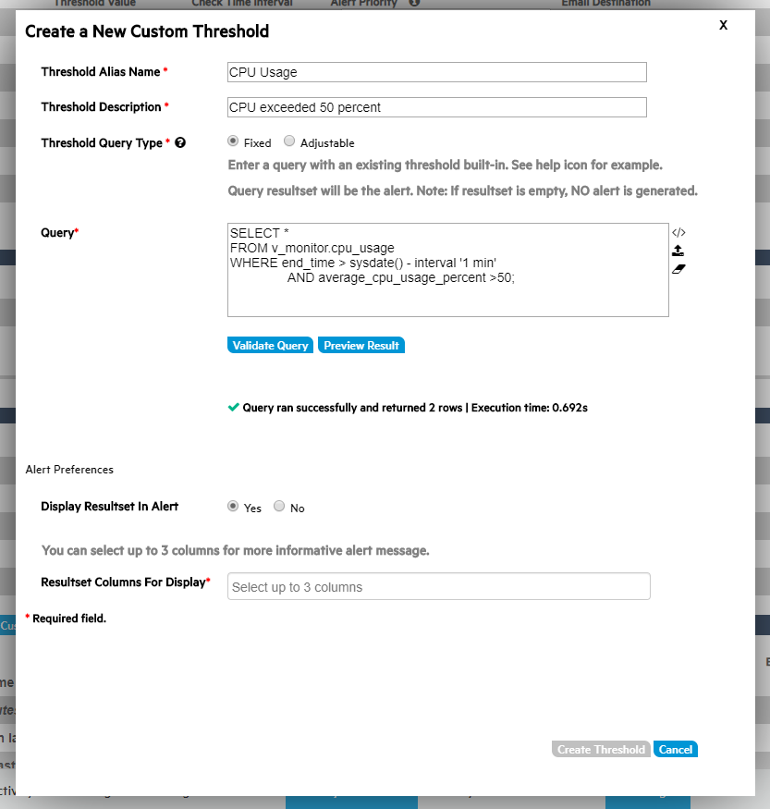
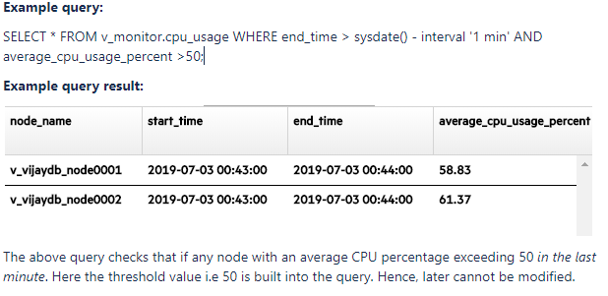
Threshold Query Type
Fixed:-
A free form query with the threshold criteria built into the query.
The MC will generate an alert based on the result-set.
If the result set is empty, then alert is not generated.
Example: Node CPU exceeding certain limit.

Slide 6
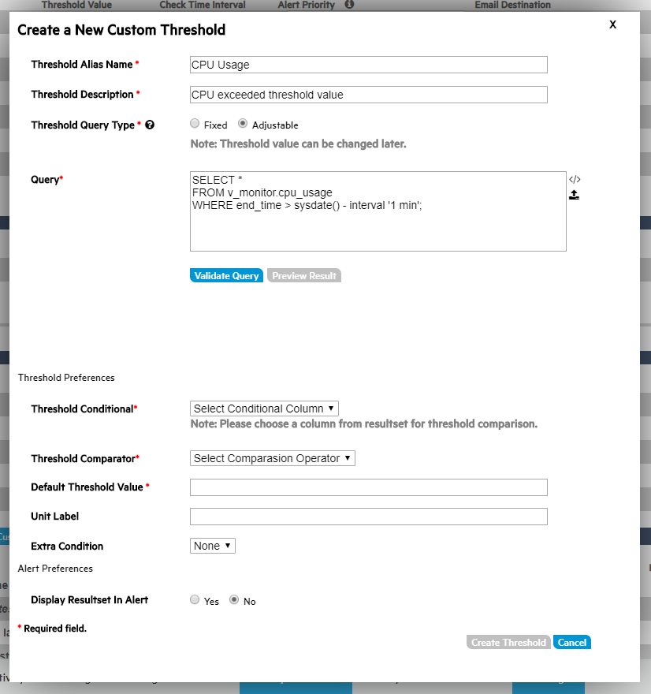
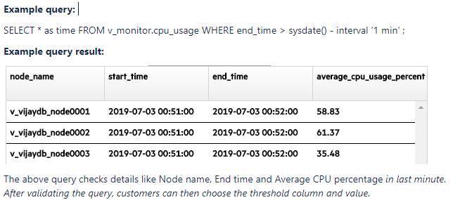
Threshold Query Type
Adjustable:-
Ability to adjust the threshold value later.

Slide 7
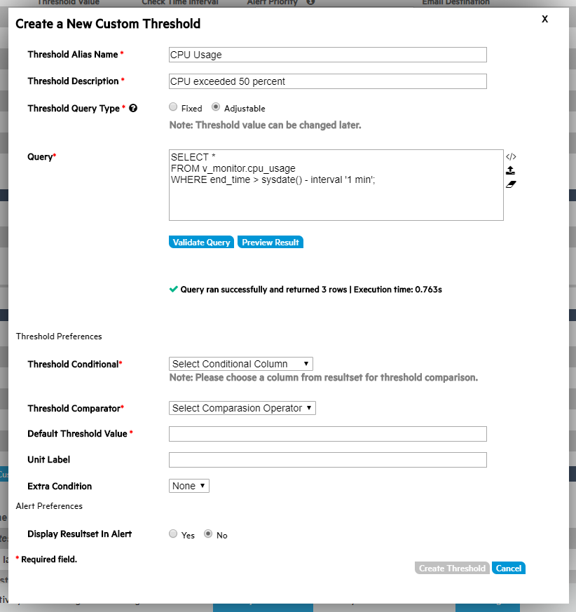
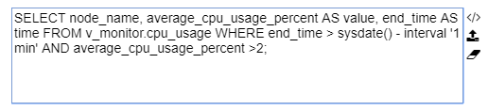
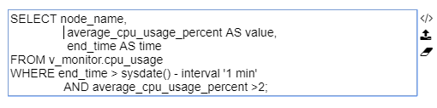
Query
Format the text
Upload a file
Erase text
Before:
After:

Slide 8
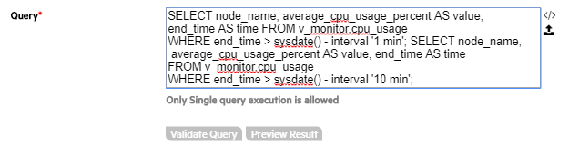
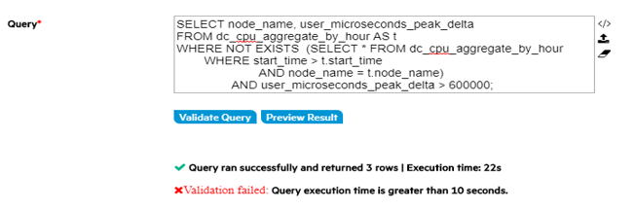
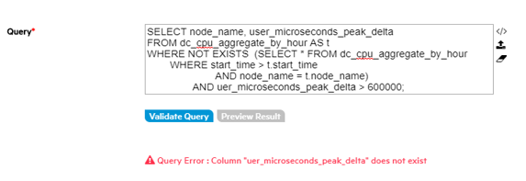
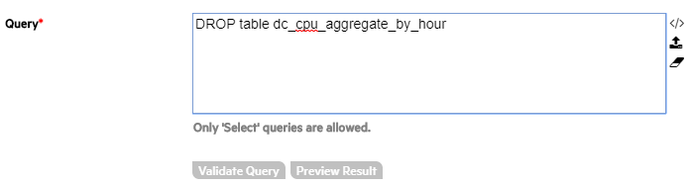
Validation Tests
Test 1
Only Single query execution is allowed.
Test 2
Query should run within valid time.
Execution time <= 10 seconds.
Value can be adjusted in the console.properties file.
Test 3
Query should return a valid result without any errors.
Test 4
Only ‘SELECT’ statements are allowed for execution.

Slide 9
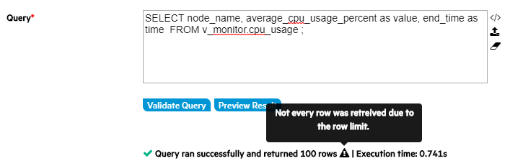
Validation Tests
Test 5
The MC code will automatically append the Limit of 100 rows to the end of the query.
If there is already a Limit in the query, the MC will abide by that number unless that value is greater than 100.
The 100 Limit value can be modifiable in the console.properties.

Slide 10
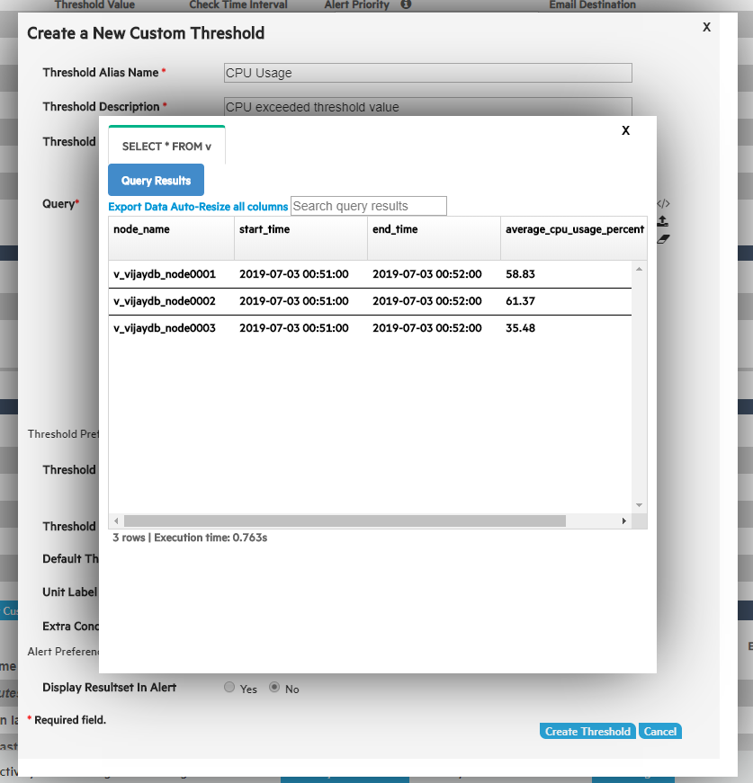
Preview Results

Slide 11
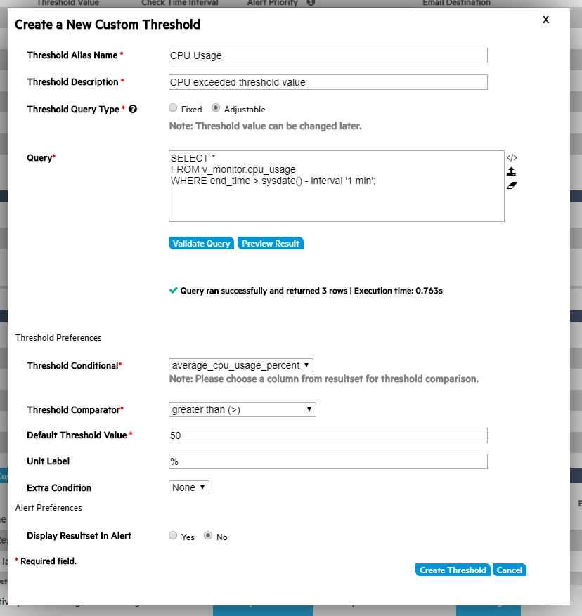
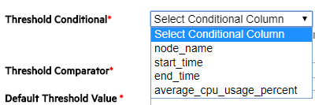
Threshold Preferences: Adjustable Query type only
Threshold Conditional
Columns from the result-set are allowed to choose.

Slide 12
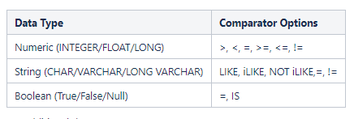
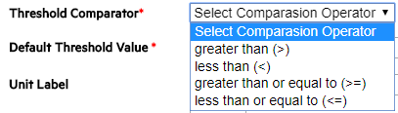
Threshold Preferences: Adjustable Query type only
Threshold Comparator
The Threshold Comparator option list is dependent on the data type from the column chosen in the Threshold Conditional.
E.g.- Numeric:

Slide 13
Threshold Preference: Custom Query type
Default Threshold Value
The Default Threshold Value text field will be validated based on the data type from the column chosen from Threshold Conditional.

Slide 14
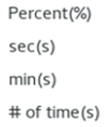
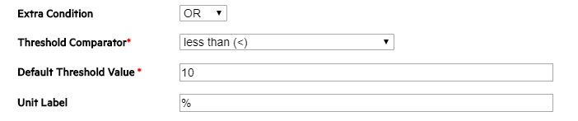
Threshold Preference: Custom Query type
Unit Label text box examples
Extra Condition: (AND/OR)

Slide 15
Alert Preference for both Threshold Query Types
Display result in alert:-
An option to choose whether to display the returned query result-set in the alert message.
If 'Yes’ is selected, the result-set of the returned query is displayed in the alert center with a limited number of columns.
If ‘No’ is selected, the alert will contain the Threshold Name and Threshold Description

Slide 16
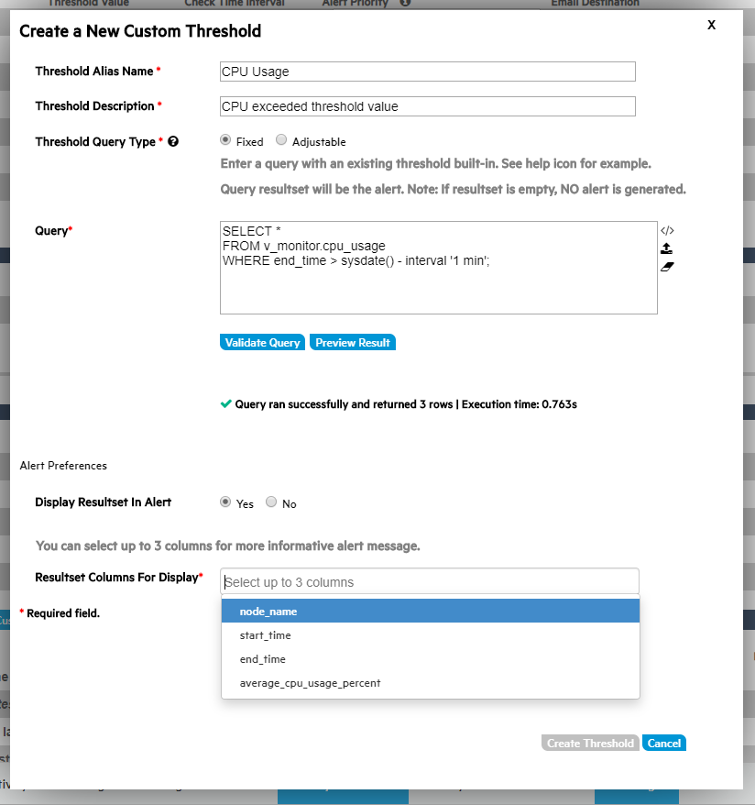
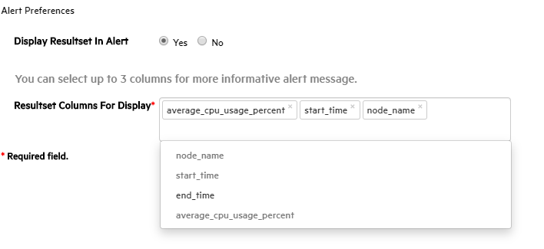
Alert Preference for both Threshold Query Types
Result-set columns for Display:
If Yes is selected for ‘Display Resultset in Alert’, then this option will be visible.
Up to 3 columns are allowed to choose from the query result-set.
To create a focused message.
Data management.
Result-set columns dropdown selection.

Slide 17
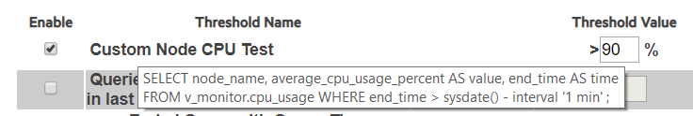
Saved Threshold
After selecting the Create button in threshold builder, the threshold attributes will be saved in the Thresholds table in Derby.
The Threshold query will be saved in a file under /opt/vconsole/thresholds.
Fixed:
CPU Usage
Adjustable:
CPU Usage
Delete Threshold:
MC will remove the threshold from Derby table.
Viewing the SQL:
On-clicking threshold name, user can view the SQL threshold for that particular threshold.
CPU Usage

Slide 18
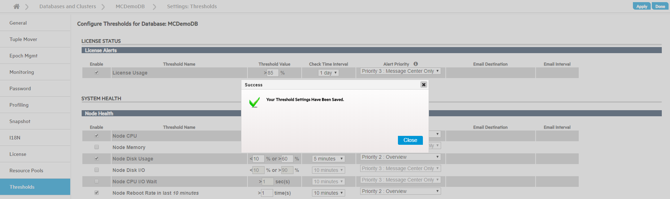
Enabled Custom Threshold
User can later enable the threshold and save it via ‘Apply’ button on thresholds page.

Slide 19
Storage: Saving an alert
Whenever a threshold gets triggered, the query result-set is stored as a CLOB column in the Threshold Notification table in Derby containing Threshold ID, Timestamp etc.
Data Retention
The CLOB data could be large, we are adding a quartz job in the MC to delete the previous week's CLOB data. This MC job will execute once a week(will evaluate this particular setting internally).
Space is not released in the derby when deleting CLOB column of table data. In order to reclaim the space, the MC's quartz job will also run commands to reclaim the space.
Example: call SYSCS_UTIL.SYSCS_COMPRESS_TABLE(‘CONFIGURATION', 'TEST_BLOB4', 1);

Slide 20
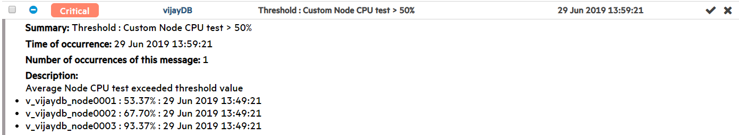
Alert Display
Alert message at ‘Message center’:
CPU Usage
CPU Usage
CPU exceeded threshold value

Slide 21
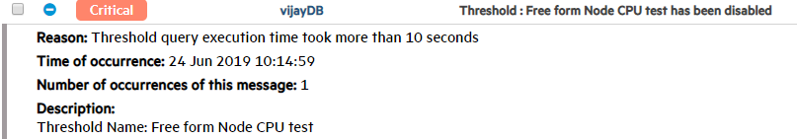
Threshold Revalidation
As MC triggers the threshold comparison based on check time interval, it will automatically re-run the validation tests. If any of the test fails, MC will do the following:
Cancel the query if it running past the validation execution time(10 seconds).
Disable the threshold.
Create an alert notifying the user that the threshold is disable as seen below.
CPU Usage has been disabled
CPU Usage

Slide 22
Questions?

