Slide 1
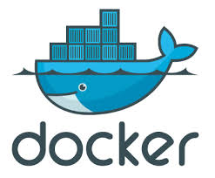
Deploying apps with Docker
Image source: docker.io
Notes:
Docker is way to deploy your applications

Slide 2
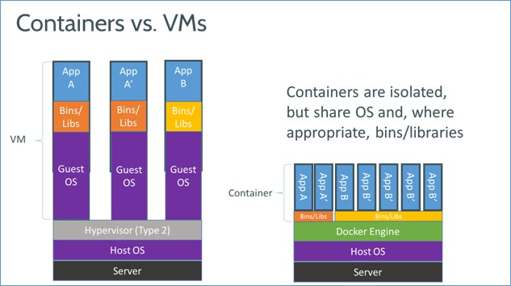
Docker is container based virtualization framework
Image source: docker.io
Notes:
Docker is a lightweight alternative to hypervisor-based virtualization. Compared to full blown Virtual machine where each VM has an OS, bins/libs, docker containers share an os and appropriate libs. Each container is an isolated sandbox.
Docker builds upon Linux Containers. Linux containers have been part of Linux since version 2.6.24 and it iz pretty mature now.

Slide 3
Containers Images The DockerFile
The basic elements of Docker
Notes:
Applications run inside Containers. An image is an application build. DockerFile contains instructions to build images. Just as virtual machines are based on images, Docker Containers are based on Docker images.

Slide 4
Why Docker? Images can be pre-built. Containers provide sand-boxing. Consistent way of packaging and deploying all your applications.
Notes:
Images can be built prior to deploying code so there is no build time when deploying apps. Continuous integration can be configured to build images and push them to image repositories.
Containers are isolated sandbox enviroments. Apps can securely run without outside access. Since typically each container runs a single process sharing of resources is eliminated.
The process could fork other processes. Ex: supervisord
Docke

Slide 5
Example DockerFile for a sample Django application with Python 2.7 on centos
# Get a base centos image from docker index
FROM centos
# Install some prereqs
RUN yum -y install bind-utils sudo which
# Python 2.7 install
RUN yum -y install python27
# Create virtual env..install Django, supervisord
………….
# Install app code
RUN git clone https://github.com/vijaykatam/devcon2014.git
# The port this container is exposing to host os
EXPOSE 8000
# Configure container as an executable
ENTRYPOINT ["/opt/.virtualenvs/devcon2014/bin/supervisord"]
CMD ["-c", "/opt/djangoprojects/devcon2014/supervisord.conf"]
Notes:
Docker index is a repository of docker images.

Slide 6
Lets build an image.

Slide 7
Build Docker image > docker build -t sample_app - < Dockerfile …. Step 28 : ENTRYPOINT ["/opt/.virtualenvs/devcon2014/bin/supervisord"] ---> Using cache ---> e62e2e4f9340 Successfully built e62e2e4f9340 Run Docker > docker run -p 127.0.0.1:49000:8000 sample_app 2014-06-04 15:08:55,192 CRIT Supervisor running as root (no user in config file) 2014-06-04 15:08:55,194 INFO supervisord started with pid 1 2014-06-04 15:08:56,199 INFO spawned: 'sample-app' with pid 8 2014-06-04 15:08:57,320 INFO success: sample-app entered RUNNING state, process has stayed up for > than 1 seconds (startsecs) Show running containers > docker ps CONTAINER ID IMAGE COMMAND CREATED STATUS PORTS NAMES 7ca77828fe5b sample_app:latest /opt/.virtualenvs/de 4 minutes ago Up 4 minutes 0.0.0.0:49164->8000/tcp loving_torvalds

