Slide 1
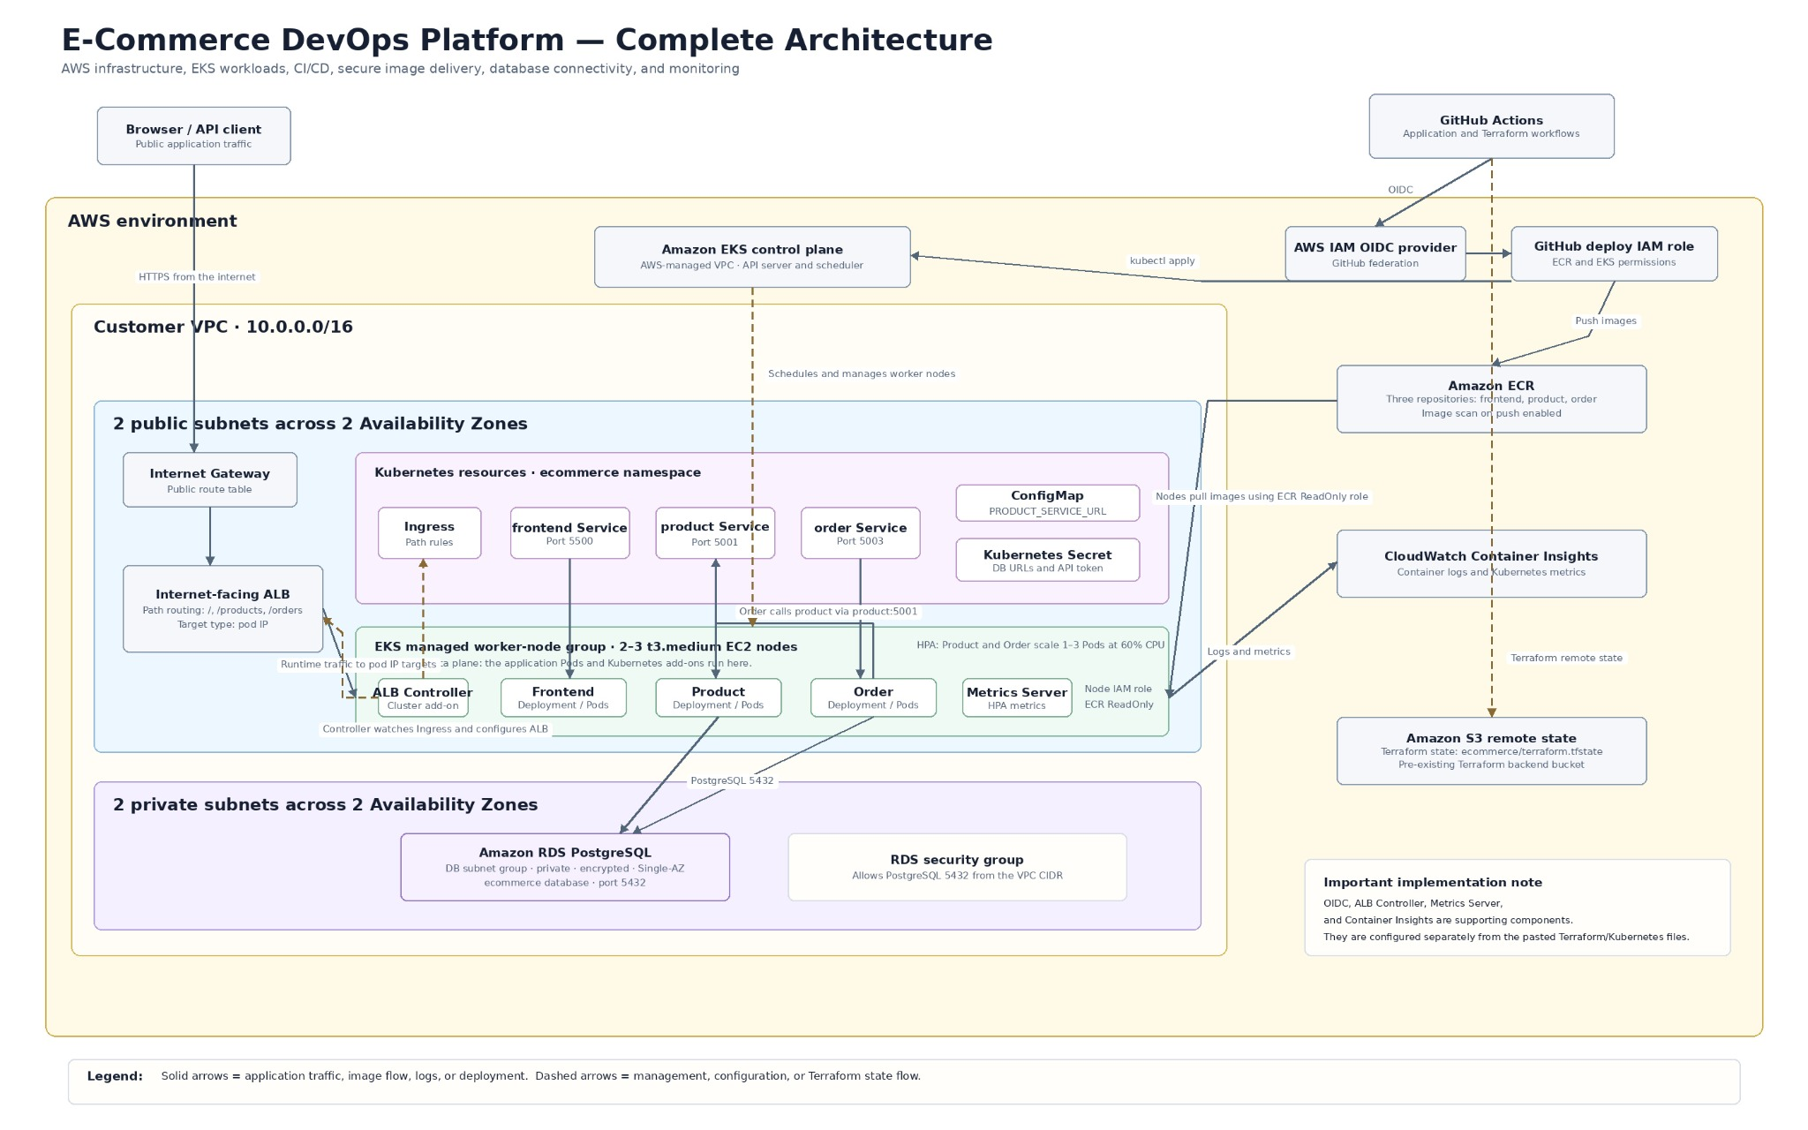
Architecture
E-Commerce DevOps Platform | 1 / 6
Notes:
Start from the user path: browser to the internet-facing ALB, then Kubernetes Ingress and the three services. The Product and Order services run as Pods on EKS worker nodes and connect to private RDS. Then explain the delivery path: GitHub Actions uses OIDC, pushes images to ECR, and deploys to EKS. CloudWatch receives logs and metrics.

Slide 2
Design choices
Each decision supports a practical goal: repeatable delivery, secure access, or reliable runtime behavior.
Separate services
Frontend, Product, and Order have clear responsibilities. Product and Order can scale independently.
One Dockerfile
The SERVICE_DIR build argument reuses one container build pattern. Containers run as non-root UID 10001.
Compose before cloud
Docker Compose reproduces the Product, Order, and PostgreSQL flow locally before deployment.
EKS and ALB Ingress
Deployments provide self-healing; Services provide discovery; one ALB routes paths to the correct service.
Terraform and OIDC
Terraform manages AWS infrastructure. GitHub Actions uses temporary OIDC credentials instead of AWS access keys.
Private data and visibility
RDS stays private and encrypted. CloudWatch, SonarQube, and ECR scanning provide operational and security signals.
E-Commerce DevOps Platform | 2 / 6
Notes:
Do not read every line. Explain the trade-offs: service separation allows independent scaling; a parameterized Dockerfile avoids three near-identical builds; Docker Compose gives a reproducible local environment; private RDS reduces exposure; OIDC removes long-lived AWS keys.

Slide 3
CI/CD workflows
Two manually triggered GitHub Actions workflows. Both authenticate to AWS with OIDC.
Infrastructure CI/CD
Application CI/CD
1
Authenticate
1
Validate
GitHub OIDC assumes the AWS deployment role.
Run Product and Order unit tests, Compose health checks, and container integration tests.
2
Validate the plan
2
Build and publish
fmt check, init, validate, then terraform plan -out=tfplan.
Build three images, tag them with the short commit SHA, then push to Amazon ECR.
3
Apply the saved plan
3
Deploy and verify
terraform apply tfplan provisions VPC, EKS, ECR, RDS, IAM, and networking.
Create or update the Kubernetes Secret, apply manifests, update images, and wait for rollouts.
The Compose cleanup step uses always(), so test containers are removed even when a check fails.
E-Commerce DevOps Platform | 3 / 6
Notes:
Show the two workflow files after this slide. For infrastructure, explain why the saved Terraform plan matters. For application delivery, show the test steps first, then image tags, ECR push, manifest apply, and rollout status.

Slide 4
Codebase walkthrough
Use this slide as the transition to the live repository. Show only the files that support the story.
Repository structure
Live walkthrough order
.
├── front_end/
├── product_services/
├── order_service/
├── Dockerfile
├── docker-compose.yml
├── kubernetes/
├── terraform/
├── tests/
├── Docs/
└── .github/workflows/
1
Container build
Dockerfile and docker-compose.yml
2
Application and tests
Product and Order APIs, then unit and integration tests
3
Kubernetes runtime
Deployments, Services, probes, HPA, and Ingress
4
Cloud infrastructure
Terraform resources and the two GitHub Actions workflows
E-Commerce DevOps Platform | 4 / 6
Notes:
Now switch to VS Code or the GitHub repository. Start with Dockerfile and Compose, then show one Product or Order API file, then the test folder. Next show Kubernetes manifests, Terraform main.tf, and finally the two workflow files. Do not read every source line.

Slide 5
Failure recovery and load handling
The platform was tested for both Pod recovery and increased Product-service traffic.
Failure recovery
HPA load test
1
Health checks
1
60% CPU
3
Readiness starts after 5 seconds; liveness starts after 15 seconds.
minimum Pods
HPA target
maximum Pods
2
Resource controls
Each service requests 100m CPU and 128Mi memory, with defined limits.
A temporary BusyBox load generator called Product continuously. Product scaled from one to three Pods, then scaled down after load removal.
3
Pod self-healing
Deleting one Product Pod causes the Deployment controller to create a replacement.
HPA scales Pods. Cluster Autoscaler or Karpenter would be the next step for worker-node scaling.
E-Commerce DevOps Platform | 5 / 6
Notes:
Open two terminals: one watches HPA and the other watches Pods. Start the BusyBox load generator and show Product reach three replicas. Remove the generator and show scale-down. Then delete one Product Pod and show the Deployment create its replacement.

Slide 6
Prioritized production roadmap
The platform is a complete working demo. These are the next improvements for a production environment.
1
Infrastructure repeatability
Bootstrap the Terraform state backend, remove hard-coded IAM values, and manage CloudWatch configuration through Terraform.
2
Security hardening
Move worker nodes to private subnets and use AWS Secrets Manager with External Secrets.
3
Availability and capacity
Add node autoscaling, Multi-AZ RDS, stronger backups, deletion protection, and disruption controls.
4
Operations and delivery
Add CloudWatch alarms, control-plane logs, pull-request gates, quality enforcement, rollback procedures, and environments.
Priority order: first make infrastructure repeatable, then improve security and availability, then mature monitoring and delivery controls.
E-Commerce DevOps Platform | 6 / 6
Notes:
Be candid: the working demo covers the requested platform capabilities. Due to the timebox, a few AWS setup items remain manual and some production controls remain roadmap work. Explain the order: repeatability first, then security and availability, then operations and delivery maturity.

