Slide 1
FINAL TEAM PROJECT
Team members
Sai Ram Ajay Krishna Gabbula Venkata Vijay Krishna Gabbula Pratik Bhatt

Slide 2
Outline
Pandemic simulator
SIR Model
SIRS Model
Other approaches
Vaccination effect
More social activity
More social activity (specific time constraint)

Slide 3
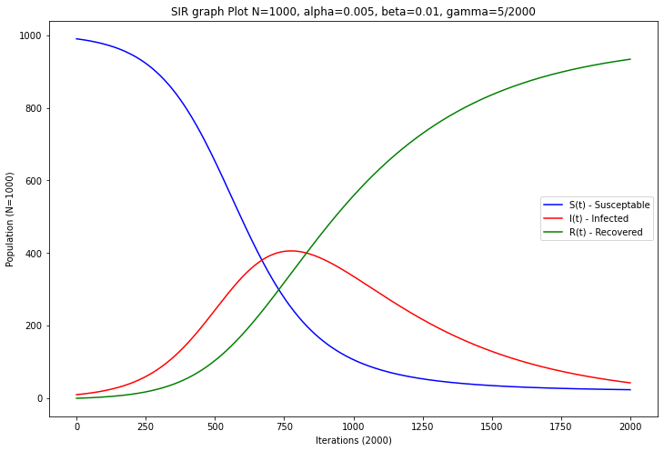
SIR MODEL (I₀= 10, R₀= 0, S₀ = 990)

Slide 4
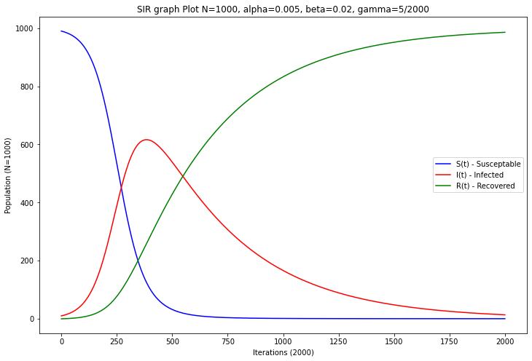
SIR MODEL (I₀= 10, R₀= 0, S₀ = 990)

Slide 5
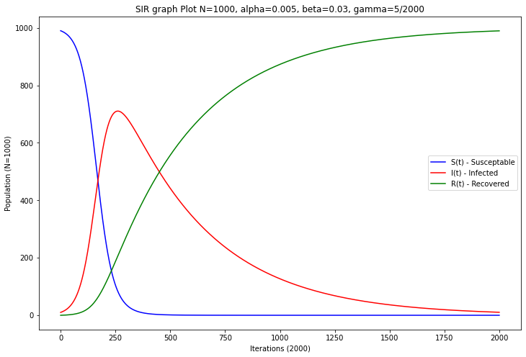
SIR MODEL (I₀= 10, R₀= 0, S₀ = 990)

Slide 6
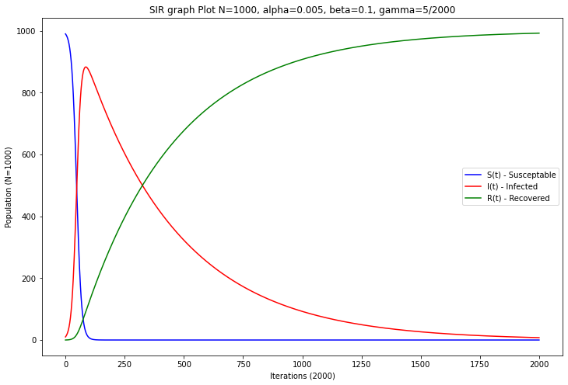
SIR MODEL (I₀= 10, R₀= 0, S₀ = 990)

Slide 7
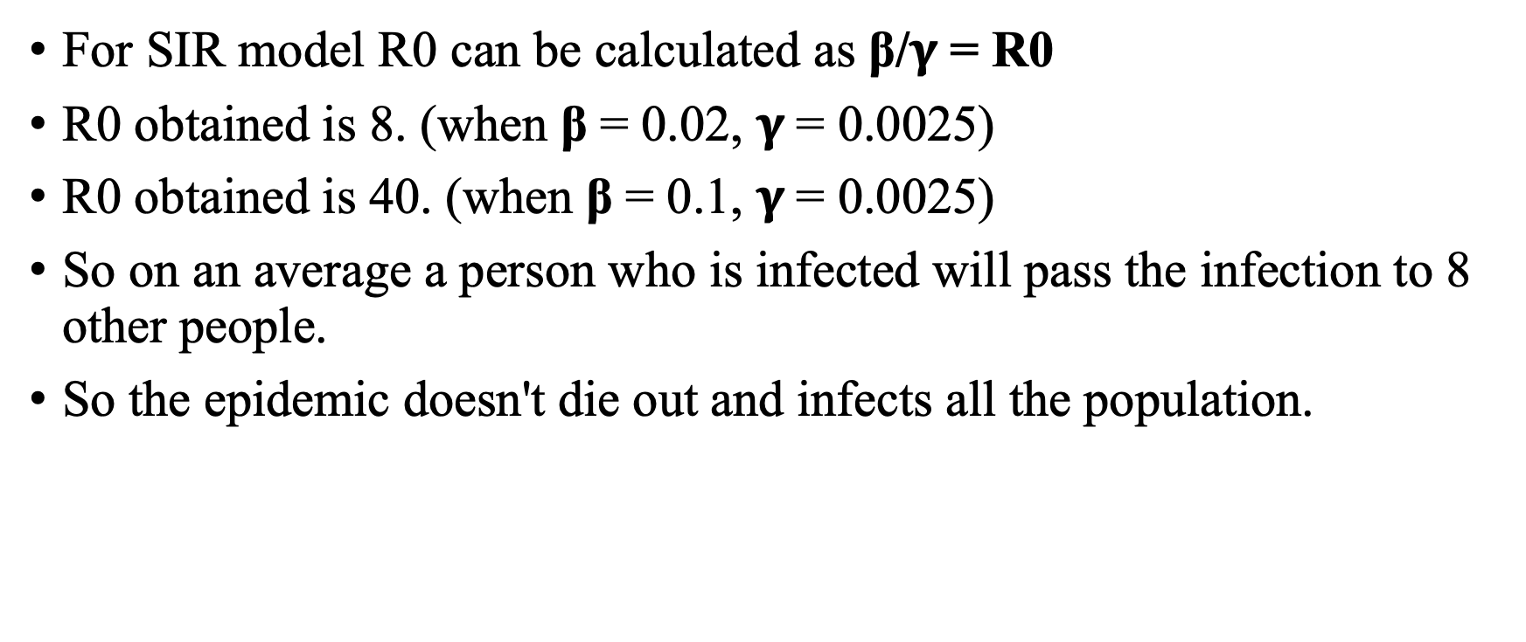
SIR Model
For SIR model R0 can be calculated as β/$γ$ = R0
R0 obtained is 8. (when β = 0.02, $γ$= 0.0025)
R0 obtained is 40. (when β = 0.1, $γ$= 0.0025)
So on an average a person who is infected will pass the infection to 8 other people.
So the epidemic doesn't die out and infects all the population.

Slide 8
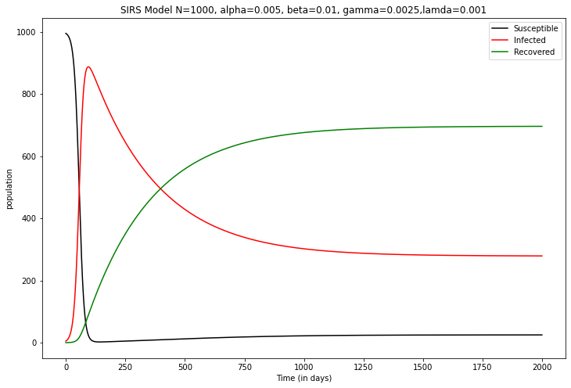
SIRS MODEL (I₀= 5, R₀= 0, S₀ = 995)

Slide 9
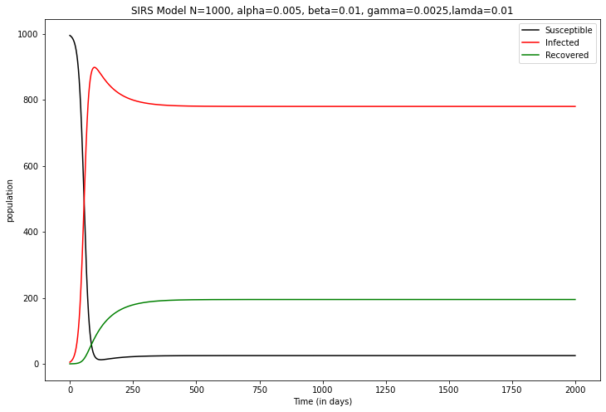
SIRS MODEL (I₀= 5, R₀= 0, S₀ = 995)

Slide 10
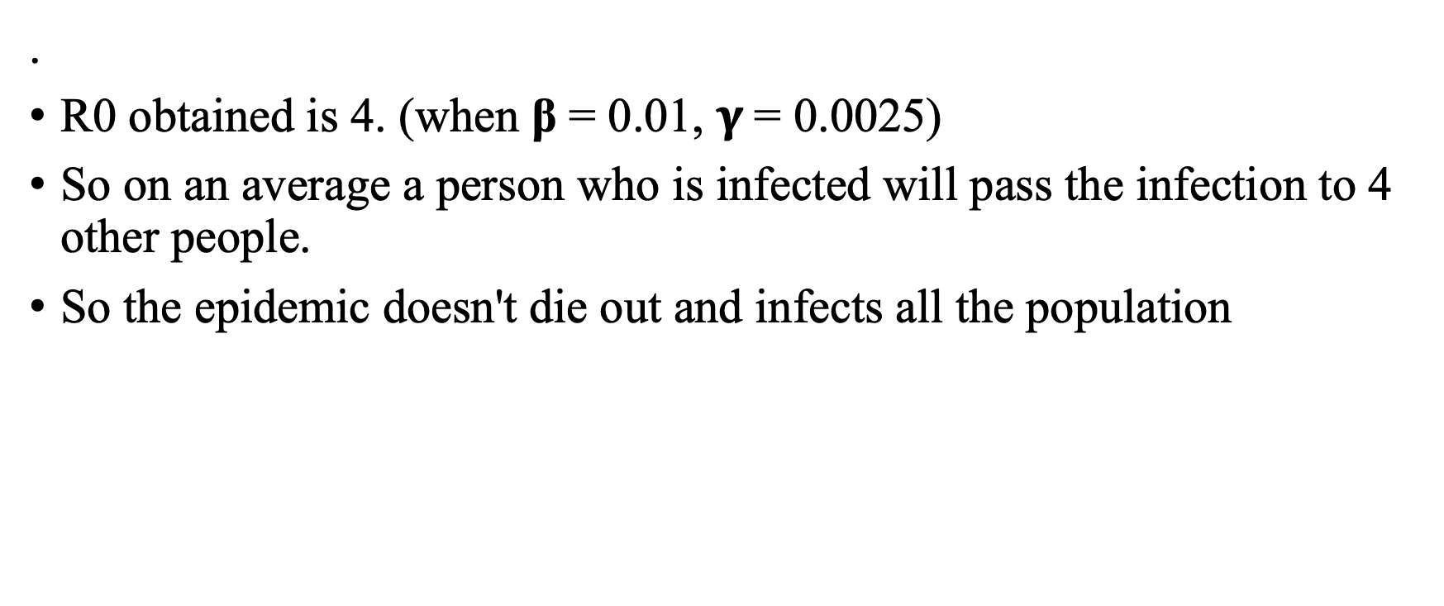
SIRS Model
.
R0 obtained is 4. (when β = 0.01, $γ$= 0.0025)
So on an average a person who is infected will pass the infection to 4 other people.
So the epidemic doesn't die out and infects all the population

Slide 11
SECTION - II
B) Vaccine Introduced after t3
Let protection rate (efficacy) theta be 0.8.
Taking vaccination rates as 40% and 50% of the population. Here considering all the vaccinations at one time.

Slide 12
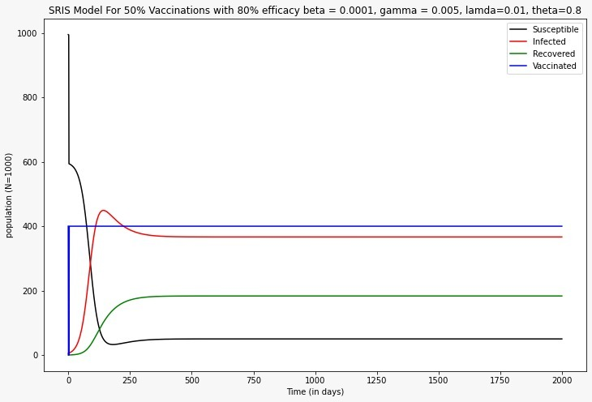
SIRS MODEL (I₀= 5, R₀= 0, S₀ = 995)

Slide 13
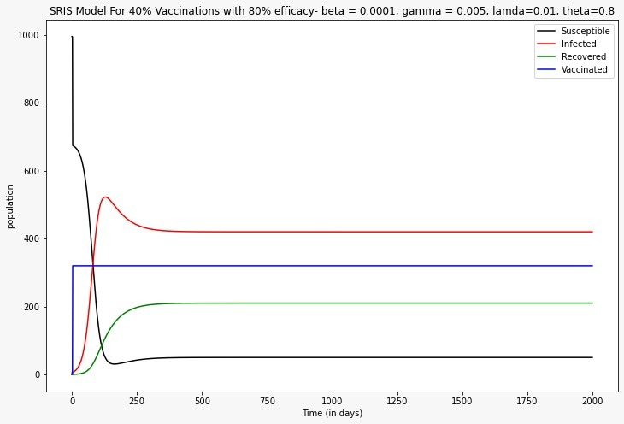
SIRS MODEL (I₀= 5, R₀= 0, S₀ = 995)

Slide 14
SECTION 2 E
Introducing some additional connections in the network.
Taking additional connections as 15%.

Slide 15
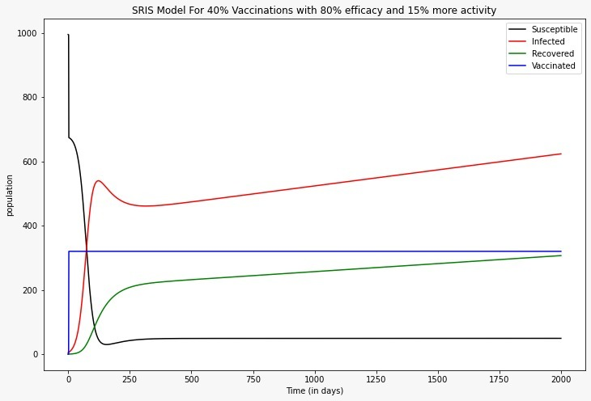
SIRS MODEL (I₀= 5, R₀= 0, S₀ = 995)

Slide 16
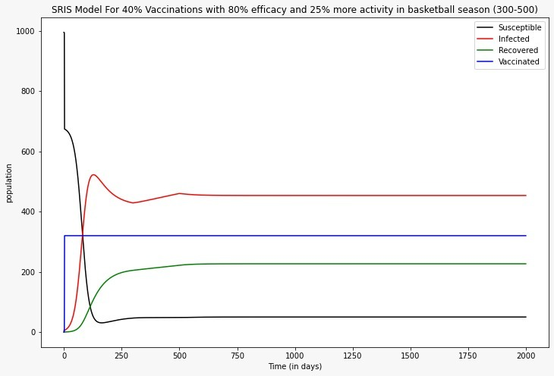
SIRS MODEL (I₀= 5, R₀= 0, S₀ = 995)

Slide 17
Conclusion
Created a Pandemic Simulator
Analyzed SIR and SIRS Models
Implemented in Python Programming Language
Explored Different approaches
Vaccine ware off effect can be implemented

