Slide 1
A Privacy- Preserving Algorithm for Graph Spanners

Slide 2
Outline of the Project
Graph Spanners
K - Graph Spanner
Previous Related Work on Privacy
Problem Formulation
Implementing Linear Programming
Performance Measures and Evaluations
Results
Conclusions

Slide 3
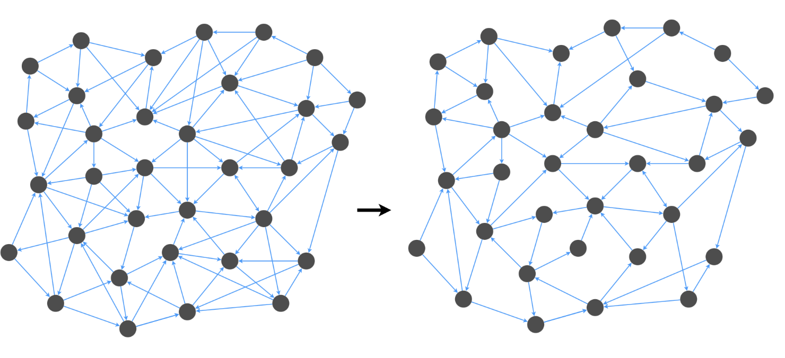
What is A Graph Spanner
Graph Spanners are important in graph applications where we want to reduce the number of edges in the graph without affecting the navigability of the graph.
Image source : https://randorithms.com/2021/04/12/directed-spanners.html

Slide 4
K - Spanner
Given an input Graph G (V, E) then a Graph Spanner (H) is a sub-graph of the Graph G such that H ⊆ G.
k - Spanner can be defined as for all edges (u, v) ∈ G, the Spanner graph ’H’ contains a path between u and v of length no greater than k.d(u, v)
A Graph Spanner preserves lengths of the shortest paths in G.

Slide 5
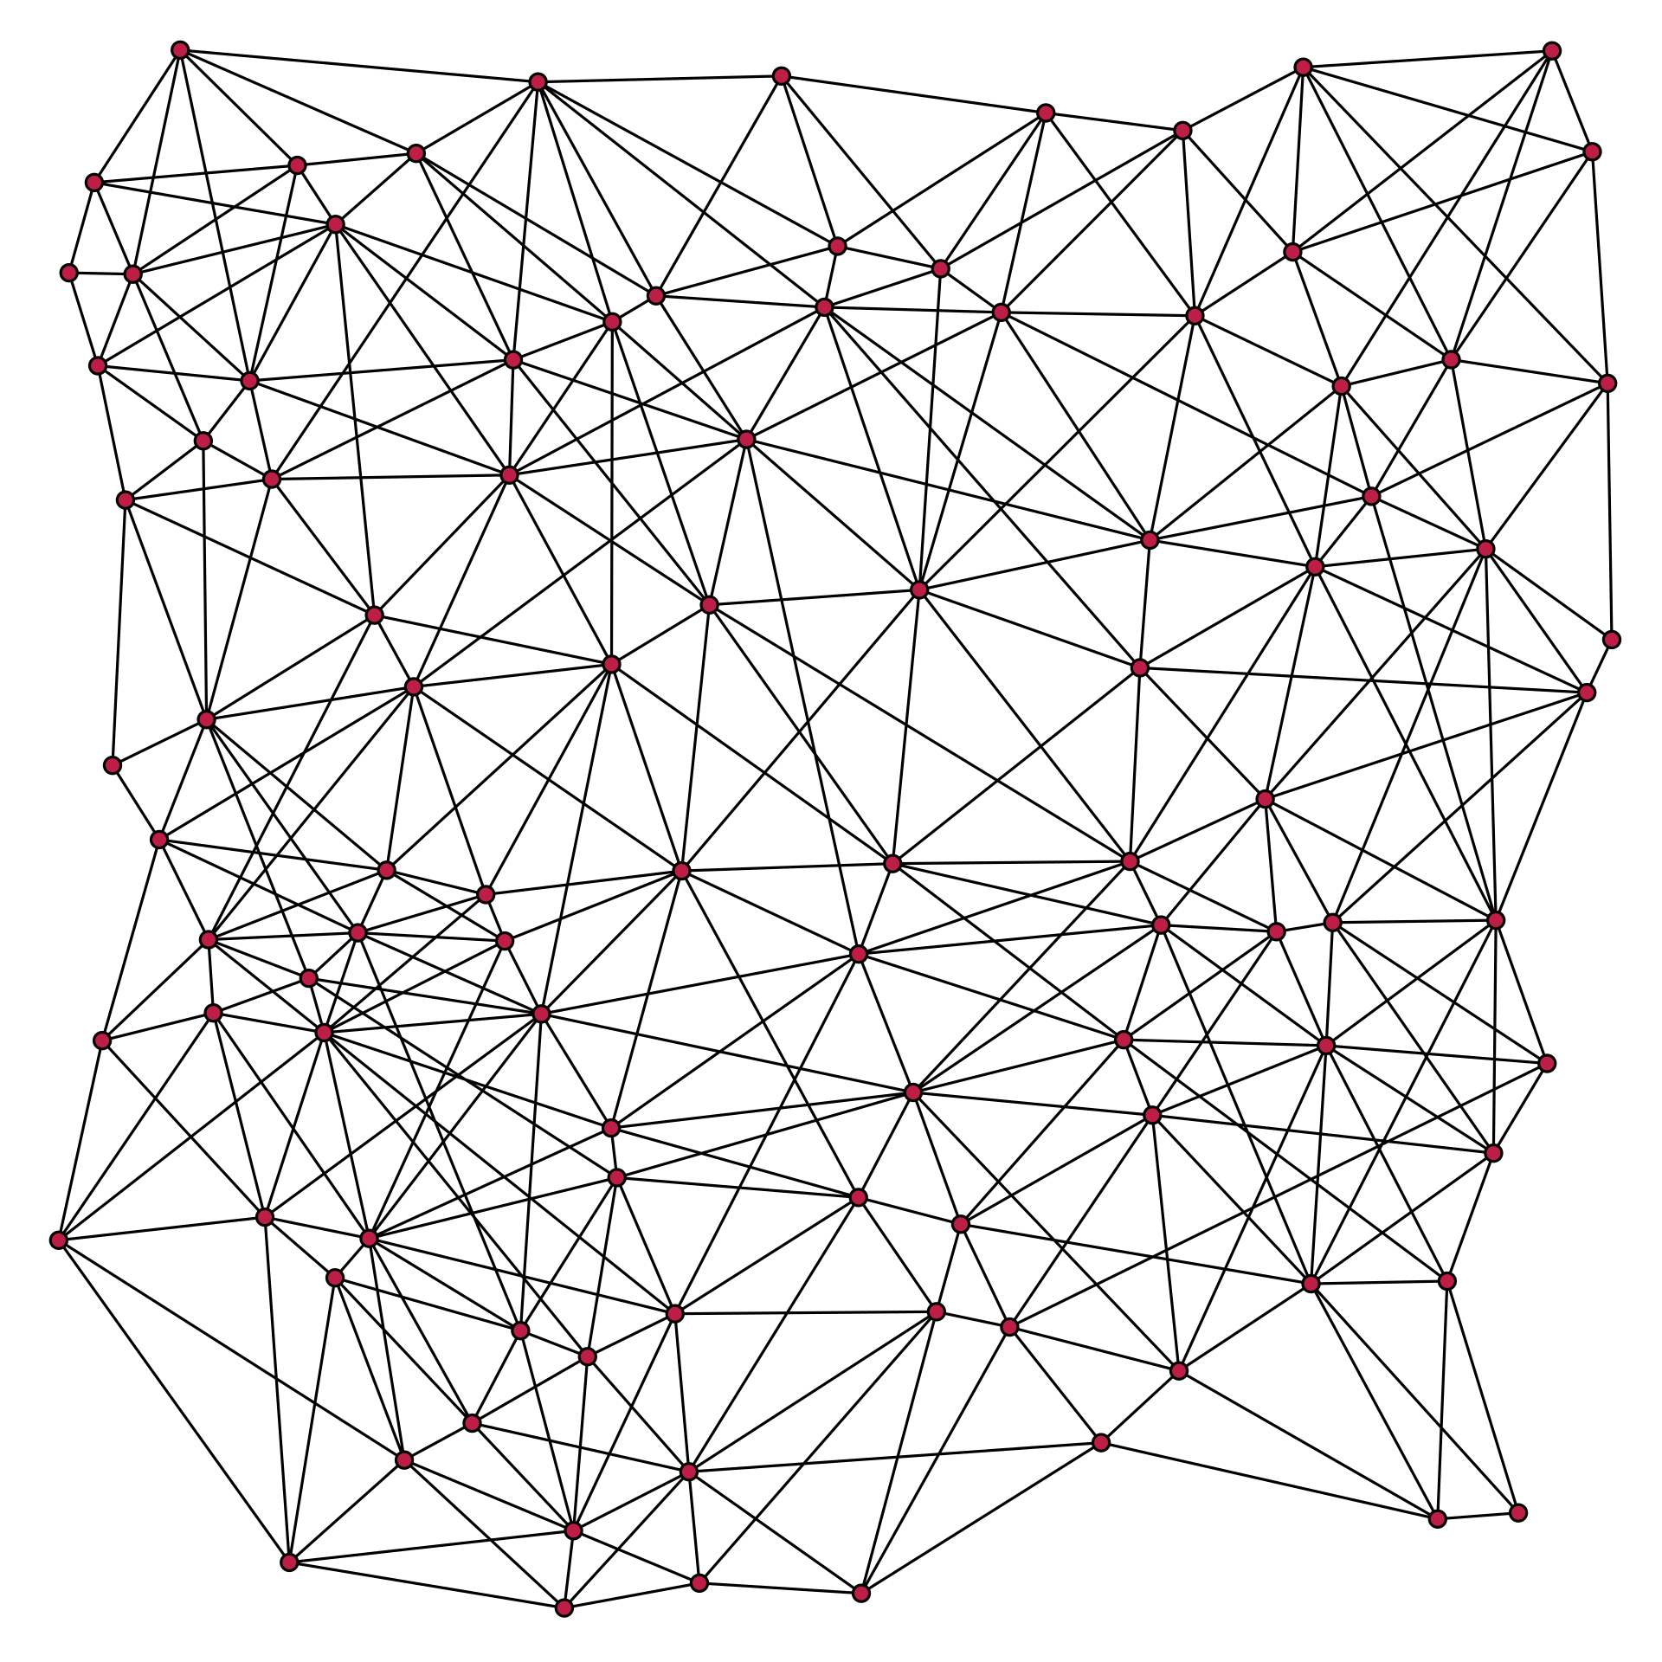
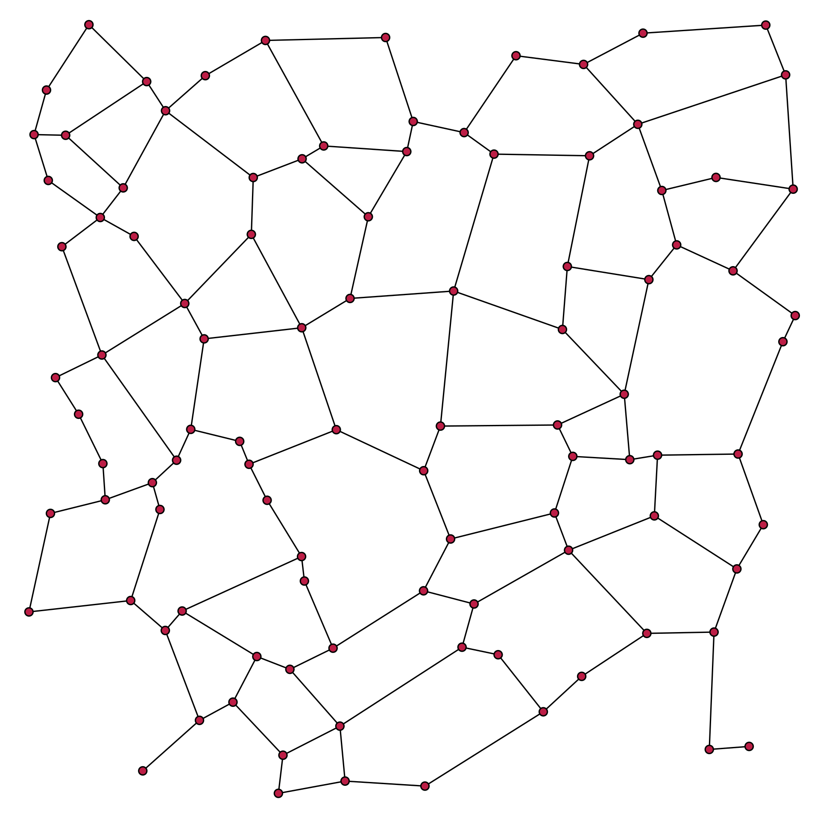
Example of k - spanner
Stretch factor when k = 1 and k = 2
Image source : https://en.wikipedia.org/wiki/Greedy_geometric_spanner

Slide 6
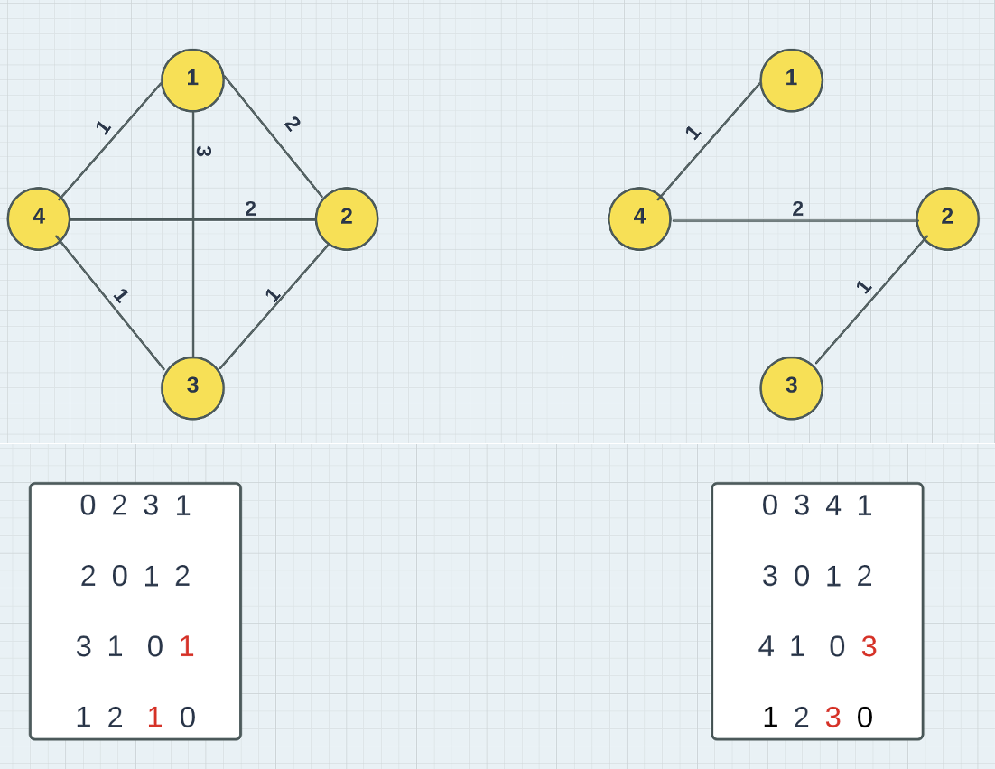
K - Spanner
Suppose if k = 3, then the subgraph H of G has at most 3 times the distance of that in G.

Slide 7
Is there a Need for Privacy?
Privacy enables us to Create and Manage barriers/boundaries to protect the network from unwanted interference.
Privacy is a key for Protecting the Data to ensure the Individual’s safety (Examples include Banking Data, Medical Data and so on…).
With increase in massive data analysis, notion of privacy is under focus over highly sensitive user information.

Slide 8
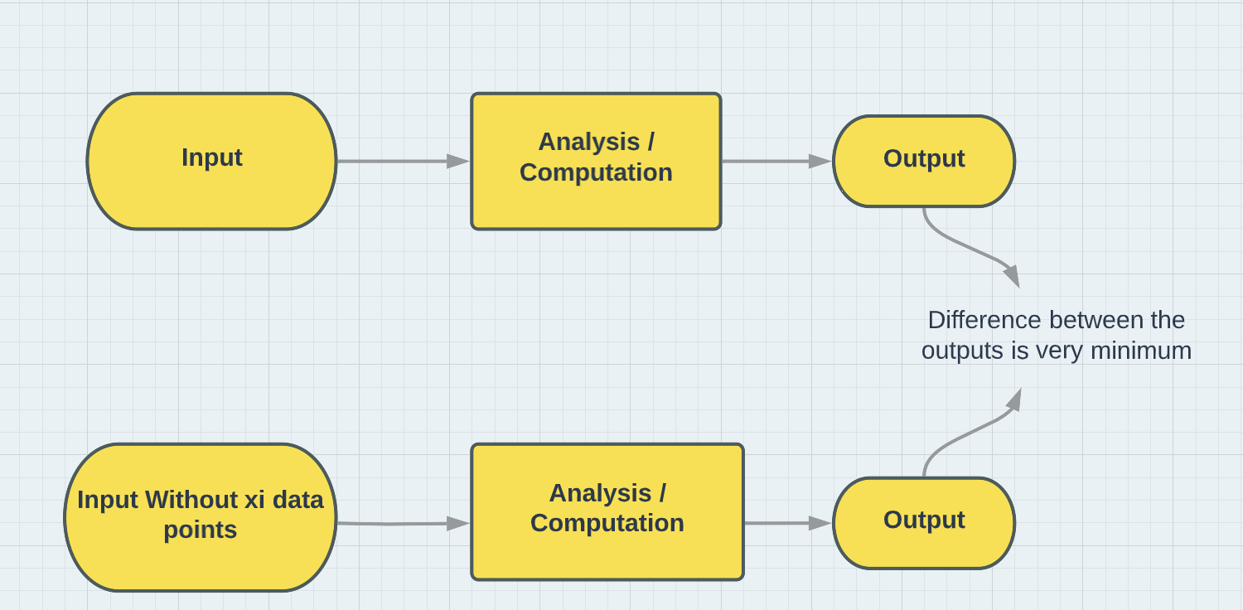
Previous related work
Differential Privacy:
Initial work on the privacy preservation is by Differential Privacy.
In this algorithm the output does not change significantly with altering the some data points in the data.

Slide 9
Implemented on large datasets
This technique was employed by various companies like Apple, Facebook, Google and many more.
Implemented on Medical Data, Employee Data etc.

Slide 10
Our Initial Problem
Given a set of edges P (Private edges) such that P ⊂ E in a Graph G (V, E) and an integer k > 1, we need to construct a (2k-1)-spanner H (V, F ⊆ E) of the Graph G such that F ∩ P = φ

Slide 11
Can we Avoid Private Data completely while building the model for our problem?
Is it possible to construct a spanner while excluding all the private edges?
May be difficult in some scenarios
Try to relax the above objective and construct a spanner with fewest possible Private Edges

Slide 12
Problem formulation
So, we can now formulate the problem from the Initial Problem
Given a set of edges P ⊂ E in a Graph G(V, E) and an integer k > 1, we need to construct a Spanner H (V, F ⊆ E) of the Graph G while minimizing the objective function of |F ∩ P|.

Slide 13
Linear Programming
To solve the above said problem, Our strategy is to formulate them as Linear Programming (LP) problems.
Implementing Pulp Package in Python for Linear Programming.
LP method in used in construction of optimizing the objective function.

Slide 14
Linear Programming
Linear Programming is a method to achieve the best outcome like Maximum profit or Lower cost to a model which has it’s representations by linear relationships.
Linear programming is widely implemented in the field of optimization.
Special cases such as Network Flow Problems can be solved by linear programming.

Slide 15
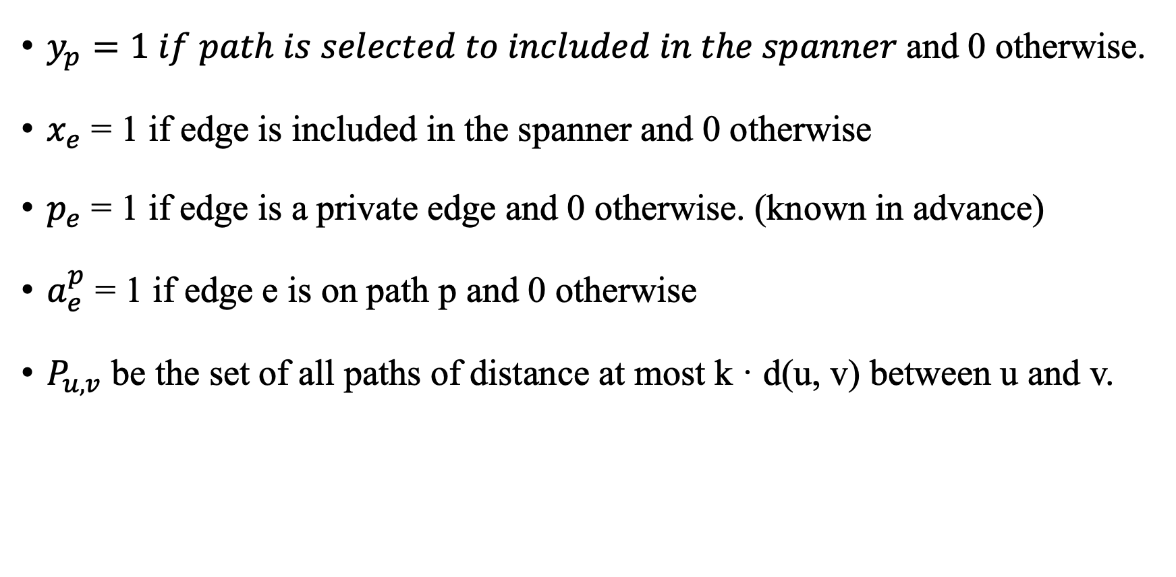
$y_{p}=1 if path is selected to included in the spanner$and 0 otherwise.
$x_{e}$ = 1 if edge is included in the spanner and 0 otherwise
$p_{e}$ = 1 if edge is a private edge and 0 otherwise. (known in advance)
$a_{e}^{p}$ = 1 if edge e is on path p and 0 otherwise
$P_{u,v}$ be the set of all paths of distance at most k · d(u, v) between u and v.

Slide 16
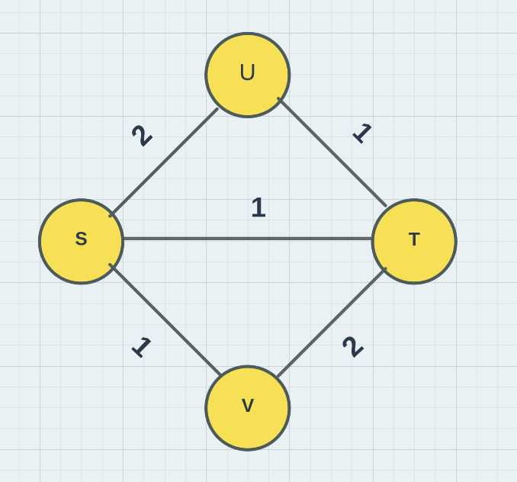
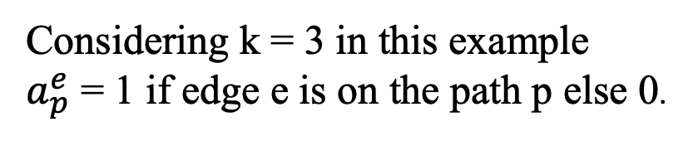
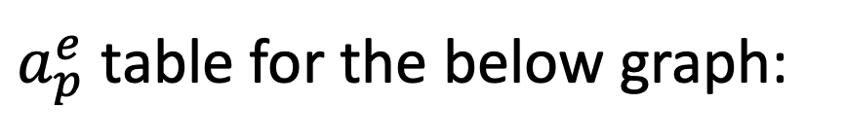
$a_{p}^{e}$ table for the below graph:
 | <S, U> | <U, T> | <S, T> | <S, V> | <V, T>
P1 <S, U, T> | 1 | 1 | 0 | 0 | 0
P2 <S, T> | 0 | 0 | 1 | 0 | 0
P3 <S, V, T> | 0 | 0 | 0 | 1 | 1
Considering k = 3 in this example
$a_{p}^{e}$ = 1 if edge e is on the path p else 0.
Distance P1 <S, U, T> = 3
Distance P2 <S, T> = 1
Distance P3 <S, V, T> = 3

Slide 17
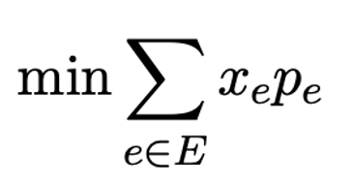
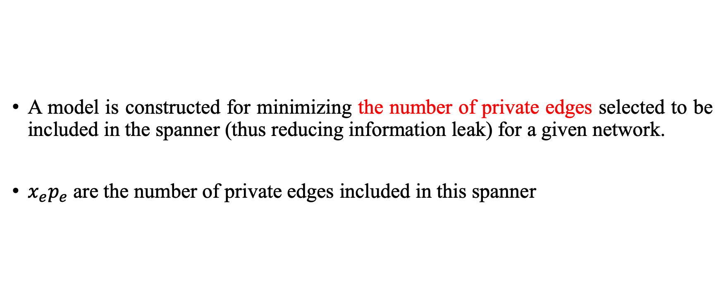
Main Objective Of the Linear Program
A model is constructed for minimizing the number of private edges selected to be included in the spanner (thus reducing information leak) for a given network.
$x_{e}p_{e}$ are the number of private edges included in this spanner

Slide 18
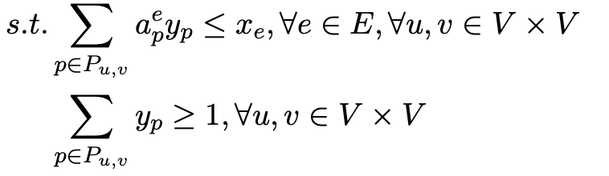
Constraints in the linear program
1st constraint: if a path is included in the spanner, all its edges are also included.
2nd constraint: For every node pair (constructing a spanner from source to target) there is at least a path P with distance at most k times the distance included in the spanner.
Relax every pair to some pair in the experiments for computational saving.

Slide 19
Datasets Implemented for analysis
Data Sets from Stanford SNAP project (https://snap.stanford.edu)
Facebook Dataset (88k edges and 4k node)
EPINIONS Dataset (508k edges and 75k nodes)

Slide 20
Performance Measures (Model Construction and Solving time)
Objective Function
The number of private edges included in the constructed spanner
LP Model Construction Time
The time to construct a linear program by adding constraints
LP Model Solving Time
The time of solving the linear program

Slide 21
Default Parameter Setting (Experiment A)
Considering 5 (s, t) pairs : Source – Target nodes are selected in random.
Edge Weights are not Considered (That is equal edge weights for all edges in the graph).
0.1 percent of edges of the graph are initially selected as private edges.
K = 2 (Spanner constructed should have distance max ‘k’ times of d(u, v)).
Number pairs = 1 (Number of (s, t) pairs selected to include in the spanner).
Early stop= True (Parameter set to only included minimum number of paths of all the available paths for the node pairs selected to obtain sub-optimal solution and so we early stop at a certain level).

Slide 22
Experiment A results (Facebook Dataset)
s – t pairs | Construction time | Solving Time | Number of Private edges included
s=2139, t=1359, distance=4 | 53.3 Seconds | 3.8 Seconds | 0
s=3405, t=2882, distance=3 | 56.5 Seconds | 3.9 Seconds | 0
s=2304, t=1961, distance=2 | 59.0 Seconds | 3.9 Seconds | 0
s=3240, t=383, distance=7 | 53.3 Seconds | 3.8 Seconds | 0
s=3297, t=415, distance=6 | 59.5 Seconds | 3.9 Seconds | 0
Range (in Seconds) | 56.32 ± 2.98 Seconds | 3.86 ± 0.054 Seconds
Table: Facebook Dataset for 5 (s-t) pairs (for Default Setting)

Slide 23
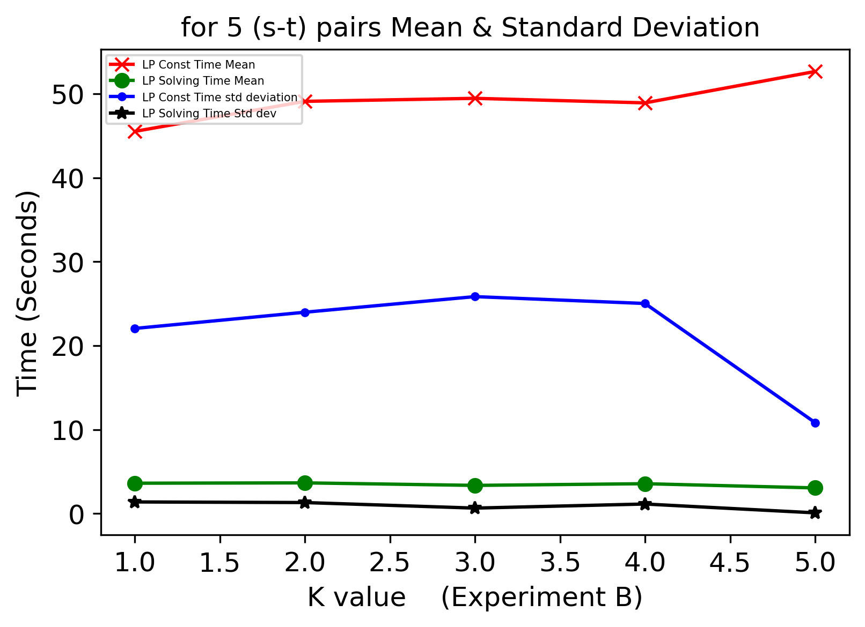
Experiment B results (Facebook Dataset)
Experiment B: Changing k = [1, 2, 3, 4, 5] while keeping other parameters constant from the default experiment.
Mean and Standard Deviations of the Model Construction time and the Model Solving time for the Considered 5 (s-t) pairs.

Slide 24
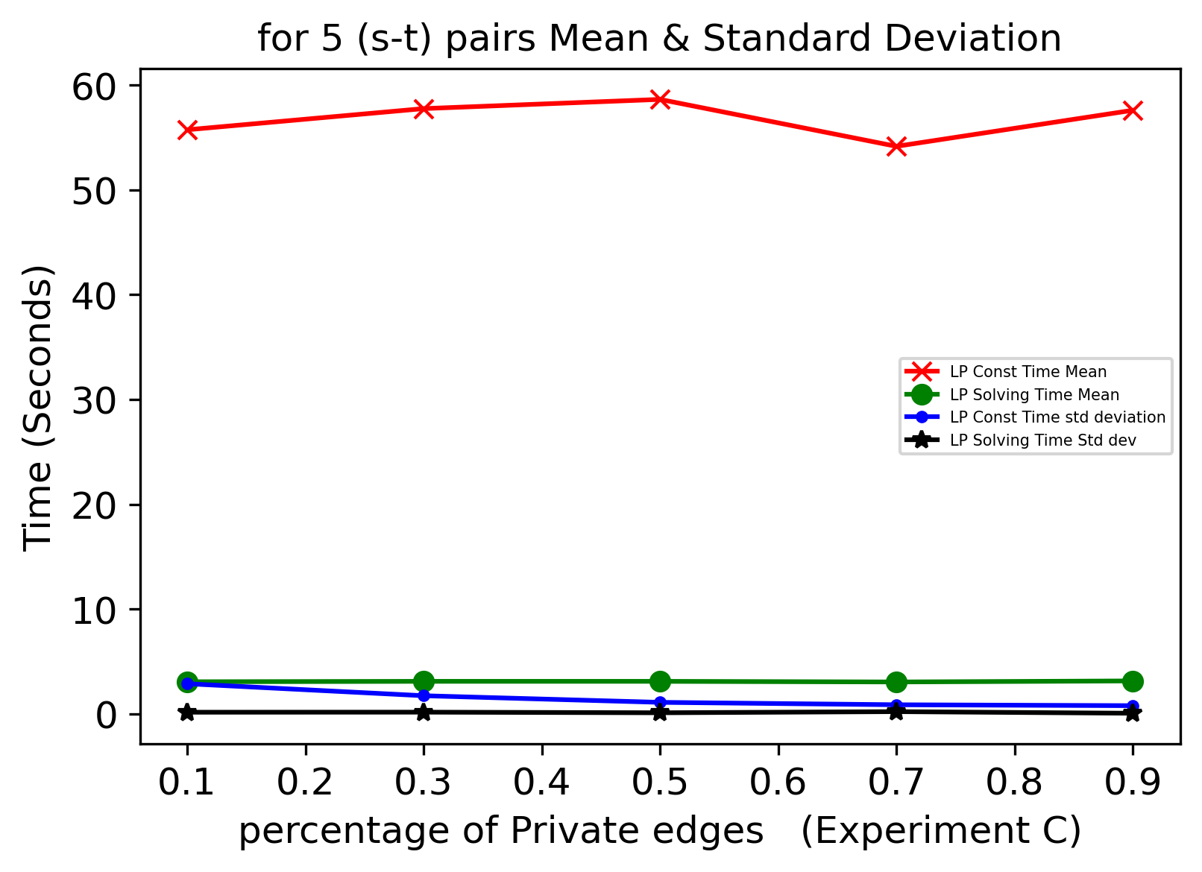
Experiment C results (Facebook Datatset)
Experiment C : Changing Percentage of private edges PercP = [0.1, 0.3, 0.5, 0.7, 0.9]

Slide 25
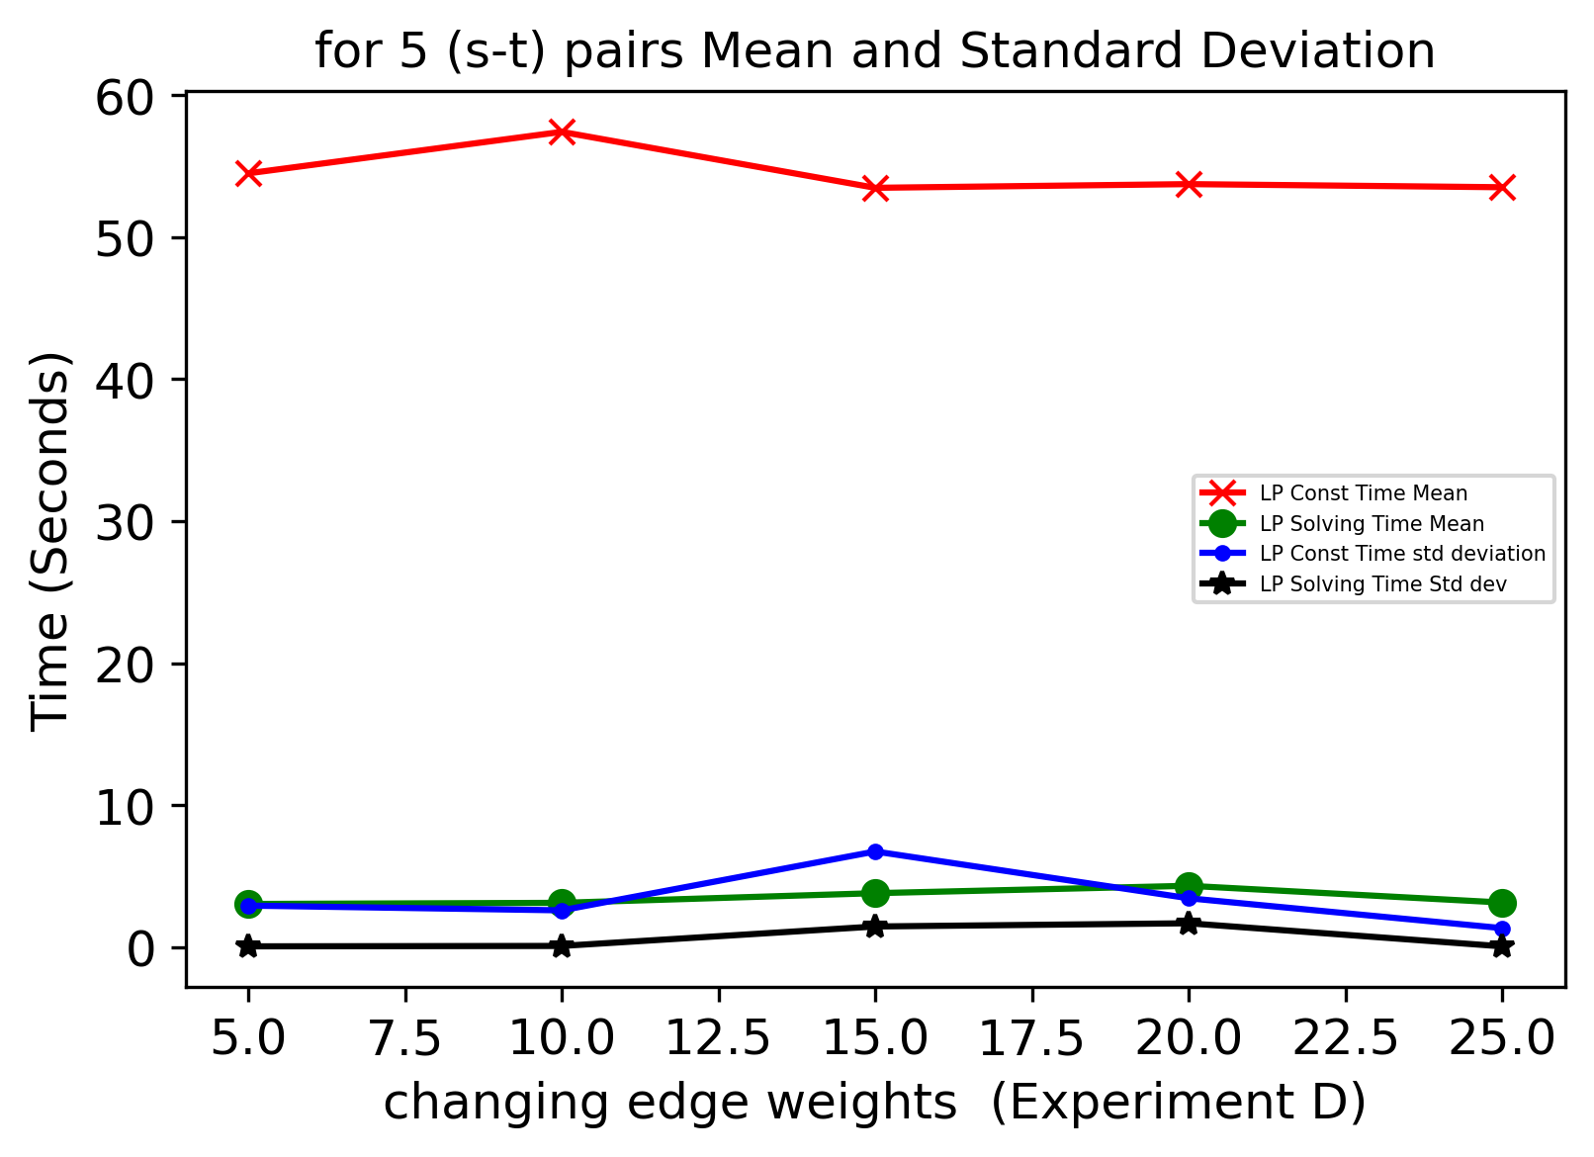
Experiment D results (Facebook Dataset)
Experiment D : Changing Edge Weights from False to True

Slide 26
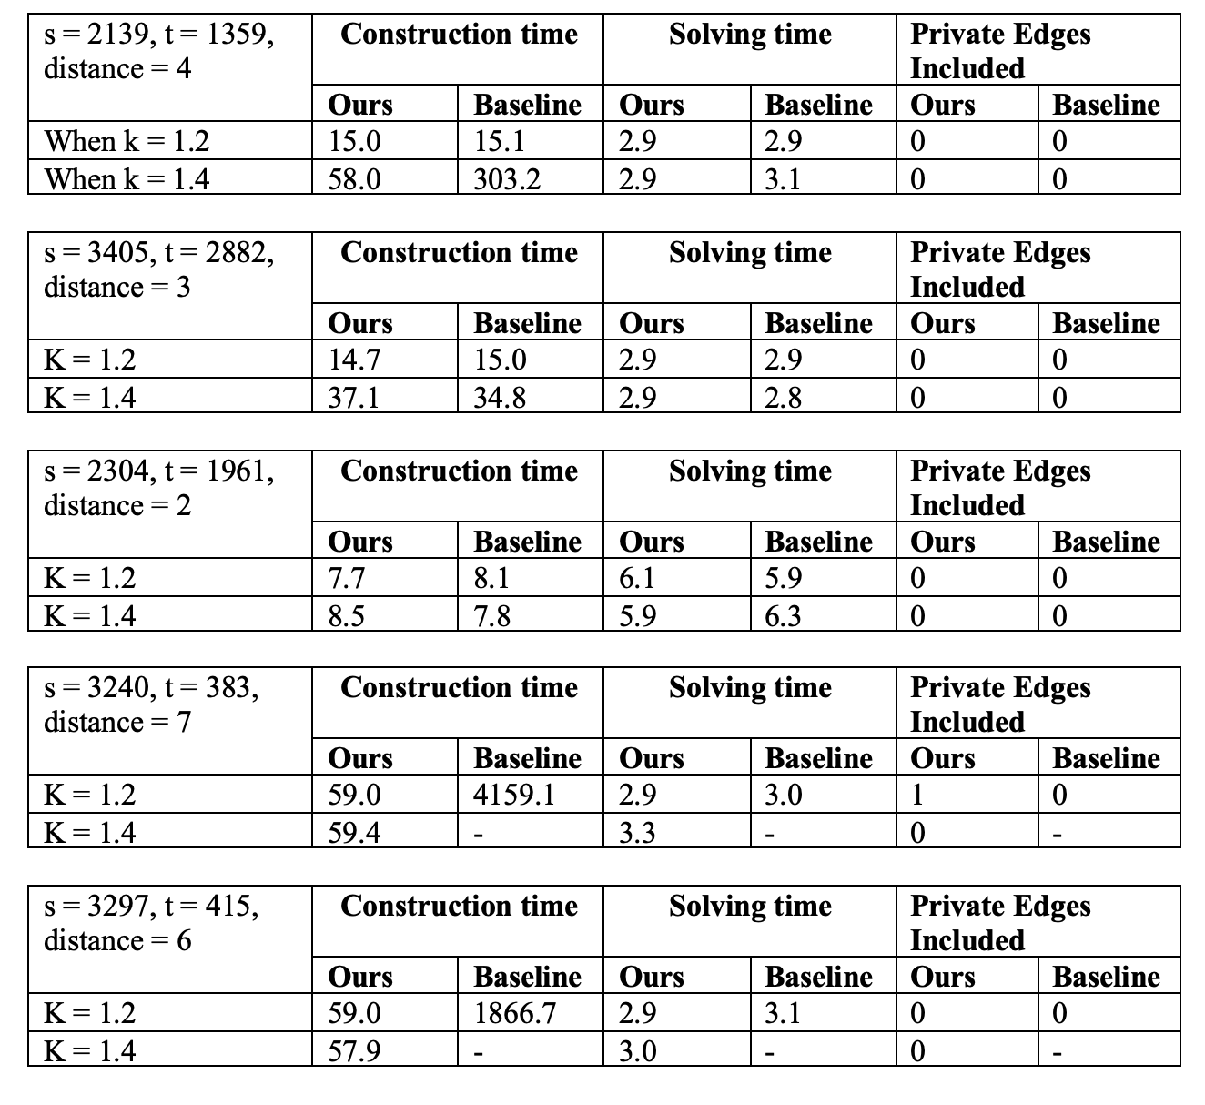
Experiment E results
Our method: We implement early stop
Baseline method : Without early stopping

Slide 27
Experiment A Results (EPINIONS Dataset)
s – t pairs | Construction time | Solving Time | Number of Private edges included
s=48722, t=723, distance=3 | 311.1 Seconds | 19.3 Seconds | 0
s=15605, t=11914, distance=4 | 303.5 Seconds | 19.4 Seconds | 0
s=42615, t=9901, distance=5 | 316.2 Seconds | 20.2 Seconds | 0
s=12365, t=14160, distance=3 | 316.0 Seconds | 19.9 Seconds | 0
s=54096, t=69623, distance=8 | 314.2 Seconds | 24.1 Seconds | 0
Range (in Seconds) | 312.2 ± 5.2 Seconds | 20.58 ± 2 Seconds
Table: EPINIONS Dataset for 5 (s-t) pairs.

Slide 28
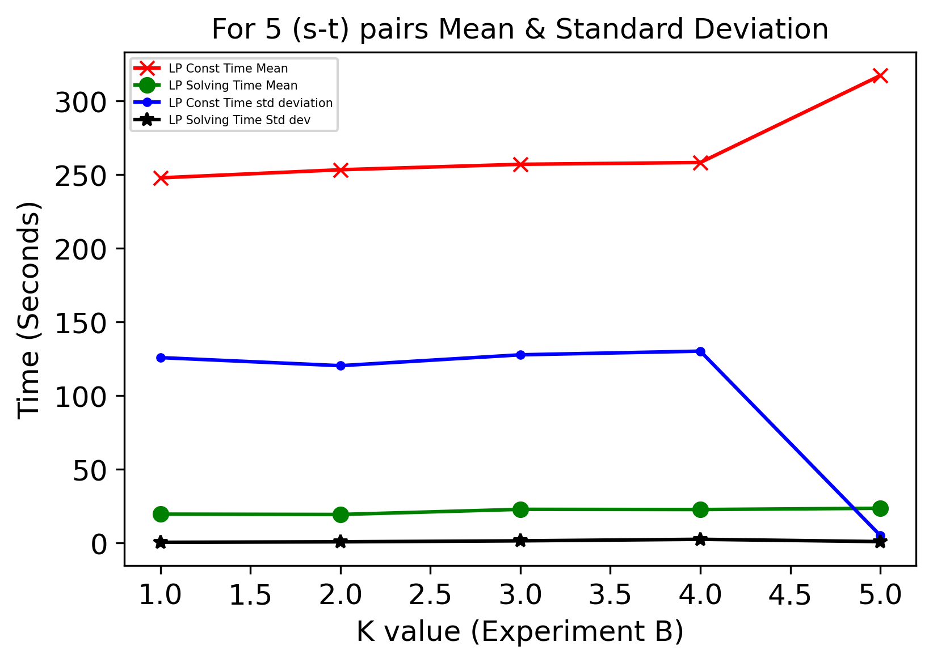
Experiment B (EPINIONS Dataset)
Changing k = [1, 2, 3, 4, 5] while keeping other parameters constant

Slide 29
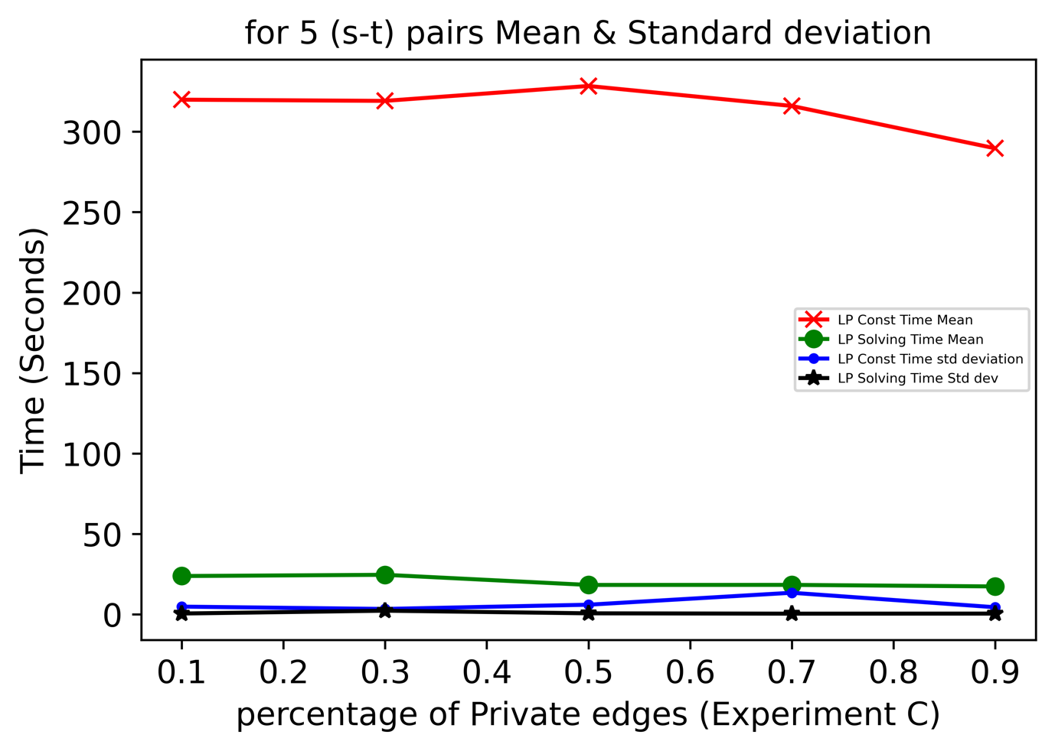
Experiment C (EPINIONS Dataset)
Experiment C : Changing Percentage of private edges PercP = [0.1, 0.3, 0.5, 0.7, 0.9]

Slide 30
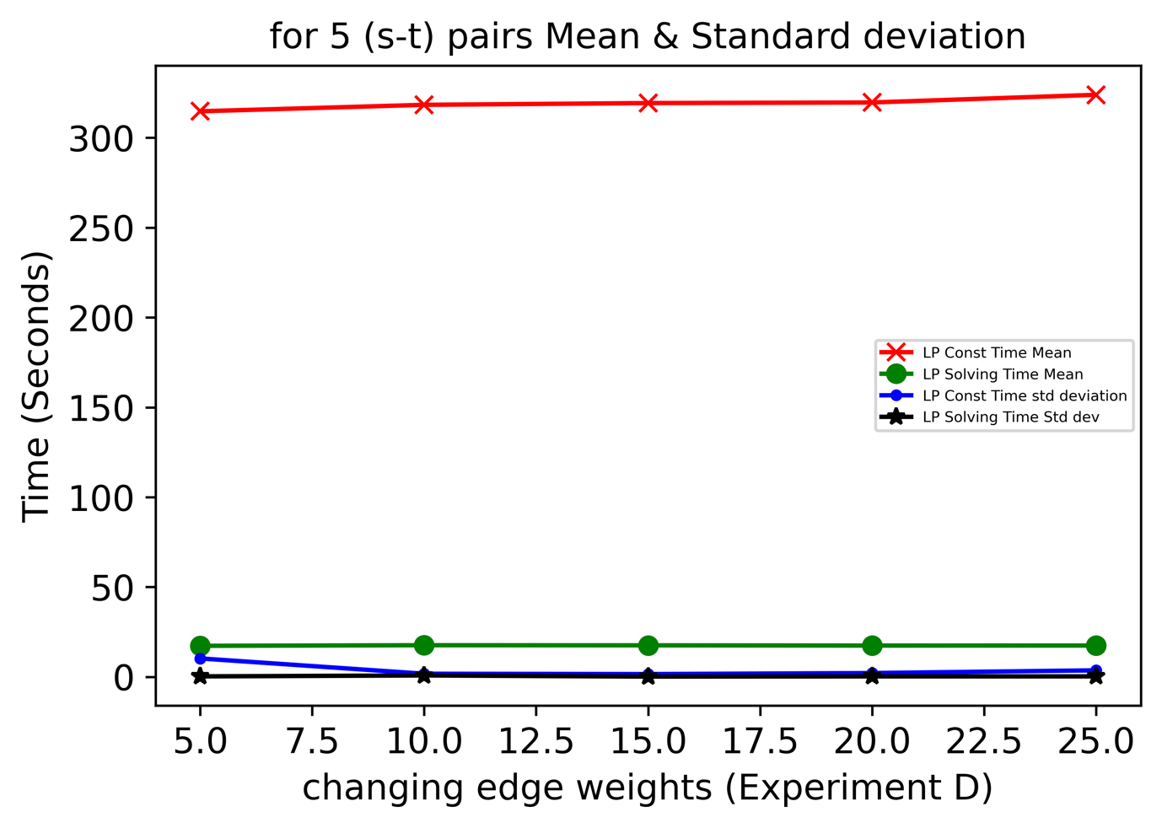
Experiment D (EPINIONS Dataset)
Experiment D : Changing Edge Weights from False to True

Slide 31
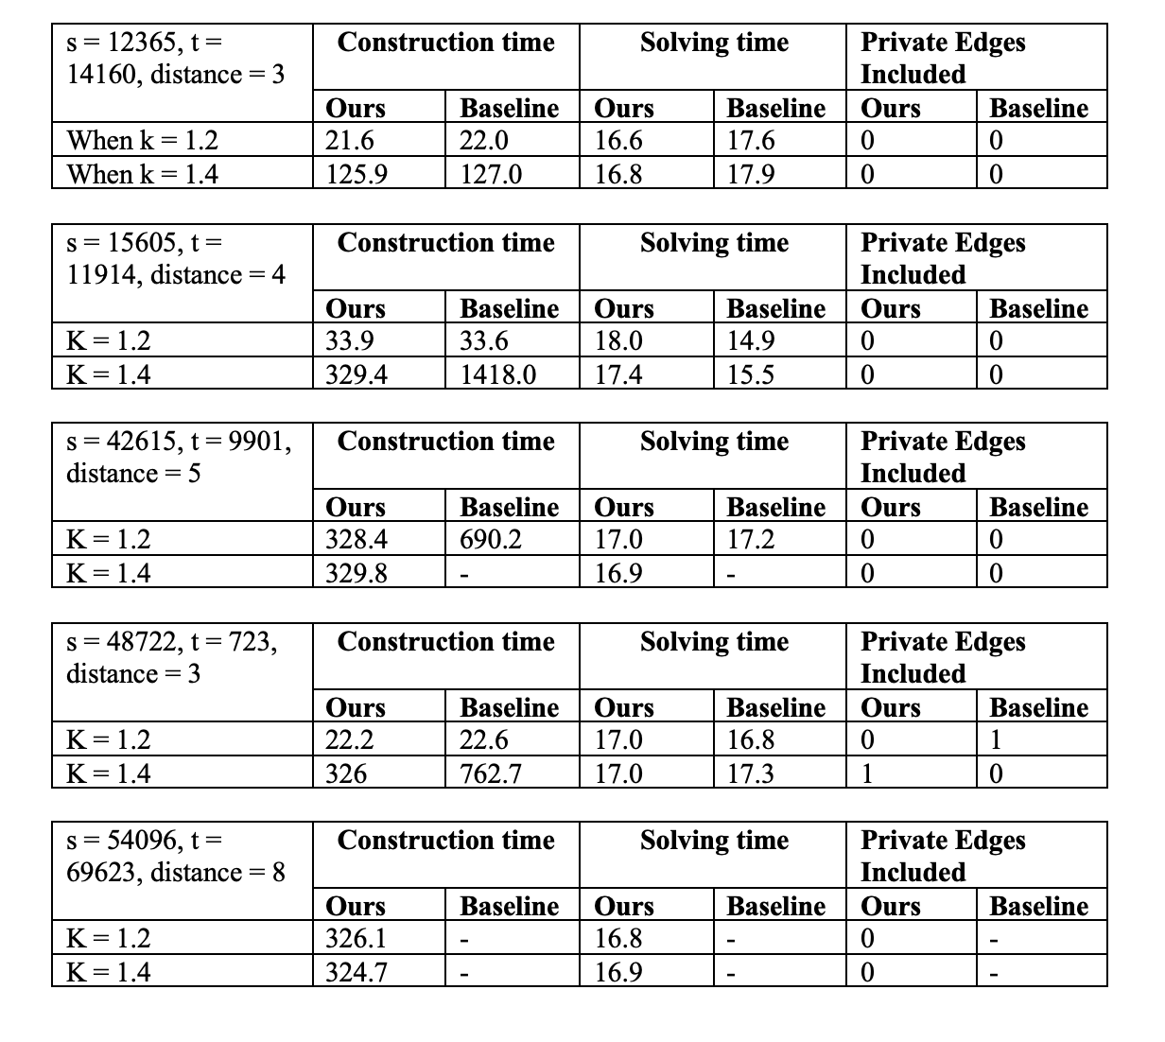
Experiment E results
Our method: We implement early stop
Baseline method : Without early stopping

Slide 32
Conclusion
In this project we implement the Objective function and get sub optimal solution in minimizing the private edges in a spanner.
Early stopping is set as we have less computational power and time.
Model performance is analyzed by several experiments.
As the future work, we can try to implement this algorithm for all the s-t pairs in the graph.

