Slide 1
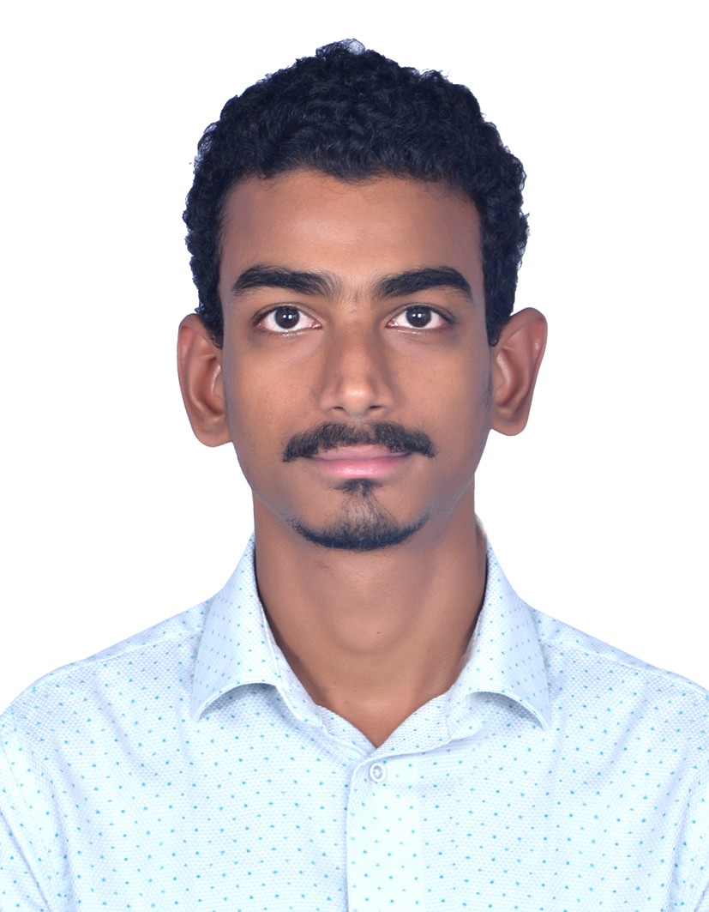
Name
Vijay Krishna K
Education : B.tech
Career : Software Engineer
Skills :
Java SE 8
JEE
Spring Framework 5.X
Spring boot
Restful services
SOAP
Microservices
Hibernate
Oracle, MySQL
Eclipse, Toad for Oracle, GIT
Grade:
C1 Consultant
City:
Hyderabad
Email:
vijaykrishnakrkd@gmail.com
Mobile:
+91 7093311069
Having 7 years and 10 months of experience as a Senior Software Engineer at Evergent Technologies Pvt Ltd, I have gained extensive expertise in both server-side and client-side programming. My experience includes all aspects of design and development using Java APIs and related technologies.
I have a strong background in web application development, particularly utilizing open-source MVC frameworks such as Spring Framework. Additionally, I possess deep expertise in Object-Oriented Programming (OOP) principles and practices.
We provide Over-The-Top (OTT) services to customers by leveraging our product to manage user life cycles and entitlement checks. Our approach involves utilizing the company’s CRM portal to define Subscription Video on Demand (SVOD) and Transactional Video on Demand (TVOD) products based on market segments. Additionally, we handle tasks such as managing taxes, invoices, and email communications through this portal. We also integrate with third-party services for payment processing.
Involved in requirement analysis, Coding, developing and testing of various modules of project associated with and Running the back job threads for renewal process and mailing

