Slide 1
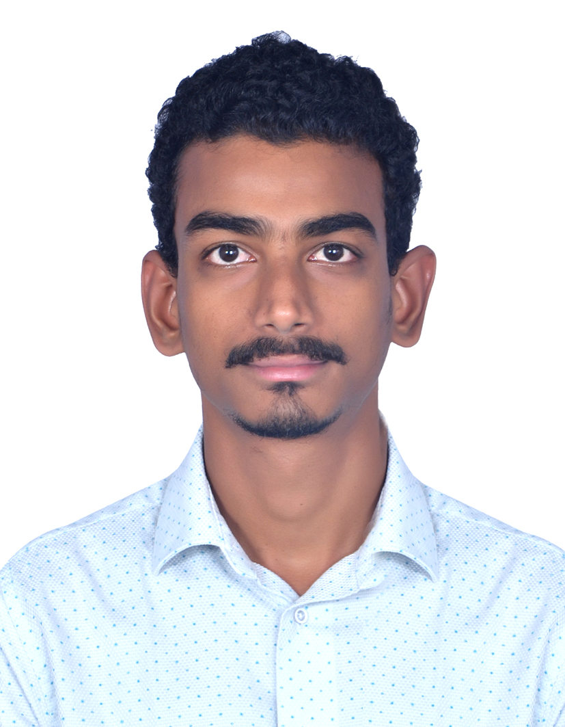
Summary
Having 7 years and 10 months of experience as a Senior Software Engineer at Evergent Technologies Pvt Ltd, I have gained extensive expertise in both server-side and client-side programming. My experience includes all aspects of design and development using Java APIs and related technologies. I have experience building end-to-end applications. I believe in providing solutions to complex problems. I am a technology enthusiast striving to keep pace with the competitive world.
Vijay Krishna K
Professional Experience & Key Projects
Certifications:
Worked as a Sr.Software Engineer
Skills:
Java SE 8
JEE
Spring Framework 5.X
Spring boot
Restful services
SOAP
Microservices
Hibernate
Oracle, MySQL
Eclipse, Toad for Oracle, GIT
vijay-krishna.kavalipurapu@capgemini.com
(m) :+91-7093311069
Involves utilizing the company’s CRM portal to define Subscription Video on Demand (SVOD) and Transactional Video on Demand (TVOD) products based on market segments by sharing the Restful APIs.
Handle tasks such as managing taxes, invoices, and email communications through this portal. We also integrate with third-party services for payment processing.
I have experience with creating APIs using Spring boot and Resuful API.
Associated with and Running the back job threads for renewal process and mailing
I have experience like Stream, lambda, API Gateway , S3.
I have experience with migrating monolith application to microservices architecture
I have working experience with CI/CD tool such as JMS, Kubernetes, Jenkins and git.
EDUCATION
B. Tech (ECE) in JNTUK University

