Slide 1
Introduction to Django

Slide 2

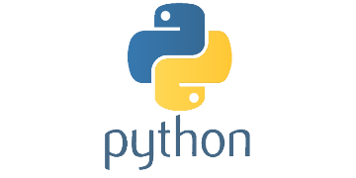



Build Web
apps using
Python

Slide 3



Who's using Python?

Slide 4

Introduction
Django is developed by Django Software Foundation.
Django makes it easier to build better Web apps more quickly and with less code
Django was designed to help developers take applications from concept to completion as quickly as possible.

Slide 5
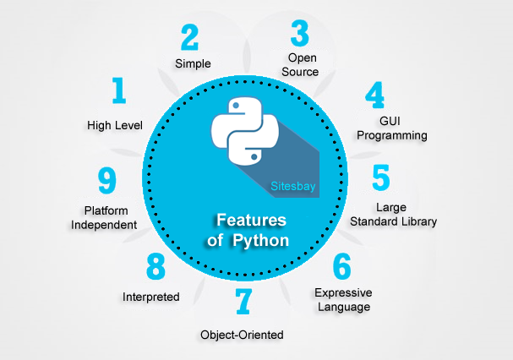
FEATURES
PYTHON IS EASY
PYTHON LETS YOU BUILD MORE FUNCTIONS WITH FEWER LINES OF CODE
PYTHON IS FLEXIBLE
IT HAS A TON OF RESOURCES
DJANGO, A HIGH-LEVEL PYTHON WEB FRAMEWORK, IS FLAT-OUT AMAZING

Slide 6
Practical Work in Django
Quick Start Django Project with Python
Migration of Database
What is MTV
Using Conditions in Python
Git Hub Dependencies.

Slide 7
About GIT
Create New Repository
Initialize Repository
Add files to Repository
Commit your work
Push data to online Repository
Pull data from Repository

Slide 8
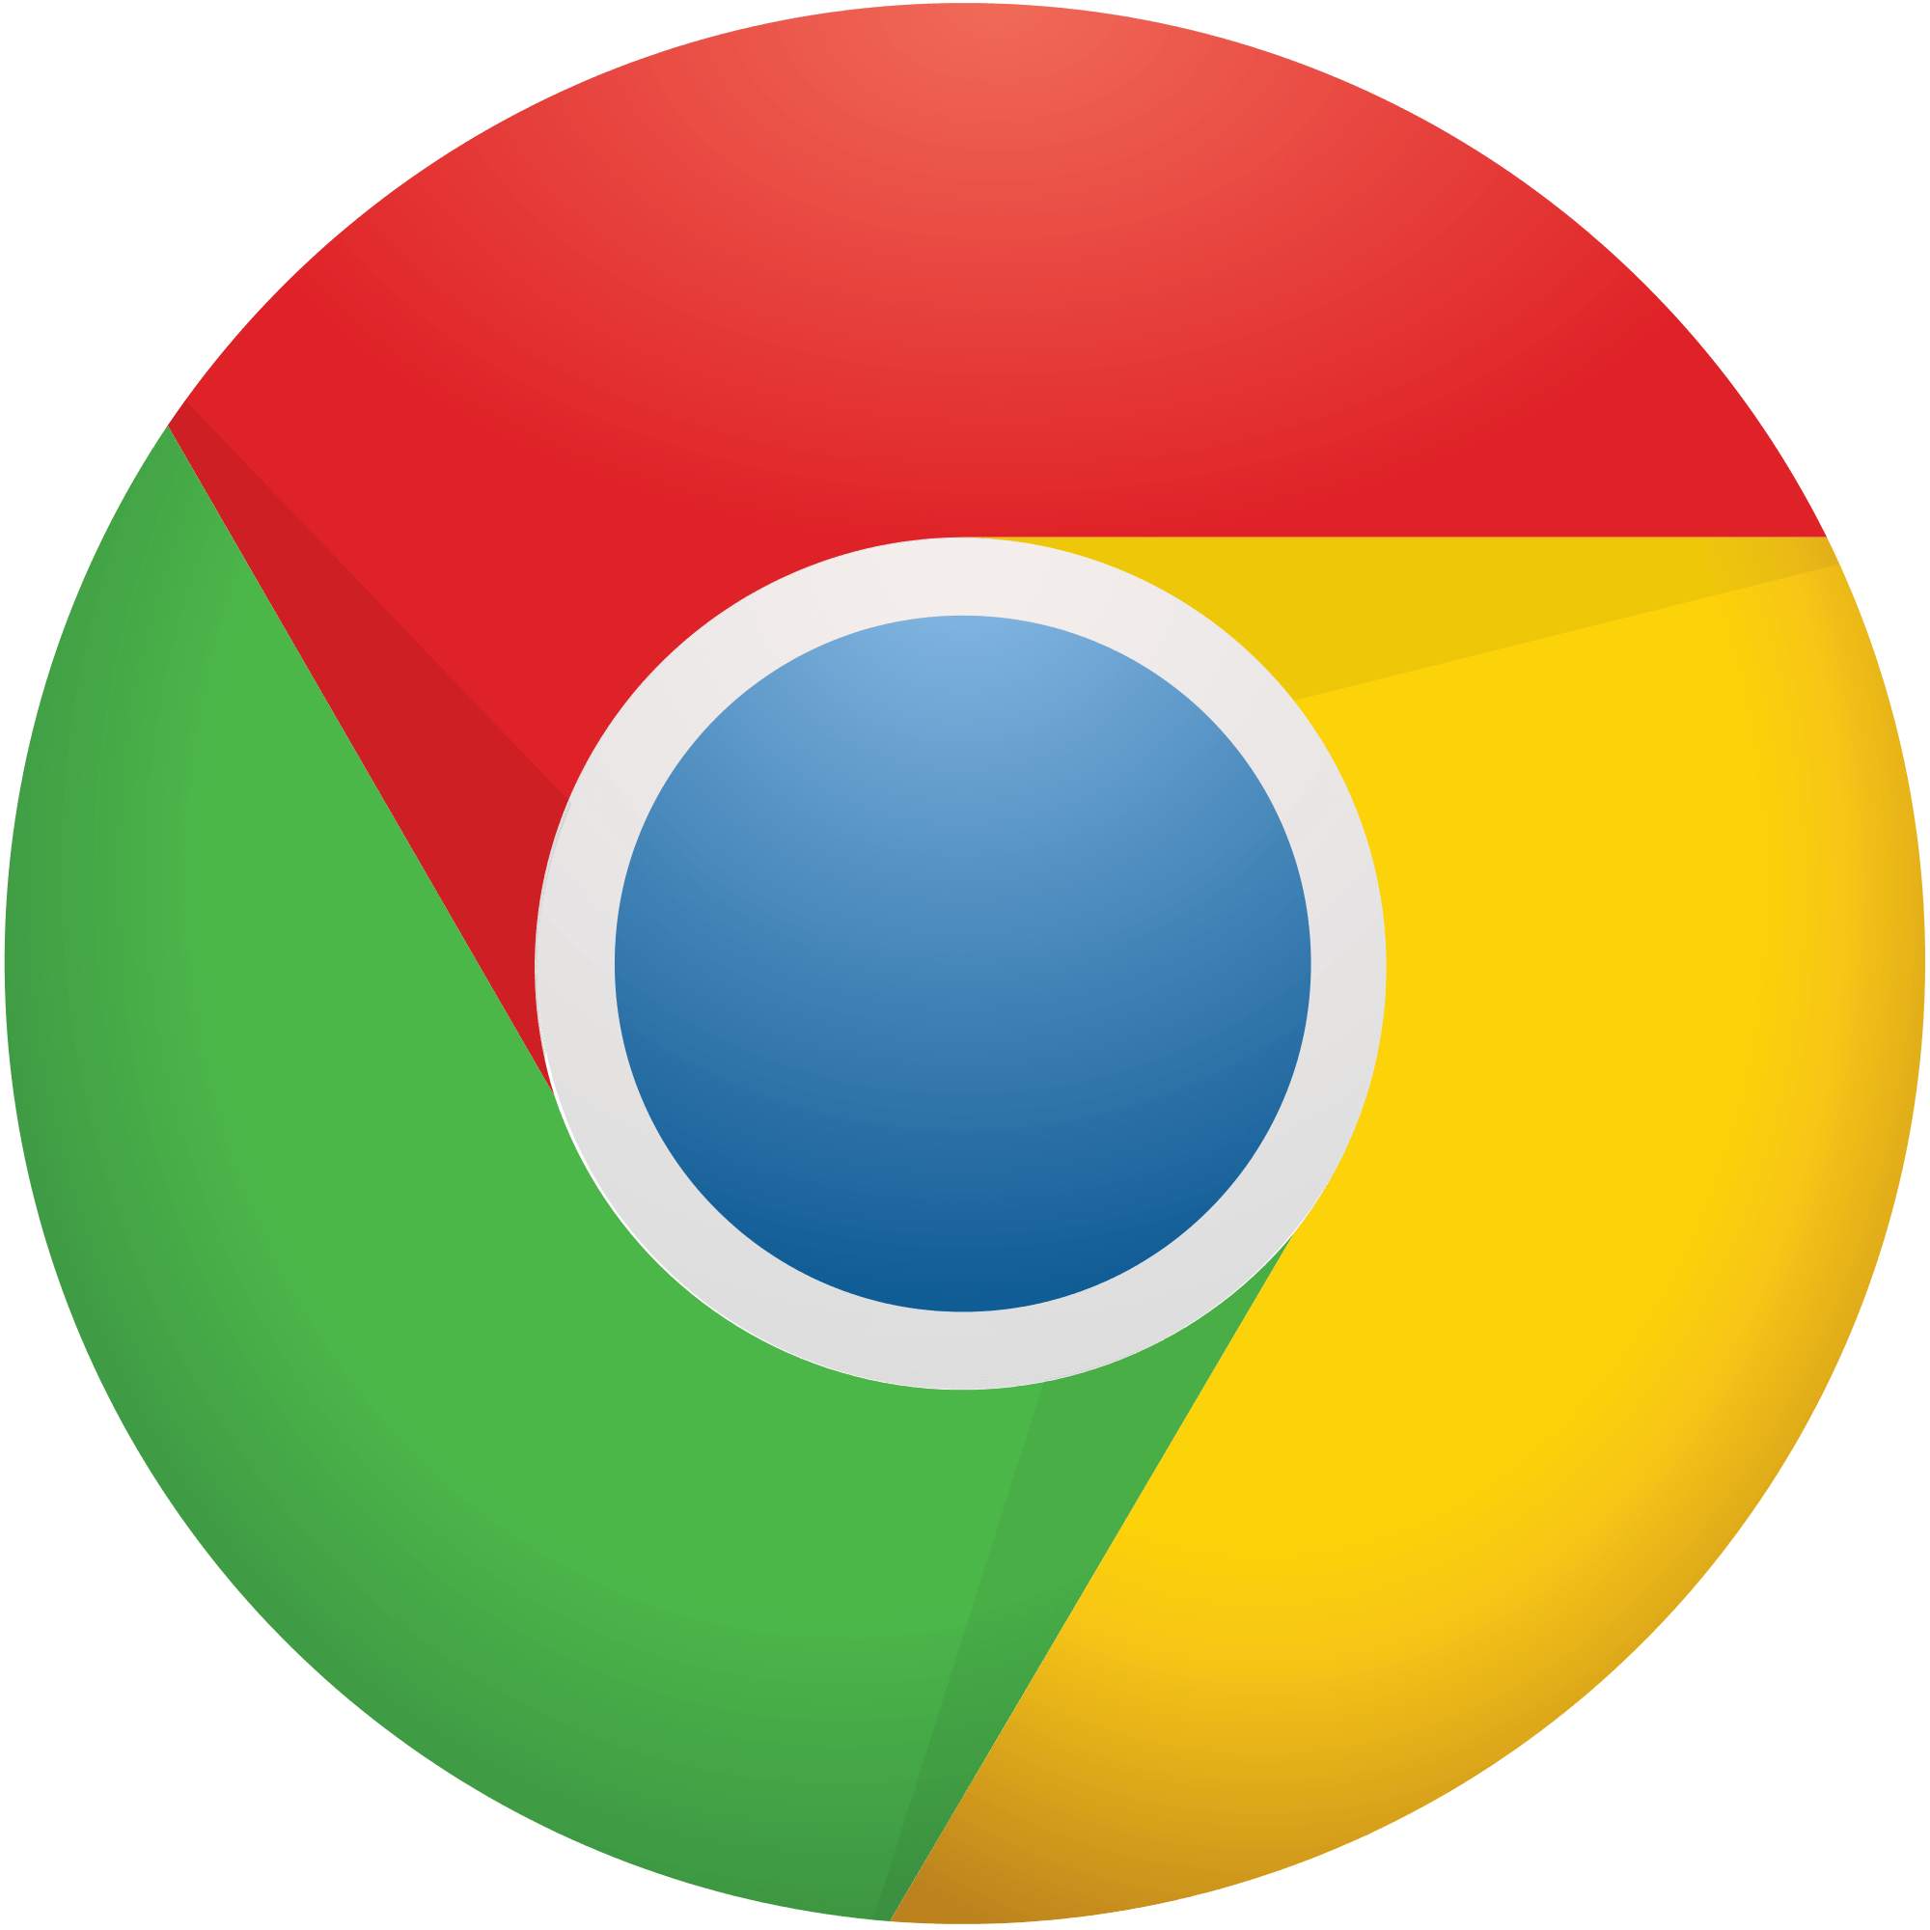

Software
Anaconda
https://conda.io/docs/download.html
Web Browser (Chrome)
Hardware
Hard Drive : 80 GB
RAM : 8GB or Minimum
Internet Connection: 2 Mbps Minimum, 10 Mbps recommended.
Requirement

