Slide 1

Creating Web Application
using Django

Slide 2
Templates are a key part to understanding how Django really works and interacts with your website (HTML,CSS).
Later on we will discuss, how templates interact with database models and create dynamic data.

Slide 3
For now we will discuss about basics of templates.
Template contains static part of our website as well as dynamic with the help of template tags
Now the question is what are template tags.

Slide 4
Templates adds special language to HTML pages called template language.
Django Template Tags are simple Python functions which accepts one or more value, an optional argument, process those values and return a value to be displayed on the page.

Slide 5
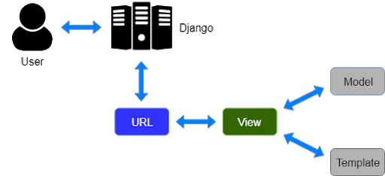
Basically template tags allows us to add dynamic content to HTML page.

Slide 6
Create directory inside project folder (template)
Change proj> proj> settings.py file
TEMPLATE_DIR= os.path.join(BASE_DIR,”template”)
Add TEMPLATE_DIR to TEMPLATE list >dictionary “DIRS”
Create view > use render function to return HTML page as a response
Map URLS to that view

Slide 7
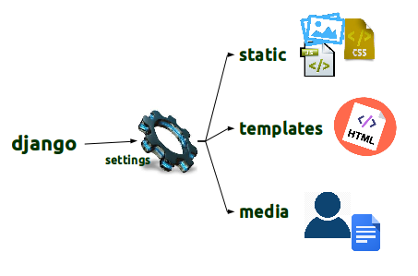
DJANGO STATICFILES
Add media to your website
Images / Bootstrap / Javascript etc.
Image Source

Slide 8
So far, we have done Django templates and how to insert dynamic data into templates
Now we will move further to Django staticfiles.
As in our previous lecture, we have created a very simple HTML page.

Slide 9
What if we want to add some styles, animation to our website?
The answer is Django staticfiles.
Websites generally need to serve additional files such as images, JavaScript, or CSS. In Django, we refer to these files as “static files”.

Slide 10
Steps to add staticfiles
First of all, we will create a new directory/folder inside of the project called static ( just like we did for templates)
Then we will add this folder path to the project’s settings.py file

Slide 11
Steps to add staticfiles
Once we’ve done that we need a place to store our static image/bootstrap files
You can create different directories inside static directory for image, CSS, JS files
Place files inside relevant directory

Slide 12
Steps to add staticfiles
Now set up template tags inside HTML file
{% load static %}
Then to insert the image with an HTML <img> tag using:
<img src={%static “images/img.jpg” %} />

Slide 13
Relative URLs
with Templates

Slide 14
Relative URL with templates
So far we write a hard code url to open a page
Now we will discuss about how to use anchor tag to access django views
Here we will use name parameter of path() function

Slide 15
Relative URL with templates
Also we had discussed we can create multiple apps in single project
We also create different urls for different apps to avoid complexity
Let’s get started!!!

Slide 16
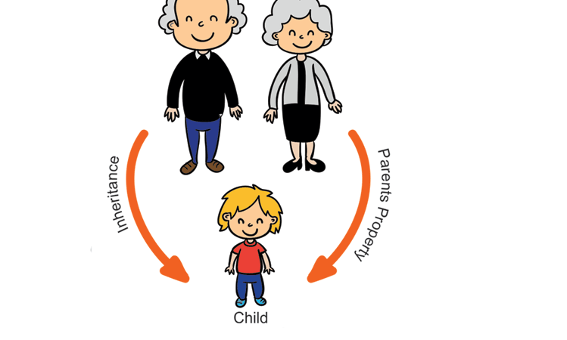
TEMPLATE INHERITANCE

Slide 17
TEMPLATE INHERITANCE
Django follows DRY coding principles.
Template inheritance allows us to create a base template, we can inherit from.
A base template can have multiple child template

Slide 18
TEMPLATE INHERITANCE
Template inheritance saves a lot of time and maintain same look for all pages.
To create a child template from base template we use “extends” keyword inside template language.

Slide 19

Django
Administration

Slide 20
DJANGO ADMIN
The main part of a website is to accept information from a user, store it on to database and maintain this information.
Almost all website has an admin panel, which monitor overall information of an website.

Slide 21
Who is admin?
An administrator (admin) is someone who can make changes on a website that will affect other users.
Admin can change security settings, add user, delete user etc.
In simple words we can say, admin has all rights to view, change information.

Slide 22
DJANGO ADMIN
Luckily, Django has an built-in admin panel.
So,it saves a lot of time and effort to design and program admin part manually.

Slide 23
DJANGO ADMIN commands
python manage.py makemigrations appname
python manage.py migrate
TO CREATE USER
python manage.py createsuperuser
username,email,password

Slide 24

Django
Models

Slide 25
DJANGO MODELS
We use Django models to include database in our Django Project.
By default Django uses SQLite, but we can customize it according to requirement.

Slide 26
DJANGO MODELS
In settings.py you can change ENGINE parameter to custom database.
To create database tables we will use app’s models.py file.
We inherit table class from Django’s built in class
django.db.models.Model

Slide 27

Customizing
Admin Panel

Slide 28
CUSTOMIZING ADMIN PANEL
We can customize admin interface by doing:
Change order of fields
Adding search field
Adding filters to a table
Create a table view
Making fields editable

Slide 29
CUSTOMIZING ADMIN PANEL
Automatic Date Time Field
Change UTC time to Asia/Kolkata
Add class Meta to remove extra “s”

Slide 30
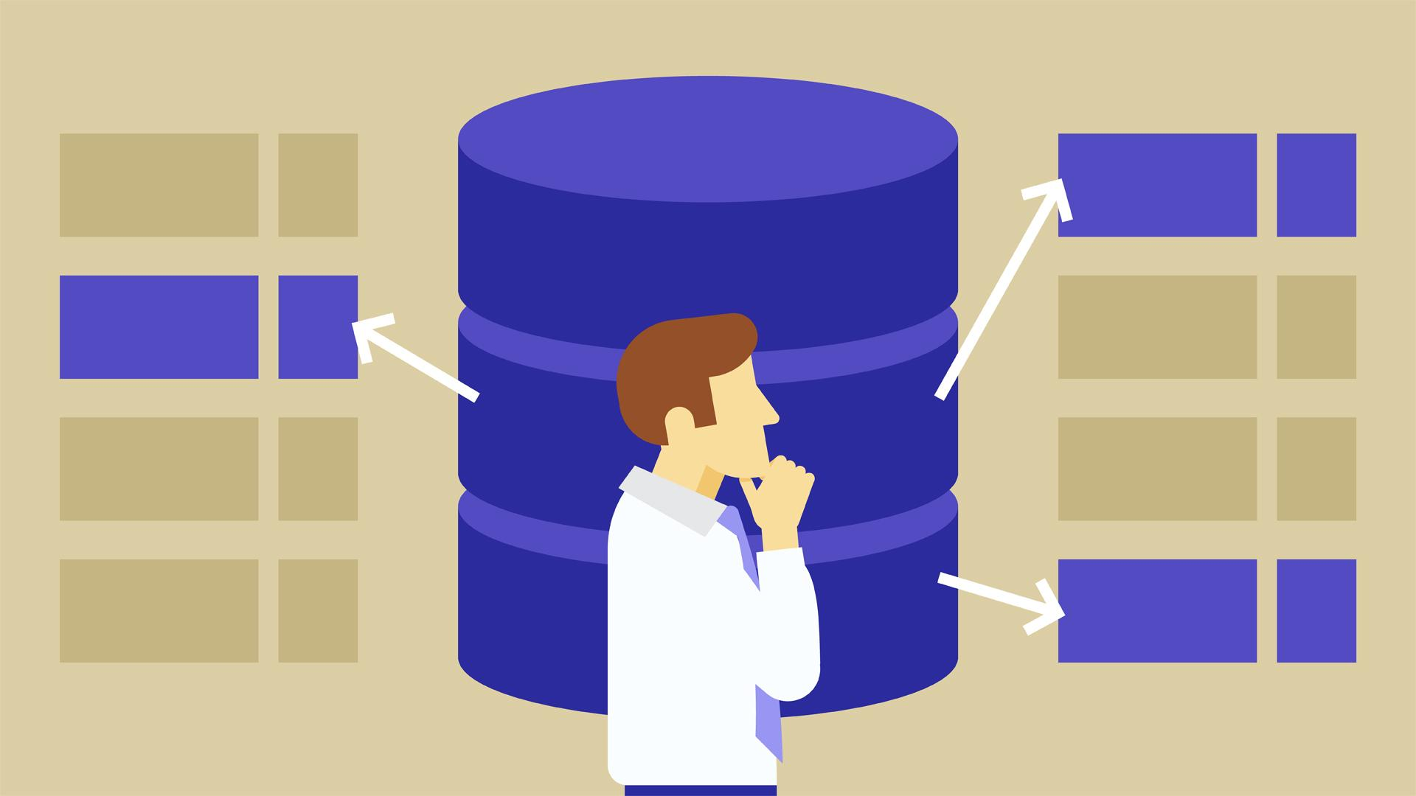
Save HTML form
data to
to Database

Slide 31
What is HTTP?
HTTP stands for Hypertext Transfer Protocol and is designed to enable communication between a client and a server.
The client submits a request, the server then responds.

Slide 32
GET & POST
The most commonly used methods for this request/response protocol are GET and POST.
GET - requests data from a resource
POST - submits data to be process to a resource.

Slide 33
What is CSRF?
This is a Cross-Site Request Forgery (CSRF) token, which secures the HTTP POST action that is initiated on the subsequent submission of a form.
The Django framework requires the CSRF token to be present with POST method

Slide 34
What is CSRF?
If it is not there, your form may not work!
It works by using a “hidden input” which is a random code and checking that it matches the user’s local site page.

Slide 35

Working with files
(Django)

Slide 36
Working with files
So far, we had discussed a lot about Django Model Template Views etc.
Now we will move further to upload files on using Django.
We can use Django’s FileField() and ImageField() for the same.

Slide 37
Working with files
First of all we will create a media folder inside project folder.
Next step is to add media path to settings.py file.
Django stores all uploaded files to media folder and its path to models.

Slide 38
Working with files
We can upload all types of files (.jpg, .mpeg, .mp4, .ogg,.pdf etc.) with the help of file filed.
We can extract data and show these files in HTML (templates).
Let’s get started!!!

Slide 39
Working with files
Create media folder
Change settings and urls file
Create a model > migrations > migrate
Register model in admin.py
Extract model fields to HTML
Div/Dropdown

Slide 40

Django Registration
& User Model

Slide 41
Django registration
It is time to move further to Registration and Login part.
For this, we need to understand what is User Modal.
User model is django’s built in tool which exists in authenticate system.

Slide 42
USER MODEL
The User object has a few key features:
Username
Email
Password
First Name
Last Name

Slide 43
USER MODEL
There are also some other attributes for the User object, such as is_active, is_staff, is_superuser etc.
Sometimes you will also want to add more attributes to a user, such as contact number or a profile image.

Slide 44
USER MODEL
We can do this in your applications models.py file by creating another class that has a relationship to the User class.
Let’s get started!!!

Slide 45
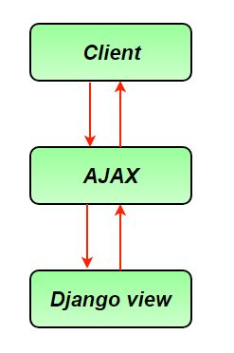

AJAX with Python
& Django

Slide 46
What is ajax
AJAX stands for Asynchronous JavaScript and XML (eXtensible Markup Language)
With AJAX we can send and retrieve data on server asynchronously i.e. without reloading the page.

Slide 47
AJAX APPLICATION
Registration (Website)
Online Cricket Scoring
Cart

Slide 48
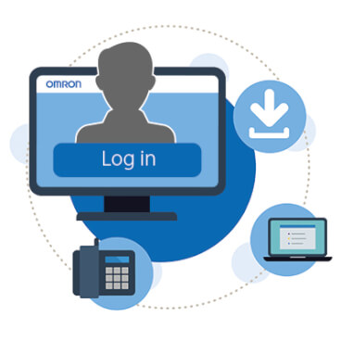
Django Login,
Logout, auth

Slide 49
DJNAGO LOGIN SYSTEM
In this section we will discuss about login system in django.
For this we will use django’s built in authentication system.
Let’s Get started!!!

Slide 50
DJNAGO LOGIN SYSTEM
HttpResponseRedirect() according to user type
Template inheritance in dashboard page
Base.html > dashboard_base.html
Inherit after login pages from dashboard_base.html

Slide 51
DJNAGO LOGIN SYSTEM
Fetch Login User data in HTML
logout user
Customize options using built-in authentication
Login required decorator

Slide 52
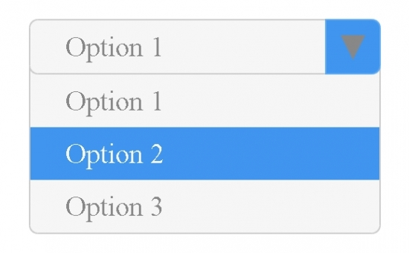
Selected Select Option
in Templates

Slide 53
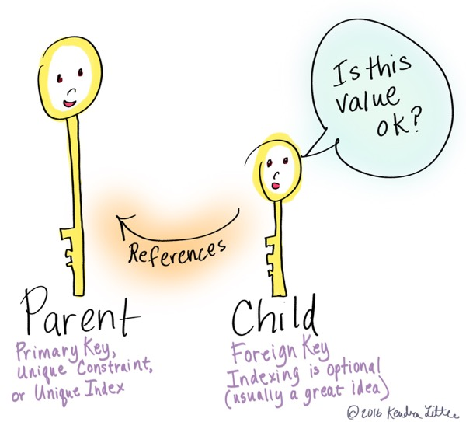
Foreign
Key

Slide 54
What is Foreign key?
A foreign key is a column or group of columns in a relational database table that provides a link between data in two tables
A foreign key can have different name than the primary key it comes from

Slide 55
What is Foreign key?
A primary key used by foreign key is also known as parent key.
The table where the parent key from is known as parent table.
Foreign key is used to make sure that row in one table refers the another table.

Slide 56
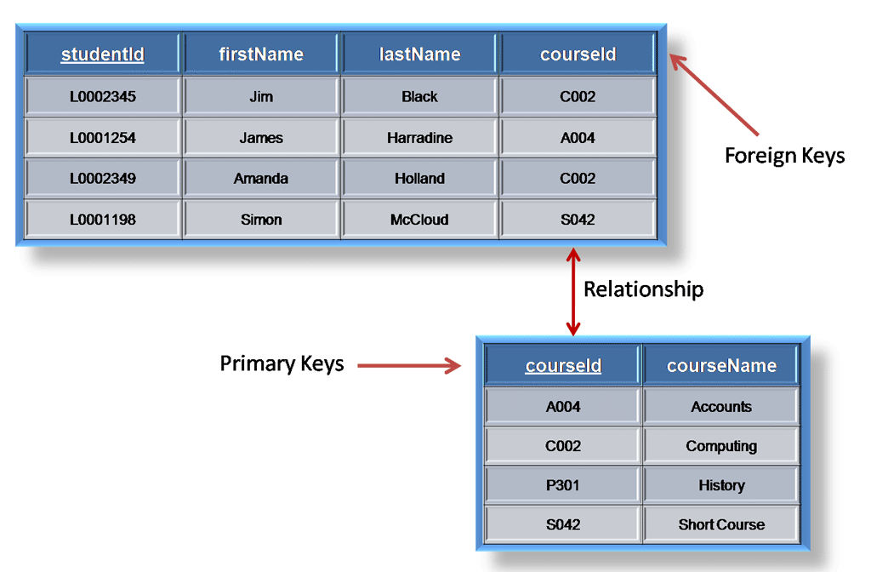
What is Foreign key?

Slide 57
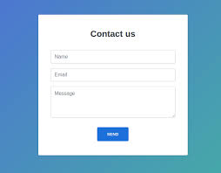
Model Forms
In
Django

Slide 58
Model Forms in Django
Create model (database table)
Create forms.py file inside app folder
Create form class in forms.py file
Add class Meta()
Model name
Fields (exclude,__all__)

Slide 59
What is Foreign key?
Import form class to view.py file
Render form object to templates using context dictionary
Fetch form to html file
{{form}}
{{form.as_p}}
{{form.as_table}}

Slide 60
STEPS TO ADD BOOTSTRAP IN DJANGO FORMS
Install bootstrap4 library
Pip install django-bootstrap4
Add bootstrap4 to project’s settings.py
Load bootstrap4 to html file where you want
{{bootstrap_form form}}

Slide 61
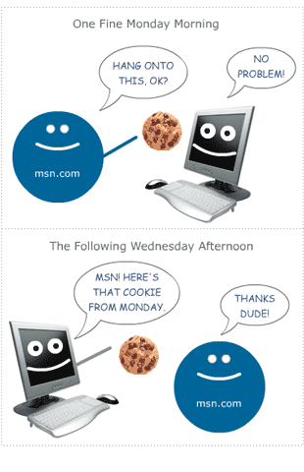
Cookies
In
Django

Slide 62

What are cookies?
A cookies is a small amount of a data from a specific website stored in user’s computer

