Slide 1
AI&RPA

Slide 2
Today we’ll discus:
Artificial Intelligence
AI Tools and its Applications
ML
MODELS USED IN ML
Neural networks and Deep learning
RPA
RPA TOOLS
BP APPLICATIONS
Current Projects in AI &RPA

Slide 3
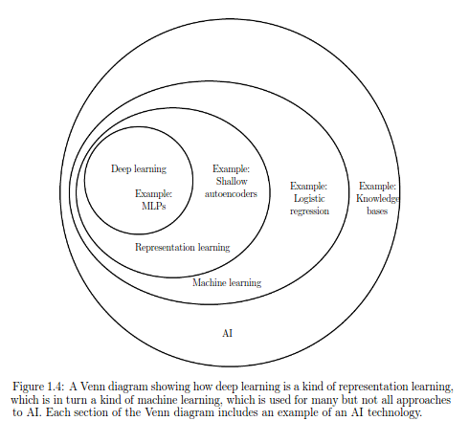
Artificial intelligence is a machine that mimics a "cognitive" function of human mind.
Artificial intelligence (AI, also machine intelligence, MI) is intelligence demonstrated by machines, in contrast to the natural intelligence (NI) displayed by humans and other animals. In computer science AI research is defined as the study of "intelligent agents": any device that perceives its environment and takes actions that maximize its chance of successfully achieving its goals. Colloquially, the term "artificial intelligence" is applied when a machine mimics "cognitive" functions that humans associate with other human minds, such as "learning" and "problem solving". ~Wiki

Slide 4
What’s involved in Intelligence?
Ability to interact with the world (speech, vision, motion, manipulation)
Ability to model the world and to reason about it
Ability to learn and to adapt

Slide 5
Goals in AI
To build systems that exhibit intelligent behavior
To understand intelligence in order to model it

Slide 6
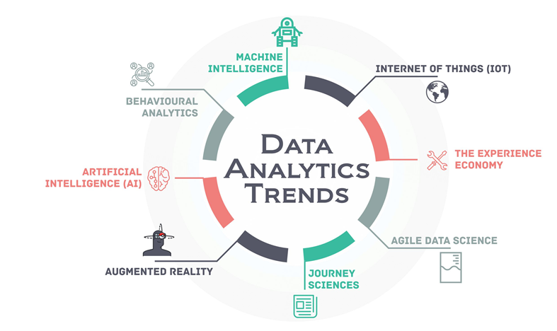
Common Applications/Use cases of these areas
Data Security
Personal Security
Financial Trading
Healthcare
Marketing Personalization
Fraud Detection
Recommendations
Online Search
Natural Language Processing (NLP)
Smart Things / Cars

Slide 7
Different types of roles in these areas
Artificial Intelligence/Machine Learning Specialist
VP of Artificial Intelligence & Advanced Analytics
Machine Learning Researcher
Machine Learning Engineer
Machine Intelligence Developer
Data Scientist
AI/Machine Learning Manager
Data Architect

Slide 8
Why Machine Learning?
No human experts
industrial/manufacturing control
mass spectrometer analysis, drug design, astronomic discovery
Black-box human expertise
face/handwriting/speech recognition
driving a car, flying a plane
Rapidly changing phenomena
credit scoring, financial modeling
diagnosis, fraud detection
Need for customization/personalization
personalized news reader
movie/book recommendation

Slide 9
Related Fields
data
mining
control theory
statistics
machine
learning
decision theory
information theory
cognitive science
databases
psychological models
evolutionary
models
neuroscience
Machine learning is primarily concerned with the accuracy and effectiveness of the computer system.

Slide 10
A few common machine learning models are:
Linear Regression
Logistic Regression
Decision Tree
SVM
Naive Bayes
kNN
K-Means
Random Forest
Dimensionality Reduction Algorithms
Gradient Boosting algorithms
GBM
XGBoost
LightGBM
CatBoost

Slide 11
Training, validation, and test datasets
Divide the total dataset into three subsets:
Training data is used for learning the parameters of the model.
Validation data is not used of learning but is used for avoiding overfitting.
Test data is used to get a final, unbiased estimate of how well the learning method works. We expect this estimate to be worse than on the training/validation data.
Often reduced to training and testing

Slide 12
Introduction to Python for machine learning
import matplotlib.pyplot as plt
import numpy as np
from sklearn import datasets, linear_model
from sklearn.metrics import mean_squared_error, r2_score
# Load the diabetes dataset
diabetes = datasets.load_diabetes()
# Use only one feature
diabetes_X = diabetes.data[:, np.newaxis, 2]
# Split the data into training/testing sets
diabetes_X_train = diabetes_X[:-20]
diabetes_X_test = diabetes_X[-20:]
# Split the targets into training/testing sets
diabetes_y_train = diabetes.target[:-20]
diabetes_y_test = diabetes.target[-20:]
# Create linear regression object
regr = linear_model.LinearRegression()
# Train the model using the training sets
regr.fit(diabetes_X_train, diabetes_y_train)
# Make predictions using the testing set
diabetes_y_pred = regr.predict(diabetes_X_test)
# The coefficients
print('Coefficients: \n', regr.coef_)
# The mean squared error
print("Mean squared error: %.2f"
% mean_squared_error(diabetes_y_test, diabetes_y_pred))
# Explained variance score: 1 is perfect prediction
print('Variance score: %.2f' % r2_score(diabetes_y_test, diabetes_y_pred))
# Plot outputs
plt.scatter(diabetes_X_test, diabetes_y_test, color='black')
plt.plot(diabetes_X_test, diabetes_y_pred, color='blue', linewidth=3)
plt.xticks(())
plt.yticks(())
plt.show()
Import packages
Create / load dataset
Identify / group feature & target
Training & Testing set [Concept of CV]
Prepare model object [initialize variables]
Fit training data[features & target]
Predict based on the trained model
Score models prediction accuracy

Slide 13
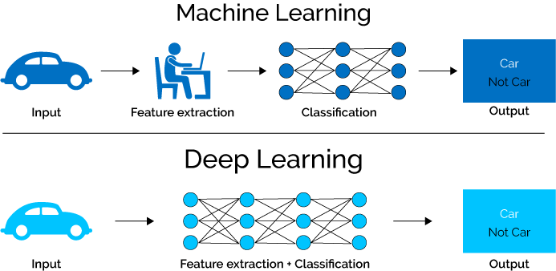
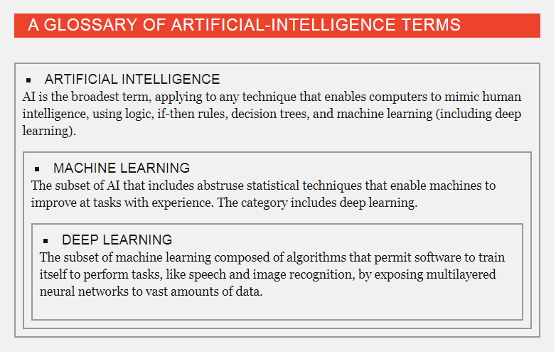
Neural Networks: NN
Where NN fits within the world of machine learning?

Slide 14
Robotic Process Automation
Introduction to Robotic Process Automation
Why RPA??
Robotic process automation (RPA) is the application of technology that allows employees in a company to configure computer software or a “robot” to capture and interpret existing applications for processing a transaction, manipulating data, triggering responses and communicating with other digital systems.

Slide 15
What is the need of Robotic Process Automation?
It Manage repeatable tasks
It reduce error rates
Improve standardization of work flow
Reduce error rates

Slide 16
Exist Automate Driven Applications
Windows application: any existing software(For eg: Team viewer or IT existing driven applications).
Browser Based application: (For eg: Gmail, Facebook, Twitter..etc).
Java based applications (eg:androidapps,gamesetc)
Main frame applications (SAP companies)

Slide 17
RPATools
There are 3 tools mostly used
1.Blue prism
2.Automation Anywhere
3.UI path

Slide 18
Description Of Each Tool
1.Blue prism: Blue prism is virtual workforce which refers to process automation where computer software drives the existing enterprise application (WindowsDesktop,Browser,Java,MainframeApllications)
It reacts with user interface and performs the actions what humans do.
https://www.blueprism.com/news/ai/blue-prism-wins-2018-artificial-intelligence-breakthrough-award
2.Automation Anywhere : Automation anywhere Is intelligent automation software, it provides intelligent task :recording, scheduling, editing & distribution capability, It is used to automate anykindof task from complex to simple, automate any web task windows Applications.
3.UI path :UiPathis a leadingRobotic Process Automationvendor providing a complete software platform to help organizations based on mainly Browser Based Applications with efficiently automate business processes.

Slide 19
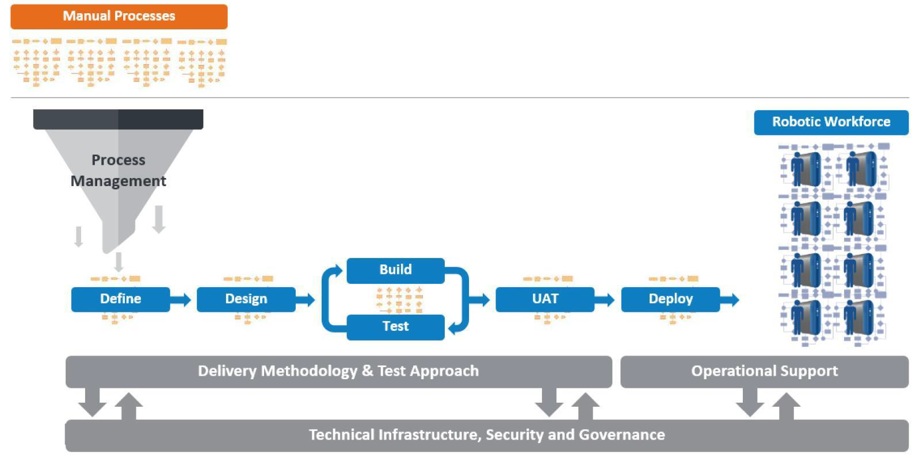
Architecture for RPA

Slide 20
REAL TIME APPLICATIONS USED IN INDUSTRIES
•Banking sectors
•BPO's sectors
•IT Companies
•DHL Couriers, Tracking sectors
•Manual Testing Purposes

Slide 21
Artificial Intelligence Award 2018
https://www.blueprism.com/news/ai/blue-prism-wins-2018-artificial-intelligence-breakthrough-award
Most powerful tool in AI

