Slide 1
Day1
What is the buzz around AI, ML, Deep learning, Neural networks, Analytics. What do all of these areas mean?
What is supervised vs unsupervised learning ? What is regression and classification ?
Common Applications/Use cases of these areas
Startups - Where is the industry heading?
Different types of roles in these areas
Tools used - Amazon Web Services, Python, Python packages to be used
Introduction to Python for machine learning
Introduction to packages packages - Deep dive Numpy, Scipy, Pandas and scikit-learn
Installing Python Modules

Slide 2
What is the buzz around AI, ML, Deep learning, Neural networks, Analytics. What do all of these areas mean?
Machine learning is a field of computer science that often uses statistical techniques to give computers the ability to "learn" (i.e., progressively improve performance on a specific task) with data, without being explicitly programmed. ~Wiki
Artificial intelligence (AI, also machine intelligence, MI) is intelligence demonstrated by machines, in contrast to the natural intelligence (NI) displayed by humans and other animals. In computer science AI research is defined as the study of "intelligent agents": any device that perceives its environment and takes actions that maximize its chance of successfully achieving its goals. Colloquially, the term "artificial intelligence" is applied when a machine mimics "cognitive" functions that humans associate with other human minds, such as "learning" and "problem solving". ~Wiki
Deep learning (also known as deep structured learning or hierarchical learning) is part of a broader family of machine learning methods based on learning data representations, as opposed to task-specific algorithms. Learning can be supervised, semi-supervised or unsupervised. ~Wiki
Deep learning architectures such as deep neural networks, deep belief networks and recurrent neural networks have been applied to fields including computer vision, speech recognition, natural language processing, audio recognition, social network filtering, machine translation, bioinformatics and drug design, where they have produced results comparable to and in some cases superior to human experts. ~Wiki
Artificial neural networks (ANNs) or connectionist systems are computing systems vaguely inspired by the biological neural networks that constitute animal brains. Such systems "learn" to perform tasks by considering examples, generally without being programmed with any task-specific rules. ~Wiki

Slide 3
What is supervised vs unsupervised learning ? What is regression and classification ?
Supervised learning is the machine learning task of learning a function that maps an input to an output based on example input-output pairs.
Unsupervised machine learning is the machine learning task of inferring a function to describe hidden structure from "unlabeled" data (a classification or categorization is not included in the observations). Since the examples given to the learner are unlabeled, there is no evaluation of the accuracy of the structure that is output by the relevant algorithm—which is one way of distinguishing unsupervised learning from supervised learning and reinforcement learning.
Reinforcement learning (RL) is an area of machine learning inspired by behaviourist psychology, concerned with how software agents ought to take actions in an environment so as to maximize some notion of cumulative reward. [E-2-ERN/DRL]
In statistical modeling, regression analysis is a set of statistical processes for estimating the relationships among variables. It includes many techniques for modeling and analyzing several variables, when the focus is on the relationship between a dependent variable and one or more independent variables (or 'predictors'). More specifically, regression analysis helps one understand how the typical value of the dependent variable (or 'criterion variable') changes when any one of the independent variables is varied, while the other independent variables are held fixed.
In machine learning and statistics, classification is the problem of identifying to which of a set of categories (sub-populations) a new observation belongs, on the basis of a training set of data containing observations (or instances) whose category membership is known. Examples are assigning a given email to the "spam" or "non-spam" class, and assigning a diagnosis to a given patient based on observed characteristics of the patient (gender, blood pressure, presence or absence of certain symptoms, etc.). Classification is an example of pattern recognition.

Slide 4
A few common machine learning models are:
Linear Regression
Logistic Regression
Decision Tree
SVM
Naive Bayes
kNN
K-Means
Random Forest
Dimensionality Reduction Algorithms
Gradient Boosting algorithms
GBM
XGBoost
LightGBM
CatBoost

Slide 5
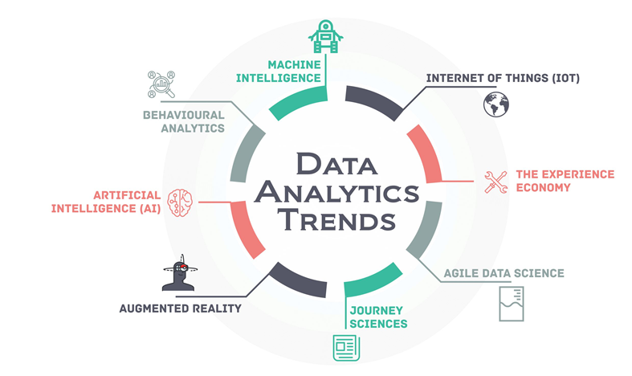
Common Applications/Use cases of these areas
Data Security
Personal Security
Financial Trading
Healthcare
Marketing Personalization
Fraud Detection
Recommendations
Online Search
Natural Language Processing (NLP)
Smart Things / Cars

Slide 6
Startups - Where is the industry heading?
2018
Absentia VR
Mad Street Den
A.I. empowered workflow for generating games.
Online fashion, mobile gaming, user engagement & analytics, IoT and connected cars, and photos & social media.
Flutura
big data analytics solutions
Niki.Ai
AI-powered shopping assistant.
Uncanny Vision
AI-based surveillance solutions.
Innefu Labs
cybersecurity solutions pertaining to biometrics authentication and multi-factor authentication, besides data analysis to predict and prevent virtual threats.
Netradyne
IoT-based Driveri platform. This is a driver monitoring device for commercial and fleet management companies.
Active.Ai
AI and SaaS-enabled platform that connects consumers with its banking partners through micro-conversations
FORMCEPT
unified data analysis platform. It helps enterprises get actionable insights from their data faster
Staqu
automated image understanding technology.

Slide 7
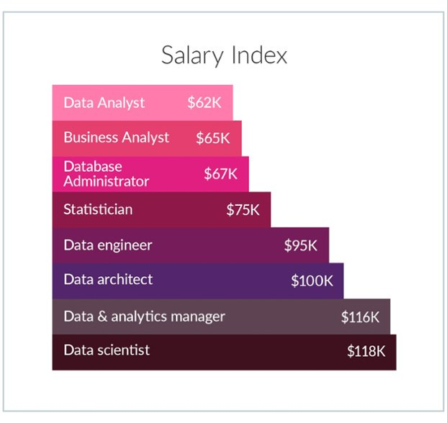
Different types of roles in these areas
Artificial Intelligence/Machine Learning Specialist
VP of Artificial Intelligence & Advanced Analytics
Machine Learning Researcher
Machine Learning Engineer
Machine Intelligence Developer
Data Scientist
AI/Machine Learning Manager
Data Architect

Slide 8
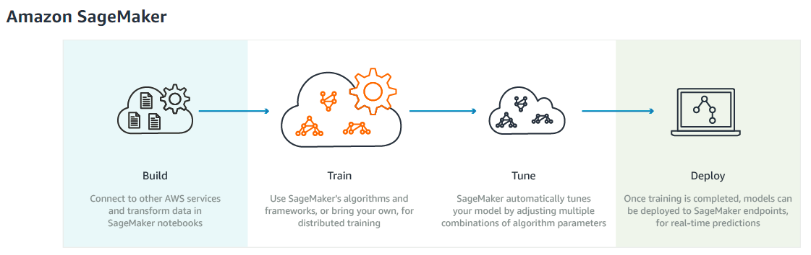
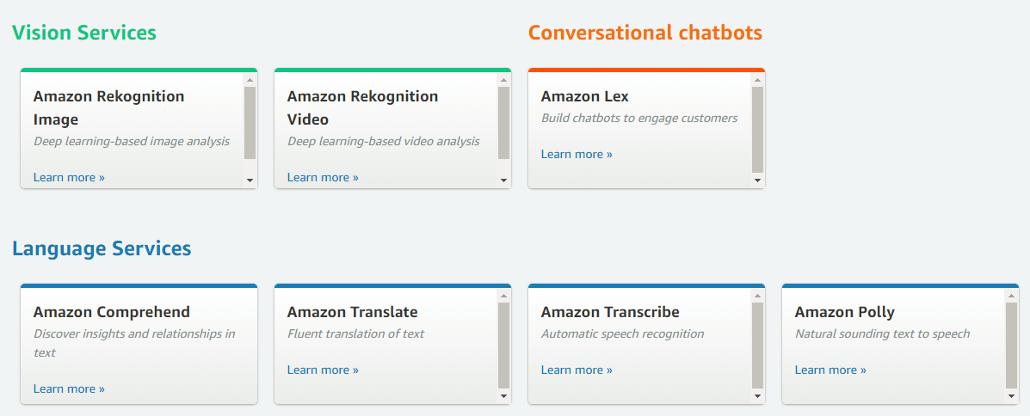
Tools used - Amazon Web Services, Python, Python packages to be used
Python 3.X
PIP - https://www.lfd.uci.edu/~gohlke/pythonlibs
Pip install joblib
Numpy+MKL,
Scipy,
Matplotlib,
Pillow,
Pandas,
Scikit-learn,
Scikit-image,
TensorFlow,
Keras,
Hyperas,
Joblib
**Remember: TensorFlow supports Python 3.5.x and 3.6.x on Windows.

Slide 9
Python Hands on - Function, looping techniques, list comprehensions, Tools
def funct(arg_11, arg_2, ..., arg_n): print(“This is a function.”) return 1
for j in range(10): print "Value number " + str(j) +" is "+value[j] for j in range(10,0,-2): x = x + j print x while (b < a): print "b is less than a." b=b+1 for j in range(0,10): while(k < j): print "j = " + str(j) + " k = "+str(k) if (j == 1): break k=k+1 print "j equals k or j equals 1" a = ["abc","def","ghi"] for x in a: print x
s = ["Lee", "Walsh", "Roberson"] s2 = ["Williams", "Redick", "Ewing", "Dockery"] s3 = [s, s2] print s3[1][2]
a = zeros((3,5)) a[1,2] = 8 print a
b = arange(25) b = reshape(b,5,5)
b=reshape(b,5,1) print concatenate((b,a),axis=1)
Notes:
https://www.astro.ufl.edu/~warner/prog/python.html

Slide 10
Introduction to packages - Deep dive Numpy, Scipy, Pandas and scikit-learn
https://docs.scipy.org/doc/numpy/user/index.html
https://docs.scipy.org/doc/scipy/reference/
https://pandas.pydata.org/pandas-docs/stable/api.html
http://scikit-learn.org/stable/documentation.html
https://matplotlib.org/tutorials/index.html

Slide 11
Introduction to Python for machine learning
import matplotlib.pyplot as plt
import numpy as np
from sklearn import datasets, linear_model
from sklearn.metrics import mean_squared_error, r2_score
# Load the diabetes dataset
diabetes = datasets.load_diabetes()
# Use only one feature
diabetes_X = diabetes.data[:, np.newaxis, 2]
# Split the data into training/testing sets
diabetes_X_train = diabetes_X[:-20]
diabetes_X_test = diabetes_X[-20:]
# Split the targets into training/testing sets
diabetes_y_train = diabetes.target[:-20]
diabetes_y_test = diabetes.target[-20:]
# Create linear regression object
regr = linear_model.LinearRegression()
# Train the model using the training sets
regr.fit(diabetes_X_train, diabetes_y_train)
# Make predictions using the testing set
diabetes_y_pred = regr.predict(diabetes_X_test)
# The coefficients
print('Coefficients: \n', regr.coef_)
# The mean squared error
print("Mean squared error: %.2f"
% mean_squared_error(diabetes_y_test, diabetes_y_pred))
# Explained variance score: 1 is perfect prediction
print('Variance score: %.2f' % r2_score(diabetes_y_test, diabetes_y_pred))
# Plot outputs
plt.scatter(diabetes_X_test, diabetes_y_test, color='black')
plt.plot(diabetes_X_test, diabetes_y_pred, color='blue', linewidth=3)
plt.xticks(())
plt.yticks(())
plt.show()
Import packages
Create / load dataset
Identify / group feature & target
Training & Testing set [Concept of CV]
Prepare model object [initialize variables]
Fit training data[features & target]
Predict based on the trained model
Score models prediction accuracy

Slide 12
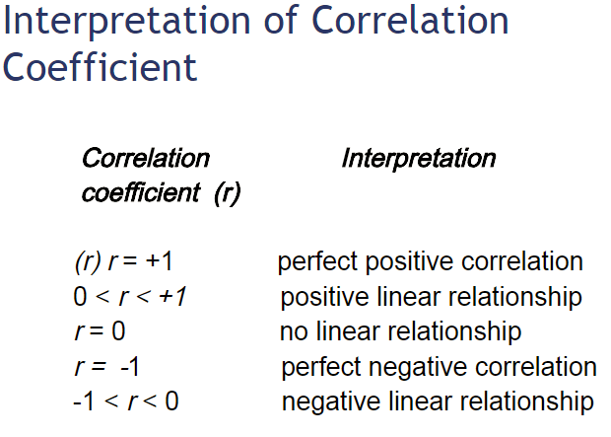
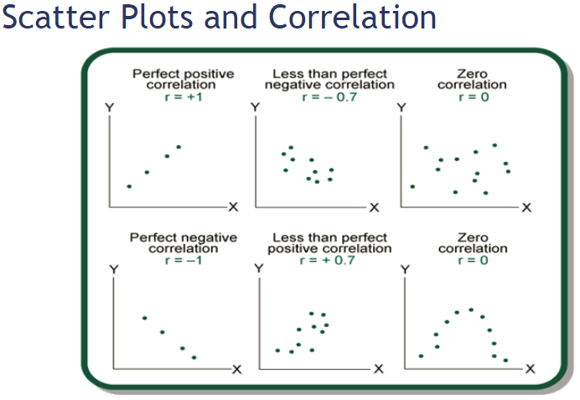
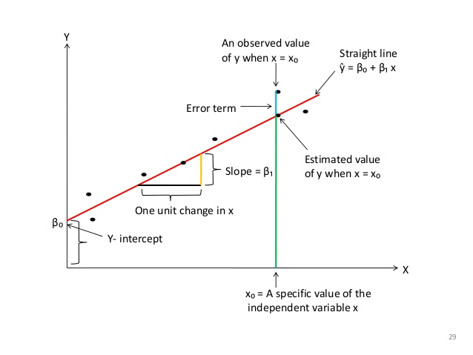
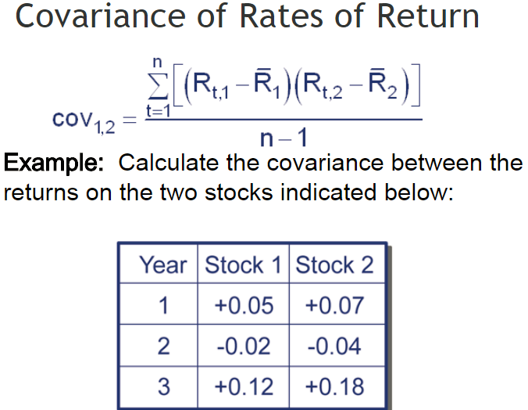
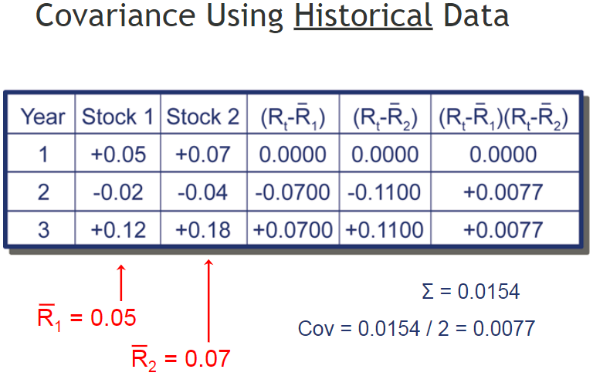
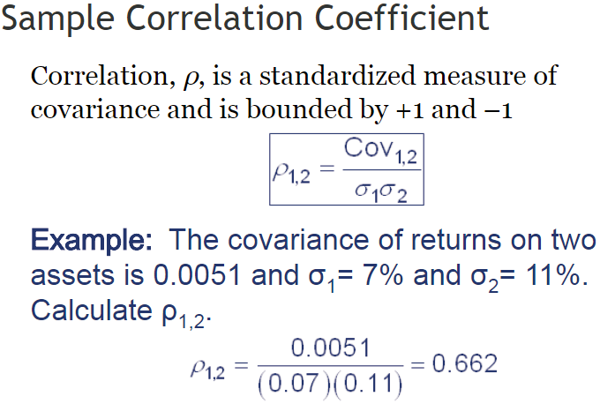
Understanding a regression model – Linear regression
Notes:
>>> from sklearn.metrics import r2_score
>>> y_true = [3, -0.5, 2, 7]
>>> y_pred = [2.5, 0.0, 2, 8]
>>> r2_score(y_true, y_pred)
0.948...
>>> y_true = [[0.5, 1], [-1, 1], [7, -6]]
>>> y_pred = [[0, 2], [-1, 2], [8, -5]]
>>> r2_score(y_true, y_pred, multioutput='variance_weighted') ... 0.938...
>>> y_true = [1,2,3]
>>> y_pred = [1,2,3]
>>> r2_score(y_true, y_pred)
1.0
>>> y_true = [1,2,3]
>>> y_pred = [2,2,2]
>>> r2_score(y_true, y_pred)
0.0
>>> y_true = [1,2,3]
>>> y_pred = [3,2,1]
>>> r2_score(y_true, y_pred)
-3.0

Slide 13
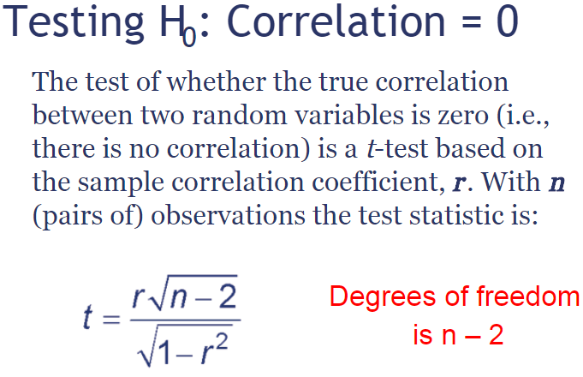
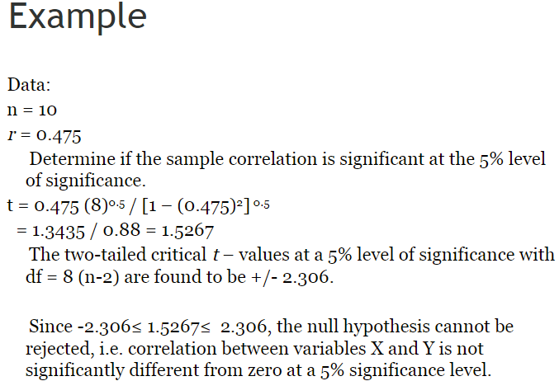
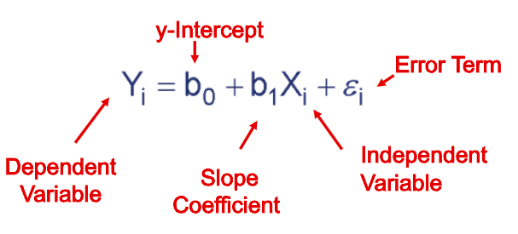
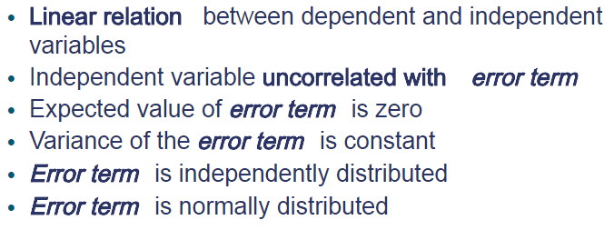
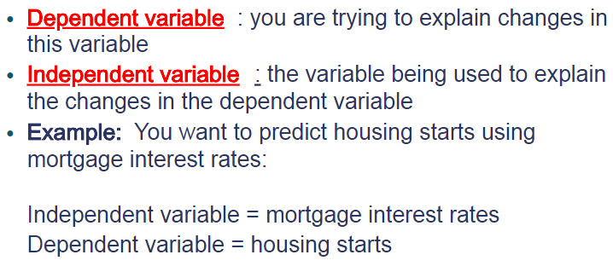
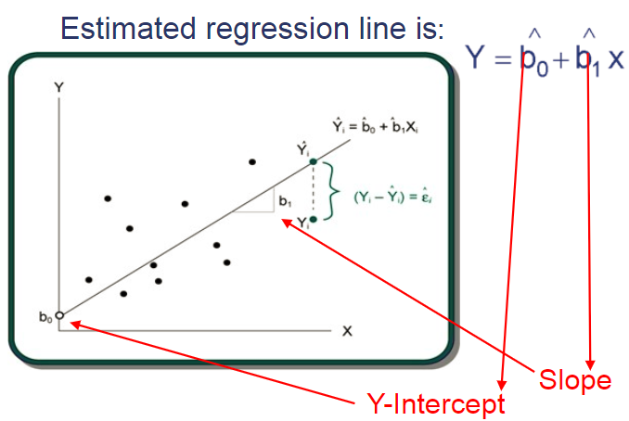
Understanding a regression model – Linear regression

Slide 14
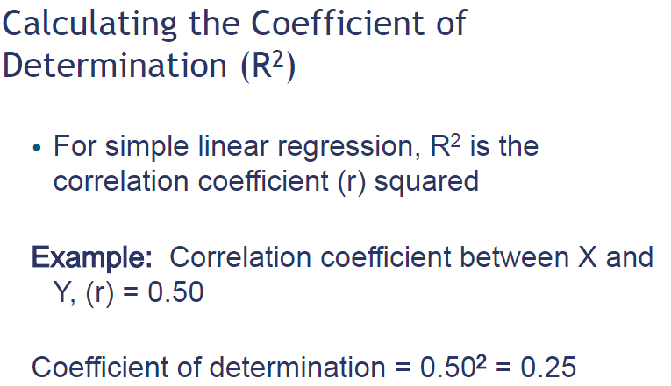
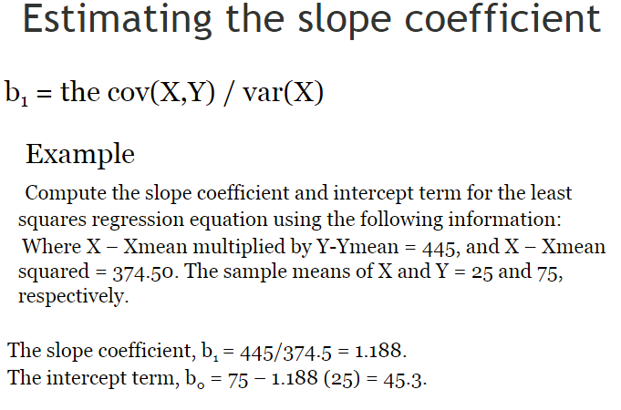
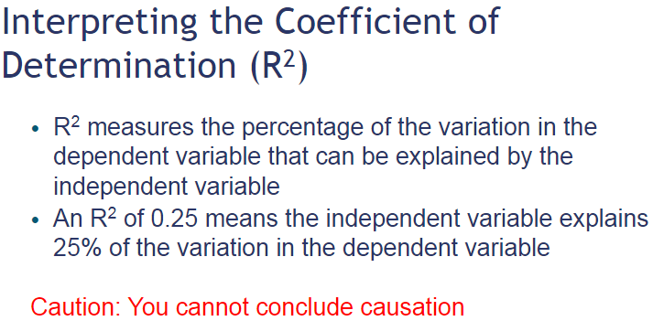
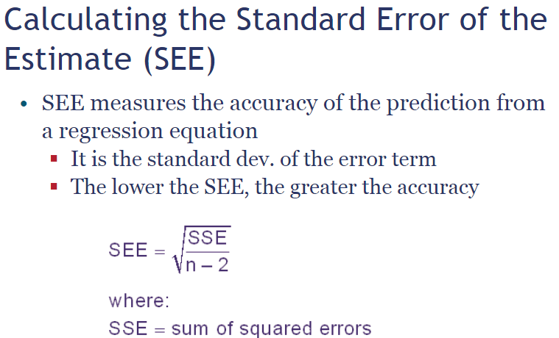

Slide 15
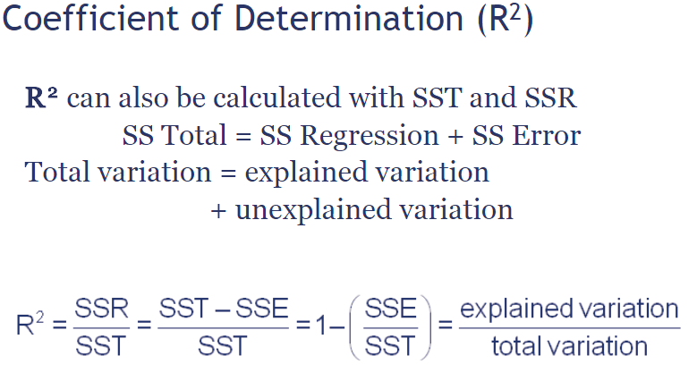


Mean Absolute Error (MAE)
MAE measures the average magnitude of the errors in a set of predictions, without considering their direction.
Root mean squared error (RMSE):
RMSE has the benefit of penalizing large errors more so can be more appropriate in some cases, for example, if being off by 10 is more than twice as bad as being off by 5. But if being off by 10 is just twice as bad as being off by 5, then MAE is more appropriate.
RMSE is a quadratic scoring rule that also measures the average magnitude of the error.
*Remember there are many more error metrics.
*Remember Higher R2(logically max is 1.0) is better but smaller RMSE is better.(logically min 0)
Notes:
#===================================
>>> from sklearn.metrics import mean_squared_error
>>> y_true = [3, -0.5, 2, 7]
>>> y_pred = [2.5, 0.0, 2, 8]
>>> mean_squared_error(y_true, y_pred)
0.375
>>> y_true = [[0.5, 1],[-1, 1],[7, -6]]
>>> y_pred = [[0, 2],[-1, 2],[8, -5]]
>>> mean_squared_error(y_true, y_pred)
0.708...
>>> mean_squared_error(y_true, y_pred, multioutput='raw_values')
... array([ 0.416..., 1. ])
>>> mean_squared_error(y_true, y_pred, multioutput=[0.3, 0.7])
... 0.824...

Slide 16
Assignments:
Install all necessary software.
assignment1: Copy paste execute and troubleshoot the code shown on slide 8.
Assignement2: Without using single function packages(such as r2_mean_squared_error and r2_score from Scikit-learn) implement a function that can take 2 list’s of numeric values & a matric variable as an input and provide the matric score as an output.
Example :
1. matric_implementation(li1,li2, matric = “RMSE”), where li1 = [1,2,3] & li2 = [2,3,4]
2. matric_implementation(li1,li2, matric = “MSE”), where li1 = [1,2,3] & li2 = [2,3,4]
3. matric_implementation(li1,li2, matric = “R2”), where li1 = [1,2,3] & li2 = [2,3,4]
Remember:
For assignement2 the function should be able to return a proper error message if uneven lists are passed as parameter, or blank list were passed. It should also take “R2” as default parameter for matric if no matric was passed.
For assignement2 Each step or line should have comment explaining what you are trying to do in the next line.
Create a project “Day1Assignments” in your Github repository and upload the 2 python script files named assignment1.py and assignement2.py.
Upload this slide’s content in the readme.md file for the “Day1Assignments” project.
Once done, share your Github project url for validation.

