Slide 1



Secure and Automated Deployment Pipeline for AWS cloud application
An in-depth analysis to secure, automated CI/CD pipeline built with Jenkins on AWS EKS for deploying microservices. The pipeline integrates DevSecOps practices including static code analysis, container scanning, compliance benchmarking, GitOps deployment, and observability via Prometheus and Grafana.
Vijay Kumar Vankayala
DevOps Architect

Slide 2

Tools and Technologies Used
GitHub: for version control
Maven: for project management and builds
Jenkins: For managing the CI/CD pipeline.
SonarQube: For static code analysis.
Amazon ECR: For managing dependencies and artifacts.
Trivy: For scanning vulnerabilities in files and Docker images.
Docker: To containerize applications.
Prometheus: For monitoring metrics from services.
Grafana: For visualizing metrics.
Kubernetes (AWS EKS): For managing containerized workloads.
Terraform: For EKS deployment.

Slide 3
Prerequisites:
1: Set up Git Repository and create Security Token for Jenkins CI
2: Setup required servers (Jenkins, Sonarqube, Prometheus and Graphana)
3: Set up Jenkins, Sonarqube and ECR
4: Install Jenkins Plugins(docker pipeline and sonarqube scanner), Trivy, SonarQube, ECR to use Jenkins

Slide 4
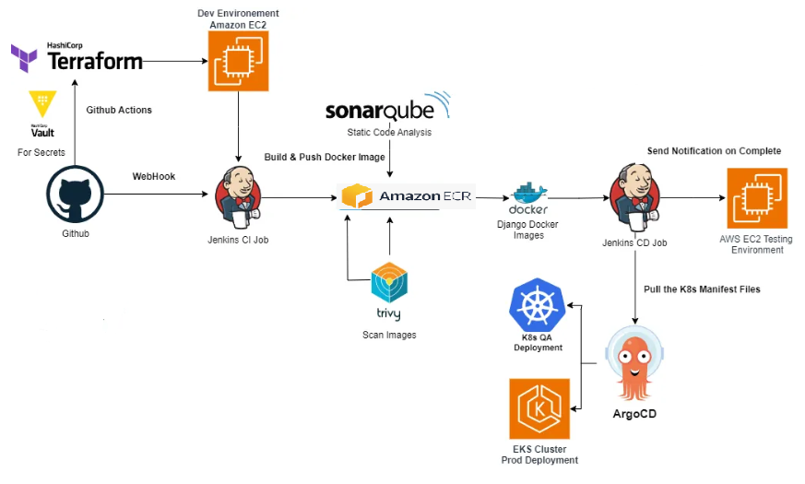
Workflow Diagram

Slide 5
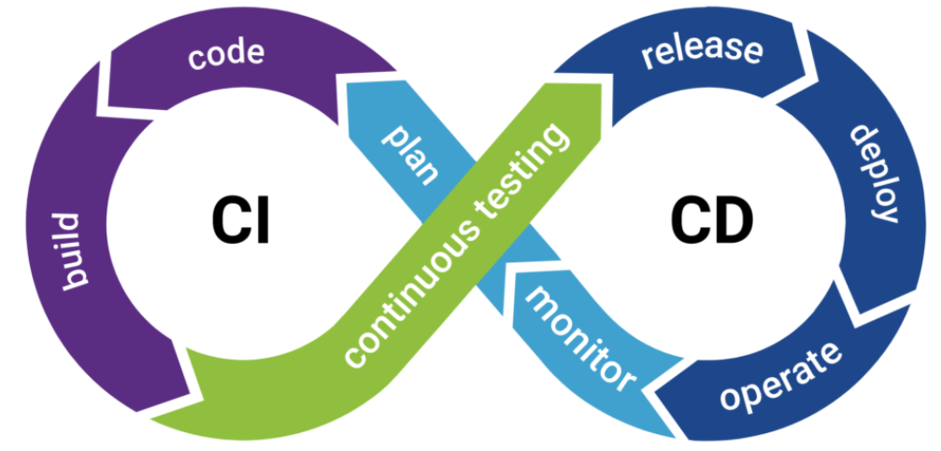
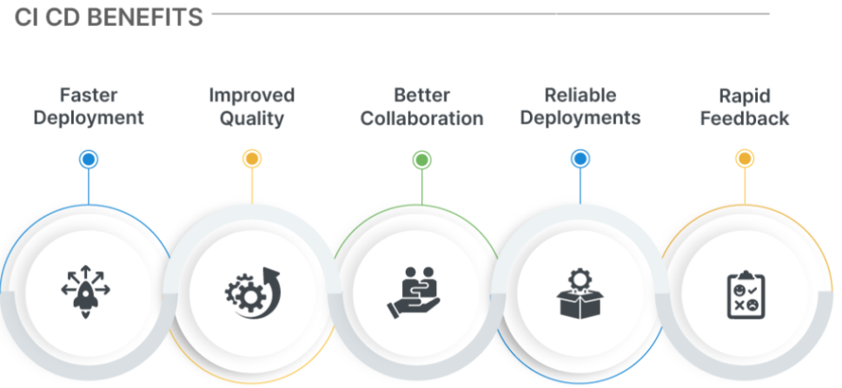
CI/CD Pipeline
Stage | Tools Used | Security Integration
Checkout | GitHub | N/A
Build | Maven | Dependency auditing (optional)
Static Code Analysis | SonarQube | Detects vulnerabilities, code quality issues
Unit Tests | Maven/JUnit | Validates logic correctness
Docker Build & Image Scan | Docker, Trivy | Detect CVEs in base/app layers
CIS Benchmark Scan | kube-bench | Ensures Kubernetes hardening
Prometheus Export Conversion | Custom script | Parses kube-bench JSON for observability
Deployment | Helm, GitOps (ArgoCD) | Rollbacks on failure, auto-sync

Slide 6




Jenkins Pipeline:
Jenkins Pipeline Stages
01
Build, Test, and Static Code Analysis using SonarQube.
02
Container Image Scanning using Trivy.
03
03
Kubernetes deployment with GitOps – ArgoCD.
04
Runtime security monitoring using Falco.
05
Compliance reporting using Trivy, kube-bench.
06
Monitoring and alerting using Prometheus + Grafana.

Slide 7




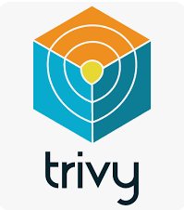
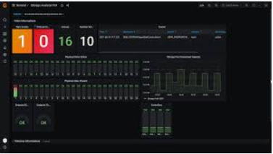



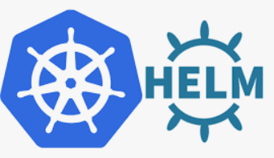
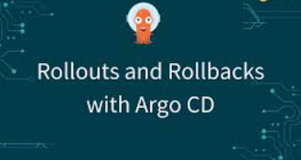
Configuration Files
trivy-scan.sh
convert-cis-report-to-prometheus.sh
Bash script to run Trivy against Docker images.
Converts kube-bench results to Prometheus metrics.
helm-chart/
argocd/
Microservice manifests and templates.
ArgoCD-managed GitOps directory structure.

Slide 8

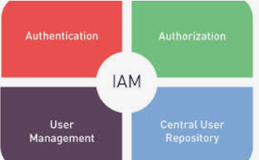
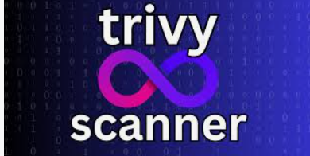
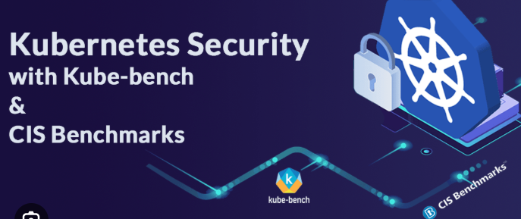


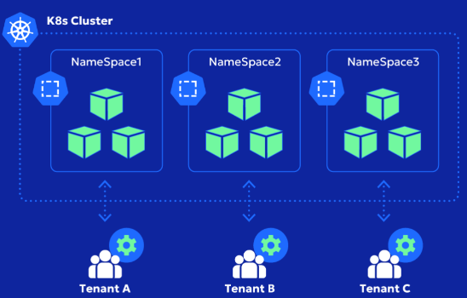
Security Policies Implemented
01
02
IAM
Image Vulnerability
IRSA roles assigned to K8s service accounts for scoped permissions
Trivy scans before pushing to registry
03
04
Static Analysis
Compliance
SonarQube scans during Jenkins build stage
kube-bench executed per build for EKS cluster nodes
05
06
Runtime Security
Network Segmentation
Falco deployed as DaemonSet (planned)
Kubernetes NetworkPolicies and separate namespaces

Slide 9

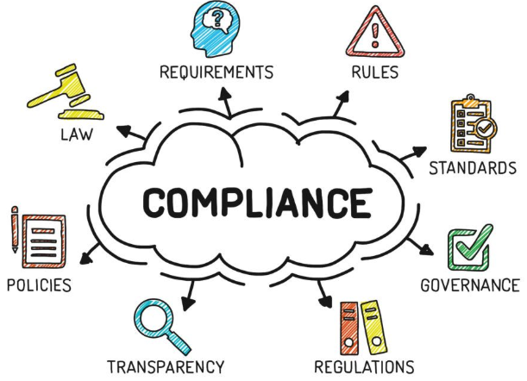





Compliance Reporting
kube-bench
Generates CIS benchmark reports for worker nodes.
Graphana Dasboards
Prometheus scrapes metrics; Grafana displays dashboards.
Results
Converted via convert-cis-report-to-prometheus.sh and sent to Pushgateway.

Slide 10


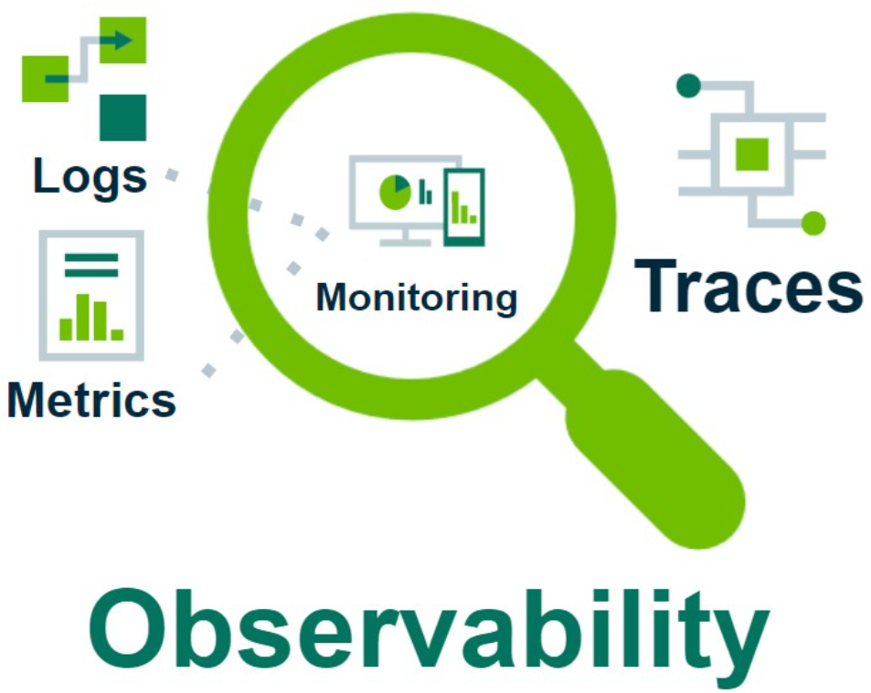

Observability
Monitoring Setup:
Prometheus: Collects metrics from:
Jenkins build success/failure
Trivy scan results
kube-bench compliance score
Grafana: Dashboards include:
CI/CD health
Vulnerability trends
CIS compliance status
Alerts: Triggered via Prometheus Alertmanager for:
High-severity CVEs
Compliance failure
Build pipeline errors

Slide 11





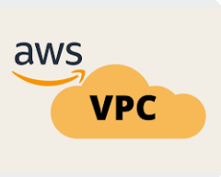

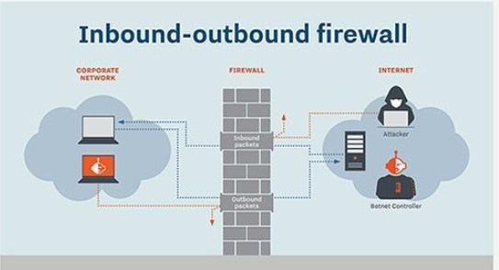
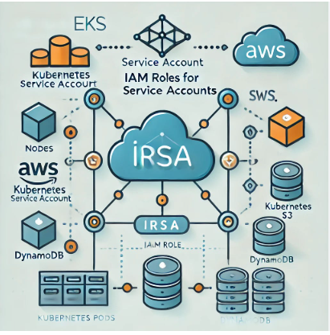

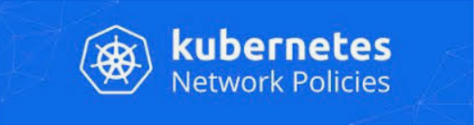
Architecture & Infrastructure
Provisioned with Terraform
VPC with public and private subnets across multiple AZs.
EKS Cluster using AWS-managed Kubernetes.
Security Groups to restrict inbound/outbound traffic.
IAM Roles for Service Accounts (IRSA): Fine-grained access for each component (e.g., Jenkins, ArgoCD).
Kubernetes Network Policies: Segment communication between namespaces and workloads.

Slide 12
Create the EKS cluster, Install AWS CLI, Kubectl and Terraform:
1: Create a new AWS EC2 Instance
2: Install AWS CLI on the above EC2 Instance
3: Install Terraform using the below command:
sudo apt install terraform --classic
4: Install kubectl using the below command:
sudo snap install kubectl –classic
5: Create 3 tf files for our terraform script. Which is the main.tf , output.tf and variable.tf.
6: Make sure to run the commands in the order given below:
terraform init : to initialize the project
terraform plan : Prepares an execution plan
terraform apply: Executes the plan and actually deploys the infrastructure
kubectl get nodes: to check the deployment and pod status

Slide 13

Security Best Practices
Area | Implementation
HashiCorp Vault | for securely managing, storing, and accessing secrets like API keys, passwords, and certificates
Network Isolation | Private subnets, deny-all network policy
IAM Permissions | Fine-grained IRSA role with specific policy
Least Privilege | Custom security group rules
Logging & Audit | EKS control plane logs enabled
Access Restriction | EKS public endpoint disabled

Slide 14
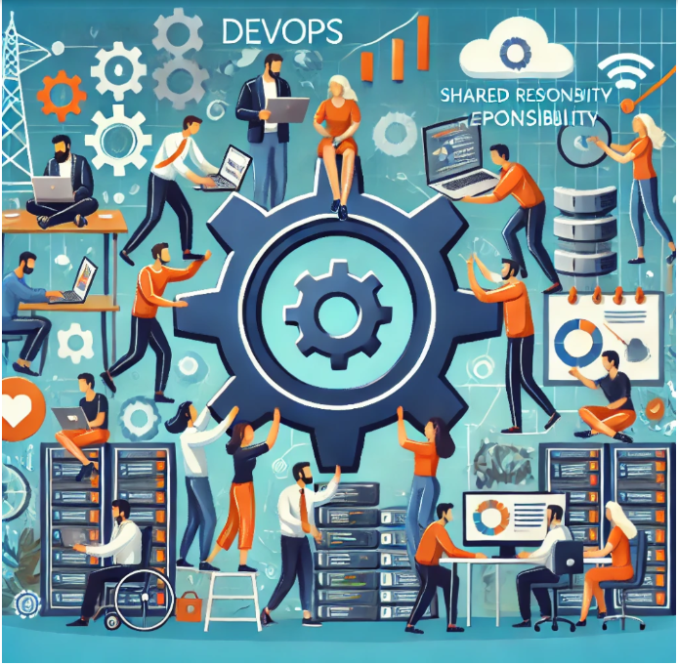
Collaboration and Governance
Team | Responsibilities
Dev Team | Application code, unit testing, Helm charts
DevOps/SRE | Terraform infra, Jenkins & ArgoCD setup, observability
Security | Policy definition, scanner config, compliance enforcement

Slide 15





Thank You
Q & A
I am open to suggestions on how to make this configuration run smoother or more securely. This was fun to work on and had some troubleshooting along the way.

