Slide 1


Department of Artificial Intelligence and Data Science
FORECASTING THE FUTURE:PREDICTION OF RENEWABLE ENERGY GENERATION USING
SARIMA
Mr.SURESH KUMAR S M.E.,(Ph.D)
Professor
VIKASHINI S
221801062
VIJAY KUMAR V
221801505

Slide 2
Problem Statement and Motivation
Develop a Predictive model to Estimate the Generation of Renewable Energy (Solar, Wind) based on Historical Data, Weather Forecasts and Environmental Factors.
MOTIVATION:
Accurate forecasting of renewable energy generation ensures stable energy supply and optimizes resource management.
Forecasting renewable energy aids in the transition to clean energy and stabilizes energy prices, contributing to environmental sustainability.​

Slide 3
Abstract
There has been a significant shift towards using renewable energy these days . To facilitate a complete transition to renewable energy, accurate forecasting of renewable energy generation is essential. This development involves creating a predictive model to estimate the generation of wind and solar power using historical data, weather forecasts and environmental conditions that includes parameters such as temperature, humidity, wind speed, and solar irradiance. Seasonal Autoregressive Integrated Moving Average (SARIMA) algorithm is employed in the model. SARIMA algorithm is selected for its efficient handling of time series data, high accuracy and reduced overfitting risks , that enhances the prediction of renewable energy generation.

Slide 4
Introduction and Overview of the Project
.Development of predictive model for estimating the wind and solar power generation involves integration of historical data with weather forecast and environmental conditions using the Seasonal Autoregressive Integrated Moving Average (SARIMA) algorithm. The model construction begins with the collection and preprocessing of data,to ensure high-quality inputs followed by feature selection. Model training involves training the SARIMA model with the historical data, capturing the seasonal fluctuations and trends. Validation is performed using a separate dataset to assess the model's accuracy. The forecasting process utilizes the trained SARIMA model to predict future energy generation, providing valuable insights for grid management.

Slide 5
Literature Survey
S.No | Author Name | Paper Title | Description | Journal | Volume/ Year
1 | Luisa Fernanda Jimenez Alvarez | Renewable Energy Prediction through Machine Learning Algorithms | This paper focuses on selecting a suitable ML algorithm among LR, RF, Multilayer perceptron,SVM using MSE and MAE . | IEEE | 2020
2 | Deepa Somasundaram | Machine learning application for predicting system production in renewable energy | Algorithms like LR,RF, Decision Tree and SVM are used to forecast the REG that is evaluated by MSE,MAE and R squared metrics is discussed in the paper. | IJPEDS | 2024
3 | N.M.S.Hassan | Forecasting Renewable energy Generation with ML and DL | This paper employs several suitable model for different prediction and gives the accurate prediction value. | Energies | 2023

Slide 6
Literature Survey
S.No | Author Name | Paper Title | Description | Jornal | Volume/ Year
4 | Olena Rubanenko | Predicting the Power Generation from RES by using ANN | This paper works on how ANN model can be used for efficient prediction of Renewable Energy. | IEEE | 2021
5 | Vishnu Vardhan | Renewable Energy and Demand Forecasting in an Integrated Smart Grid | This paper presents a framework that realistically simulate a microgrid and forecasts renewable energy and load demand using LSTM. | IEEE | 2021

Slide 7
Existing System
The existing system for predicting renewable energy generation has utilized machine learning algorithms such as Linear Regression, Decision Tree, Support Vector Machine (SVM), Random Forest, Multilayer Perceptron (MLP). These algorithms analyzed historical data and various environmental factors including wind speed, air pressure, sunshine, air temperature, radiation, and relative humidity. Linear Regression identified linear relationships between input features and energy output, while Decision Trees and Random Forests captured more complex non-linear patterns, with Random Forests improving accuracy through ensemble learning. SVMs found optimal dividing lines in the data for prediction, and MLP modeled intricate relationships in the data by learning from multiple layers enhance the accuracy and robustness of energy generation forecasts.

Slide 8
Drawback of Existing System
Linear regression struggles with capturing non-linear relationships in the data, leading to less accurate predictions for complex systems.
Decision Trees can overfit the training data and inefficient in handling the order of time series data, making them less effective time series data .
Random Forests assumes independence between observations, which is often not true in time series data where past values influence future values.
Training SVMs on large time series datasets can be slow and requires high computational power.
While capable of modeling complex, non-linear relationships, MLP is computationally intensive, prone to overfitting

Slide 9
Proposed System Advantages
Effective Seasonality Handling: Captures seasonal patterns in renewable energy data effectively.
Enhanced Prediction Accuracy: Models seasonal trends and time dependencies for reliable forecasts.
Reduced Overfitting: Structured approach minimizes overfitting risks.
Computational Efficiency: Less resource-intensive than deep learning models.
Adaptability: Easily fine-tuned to changing data patterns.
Robustness: Reliable and widely used for time series forecasting.

Slide 10
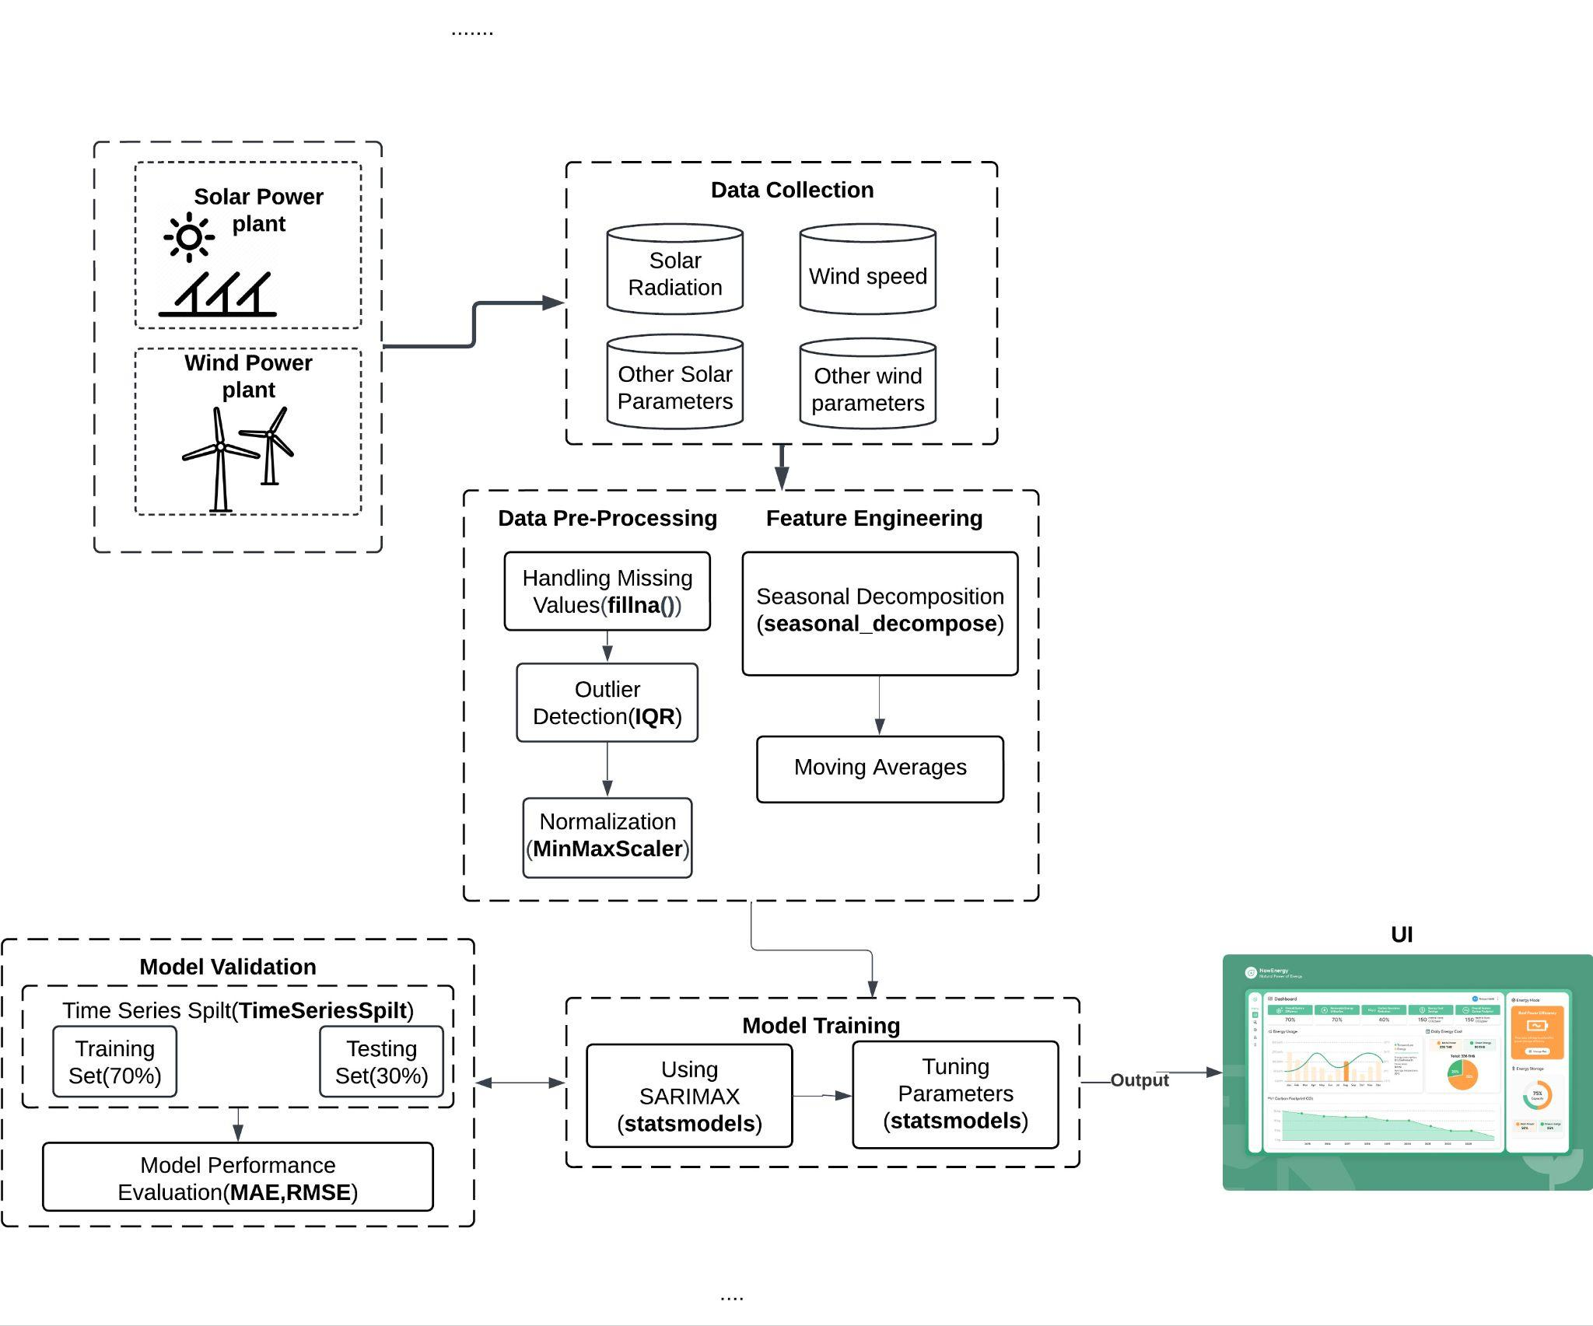
System Architecture

Slide 11
List of Modules
Data Collection
Data Preprocessing
Feature Engineering
Model Training
Model Validation

Slide 12
Module 1: Preprocessing
Step 1: Parse the Time column from both datasets into a datetime format and merge the solar and wind datasets on this Time index.
Step 2: Handle missing values using a mean strategy for columns across both datasets like Total solar irradiance, Wind speed, Power (MW)).
Step 3: Detect outliers for key variables like Power (MW), wind speed, and irradiance using the Z-score method and remove them.
Step 4: Normalize all numerical columns such as irradiance, wind speed, temperature, and pressure using MinMaxScaler
Step 6: The cleaned and scaled dataset with solar and wind variables is ready for feature engineering.

Slide 13
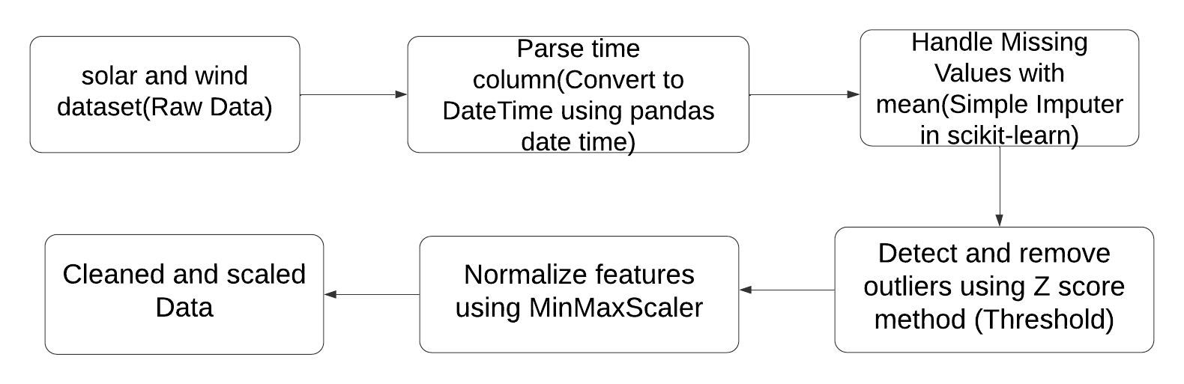
Data Flow Diagram

Slide 14
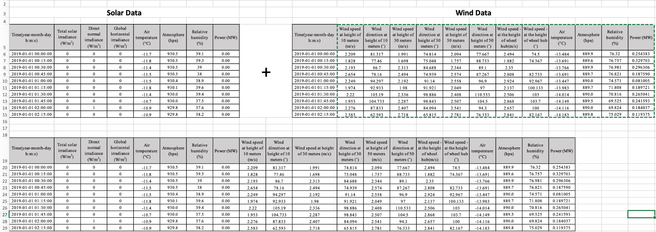
Solar and Wind Data merging

Slide 15
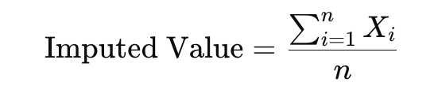
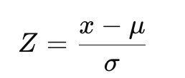
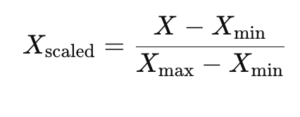
Preprocessing
SimpleImputer(Mean):- It is a method in sklearn where the simple imputer used to fill the null values with the strategies like mean, median, most frequent and constant.
Outlier Detection(Z score):- Z score is used to calculate the extreme low and high data(outliers) usually the score of (+3 or -3) and removing it.
Normalize(MinMaxScaler):- It is used convert the data in different scale to a defined range typically between the 0 and 1

Slide 16
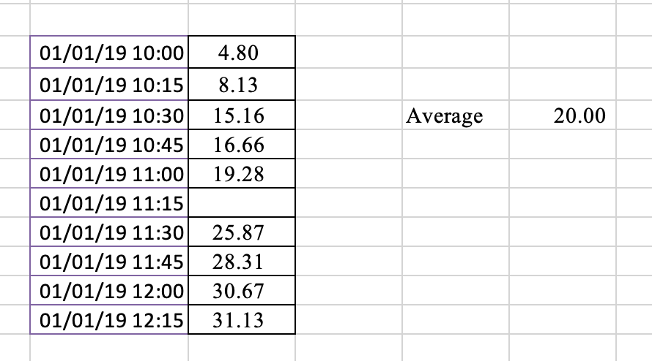
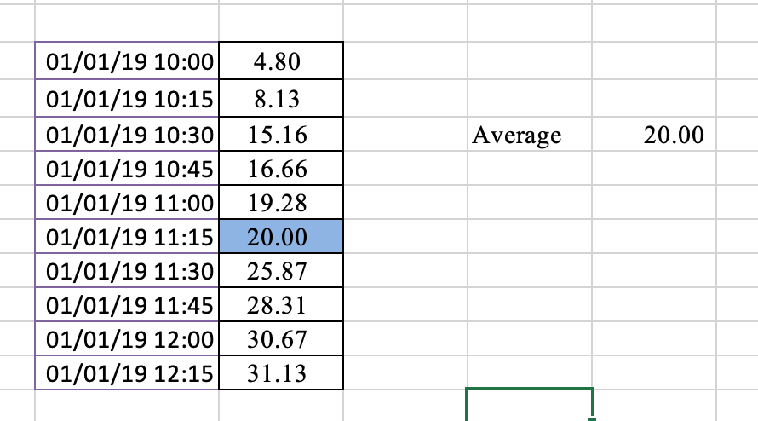
Handling Missing values

Slide 17
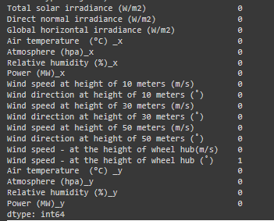
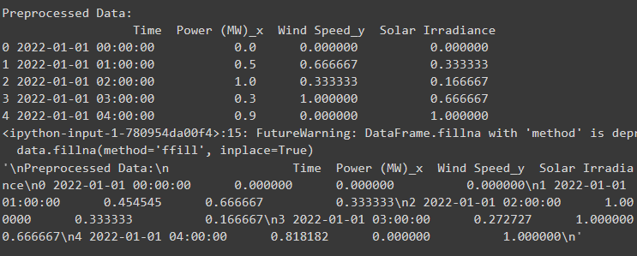
Outputs

Slide 18
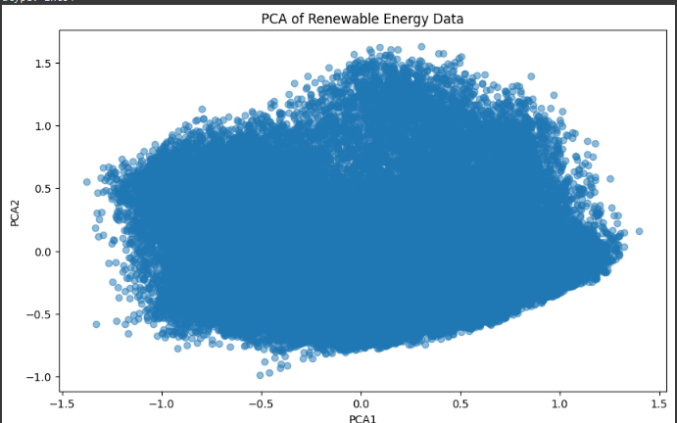
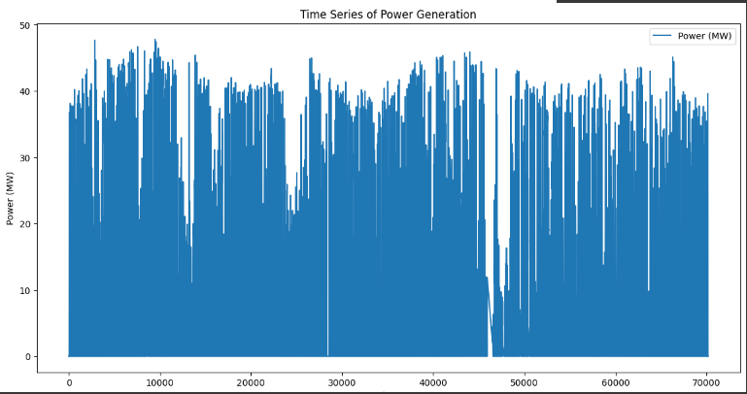
Outputs

Slide 19
Module 2: Feature Engineering
Step 1: Create lag features for variables such as Power (MW), Total solar irradiance, Wind speed, and Air temperature to capture temporal dependencies.
Step 2: Extract additional time features like hour, day_of_week, and month from the Time column to capture seasonality and time-based trends.
Step 3: Drop rows with NaN values generated during the lag feature creation.
Step 4: Combine all lag features and time-based features into the main dataset, ensuring all variables from solar and wind data are included.
Step 5: Ensure all features are normalized and free from missing values, ready for model training..

Slide 20
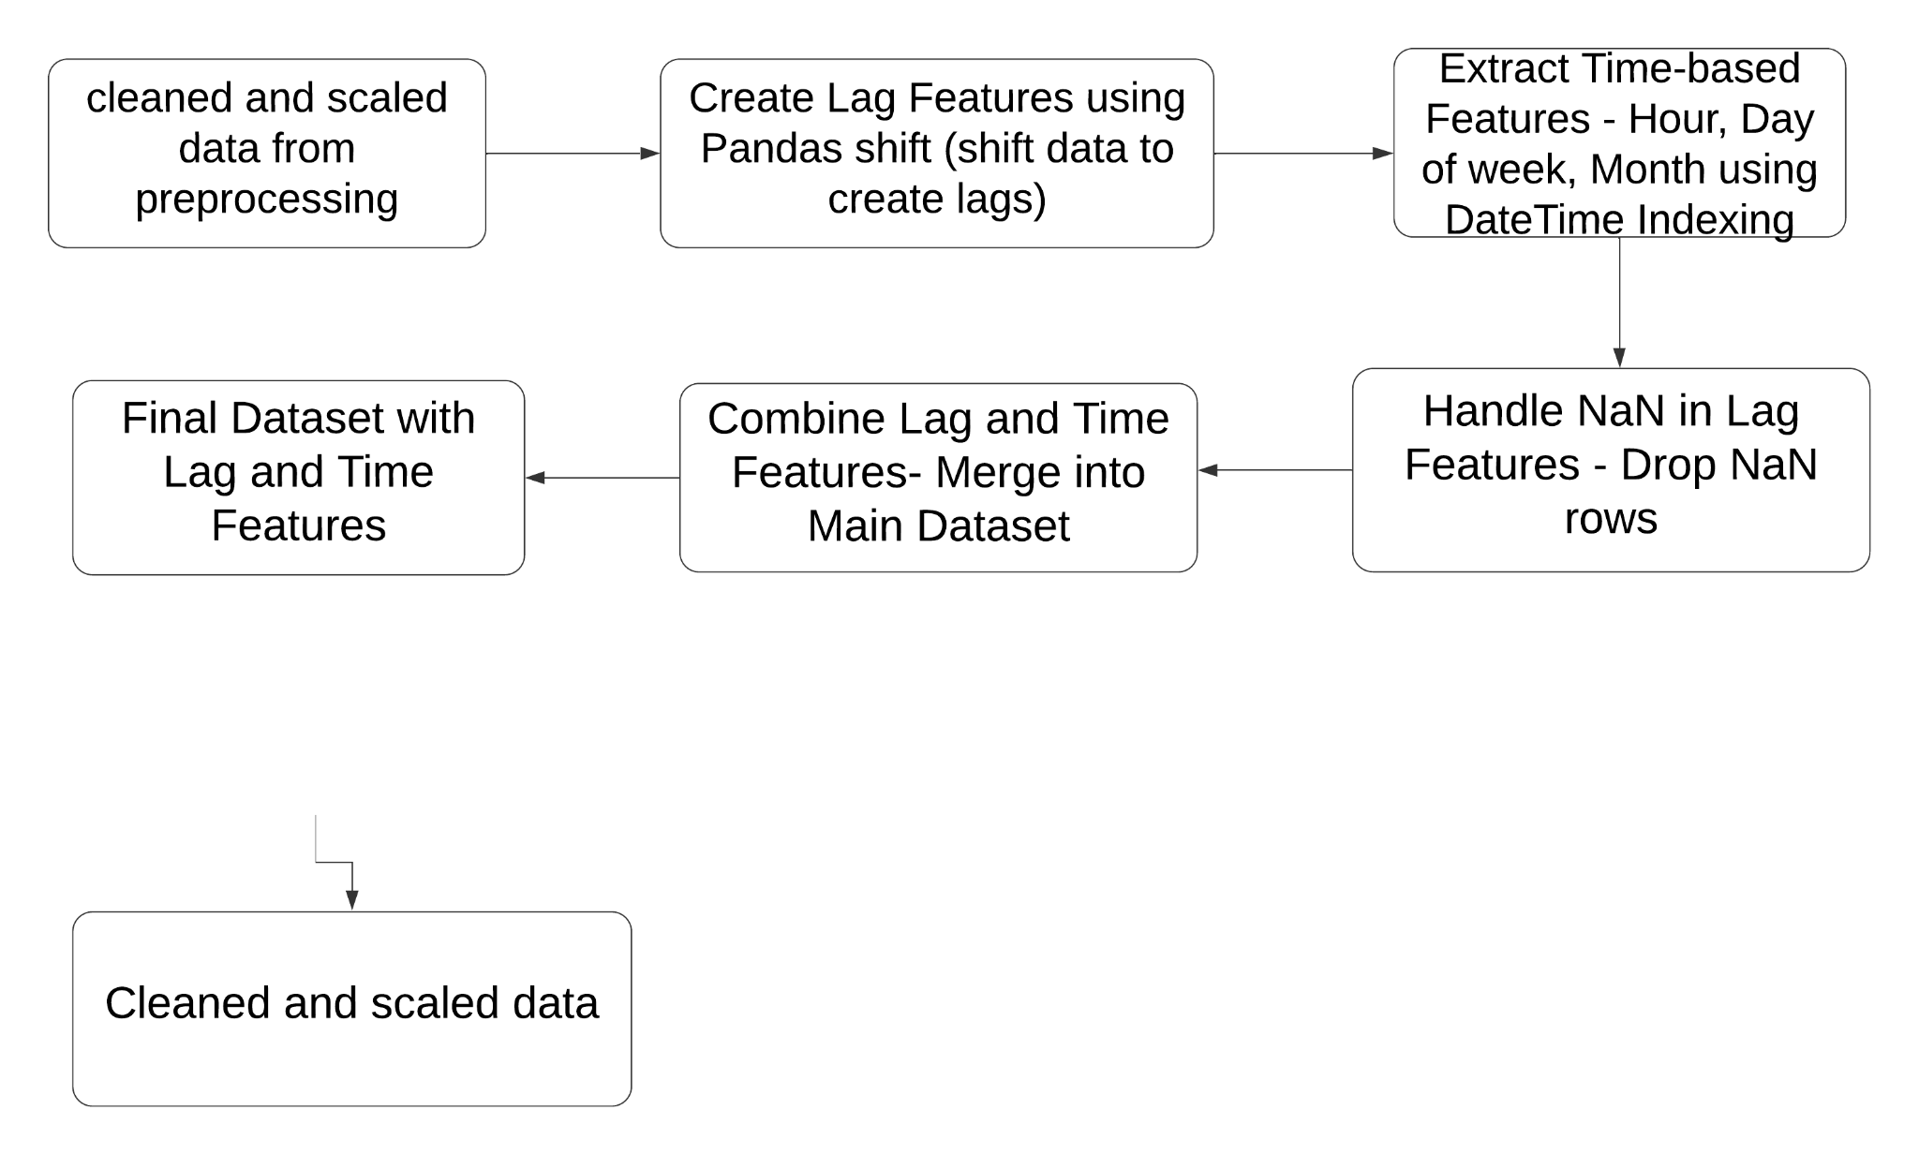
Data Flow Diagram

Slide 21
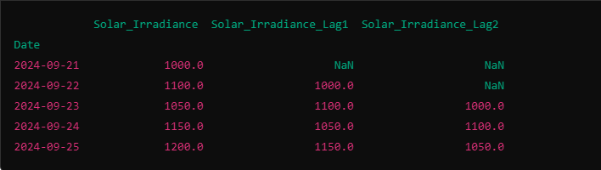
Feature Engineering
Creating Lag Features(shift()):- It is feature that is used to downshift a row for the predictor value of the time series data. It is used to find the temporal dependencies between data and it is crucial step in the models like SARIMA, ARIMA etc
Dropna:- Dropping tha nan values that are created by the lag features using the dropna method

Slide 22
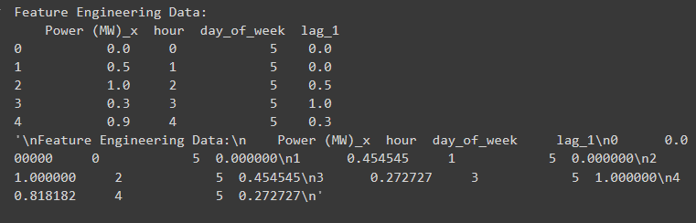
Outputs

Slide 23
Module 3: SARIMA Model Training
Differencing: Apply regular and seasonal differencing to make the time series stationary (remove trends and seasonality).
Auto-Regressive (AR) Component: Use past observations (lags) to predict the current value based on the p and P parameters.
Moving Average (MA) Component: Use past forecast errors to improve predictions, controlled by q and Q parameters.
Seasonal Components: Incorporate seasonal AR and MA terms using the seasonal lag s to account for recurring patterns.
Parameter Estimation: Estimate the AR, MA, SAR, and SMA parameters using Maximum Likelihood Estimation (MLE).
Model Fitting and Prediction: Fit the model with the estimated parameters and use it to predict future values by summing AR, MA, SAR, and SMA terms.

Slide 24
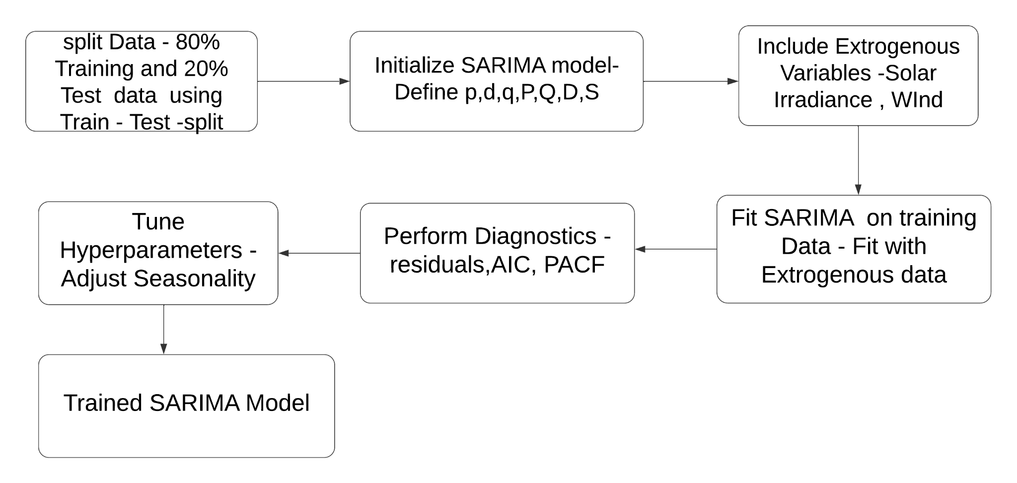
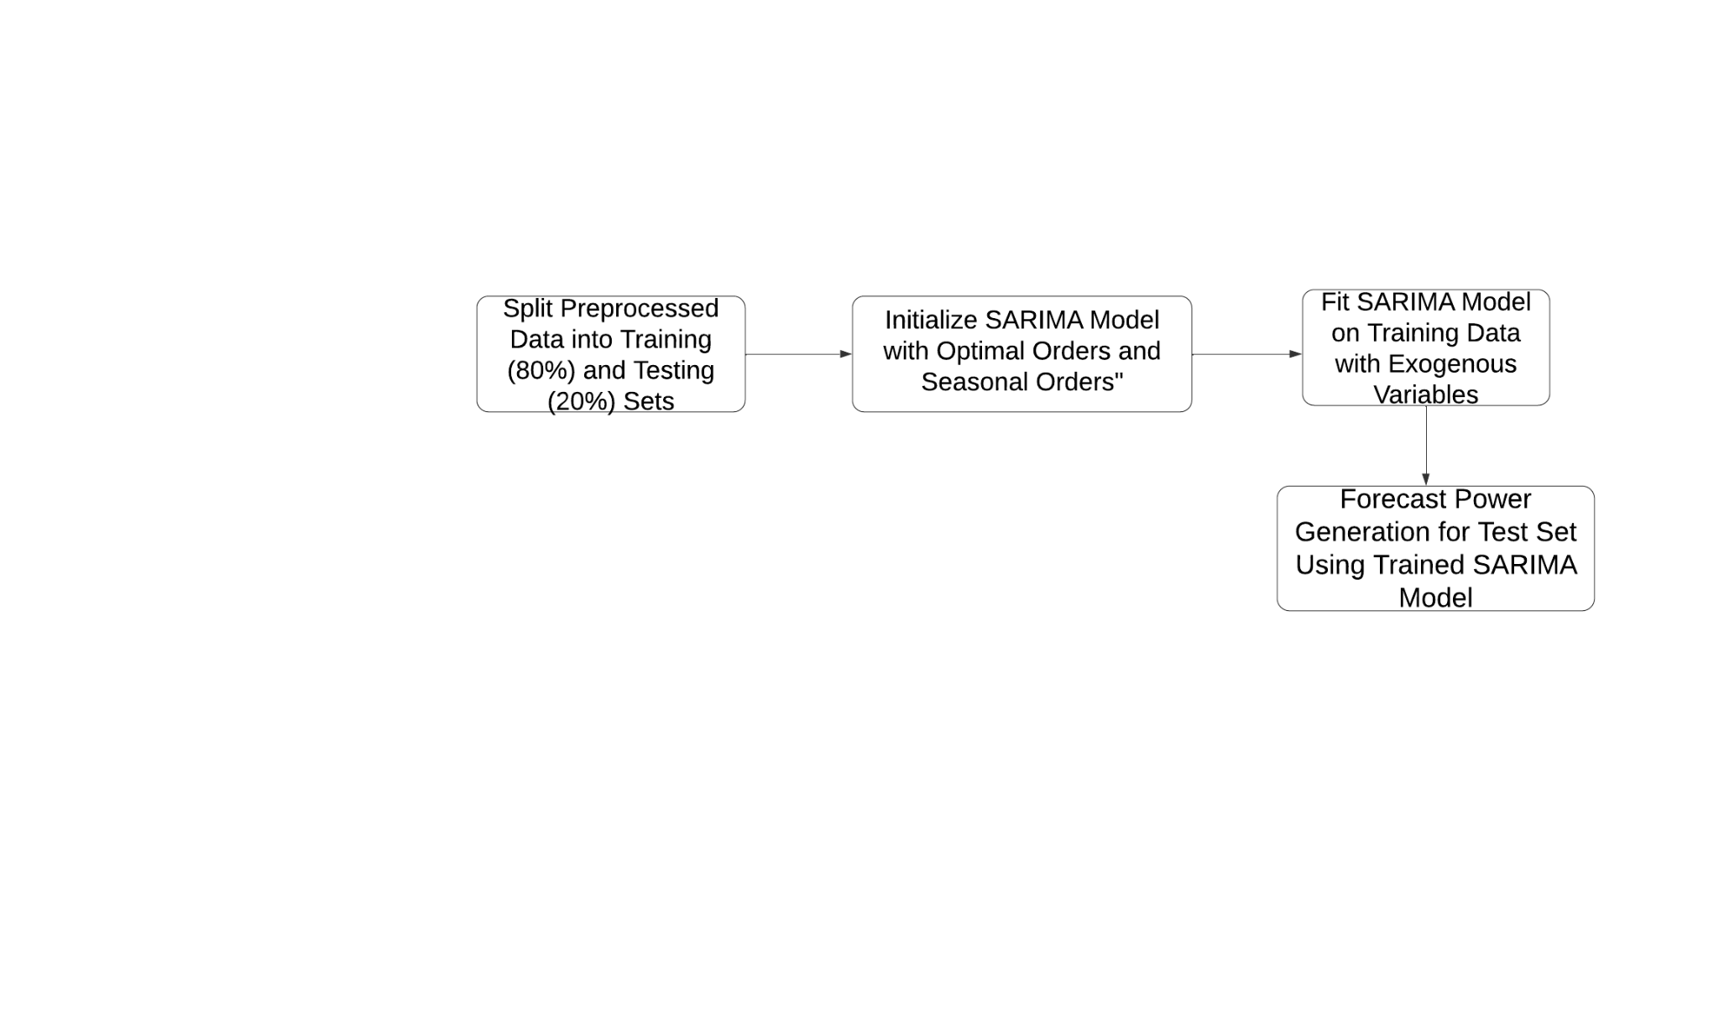
Data Flow Diagram

Slide 25
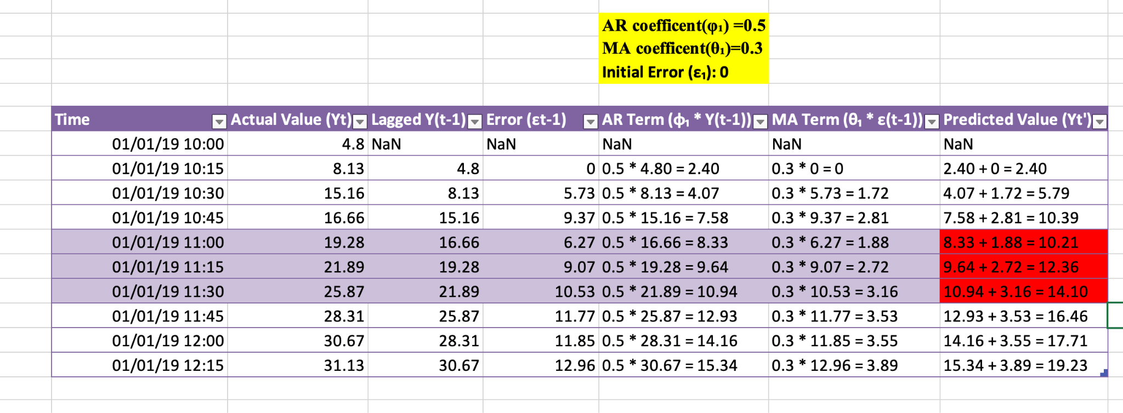
Calculation using Excel

Slide 26
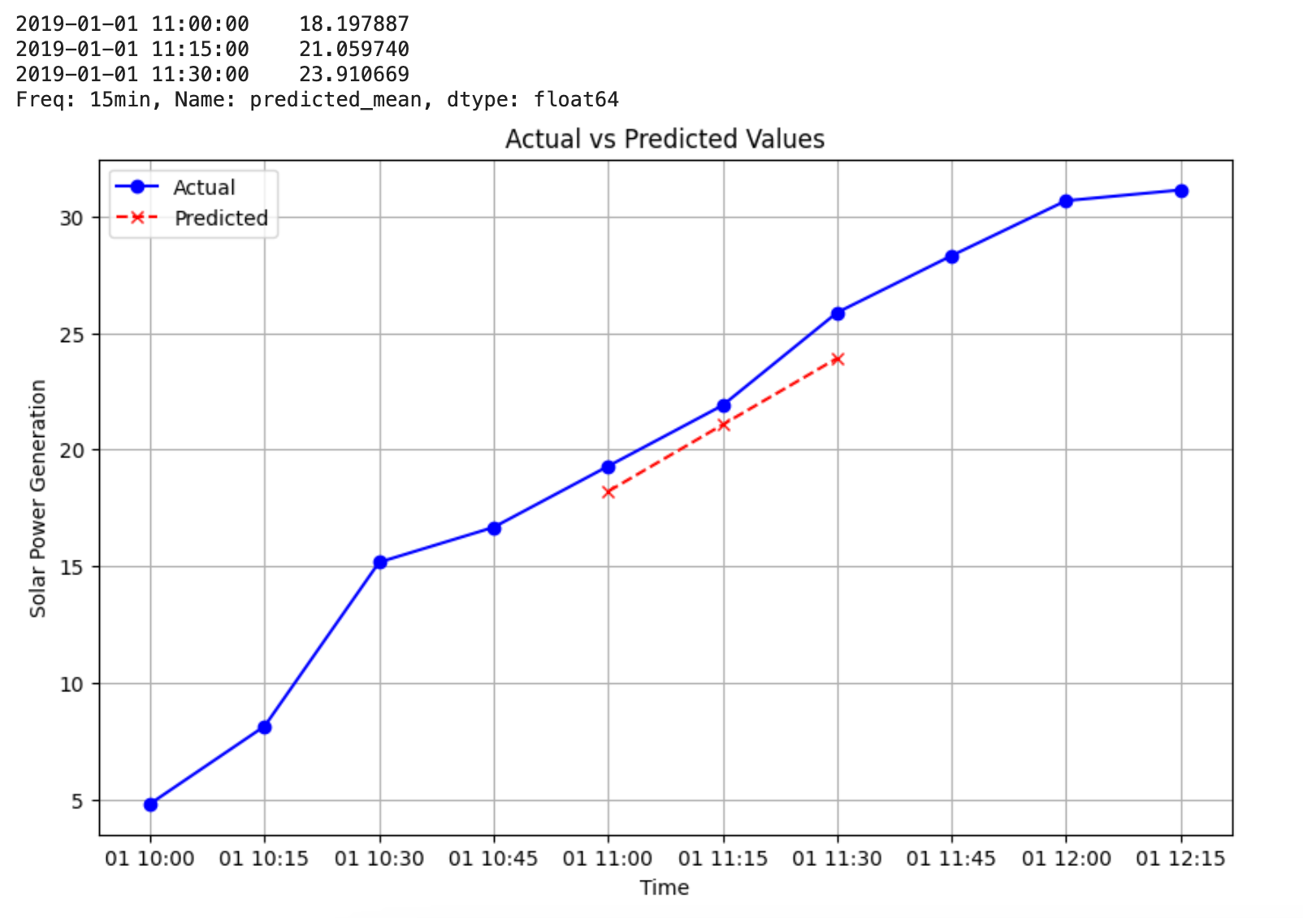
Calculation by the model

Slide 27
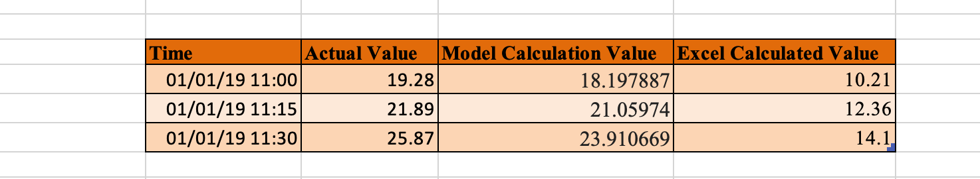
Actual VS Excel VS Model
Formula

Slide 28
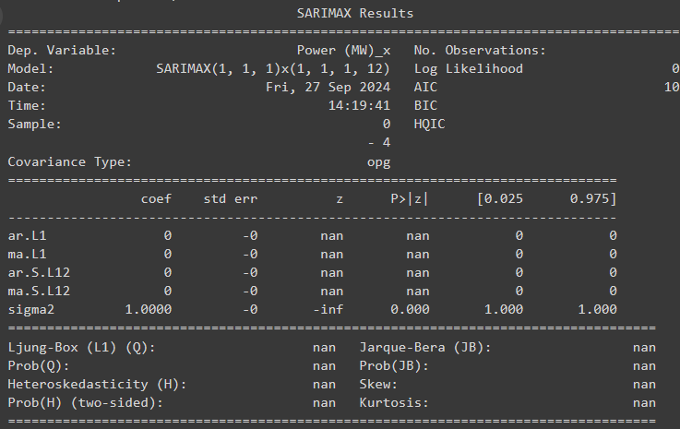
Outputs

Slide 29
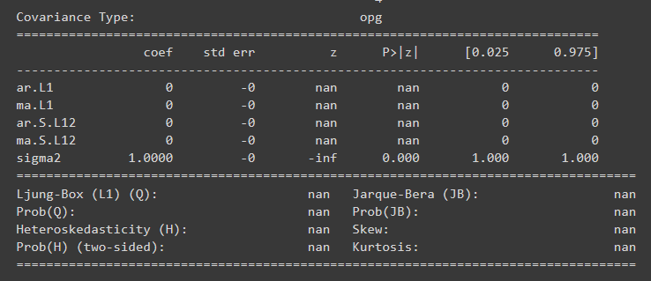
Outputs

Slide 30
Module 4 :Evaluation and forecasting
Step 1: Forecast power generation (Power (MW)) for both solar and wind power using the SARIMA model on the test set.
Step 2: Evaluate model performance using MAE and RMSE to quantify prediction accuracy.
Step 3: Plot actual vs predicted power generation values for both wind and solar power.
Step 4: Ensure residuals from the model are random and normally distributed.
Step 5: Retrain SARIMA on the full dataset to improve accuracy for future forecasting.
Step 6: Forecast future combined power generation from solar and wind using the trained SARIMA model, and plot these forecasted values along with confidence intervals to identify trends and uncertainties.

Slide 31
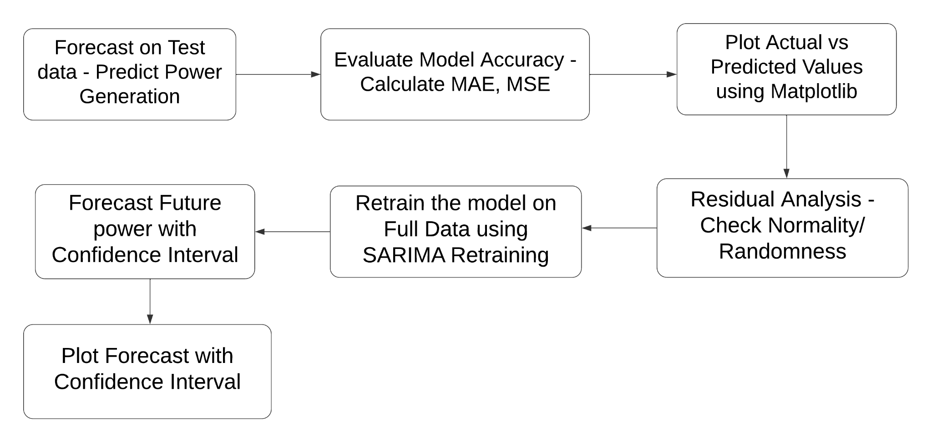
Data Flow Diagram

Slide 32

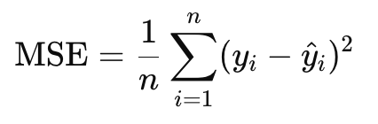
Evaluation
MAE(Mean Absolute Error):- It is a absolute difference between the predicted and actual values. If mae is 100 then the model deviate by 100 units from the actual value
MSE(Mean Squared Error):- It is the average of the squared error between the predicted and actual values. It gives more weight to large errors. If the mse is 100 the deviate by 10 units from the actual value.

Slide 33
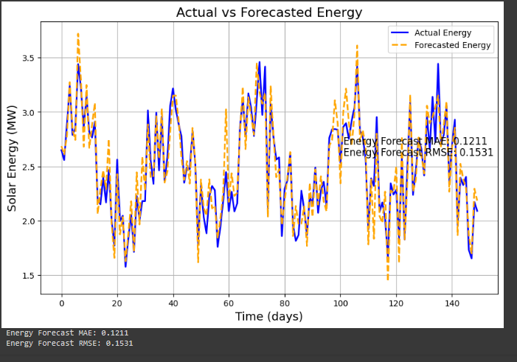
Outputs

Slide 34
Results
MAE and RMSE: Mean Absolute Error (MAE) was 0.1211, and Root Mean Squared Error (RMSE) was 0.1531, showing good model performance and high accuracy.
Forecast Performance: The predicted power generation closely followed the actual values, with minor deviations.
Visual Results: The plot of forecasted vs actual power generation showed a strong alignment, confirming the model’s reliability.
Model Insights: The SARIMA model effectively captured the seasonal and temporal patterns in renewable energy generation.

Slide 35
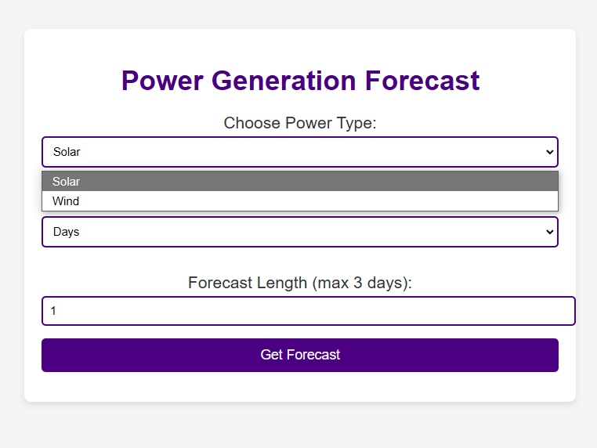
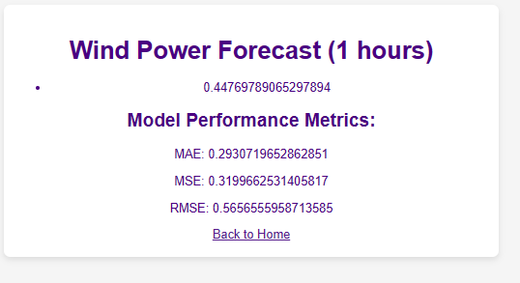
UI Output

Slide 36
Comparison and Analysis
The SARIMA model demonstrated strong predictive performance in forecasting renewable energy generation, with a low MAE of 0.1211 and RMSE of 0.1531.
These metrics reflect the model's high accuracy and ability to closely follow actual power generation patterns. SARIMA effectively captured the seasonal and temporal trends in the data, making it superior to simpler models that don’t account for these variations.
The close visual alignment between forecasted and actual values reinforces the model’s reliability, making it a valuable tool for future energy planning and operational decision-making.

Slide 37
Conclusion
The SARIMA model proved to be an effective tool for forecasting renewable energy generation, delivering high accuracy with low MAE and RMSE values. By capturing both seasonal and temporal patterns, the model demonstrated its ability to handle the inherent variability in solar and wind power data. Its performance, reflected in the strong alignment between predicted and actual values, highlights its potential for practical applications in energy grid management and planning. With further enhancements, such as incorporating more exogenous variables like weather conditions, the model can become even more reliable for long-term forecasting. Overall, SARIMA provides a solid foundation for improving the integration of renewable energy into power grids, helping to optimize resource allocation and ensure energy stability.

Slide 38
References
[1] M. Islam, M. Mahmud, and E. Hossain, "Forecasting of Solar and Wind Resources for Power Generation," Energies, vol. 16, no. 5, pp. 1234-1250, 2023.
[2] A. Ahmed, L. Gauntlett, and N. Jenkins, "Short-term forecasting of wind speed and power," Renewable Energy, vol. 40, no. 2, pp. 185-189, 2021.
[3]J. Smith and K. Brown, "Predicting Solar Power Output Using Machine Learning," in “Proc. 2023 Int. Conf. Renew. Energy Sustain. Technol. (ICREST)”, Berlin, Germany, 2023, pp. 45-50.
[4]W. Chen and Y. Li, “Renewable Energy Forecasting: From Models to Applications”. New York, NY, USA: Wiley, 2021.

Slide 39
Thank You

