Slide 1
Password Cracking & Credential Attack Suite
Advanced Cybersecurity Auditing Toolkit
Developed By: Vijay Gi | Version 1.1

Slide 2
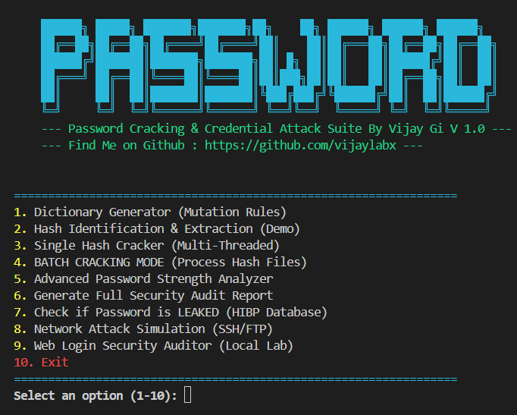
Image Overview

Slide 3
Full Detailed Overview And what will be use for development
Ethical Use & Compliance
Visual Analytics & Reporting
Service Auditing Modules
HIBP Leak Integration
Security Analysis & Compliance
High-Performance Cracker
Smart Dictionary Generation
Without Useing a single Api

Slide 4
Project Overview
A comprehensive security auditing suite for credential testing.
• Built with Python for module and speed.
• Multi-threaded architecture for high performance.
• Focus on educational research and authorized auditing for Real World .

Slide 5
Smart Dictionary Generation
Beyond simple wordlists: Mutation and Permutation logic.
• Creates thousands of variants from base words.
• Rule-based suffix/prefix injection.
• Case sensitivity and special character mutations.

Slide 6
High-Performance Cracker
Efficiency in breaking hashes and recovering credentials.
• Supports MD5, SHA-1, SHA-256, SHA-512.
• Multi-threading utilization (Configurable).
• Batch Mode: Process multiple users/hashes simultaneously.

Slide 7
Security Analysis & Compliance
Measuring password strength with data-driven metrics.
• Shannon Entropy calculation (bits of security).
• NIST Password Policy Compliance check.
• Real-time recommendations for strengthening credentials.

Slide 8
HIBP Leak Integration
Checking passwords against billions of breached records.
• Uses Have I Been Pwned (HIBP) Range API.
• K-Anonymity Model: Passwords never leave local system.
• Identifies real-world vulnerability risks.

Slide 9
Service Auditing Modules
Testing external services for weak credentials.
• SSH Brute-force simulation (via Paramiko).
• FTP Authentication auditing.
• Web Login Form Auditor for local lab environments and setup.

Slide 10
Visual Analytics & Reporting
Professional results for security audits.
• Automated generation of Text reports.
• Visual charts for password strength distribution.
• Detailed vulnerability logs.

Slide 11
Ethical Use & Compliance
Strictly for authorized use.
• Intended for educational and security research purposes.
• Usage on unauthorized systems is strictly prohibited.
• Designed to improve security, not compromise it.

Slide 12
Thank You!
Stay Secure. Audit Responsibly.
Questions? Contact: Vijay Gi
=======================================================
It’s my Contact Details
Find me on Github : https://github.com/vijaylabx
Linkdin : https://www.linkedin.com/in/vijay-kumar-334911270

