Slide 1

OPERATIONS & ANALYTICS REVIEW
Credit Card Transactions and Weekly Customer Report
Operations monitoring, portfolio KPIs, and Week 53 ingestion performance.
Business Intelligence & Risk Operations
Portfolio Reporting Period: Weeks 1–53
CCDB Pipeline · PostgreSQL & Power BI Architecture
Notes:
Welcome stakeholders. Today we present the operational and customer analytics report across credit card transactions, covering the architecture, year-end Week 52 milestones, automated ingestion, and the strong expansion in Week 53.

Slide 2
EXECUTIVE SUMMARY
A live weekly dashboard for credit card operations
OPERATIONAL OBJECTIVE
TRANSACTION BASE
CUSTOMER DEMOGRAPHICS
Real-time performance tracking
10,108 purchase records
Multi-dimensional splits
Granular telemetry capturing revenue generation across interest earned, card activation milestones, swipe vs chip spending, and customer usage frequency.
Deep revenue decomposition segmented across customer age cohorts, professional categories, marital status, income brackets, and gender segments.
Delivers continuous operational visibility into key card metrics, monitoring transaction velocity, delinquency risk, and customer trends week over week.
Source: CCDB Database · Weekly Customer Intelligence Dashboard
02
Notes:
Our weekly operations dashboard was built to transform raw transaction feeds into operational clarity, dissecting over 10,000 purchases across revenue mechanics and demographic cohorts.

Slide 3
Two linked tables hold the data
CREDIT_CARD
CUSTOMER
10,108 rows · 18 columns
10,108 rows · 15 columns
Card type: Blue, Silver, Platinum, Gold; interest earned; credit limit; fees; acquisition cost; utilization; delinquency.
Demographics; education; profession; income; satisfaction score.
Joined on Client ID
03
Notes:
The schema relies on two clean relational entities: the CREDIT_CARD transaction table tracking balances and tiers, and the CUSTOMER dimension capturing socioeconomic and satisfaction attributes, joined on Client ID.

Slide 4
From CSV to dashboard in four moves
01
02
03
04
Load CSV files into PostgreSQL (database CCDB)
Connect to Power BI through Get Data
Add age group, income group and revenue columns; build DAX measures
Publish two dashboards: transactions and customers
04

Slide 5
REVENUE MECHANICS & SLICERS
Revenue = annual fees + interest + transaction amount
WoW
KPIs
1–52
3 Modes
Week-on-Week Tracking
Health & Risk Metrics
Temporal Granularity
Delinquent rate and card activation rates
Interactive week selector and quarterly slicers
Transaction Modalities
Current vs previous week revenue delta
Slicers for swipe, chip, and online purchases
Interactive filters also isolate gender demographics and credit card categories across Blue, Silver, Gold, and Platinum.
05
Notes:
Total card revenue compounds three streams: annual membership fees, revolving interest, and transaction volume. The interface provides granular slicing from Week 1 to 52 across payment modes and risk indicators.

Slide 6
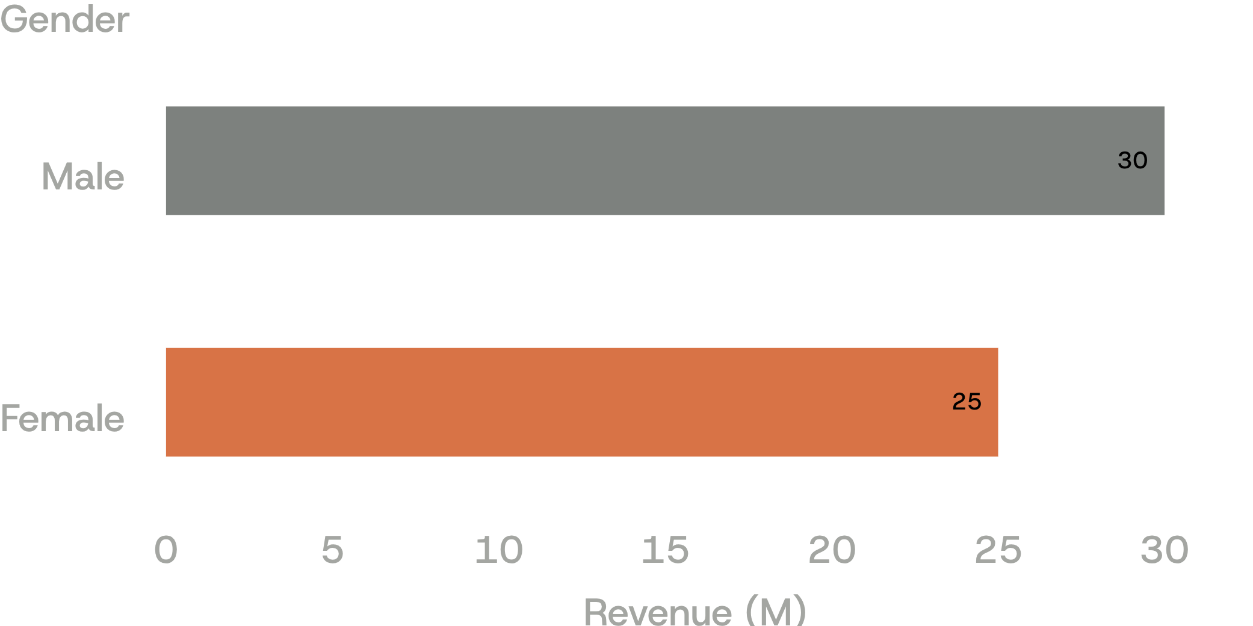
YEAR-END MILESTONE · WEEK 52
Week 52: revenue reached 55M
Total interest 8M; transaction amount 45M.
57.5%
Activation Rate
Sustained portfolio activation baseline
6.06%
Delinquent Rate
Monitored risk threshold at year-end
Revenue by gender, Week 52 · Currency in Millions (M)
06
Notes:
By Week 52, annual cumulative revenue crossed 55M, driven by 45M in direct transactions and 8M in interest. Male cardholders generated 30M against 25M from female cardholders, maintaining a 57.5% activation rate.

Slide 7
PORTFOLIO CONCENTRATION
Blue cards and three states dominate
PRODUCT CONCENTRATION
PRODUCT CONCENTRATION
PRODUCT CONCENTRATION
GEOGRAPHIC CONCENTRATION
83%
83%
83%
77%
Blue cards share of transactions
Blue cards share of transactions
Blue cards share of transactions
Revenue from TX, NY & CA
Silver tier represents a distant second at 10% of transaction activity, while Gold and Platinum form specialized low-volume tiers.
Silver tier represents a distant second at 10% of transaction activity, while Gold and Platinum form specialized low-volume tiers.
Silver tier represents a distant second at 10% of transaction activity, while Gold and Platinum form specialized low-volume tiers.
California leads as the single highest revenue-generating market, combining with Texas and New York to represent over three-quarters of portfolio earnings.
Analysis across 10,108 customer purchase events · Geographical and Tier Breakdown
07
Notes:
The business displays marked concentration: Blue cards generate 83% of all volume, and geographically, just three states—Texas, New York, and California—account for 77% of total revenue.

Slide 8

CONTINUOUS PIPELINE
Week 53 data flowed in automatically
185 new rows for 31 December 2025 added to PostgreSQL
Both dashboards refreshed in real time, KPIs and charts included
A separate week-on-week view shows revenue in thousands (K)
Notes:
The robustness of the ETL setup was demonstrated as Week 53 data entered the system: 185 records for December 31 were automatically appended to PostgreSQL, triggering real-time dashboard updates.

Slide 9
OPERATIONAL SURGE · WEEK 53
Transaction amount
+33.5%
Customer count up +12.8% WoW
+28%
Interest earned
139K
Week-on-week revenue expansion during Year-End closing.
Direct financing revenue
Activation rate
56.8%
Customer satisfaction score rose to 3.49 against the full-year average benchmark of 3.19.
Delinquent rate held at 5.41%
Notes:
Week 53 delivered remarkable expansion: revenue jumped 28%, transaction volume surged 33.5%, and active customers grew 12.8%. Delinquency improved down to 5.41% while satisfaction reached a peak of 3.49.

Slide 10
DEMOGRAPHIC & SPEND ATTRIBUTION
Who drove Week 53 revenue
Breakdown across customer demographics, professional segments, and card categories during the final week.
DIMENSION | PRIMARY SEGMENT | REVENUE CONTRIBUTION | SECONDARY COMPARISON
Gender | Male cardholders | 708K | Female: 493K
Merchant category | Entertainment & Fuel | 260K each | Leading spend sectors
Profession | Businessmen & Self-employed | Top job classes | Primary income engines
Payment mode | Swipe modality | 749K | Chip & Online follow
Card tier | Blue cards | 1.04M | Dominant product tier
Marital status | Married cardholders | 643K | Followed by singles
Week 53 cohort telemetry · Revenue reported in Thousands (K) and Millions (M)
10
Notes:
In Week 53, male cardholders contributed 708K versus 493K from females. Fuel and entertainment topped merchant categories at 260K each, swipe led transaction modes at 749K, and Blue cards earned 1.04M.

