Slide 1
What 3,900 purchases reveal about our customers

Slide 2
ANALYSIS SCOPE
The analysis covers 3,900 purchases across 18 attributes
3,900
18
Purchases
Attributes
Demographics, purchase details and shopping behavior
Guide decisions on spending, segments, products and subscriptions
Only 37 review ratings were missing, filled with the category median.
What 3,900 purchases reveal about our customers
2

Slide 3
METHOD
Python cleaned the data, SQL answered ten business questions
01
02
03
04
Cleaned
Engineered
Dropped
Loaded
Cleaned and standardized in Python with pandas
Engineered age groups and purchase frequency
Dropped promo code as redundant with discount applied
Loaded into PostgreSQL for analysis
What 3,900 purchases reveal about our customers
3

Slide 4
CUSTOMER SNAPSHOT
The average purchase is $59.76 with a 3.75 rating
$59.76
3.75
Average purchase
Average rating
3,900 customers; purchases range from $20 to $100
Average age 44; 68% of purchases by men (2,652)
What 3,900 purchases reveal about our customers
4

Slide 5
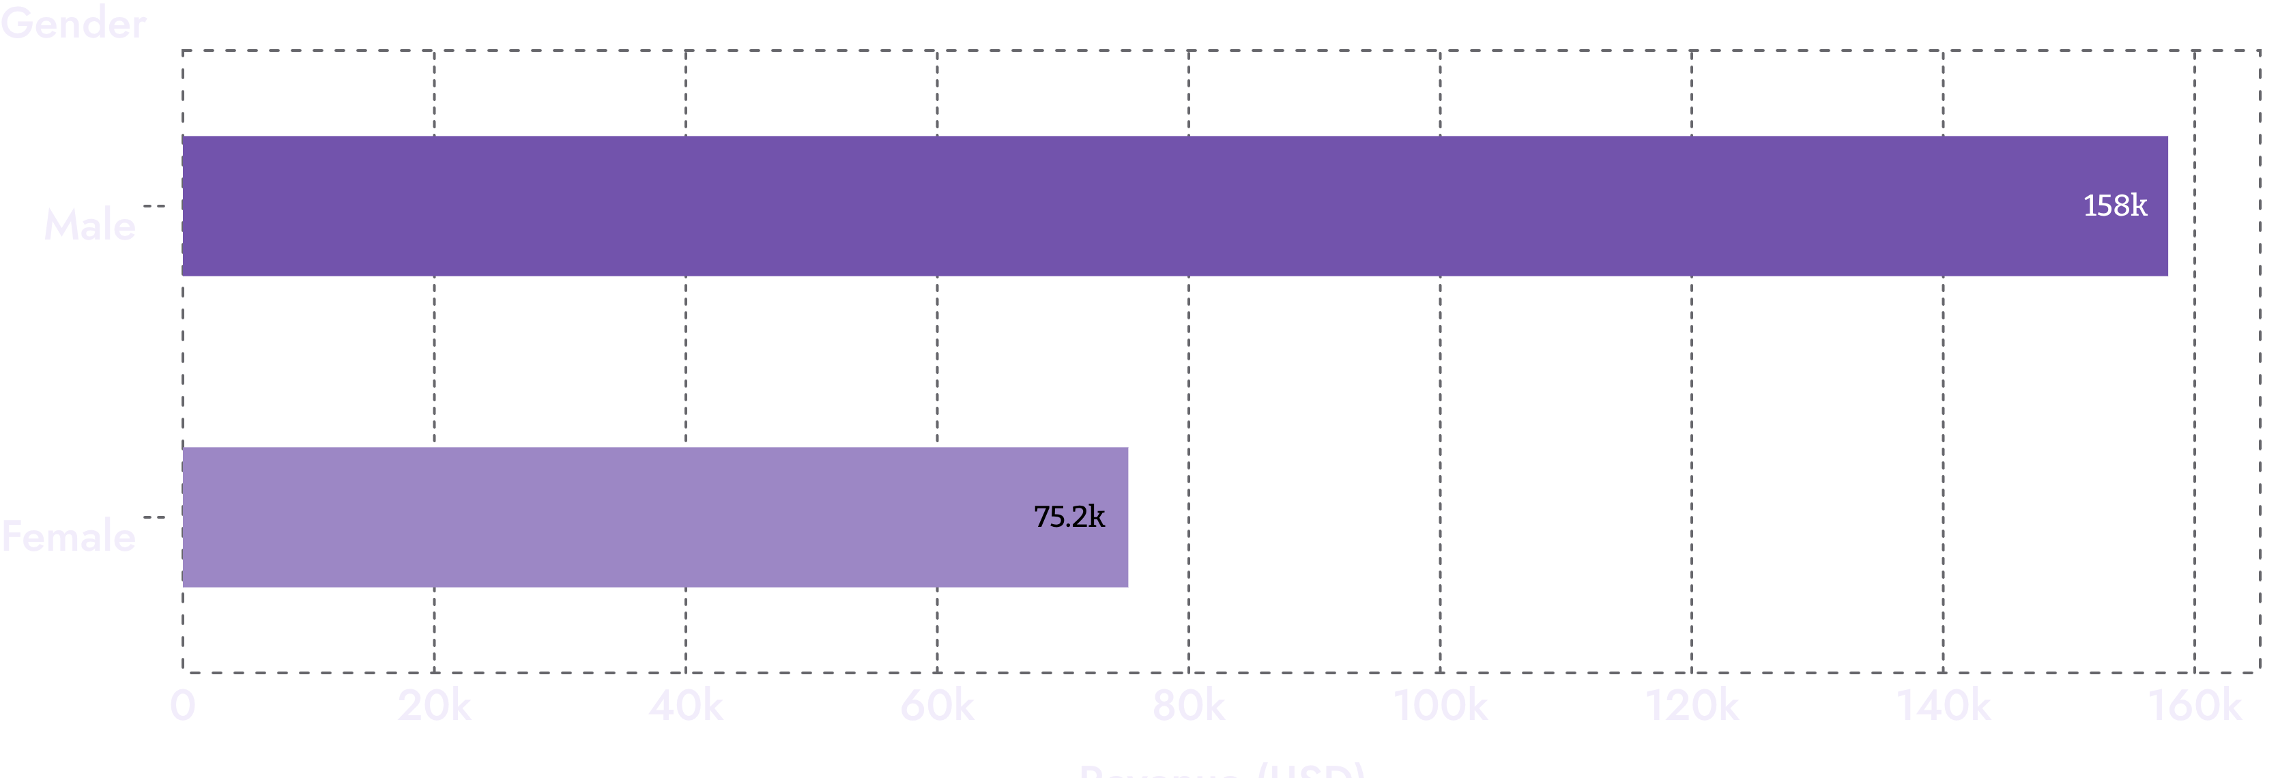
REVENUE BY GENDER
Male customers generate about twice the revenue of female customers
Male: $157,890 · Female: $75,191
What 3,900 purchases reveal about our customers
5

Slide 6
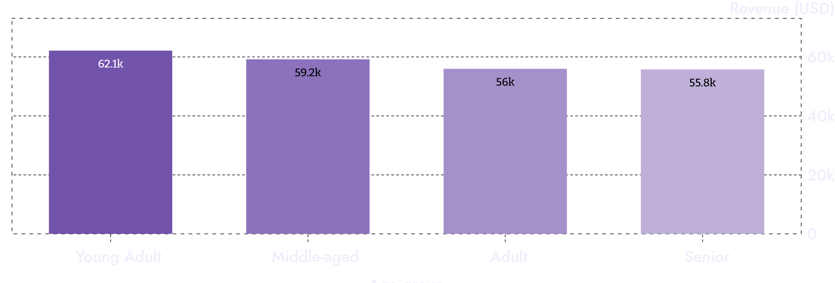
REVENUE BY AGE GROUP
Young adults lead revenue, but age groups sit close together
Young adults lead, yet all four groups are within about $6K.
What 3,900 purchases reveal about our customers
6

Slide 7
PRODUCT REVENUE
Clothing and accessories drive the most revenue
Dashboard estimates
CLOTHING
ACCESSORIES
FOOTWEAR
OUTERWEAR
$90K
$70K
$30K
$15K
Roughly
About
About
About
Top sellers: Blouse, Pants, Jewelry, Sandals, Jacket
What 3,900 purchases reveal about our customers
7

Slide 8
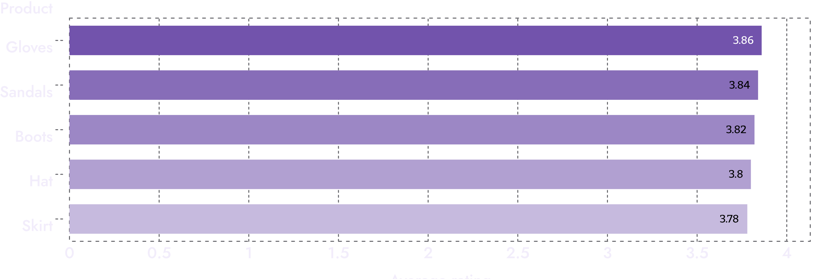
TOP RATED PRODUCTS
Gloves, sandals and boots earn the highest ratings
Top five products all rate between 3.78 and 3.86.
What 3,900 purchases reveal about our customers
8

Slide 9
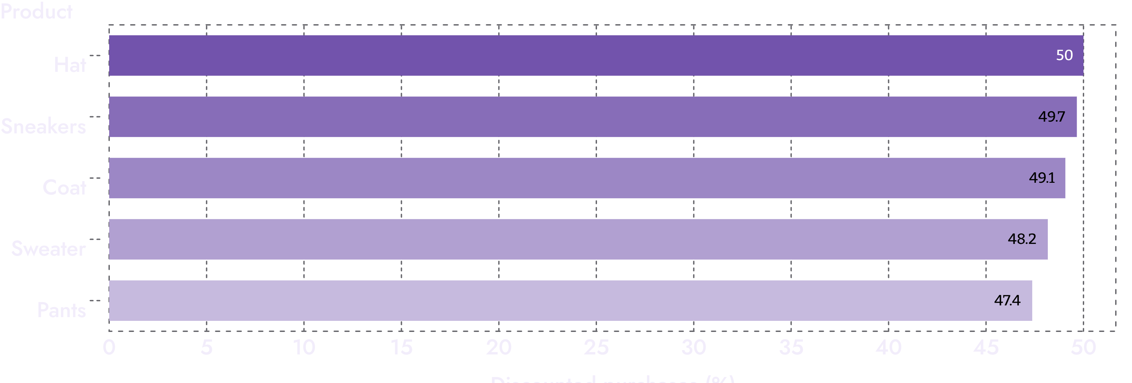
DISCOUNT RATE BY PRODUCT
Nearly half of hats, sneakers and coats sell on discount
Five products sell on discount about half the time.
What 3,900 purchases reveal about our customers
9

Slide 10
SUBSCRIPTIONS
Subscribers are only 27% of customers and spend the same
 | Subscribers | Non-subscribers
Customers | 1,053 | 2,847
Average spend | $59.49 | $59.87
Revenue | $62,645 | $170,436
Repeat buyers | 958 | 2,518
What 3,900 purchases reveal about our customers
10

