Slide 1
Project – GW-Basic Programming Language Team - A Program Interface Module Overview Command Line Editor REPL System
-Presented by
Vijaylaxmi(293952)

Slide 2
What is Program Interface?????
Mimics classic GW-BASIC command line interface
Handles input editing, cursor control, and special key commands
Built using modular components:
CommandLineEditor,
ScreenRenderer,
SpecialKeyHandler

Slide 3
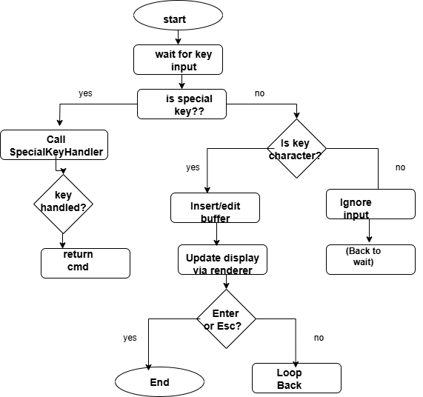
Flow Diagram (Input Handling)

Slide 4
CommandLineEditor
Purpose: Captures user input from the terminal, supports character insertion, deletion, and cursor navigation.
Key Members:
std::string buffer: Current input line buffer.
int cursorPosition: Current position of the cursor in the buffer.
SpecialKeyHandler* specialKeyHandler: Optional handler for function keys (F1–F10).
Features:
Live text editing
Cursor movement with arrow keys
Backspace handling
Special key recognition

Slide 5
Screen Renderer
Purpose: Manages the display of the current buffer on the terminal.
Intercepts special keys (F1–F10, arrow keys, ESC)
Injects commands like RUN, LIST, LOAD, etc. into buffer
Returns control if a special command is recognized

Slide 6
SpecialKeyHandler
Purpose: Maps function keys (F1–F10) to specific commands such as "RUN", "LIST", "NEW", etc.
Key Methods: handleSpecialKey(const check_SKey&, std::string&): If a known special key is pressed, sets a predefined command in the input buffer.
Handles redrawing the command buffer on screen
Moves cursor to correct position after edits
Static methods using SystemInterface for positioning

Slide 7
Function Key mapping
FunctionKey injrected cmd Console Effect
F1 RUN Runs the current program
F2 LIST Lists all program lines
F3 NEW Clears program memory
F4 LOAD" Prepares to load a program
F5 SAVE" Prepares to save a program
F6 CONT Continues from the last break
F7 LPT1 Sends output to printer (simulated)
F8 TRON Enables trace mode
F9 TROFF Disables trace mode
F10 KEY Lists key mappings or shortcuts

Slide 8
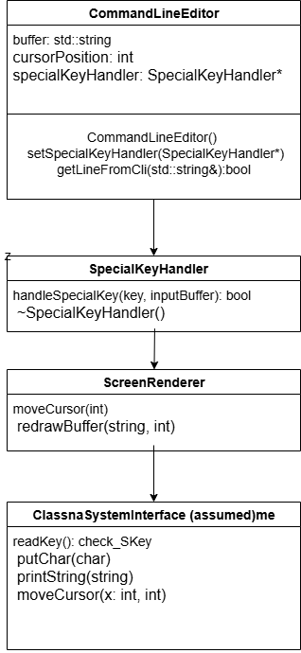
Class diagram

Slide 9
Class Structure
CommandLineEditor
├── getLineFromCli(std::string&): Reads user input interactively
├── SpecialKeyHandler(...): Attaches special key handle
└── Uses ScreenRenderer and SystemInterface
SpecialKeyHandler
└── handleSpecialKey(...): Handles function keys and injects command
ScreenRenderer
└── redrawBuffer(), moveCursor()

Slide 10
SystemInterface:
init(): Setup stub
readKey(): Reads a character or key
putChar(): Prints one char
getChar(): Reads one char using _getch()
printString(): Prints full string
clearScreen(): ANSI clear
moveCursor(x, y): Positions cursor

Slide 11
Internal Data Members
*CommandLineEditor: - buffer:
Current input - cursorPosition: Index in buffer - specialKeyHandler: Handles F1-F10
check_SKey (Struct): - isSpecial: True if key is special - ch: Normal character - sKey: Enum for F1-F10, arrows

Slide 12
Future Enhancement
Tab Completion
Implement a command/filename auto-completion on Tab.
Syntax Highlighting
Color-code keywords, strings, or syntax while typing.
Multiline Editing
Support for line wrapping and multiline input.
Mouse Support
Handle mouse events for cursor movement and selection.
Command Validation
Integrate a parser to provide live feedback on command correctness.
Modular Plugin System
Allow users to inject their own special key behavior dynamically.

Slide 13
Console Interaction Example
shell
GW-BASIC64 v1.0
READY. > PRINT Hello World
(user presses ← to fix typo)
> PRINT "Hello World" ↑
(user presses → and ENTER) Hello World
READY.
> 10 PRINT "HELLO“
> 20 GOTO 10
>LIST 10 PRINT "HELLO" 20 GOTO 10
> RUN HELLO HELLO HELLO .
.. (user presses Ctrl+C or ESC to stop)
READY.
> SAVE "loop.bas" Saved successfully.
> LOAD "loop.bas" Loaded: loop.bas
> NEW All program lines cleared. READY.

Slide 14
Conclusion
The Program Interface module in our GW-BASIC interpreter enables interactive user input with features like cursor movement, real-time editing, and backspace handling. It cleanly separates responsibilities across CommandLineEditor, ScreenRenderer, and SpecialKeyHandler. Function keys are mapped to BASIC commands for quick access. The design ensures modularity, ease of extension, and a classic BASIC feel. Overall, this module enhances
usability while maintaining maintainable and scalable code structure.

Slide 15

Thank you

