Slide 1
RETAIL CUSTOMER INTELLIGENCE & REVENUE OPTIMIZATION

Slide 2

CUSTOMER-LEVEL SHOPPING DATASET
3,900
CUSTOMER RECORDS, ONE QUESTION: WHERE IS THE OPPORTUNITY?
18 original columns, multiple product categories.
Understand purchasing patterns, promotions, subscriptions and customer experience.

Slide 3
THE DATA COVERS WHO BUYS, WHAT, AND HOW
Demographics
Purchases
Age, gender, location, subscription status
Item, category, amount, season, size, color
Behavior
Experience
Discounts, promo codes, previous purchases, frequency
Review rating, shipping type

Slide 4
FROM RAW FILE TO DECISION-READY DATA
01
Python and Pandas: inspect, clean, standardize columns
02
Fill 37 missing ratings (about 0.95%) with category medians
03
Engineer age group, subscription, discount, promo and purchase-history segments
04
PostgreSQL: answer 10 business questions
05
Power BI: three-page interactive dashboard

Slide 5

CLOTHING LEADS ON TOTAL VALUE, AT ABOUT $104K
TOTAL PURCHASE VALUE · AROUND
$104K
The driver is purchase volume, not a higher transaction value.

Slide 6
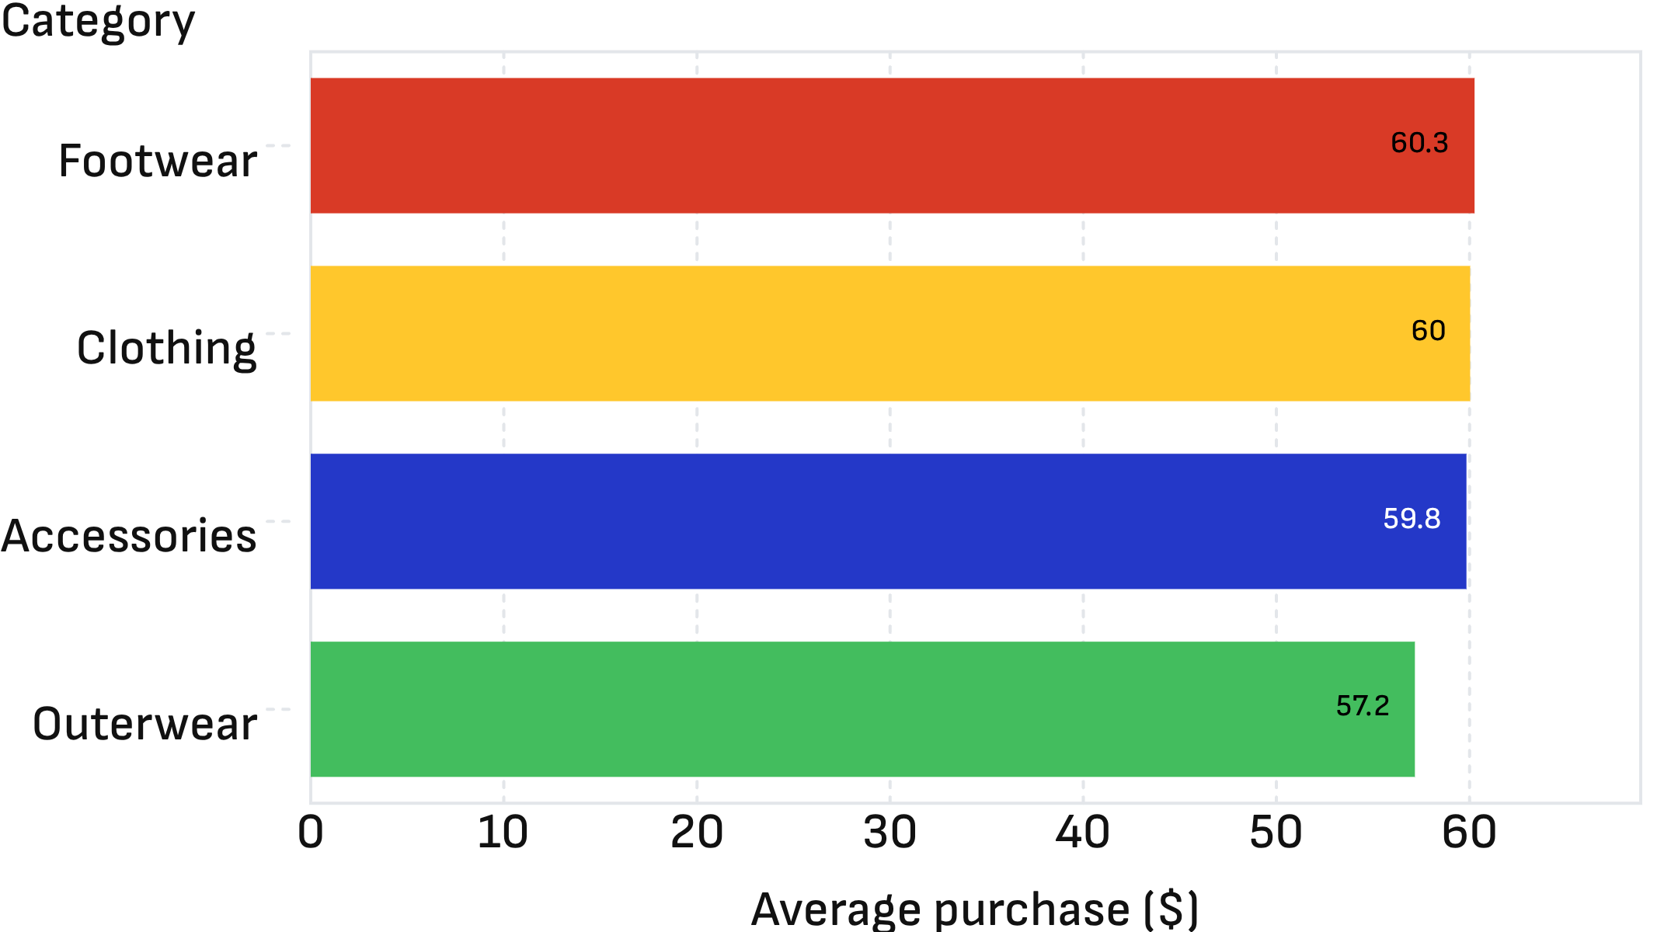
AVERAGE SPEND IS NEARLY IDENTICAL ACROSS CATEGORIES
REVENUE OPPORTUNITY
MORE PURCHASES
Growth comes from more purchases, not pricier baskets.
Average purchase amount by category

Slide 7
AGE AND PURCHASE HISTORY DON'T PREDICT SPEND
PURCHASE AMOUNT VS. AGE
PURCHASE AMOUNT VS. PREVIOUS PURCHASES
Correlation about
0.008
-0.01
Correlation about
Segment on several behaviors, not on age alone.

Slide 8
RATINGS ARE STEADY, WITH FOOTWEAR ON TOP
Highest average rating among major categories.
Discount and subscription data show useful segments, but not causal effects.
FOOTWEAR · AVERAGE RATING ABOUT
3.79

Slide 9

FIVE MOVES TO GROW REVENUE
01
Cross-sell Accessories and Footwear to high-volume Clothing buyers
02
Build multi-variable customer segments
03
Merchandise and recommend the top-rated products
04
Add dates, discount amounts and profit data to measure promotions
05
Expand the data for retention, cohort and lifetime-value work

Slide 10
WHAT THIS ANALYSIS CAN'T TELL US YET
No transaction dates
No profit or margin field
Descriptive findings
No time-series or cohort analysis.
No ROI claims.
Not causal.
Next step: richer data to measure what drives revenue.

